Slide 1

HOW TO BOOK TOURS?
A detailed guide to booking tours and other website services is available in the "For Tourists" section.
Attention: You can book tours using Visa or Mastercard by paying 10% or 25% of the tour cost in advance, with the remaining balance due on the first day of the tour..

Slide 2
HOW TO BOOK TOURS?
Find
Use filter
Book now
Select date and time
Get
Get a Voucher
Enjoy
Enjoy the journey
Pay
Fill out the form
Select dates
Number of tourists
Pay
Getting Ready for a Trip
Share

Slide 3
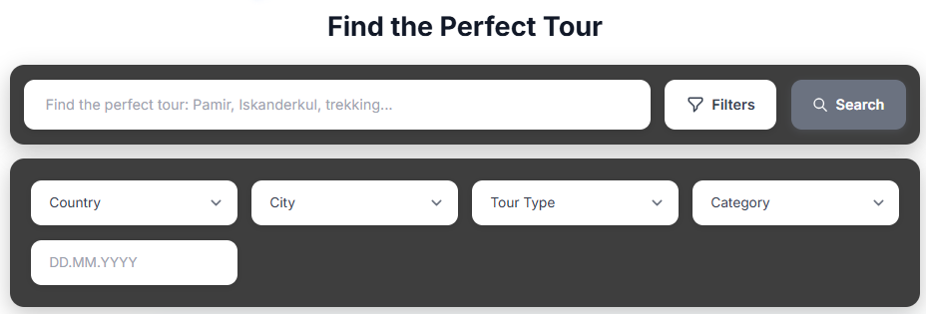
FIND A SUITABLE TOUR
Find
Use the filter. You must select at least one parameter, but you can: 1) enter the route name, 2) select the country, 3) city, 4) type, 5) tour category, and 6) available dates; then click "Search."

Slide 4
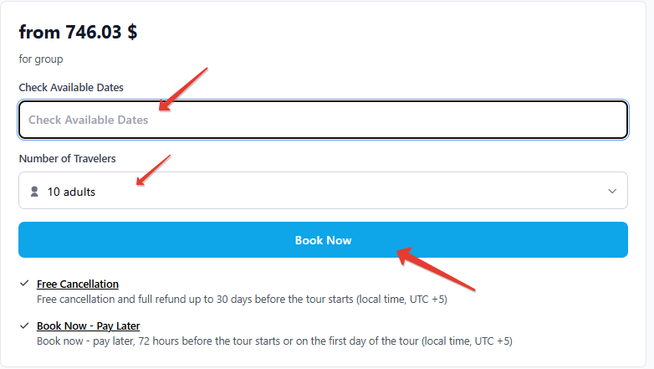
BOOK NOW
Book now
The booking process consists of two stages.
Stage 1 includes three steps: 1) select tour dates and 2) start time; 3) specify the number of tourists; and then click the "Book Now" button.

Slide 5
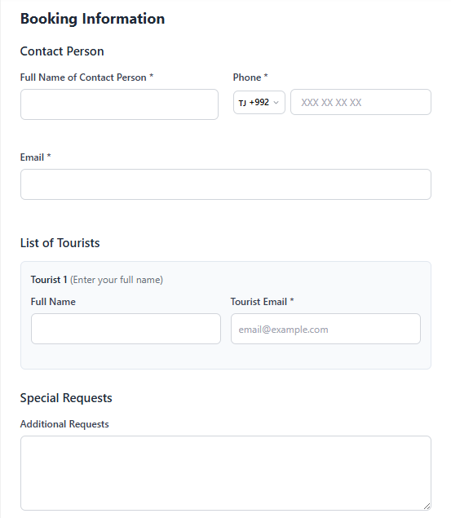
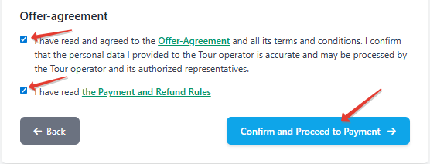
BOOK NOW
Book now
Stage 2 also includes three steps:
1) fill out the form; 2) read the "Offer-Agreement" and check the box; 3) read the "Payment and Refund Policy" and check the box; then click "Confirm and Proceed to Payment."

Slide 6
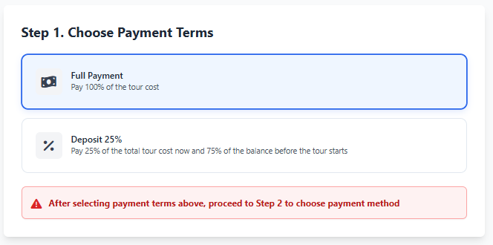
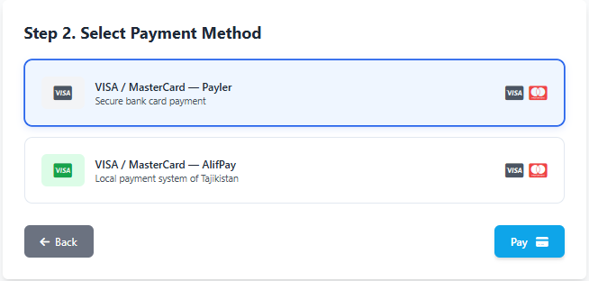
PAY FOR THE TOUR
Pay
To select a payment method, you need to complete two steps:
Select the payment terms "Full Payment" or "Deposit" (however, a deposit is possible if the reservation period is at least 30 days);
Select the payment method, and then click the "Pay" button.

Slide 7
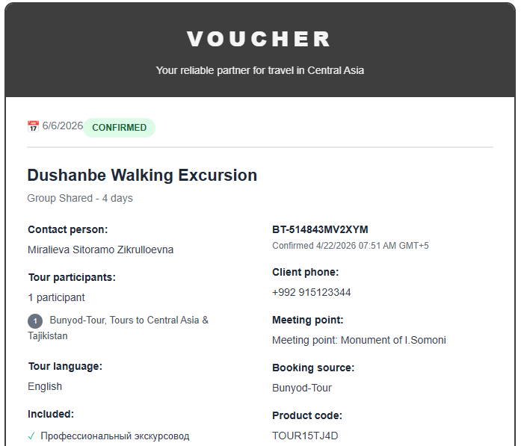
GET A TOUR
Get
After payment, you will immediately receive a confirmation (Voucher) of the booked tour by email, which you must have with you (it is recommended to have a printed version).

Slide 8

TIME OF ENJOYMENT
Enjoy
Have a nice trip!
You will be met at the border, at the airport, or at hotels displaying this sign (logo).

