Slide 1
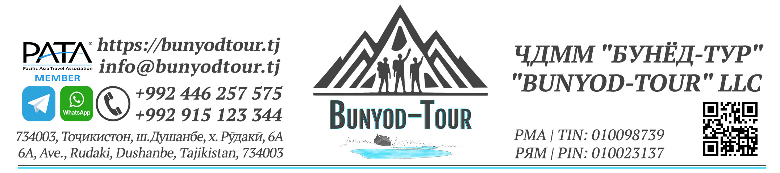
Affiliate program «TOUR AGENT»

Slide 2

PROGRAM PURPOSE
This program, within the framework of the activities of Bunyod-Tour LLC, is presented as a loyal partner platform, a condition for cooperation and an opportunity to find an accessible place and type of employment (profession) for relevant groups of people.

Slide 3

BUNYYOD-TOUR LLC
Limited Liability Company "Bunyod-Tour" is a regional travel company founded in 2017 in Dushanbe, Tajikistan (license No. 0000253 dated October 25, 2022). Its primary activity is inbound tourism, aimed at welcoming foreign tourists and providing them with services in Tajikistan and Central Asia.
Bunyod-Tour operates an online portal for booking tourism products (one of the first in Central Asia), offers over 200 tourist routes (tours), provides transportation (transfers) and tour guiding services, and features an independent, autonomous (online) tourist route development system. The company collaborates with over 50 regional and international organizations. In particular, it has established partners in Central Asian countries and offers combined (regional) tours.

Slide 4
Who can become a tour partner (TOUR agent)?
The following groups can become our tour partners:
travel companies;
bloggers;
travel industry specialists;
interns;
freelancers;
job seekers, as well as students.

Slide 5
WHAT ARE THE MAIN RESPONSIBILITIES OF A TOUR AGENT?
Through the website https://bunyodtour.tj:
Selling tourist products (tour packages) to tourists;
Offering tourism products (tour packages) to tourists in whatever way possible, including at exhibitions and online;
Advertising tourist products in whatever way possible, especially online, to attract foreign tourists.
Come up with a special type of tourism product and put it into action using the Company’s capabilities.

Slide 6
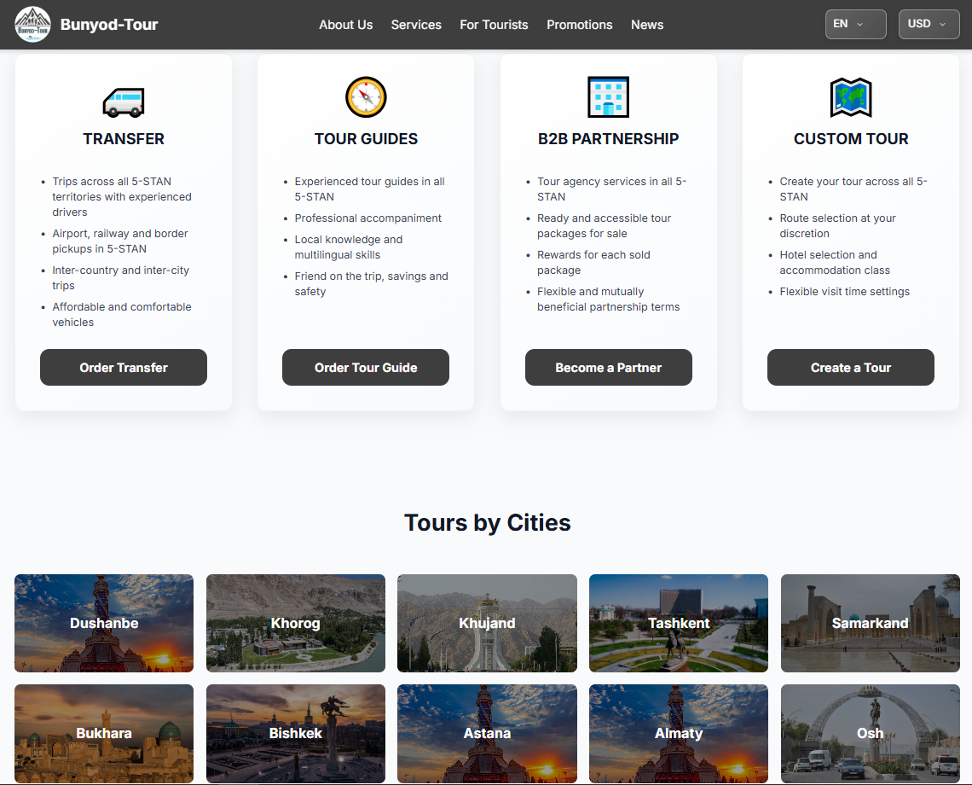
WHAT IS A TOURIST PRODUCT?
A tourist product is a tour and tourism service that is available for tourists and other actors to book on our website - https://bunyodtour.tj

Slide 7

HOW CAN I BECOME A TOUR AGENT?
If you'd like to work with us, please submit an application through our website – https://bunyodtour.tj, page "Become a Partner", and read the relevant terms and conditions and partnership agreement.
If approved, a confirmation email will be sent to the applicant's email address.

Slide 8
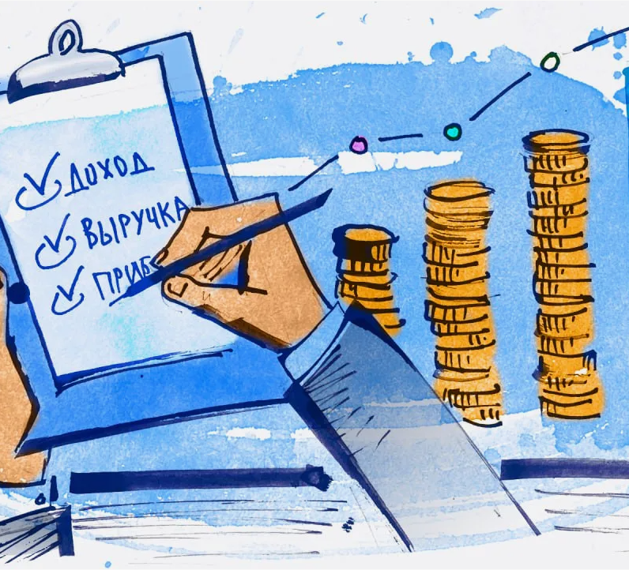
HOW DOES THIS SYSTEM WORK?
The system is very simple and easy:
After a tourist has finished choosing what they want to do, the tour agent sends the right information to the company through their personal account. This includes the Voucher ID number for the tour that they have ordered.
Then, the travel agent will receive a confirmation that their order has been accepted.

Slide 9

HOW DOES A TOUR AGENT MAKE MONEY?
Tour agents get a commission of 10% (15% for ATACA members) of the tour price for selling the tour product.
The money for the tour will be paid to the tour agent within 10 days of the tour finishing.

Slide 10
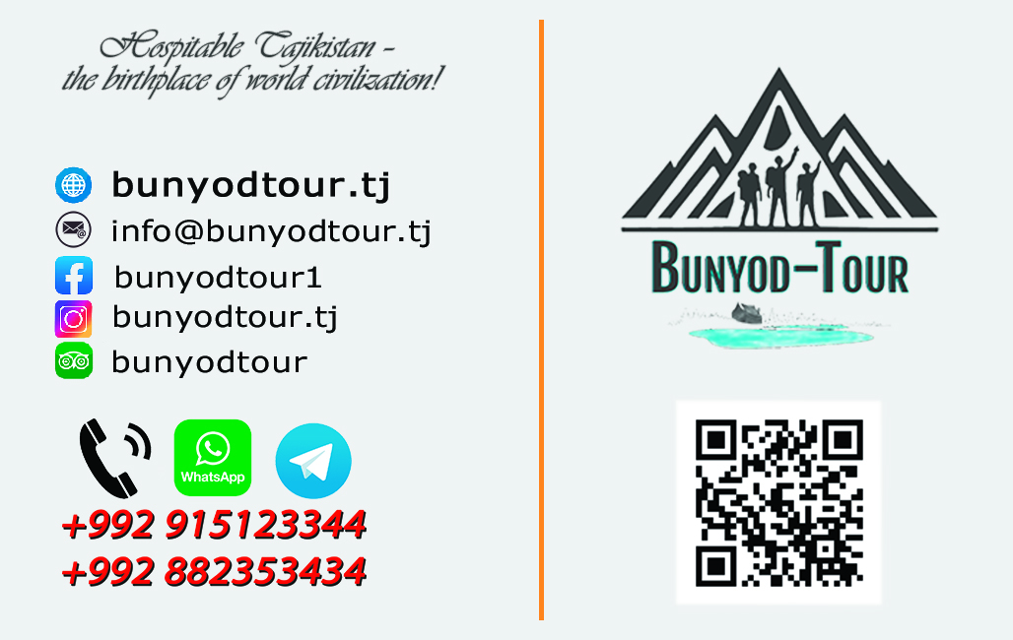
Come and join us, and you can achieve success!

