Slide 1
Suggesting Improvements to Questions and Answers
Felix Grezes & Michelle Morales

Slide 2
Overview
Question
Can we improve upon existing answers and questions within the stack exchange system?
Data
Stack Exchange http://stackexchange.com/

Slide 3
Tasks
Correlate the score/rank with the question/answer pair text
Identify the content of the question/answer (picture, code, etc.)
Given an answer, predict its score
Given an answer/question, predict an improvement
Rank all our predictions and see if it performs better, if it does suggest it

Slide 4
Techniques
Computational approach
finding the best representation (word pairs, n-grams, etc.)
Linguistic approach
List of English interrogatives (who, what, when, where, etc.)
Interrogative position

Slide 5
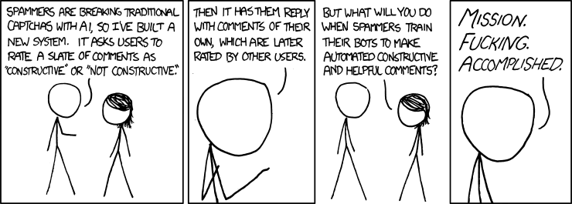
Our Inspiration
http://xkcd.com/810/

