Slide 1
Experimental results with Bayesopt (C++)
DataSets | MSE | mtry | Min_node_size | Sample fraction | iterations | Time(s)
AirFoil | 3.49592 | 1 | 1 | 0.474638 | 110 | 62.4625
BikeSharing_day | 22146.2 | 0.99871 | 5.96573 | 0.49009 | 110 | 73.8049
CommunityCrimes | 0.0163489 | 0.841557 | 1 | 0.279256 | 110 | 332.956
winequality-red | 0.305606 | 0.999543 | 1 | 0.32875 | 110 | 71.9084
winequality-white | 0.351624 | 0.596203 | 1 | 0.336524 | 110 | 162.264
Tuning Setting:
mtry: [0.01,1] fraction of total variables randomly sampled as candidate at each split
min_node_size: [1,100] minimum leaf size
Sample fraction: [0.01,0.5] fraction of sample to draw
Since the problem of data format, there are still some bugs to run on other datasets.

Slide 2
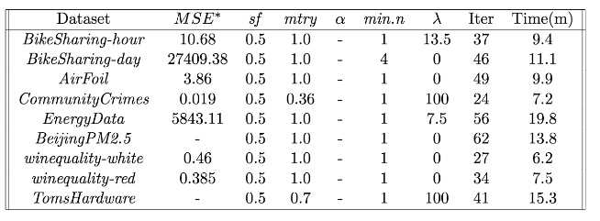
Experimental Results from Jiaming
https://github.com/susanathey/grftuning/blob/master/test_results.pdf

