Slide 1

Fake News Classification
Final Project in CSPB 3022
Grant Fairbairn

Slide 2
Project Topic
“Fake news” refers to news articles that are intentionally and verifiably false.
The phrase has become ubiquitous in American politics and culture in recent years, perhaps leading us to believe this is a new phenomenon.
Examples in writing date back to 15th century Italy.
The Internet has accelerated dissemination, making it more common.

Slide 3
Project Goal
Use classification techniques on two datasets containing fake and true news entries to train models to predict whether an article presented fake or true news.

Slide 4

Data Source

Slide 5
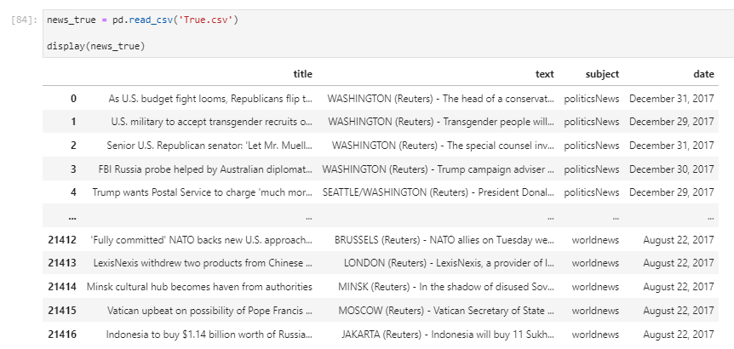

Data Source

Slide 6
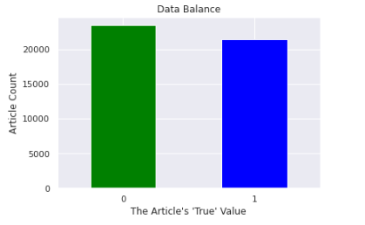
Data Cleaning
To aid in classification, added “True” column to both datasets.
Value of 1 for true articles and 0 for fake articles.
Then merged the datasets into one balanced set with 44898 rows:

Slide 7
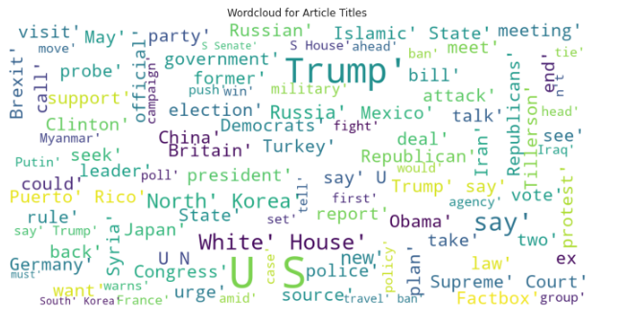

Exploratory Data Analysis
Found a potential differentiator in the data with the use of “stopwords”, common English-language words like “to”, “the”, and “for”.

Slide 8
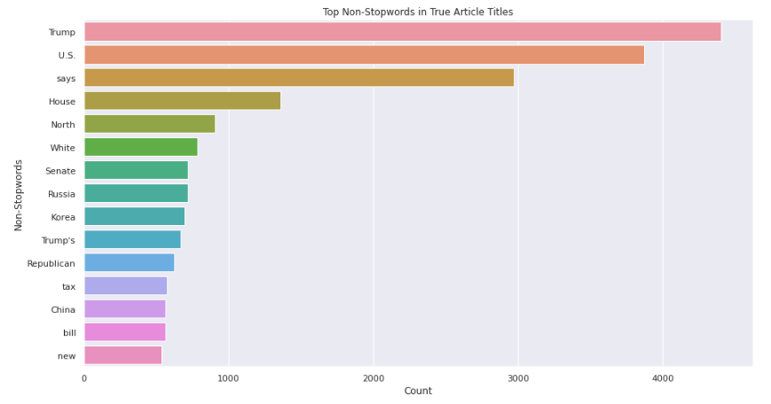
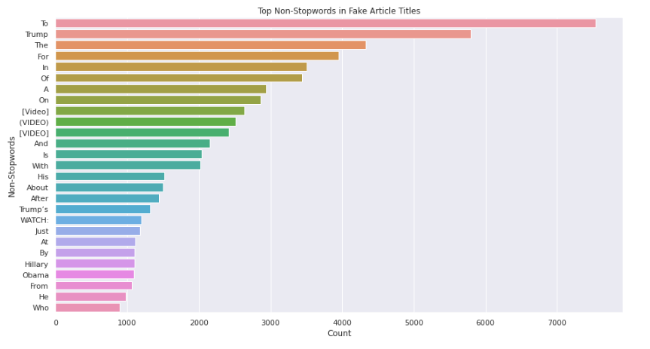
Exploratory Data Analysis

Slide 9
Models
Created four models (two with stopwords and two without):
Two logistic regression models.
Two Support Vector Machine (SVM) models, using Support Vector Classifier (SVC) function.
Converting text to numerical values required use of Term Frequency Inverse Document Frequency (TF-IDF) function from sklearn

Slide 10
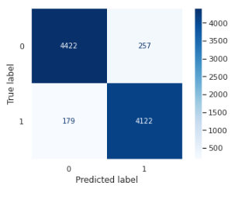
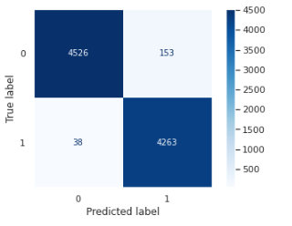
Results and Analysis
The two linear regression models each exceeded 95% accuracy.
The model with stopwords removed performed 2-3% better in accuracy, precision, recall, and f1-score.
With stopwords Without stopwords

Slide 11
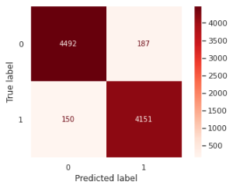
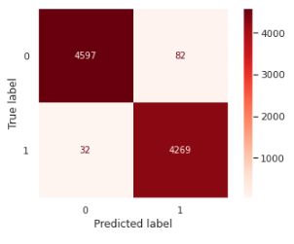
Results and Analysis
The two SVC models each exceeded 96% accuracy.
The model with stopwords removed performed 2-3% better in accuracy, precision, recall, and f1-score. In many runs, it achieved 99%.
With stopwords Without stopwords

Slide 12
Results and Analysis
SVC performed slightly better, but at a significant cost in time: 240 seconds versus 4 for logistic regression.
Given the already high accuracy of logistic regression models on this dataset, savings in speed make that the preferred model even if SVC is slightly more accurate.

Slide 13


Thank You
https://github.com/grfa5712/CSPB3022_Fake-News-Classification

