Slide 1
Nvshare
A Kubernetes Use Case
George Alexopoulos <giorgosalexo0@gmail.com>

Slide 2


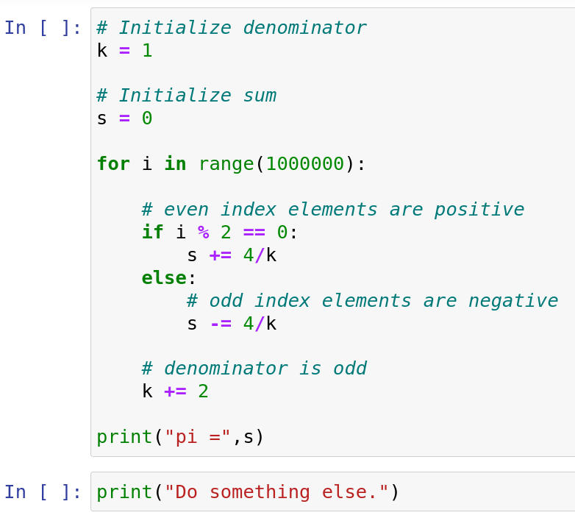
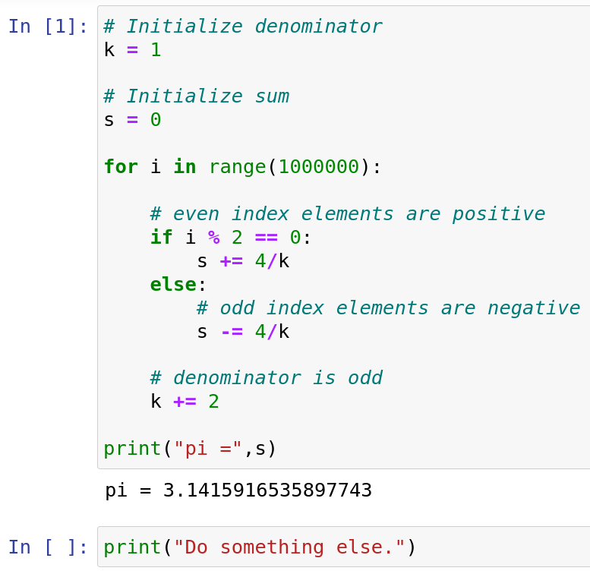




Interactive environment
Browser
*
backend-IPython
run code
write
send cell code
run cell
user
receive result
run cell
.
.
.

Slide 3




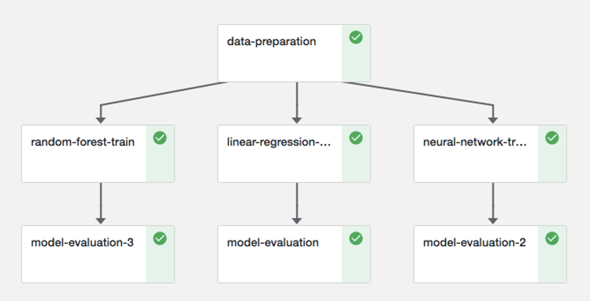
What is Kubeflow?
web app
run as Pod
convert
Pipelines
Pod per step
inferencePod(s)
KFServing

Slide 4


The Problem
Schedule
create Pod
?
?
?

Slide 5
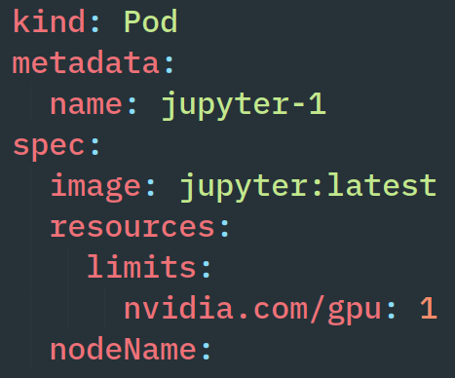
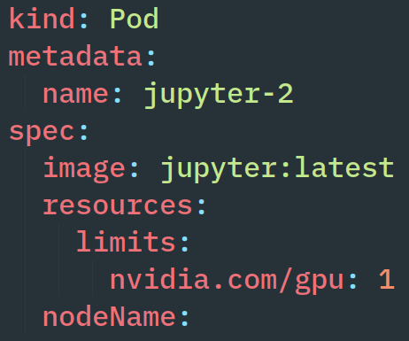
doing work...
IDLE!
write
schedule
Scheduler
user A
Node 1
insufficient “nvidia.com/gpu”
???
?
jupyter-1
write
Node 1
user B

Slide 6
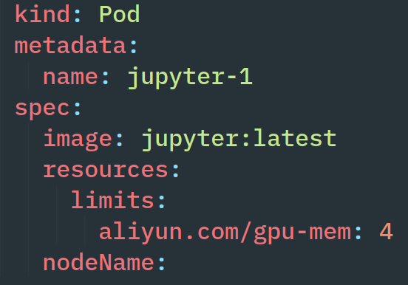
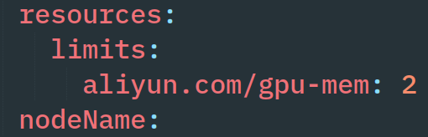

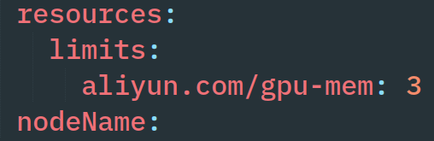
Existing Approaches (Aliyun, Kubeshare)
Scheduler
write
schedule
user A
Node 1
insufficient GPU Memory
write
schedule
8 GB VRAM
Node 1
user B
A
B
C
write
4 GB
2 GB
3 GB
user B
jupyter-1
jupyter-2
Node 1

Slide 7


Key Idea
Result
libnvshare.so
GPU
cudaMalloc(size, &p)
cudaMallocManaged(size, &p)
user
user A
user A
user B
user B
user A
# of co-located processes limited by system RAM
GPU
GPU
GPU
A0
A0
B0
A
B0
A0
A1
A1
B1
each process can use the whole GPU memory
B1
A1
A2
B2
B2
A2
A2
A3
A3
B3
A3
B3
.
.
.

Slide 8


CUDA programming model
GPU code
run
__global__
void saxpy(int n, float a, float *x, float *y)
main program (CPU)
1.
malloc();
cudaMalloc();
run
user
2.
cudaMemcpy(HostToDevice);
3.
asynchronous!
saxpy<<<>>>();
cudaDeviceSynchronize();
4.
cudaMemcpy(DeviceToHost);
5.
cudaFree();
free();

Slide 9
CUDA multi-processing
Process A
Process B
OS thread
OS thread
OS thread
OS thread
CUDA context A
CUDA context B
What process A issues:
What process B issues:
Work-queue
Work-queue
Kernel A1
Kernel A2
Kernel A3
Kernel B1
Kernel B2
Kernel B3
time-sliced
scheduler
GPU scheduling
time
A
B
A
B
A1
A2...
B1
B2...
...A2
A3
...B2
B3

Slide 10
Default CUDA Memory Model
FCFS
No oversubscription
No page faults
CPU
malloc(4)
cudaMalloc(4)
GPU
user A
A0
?
A0
cudaMemcpy()
access
A1
?
A1
A2
?
A2
A3
cudaMalloc(3)
?
A3
cudaMalloc(3)
cudaMalloc(3)
OOM!
user B

Slide 11
Controller Pattern
Used everywhere in Kubernetes
Controller
Kubernetes
Objects
Observe
write
Spec
(desired)
Calculate
Status
(real)
Physical Resources
Reconcile
Physical Resources
Physical Resources

Slide 12
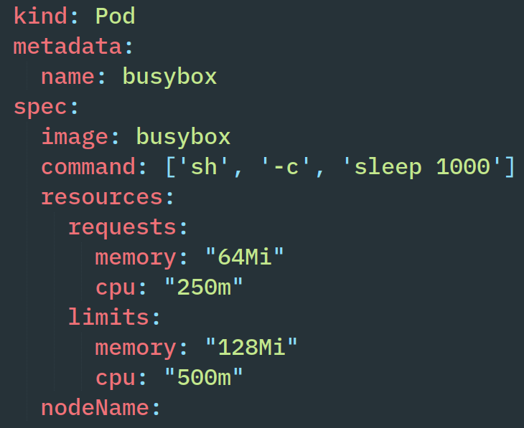
Kubernetes Scheduling
etcd
nginx
Various
Controllers
Pod
save
new
Pod
API Server
kubelet
kubelet
Scheduler
Pod
Node 1
Node 2
Controllers
kubectl apply -f
Master
schedule
MySQL
busybox
Pod
Pod
new Pod
write
kubelet
kubelet
Node 3
Node 4
User
Node 4
Node 4

Slide 13
The Problem (once more)
etcd
Various
Controllers
doing work...
save
IDLE!
new
Pod
API Server
write
schedule
Scheduler
Pod
kubectl apply -f
user A
Controllers
Master
Node 1
insufficient “nvidia.com/gpu”
???
?
jupyter-1
write
kubectl apply -f
new Pod
user B
kubelet
Node 1

Slide 14
Existing Approaches
Scheduler
write
schedule
user A
Node 1
insufficient GPU Memory
write
schedule
8 GB VRAM
Node 1
user B
A
B
C
write
4 GB
2 GB
3 GB
user B
jupyter-1
jupyter-2
Node 1

Slide 15


Existing Approaches
Aliyun Scheduler Extender
  GPUs no longer exclusively assigned to Pods
  users specify GPU memory requests
  uses GPU memory to bin pack Pods in Kubernetes
  does not enforce memory limits (only used for scheduling)
Kubeshare (HPDC ‘20)
  similar to Aliyun w.r.t. the scheduling part
  enforces GPU memory limits (assigns a memory slice to each process)
  wraps CUDA API to keep track of how much memory each process allocates

Slide 16
Unified Memory
Oversubscription
LRU Eviction
CPU
cudaMallocManaged(4)
user A
GPU
access
A0
fetch page
A0
A0
A0
GPU page fault
A1
A1
A1
A1
B0
A1
A1
evict page
A2
A2
A2
A2
A3
A3
A3
fetch page
A3
[ B0, B1, B2, B3 ]
B0
B0
B1
cudaMallocManaged(4)
access
B2
B3
GPU page fault
user B

Slide 17
Function wrappers
print dynamic symbol table entries
$ nm -D ./matrixMul
U cudaLaunchKernel
U cudaMalloc
U cudaMemcpy
$ nm -D libcudart.so
..00002510 T cudaMalloc
execve() loads executable code into memory and passes control to ld.so
ld.so maps shared objects to program address space and resolves symbols
$ nm -D libnvshare.so
..00002510 T cudaMalloc
application begins execution
Undefined Symbol
our custom version
Symbol defined in .text
Normally:
LOADER
DYNAMIC LINKER
matrixMul
cudaMalloc() ??
libcudart.so
program uses original cudaMalloc
LD_PRELOAD=libnvshare.so
which can internally call the original
LOADER
DYNAMIC LINKER
matrixMul
cudaMalloc() ??
libnvshare.so
program uses our version
… if we will it

Slide 18
Key Idea
libnvshare.so
GPU
cudaMalloc(size, &p)
cudaMallocManaged(size, &p)
user
user A
user A
user B
user B
user A
user A
user B
GPU
GPU
GPU
A0
A0
A
?
B0
B0
A0
A1
A1
B1
B1
B
A2
A2
B2
B2
C
A3
A3
D
B3
B3
.
.
.

Slide 19




When GPU bursts overlap
LD_PRELOAD=libnvshare.so
Sometimes
Other times
Solution
GO
GO
WAIT
WAIT
user A
user B
user A
user B
GPU
GPU
A0
A
E
B0
A
E
A0
user A
user B
A1
B
A1
many page faults!
B2
B3
B
B0
GPU
C
A3
A2
C
A
E
A
D
B0
B1
A0
A2
B2
B1
D
H
B
B
B2
A1
B3
C
ΣWss_{i}< GPU memory
ΣWss_{i} > GPU memory
A3
C
B0
F
D
A2
No page faults
Thrashing!
B1
pause only GPU computations

Slide 20
Anti-thrashing idea
WSS > GPU Memory
context switch
Default case:
~few ms
memory swaps happen too frequently
A
B
A
B
Thrashing!
GBs of
page faults!
anti-thrashing mechanism:
orders of magnitude fewer memory swaps
TQ=~10s of seconds
A
B
A
B
Cooperative Scheduling
No Thrashing!

Slide 21
Demo

Slide 22
Evaluation
16-core CPU (Intel Xeon 2.3 GHz - Haswell), 104 GB of RAM and an NVIDIA Tesla P100 GPU (16 GB).
non-interactive (conventional) tasks
measure Total Completion Time
Programs
Name | Working Set Size | GPU/CPU ratio
small_90 | 7.2 GB | 90/10
small_50 | 7.2 GB | 50/50
big_90 | 15.3 GB | 90/10
big_50 | 15.3 GB | 50/50
Running 2 x big_{50,90} in parallel causes thrashing!

Slide 23
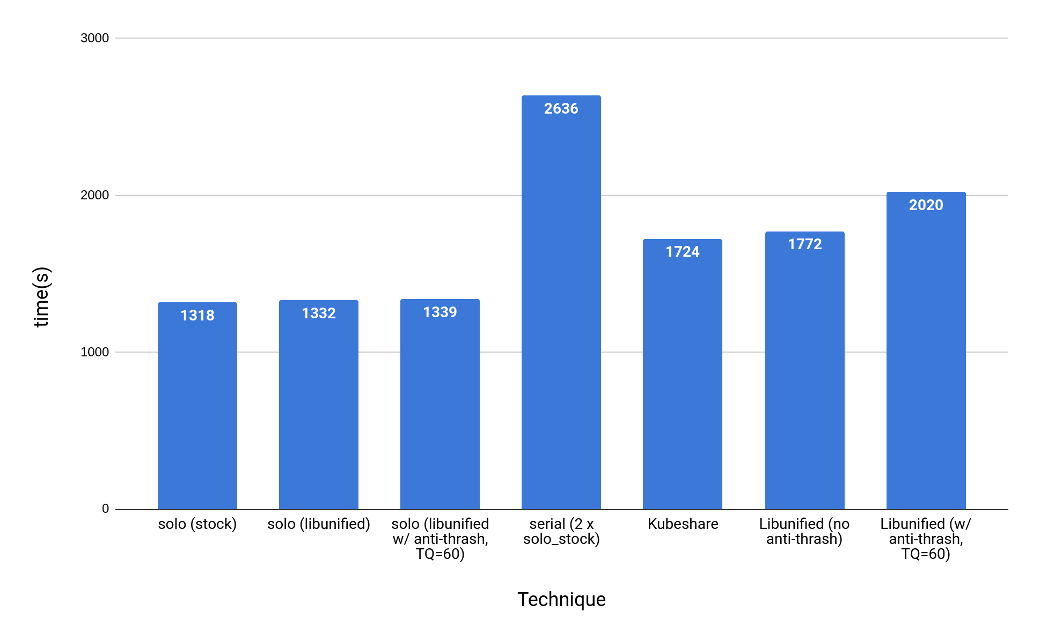
Results for small_50
15% overhead vs plain libnvshare
comparable to Kubeshare (~2.5% slower)
1% overhead from Unified Memory in and of itself
2020
anti-thrashing scheduler not necessary

Slide 24
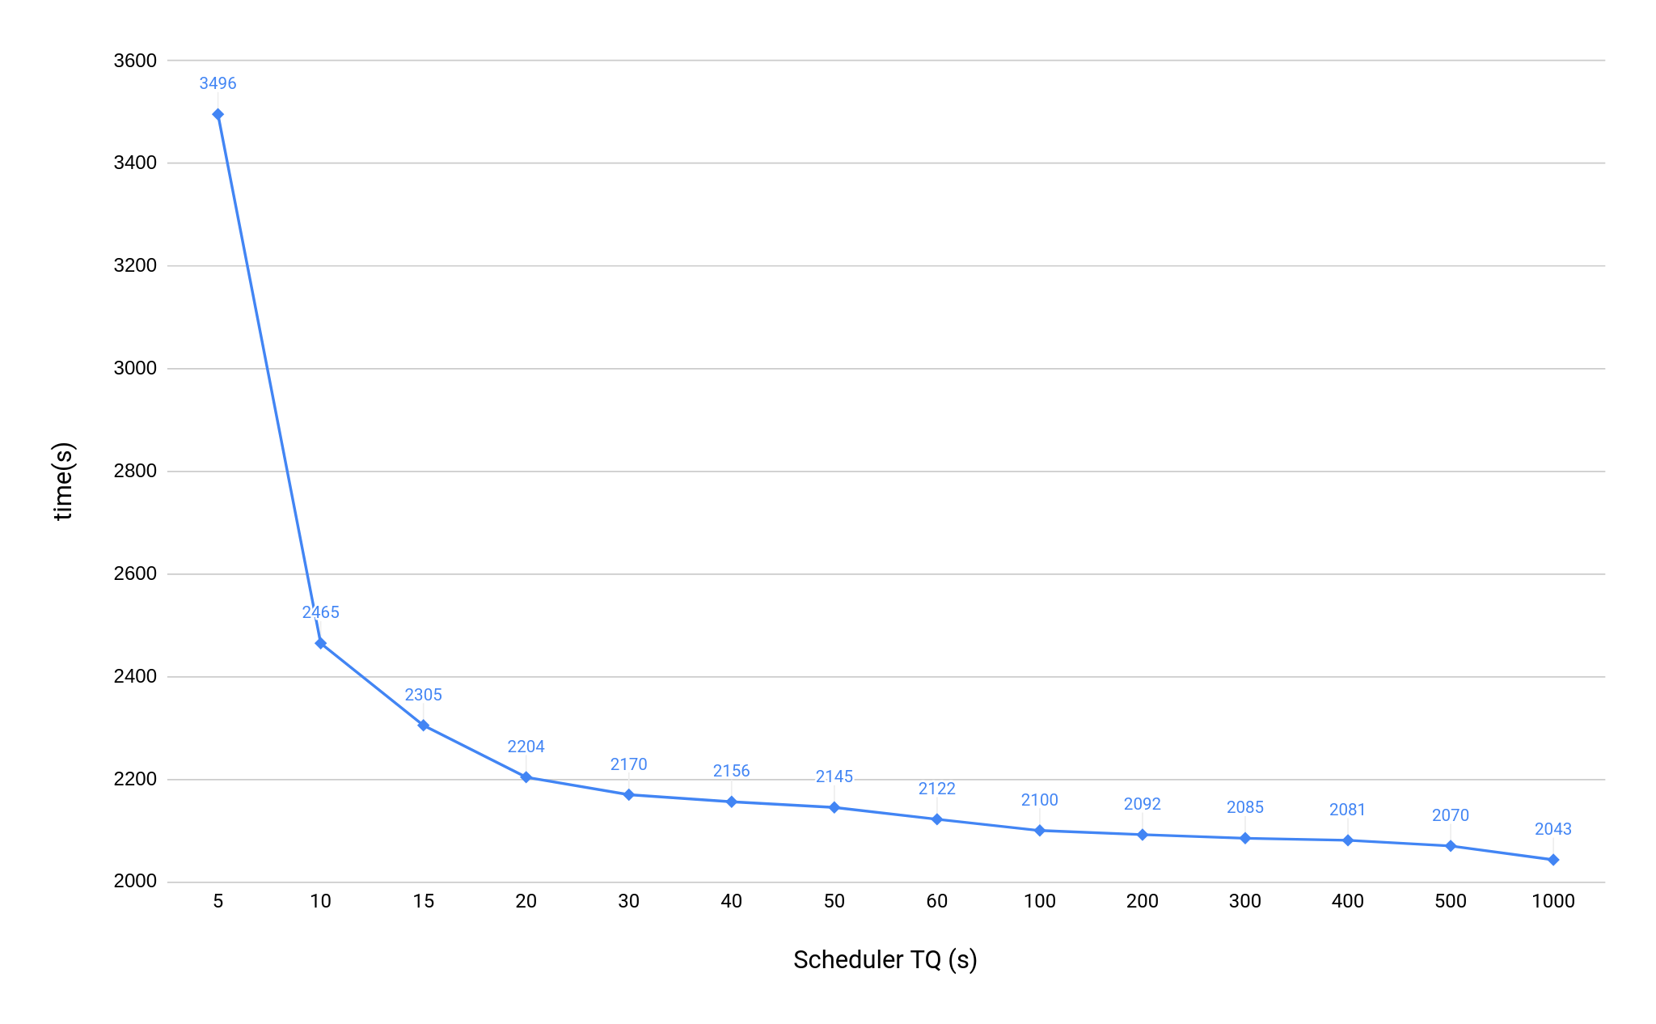
Results for big_50
T(libnvshare, no anti-thrash) = 11757 s
Kubeshare can’t run 2 x big !
TQ too small
too much swapping!
More interactive (smaller latency)
Faster (bigger throughput)
T(serial[2 x solo]) = 2766 s
ideal TQ range
30% speedup
35% speedup

Slide 25
A new state of the art
# of co-located processes limited by system RAM
each process can use the whole GPU memory
GPU utilization increases even for non-interactive jobs
No code changes to user programs
Sensible default policies:
  anti-thrashing scheduler always on
  default TQ = 20 sec

Slide 26
Future Work
Deploy to production environments
Support multiple GPUs per node
Create heuristics (e.g. PCIe traffic) to automatically enable/disable the anti-thrashing mechanism
Publish our work
Later on: Intra-node job migration from one GPU to another
Later on: Inter-node GPU job migration (Checkpoint-restart)

Slide 27
Thank you!
Questions?

