Slide 1
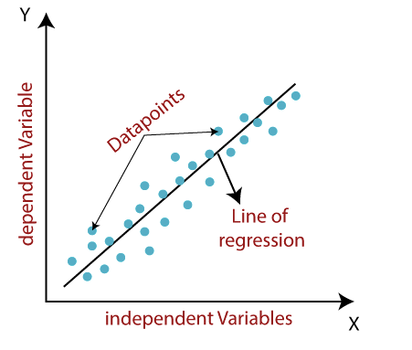
Linear Regression
Linear regression algorithm shows a linear relationship between a dependent (y) and one or more independent (y) variables, hence called as linear regression. Since linear regression shows the linear relationship, which means it finds how the value of the dependent variable is changing according to the value of the independent variable.
The linear regression model provides a sloped straight line representing the relationship between the variables.

Slide 2

Linear Regression
Mathematically, we can represent a linear regression as:
Here,
Y= Dependent Variable (Target Variable) X= Independent Variable (predictor Variable) a0= intercept of the line (Gives an additional degree of freedom) a1 = Linear regression coefficient (scale factor to each input value). ε = random error
The values for x and y variables are training datasets for Linear Regression model representation.

Slide 3
Finding the best fit line:
When working with linear regression, our main goal is to find the best fit line that means the error between predicted values and actual values should be minimized. The best fit line will have the least error.
The different values for weights or the coefficient of lines (a0, a1) gives a different line of regression, so we need to calculate the best values for a0 and a1 to find the best fit line, so to calculate this we use cost function.
Cost function:
The different values for weights or coefficient of lines (a0, a1) gives the different line of regression, and the cost function is used to estimate the values of the coefficient for the best fit line.
Cost function optimizes the regression coefficients or weights. It measures how a linear regression model is performing.
We can use the cost function to find the accuracy of the mapping function, which maps the input variable to the output variable. This mapping function is also known as Hypothesis function.

Slide 4

Continued…
For Linear Regression, we use the Mean Squared Error (MSE) cost function, which is the average of squared error occurred between the predicted values and actual values. It can be written as:
Where,
N=Total number of observation Yi = Actual value (a1xi+a0)= Predicted value.
Residuals:
The distance between the actual value and predicted values is called residual.
If the observed points are far from the regression line, then the residual will be high, and so cost function will high.
If the scatter points are close to the regression line, then the residual will be small and hence the cost function.

Slide 5

Model Performance:
The Goodness of fit determines how the line of regression fits the set of observations. The process of finding the best model out of various models is called optimization. It can be achieved by R-squared method:
R-squared is a statistical method that determines the goodness of fit.
It measures the strength of the relationship between the dependent and independent variables on a scale of 0-100%.
The high value of R-square determines the less difference between the predicted values and actual values and hence represents a good model.
It is also called a coefficient of determination, or coefficient of multiple determination for multiple regression.
It can be calculated from the below formula:

Slide 6
Assumptions of Linear Regression
Linear regression assumes the linear relationship between the dependent and independent variables.
Due to multicollinearity, it may difficult to find the true relationship between the predictors and target variables. Or we can say, it is difficult to determine which predictor variable is affecting the target variable and which is not. So, the model assumes either little or no multicollinearity between the features or independent variables.
Homoscedasticity is a situation when the error term is the same for all the values of independent variables. With homoscedasticity, there should be no clear pattern distribution of data in the scatter plot.
Linear regression assumes that the error term should follow the normal distribution pattern. If error terms are not normally distributed, then confidence intervals will become either too wide or too narrow, which may cause difficulties in finding coefficients.

Slide 7
Logistic Regression
Logistic regression is one of the most popular Machine Learning algorithms, which comes under the Supervised Learning technique. It is used for predicting the categorical dependent variable using a given set of independent variables.
Logistic regression predicts the output of a categorical dependent variable. Therefore, the outcome must be a categorical or discrete value. It can be either Yes or No, 0 or 1, true or False, etc. but instead of giving the exact value as 0 and 1, it gives the probabilistic values which lie between 0 and 1
Logistic Regression is much like the Linear Regression except that how they are used. Linear Regression is used for solving Regression problems, whereas Logistic regression is used for solving the classification problems.
In Logistic regression, instead of fitting a regression line, we fit an "S" shaped logistic function, which predicts two maximum values (0 or 1)

Slide 8
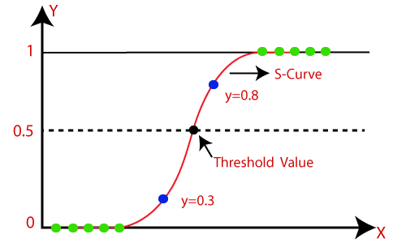
Logistic Regression
The curve from the logistic function indicates the likelihood of something such as whether the cells are cancerous or not, a mouse is obese or not based on its weight, etc.
Logistic Regression is a significant machine learning algorithm because it can provide probabilities and classify new data using continuous and discrete datasets.
Logistic Regression can be used to classify the observations using different types of data and can easily determine the most effective variables used for the classification. The below image is showing the logistic function:

Slide 9
Logistic Function (Sigmoid Function):
The sigmoid function is a mathematical function used to map the predicted values to probabilities.
It maps any real value into another value within a range of 0 and 1.
The value of the logistic regression must be between 0 and 1, which cannot go beyond this limit, so it forms a curve like the "S" form. The S-form curve is called the Sigmoid function or the logistic function.
In logistic regression, we use the concept of the threshold value, which defines the probability of either 0 or 1. Such as values above the threshold value tends to 1, and a value below the threshold values tends to 0.
Assumptions for Logistic Regression:
The dependent variable must be categorical in nature.
The independent variable should not have multi-collinearity.

Slide 10


Logistic Regression Equation:
The Logistic regression equation can be obtained from the Linear Regression equation. The mathematical steps to get Logistic Regression equations are given below:
We know the equation of the straight line can be written as:
In Logistic Regression y can be between 0 and 1 only, so for this let's divide the above equation by (1-y):
But we need range between -[infinity] to +[infinity], then take logarithm of the equation it will become:
The above equation is the final equation for Logistic Regression.

Slide 11
Logistic Regression Equation:
If the number of observations is lesser than the number of features, Logistic Regression should not be used, otherwise, it may lead to overfitting.
It constructs linear boundaries.
The major limitation of Logistic Regression is the assumption of linearity between the dependent variable and the independent variables.
Non-linear problems can’t be solved with logistic regression because it has a linear decision surface. Linearly separable data is rarely found in real-world scenarios.
Logistic Regression requires average or no multicollinearity between independent variables.
In Linear Regression independent and dependent variables are related linearly. But Logistic Regression needs that independent variables are linearly related to the log odds (log(p/(1-p)).

Slide 12
K-Nearest Neighbor(KNN)
K-Nearest Neighbour is one of the simplest Machine Learning algorithms based on Supervised Learning technique.
K-NN algorithm assumes the similarity between the new case/data and available cases and put the new case into the category that is most similar to the available categories.
K-NN algorithm stores all the available data and classifies a new data point based on the similarity. This means when new data appears then it can be easily classified into a well suite category by using K- NN algorithm.
K-NN algorithm can be used for Regression as well as for Classification but mostly it is used for the Classification problems.
K-NN is a non-parametric algorithm, which means it does not make any assumption on underlying data.
It is also called a lazy learner algorithm because it does not learn from the training set immediately instead it stores the dataset and at the time of classification, it performs an action on the dataset.
KNN algorithm at the training phase just stores the dataset and when it gets new data, then it classifies that data into a category that is much similar to the new data.

Slide 13
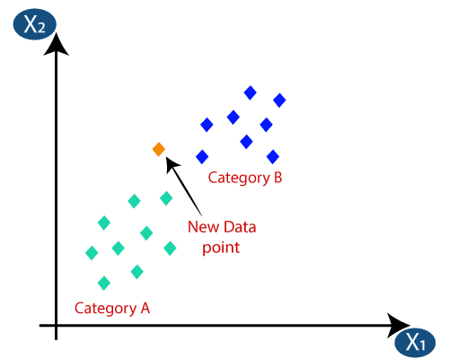
How does K-NN work?
The K-NN working can be explained on the basis of the below algorithm:
Step-1: Select the number K of the neighbors
Step-2: Calculate the Euclidean distance of K number of neighbors
Step-3: Take the K nearest neighbors as per the calculated Euclidean distance.
Step-4: Among these k neighbors, count the number of the data points in each category.
Step-5: Assign the new data points to that category for which the number of the neighbor is maximum.
Step-6: Our model is ready.

Slide 14
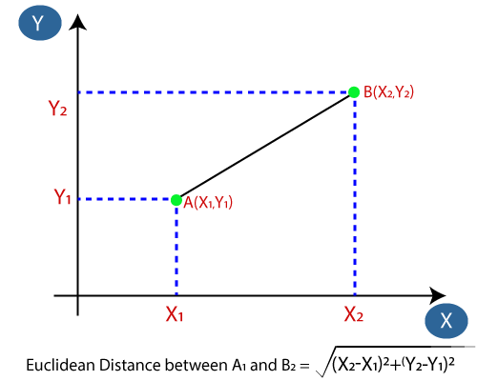
Continued…
Firstly, we will choose the number of neighbors, let suppose we choose the k=5.
Next, we will calculate the Euclidean distance between the data points. The Euclidean distance is the distance between two points, which we have already studied in geometry. It can be calculated as:

Slide 15
Continued…
By calculating the Euclidean distance we got the nearest neighbors, as three nearest neighbors in category A and two nearest neighbors in category B. Consider the below image:
As we can see the 3 nearest neighbors are from category A, hence this new data point must belong to category A.

Slide 16
How to select the value of K in the K-NN Algorithm?
There is no particular way to determine the best value for "K", so we need to try some values to find the best out of them. The most preferred value for K is 5.
A very low value for K such as K=1 or K=2, can be noisy and lead to the effects of outliers in the model.
Large values for K are good, but it may find some difficulties.
Advantages:
It is simple to implement.
It is robust to the noisy training data
It can be more effective if the training data is large.
Disadvantages:
Always needs to determine the value of K which may be complex some time.
The computation cost is high because of calculating the distance between the data points for all the training samples.

Slide 17
Support Vector Machine
Support Vector Machine or SVM is one of the most popular Supervised Learning algorithms, which is used for Classification as well as Regression problems.
It is used for Classification problems in Machine Learning.
The goal of the SVM algorithm is to create the best line or decision boundary that can segregate n-dimensional space into classes so that we can easily put the new data point in the correct category in the future.
This best decision boundary is called a hyperplane.
SVM chooses the extreme points/vectors that help in creating the hyperplane.
These extreme cases are called as support vectors, and hence algorithm is termed as Support Vector Machine.

Slide 18

Continued…
Consider the below diagram in which there are two different categories that are classified using a decision boundary or hyperplane:

Slide 19
Types of SVM
SVM can be of two types:
Linear SVM:
Linear SVM is used for linearly separable data, which means if a dataset can be classified into two classes by using a single straight line, then such data is termed as linearly separable data, and classifier is used called as Linear SVM classifier.
Non-linear SVM:
Non-Linear SVM is used for non-linearly separated data, which means if a dataset cannot be classified by using a straight line, then such data is termed as non-linear data and classifier used is called as Non-linear SVM classifier.

Slide 20
Hyperplane and Support Vectors in the SVM
Hyperplane:
There can be multiple lines/decision boundaries to segregate the classes in n-dimensional space, but we need to find out the best decision boundary that helps to classify the data points. This best boundary is known as the hyperplane of SVM.
The dimensions of the hyperplane depend on the features present in the dataset, which means if there are 2 features (as shown in image), then hyperplane will be a straight line. And if there are 3 features, then hyperplane will be a 2-dimension plane.
We always create a hyperplane that has a maximum margin, which means the maximum distance between the data points.
Support Vectors:
The data points or vectors that are the closest to the hyperplane and which affect the position of the hyperplane are termed as Support Vector. Since these vectors support the hyperplane, hence called a Support vector.

Slide 21
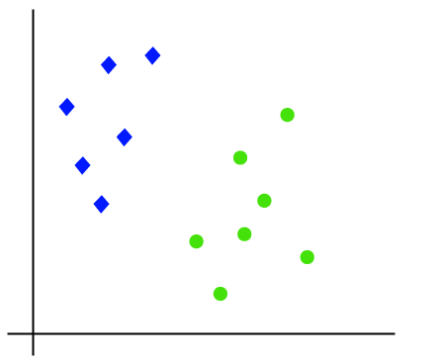
How does SVM works?
Linear SVM:
The working of the SVM algorithm can be understood by using an example. Suppose we have a dataset that has two tags (green and blue), and the dataset has two features x1 and x2. We want a classifier that can classify the pair(x1, x2) of coordinates in either green or blue. Consider the below image:

Slide 22
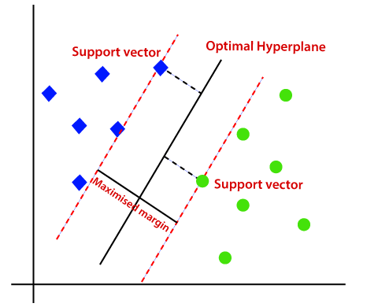
Continued…
Hence, the SVM algorithm helps to find the best line or decision boundary; this best boundary or region is called as a hyperplane.
SVM algorithm finds the closest point of the lines from both the classes.
These points are called support vectors. The distance between the vectors and the hyperplane is called as margin.
And the goal of SVM is to maximize this margin. The hyperplane with maximum margin is called the optimal hyperplane.

Slide 23
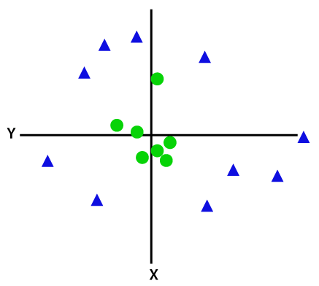
Non-Linear SVM:
If data is linearly arranged, then we can separate it by using a straight line, but for non-linear data, we cannot draw a single straight line. Consider the below image:
So to separate these data points, we need to add one more dimension. For linear data, we have used two dimensions x and y, so for non-linear data, we will add a third dimension z. It can be calculated as:
2
2
Z = x + y

Slide 24
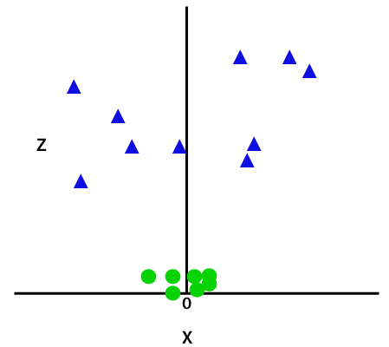
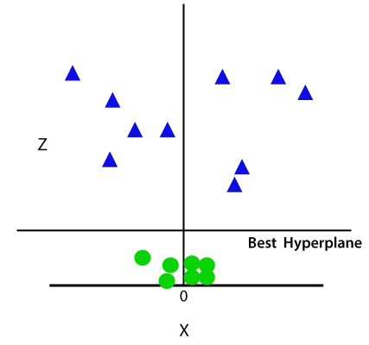
Continued…
By adding the third dimension, the sample space will become as below image:
So now, SVM will divide the datasets into classes in the following way. Consider the below image:

Slide 25
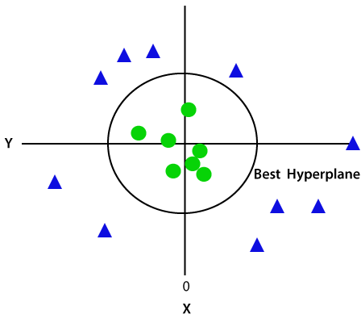
Continued…
Since we are in 3-d Space, hence it is looking like a plane parallel to the x-axis. If we convert it in 2d space with z=1, then it will become as:
Hence we get a circumference of radius 1 in case of non-linear data.

Slide 26
Limitations
SVM algorithm is not suitable for large data sets.
SVM does not perform very well when the data set has more noise i.e. target classes are overlapping.
In cases where the number of features for each data point exceeds the number of training data samples, the SVM will underperform.
As the support vector classifier works by putting data points, above and below the classifying hyperplane there is no probabilistic explanation for the classification.

Slide 27
Decision Tree
Decision Tree is a Supervised learning technique that can be used for both classification and Regression problems, but mostly it is preferred for solving Classification problems. It is a tree-structured classifier, where internal nodes represent the features of a dataset, branches represent the decision rules and each leaf node represents the outcome.
In a Decision tree, there are two nodes, which are the Decision Node and Leaf Node. Decision nodes are used to make any decision and have multiple branches, whereas Leaf nodes are the output of those decisions and do not contain any further branches.
The decisions or the test are performed on the basis of features of the given dataset.
It is a graphical representation for getting all the possible solutions to a problem/decision based on given conditions.

Slide 28

Continued…
It is called a decision tree because, similar to a tree, it starts with the root node, which expands on further branches and constructs a tree-like structure.
In order to build a tree, we use the CART algorithm, which stands for Classification and Regression Tree algorithm.
A decision tree simply asks a question, and based on the answer (Yes/No), it further split the tree into subtrees.

Slide 29
Decision Tree Terminologies
Root Node: Root node is from where the decision tree starts. It represents the entire dataset, which further gets divided into two or more homogeneous sets.
Leaf Node: Leaf nodes are the final output node, and the tree cannot be segregated further after getting a leaf node.
Splitting: Splitting is the process of dividing the decision node/root node into sub-nodes according to the given conditions.
Branch/Sub Tree: A tree formed by splitting the tree.
Pruning: Pruning is the process of removing the unwanted branches from the tree.
Parent/Child node: The root node of the tree is called the parent node, and other nodes are called the child nodes.

Slide 30
How does the Decision Tree algorithm Work?
Step-1: Begin the tree with the root node, says S, which contains the complete dataset.
Step-2: Find the best attribute in the dataset using Attribute Selection Measure (ASM).
Step-3: Divide the S into subsets that contains possible values for the best attributes.
Step-4: Generate the decision tree node, which contains the best attribute.
Step-5: Recursively make new decision trees using the subsets of the dataset created in step -3. Continue this process until a stage is reached where you cannot further classify the nodes and called the final node as a leaf node.

Slide 31
Attribute Selection Measures
There are two popular techniques for ASM, which are:
Information Gain
Gini Index
1. Information Gain
Information gain is the measurement of changes in entropy after the segmentation of a dataset based on an attribute.
It calculates how much information a feature provides us about a class.
According to the value of information gain, we split the node and build the decision tree.
A decision tree algorithm always tries to maximize the value of information gain, and a node/attribute having the highest information gain is split first. It can be calculated using the below formula:
Information Gain= Entropy(S)- [(Weighted Avg) *Entropy(each feature)

Slide 32
Continued….
Entropy: Entropy is a metric to measure the impurity in a given attribute. It specifies randomness in data. Entropy can be calculated as:
Entropy(s)= -P(yes)log2 P(yes)- P(no) log2 P(no)
Where,
S= Total number of samples
P(yes)= probability of yes
P(no)= probability of no
2. Gini Index:
Gini index is a measure of impurity or purity used while creating a decision tree in the CART(Classification and Regression Tree) algorithm.
An attribute with the low Gini index should be preferred as compared to the high Gini index.
It only creates binary splits, and the CART algorithm uses the Gini index to create binary splits.

Slide 33
Continued…
Gini index can be calculated using the below formula:
Pruning:
Pruning is a process of deleting the unnecessary nodes from a tree in order to get the optimal decision tree.
A too-large tree increases the risk of overfitting, and a small tree may not capture all the important features of the dataset. Therefore, a technique that decreases the size of the learning tree without reducing accuracy is known as Pruning. There are mainly two types of tree pruning technology used:
Cost Complexity Pruning
Reduced Error Pruning.
Gini Index= 1- ∑_{j}P_{j}²

Slide 34
Continued….
Advantages of the Decision Tree
It is simple to understand as it follows the same process which a human follow while making any decision in real-life.
It can be very useful for solving decision-related problems.
It helps to think about all the possible outcomes for a problem.
There is less requirement of data cleaning compared to other algorithms.
Disadvantages of the Decision Tree
The decision tree contains lots of layers, which makes it complex.
It may have an overfitting issue, which can be resolved using the Random Forest algorithm.
For more class labels, the computational complexity of the decision tree may increase.

Slide 35
Gradient Descent in Machine Learning
Gradient descent was initially discovered by "Augustin-Louis Cauchy" in mid of 18th century. Gradient Descent is defined as one of the most commonly used iterative optimization algorithms of machine learning to train the machine learning and deep learning models.
It helps in finding the local minimum of a function.
The best way to define the local minimum or local maximum of a function using gradient descent is as follows:
If we move towards a negative gradient or away from the gradient of the function at the current point, it will give the local minimum of that function.
Whenever we move towards a positive gradient or towards the gradient of the function at the current point, we will get the local maximum of that function.

Slide 36
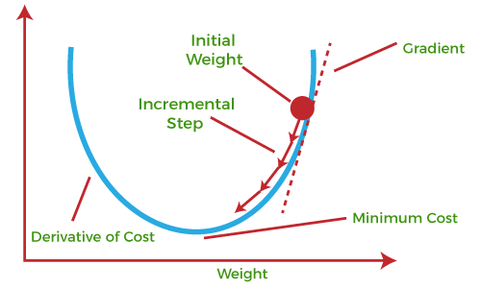
Continued….

Slide 37
Continued….
The main objective of using a gradient descent algorithm is to minimize the cost function using iteration.
To achieve this goal, it performs two steps iteratively:
Calculates the first-order derivative of the function to compute the gradient or slope of that function.
Move away from the direction of the gradient, which means slope increased from the current point by alpha times, where Alpha is defined as Learning Rate. It is a tuning parameter in the optimization process which helps to decide the length of the steps.
What is Cost-function?
The cost function is defined as the measurement of difference or error between actual values and expected values at the current position and present in the form of a single real number.
It helps to increase and improve machine learning efficiency by providing feedback to this model so that it can minimize error and find the local or global minimum.

Slide 38
How does Gradient Descent work?
The starting point(shown in above fig.) is used to evaluate the performance as it is considered just as an arbitrary point.
At this starting point, we will derive the first derivative or slope and then use a tangent line to calculate the steepness of this slope. Further, this slope will inform the updates to the parameters (weights and bias).
The slope becomes steeper at the starting point or arbitrary point, but whenever new parameters are generated, then steepness gradually reduces, and at the lowest point, it approaches the lowest point, which is called a point of convergence.
The main objective of gradient descent is to minimize the cost function or the error between expected and actual. To minimize the cost function, two data points are required:

Slide 39
Types of Gradient Descent
1. Batch Gradient Descent:
Batch gradient descent (BGD) is used to find the error for each point in the training set and update the model after evaluating all training examples. This procedure is known as the training epoch. In simple words, it is a greedy approach where we have to sum over all examples for each update.
Pros:
More stable convergence and error gradient than Stochastic Gradient descent
Embraces the benefits of vectorization
A more direct path is taken towards the minimum
Cons:
Can converge at local minima and saddle points
Slower learning since an update is performed only after we go through all observations

Slide 40
Continued….
2. Stochastic gradient descent:
Stochastic gradient descent (SGD) is a type of gradient descent that runs one training example per iteration. Or in other words, it processes a training epoch for each example within a dataset and updates each training example's parameters one at a time. As it requires only one training example at a time, hence it is easier to store in allocated memory.
Pros
Only a single observation is being processed by the network so it is easier to fit into memory
May (likely) to reach near the minimum (and begin to oscillate) faster than Batch Gradient Descent on a large dataset
Cons
Can veer off in the wrong direction due to frequent updates
Lose the benefits of vectorization since we process one observation per time
Frequent updates are computationally expensive due to using all resources for processing one training sample at a time

Slide 41
3. MiniBatch Gradient Descent:
Mini Batch gradient descent is the combination of both batch gradient descent and stochastic gradient descent. It divides the training datasets into small batch sizes then performs the updates on those batches separately. Splitting training datasets into smaller batches make a balance to maintain the computational efficiency of batch gradient descent and speed of stochastic gradient descent. Hence, we can achieve a special type of gradient descent with higher computational efficiency and less noisy gradient descent.
Pros:
Convergence is more stable than Stochastic Gradient Descent
Computationally efficient
Fast Learning since we perform more updates
Cons:
We have to configure the Mini-Batch size hyperparameter

Slide 42
Bagging
Bagging, also known as bootstrap aggregation, is the ensemble learning method that is commonly used to reduce variance within a noisy dataset.
In bagging, a random sample of data in a training set is selected with replacement—meaning that the individual data points can be chosen more than once.
After several data samples are generated, these weak models are then trained independently, and depending on the type of task—regression or classification, for example—the average or majority of those predictions yield a more accurate estimate.
The random forest algorithm is considered an extension of the bagging method, using both bagging and feature randomness to create an uncorrelated forest of decision trees.

Slide 43
Boosting:
Boosting is another ensemble procedure to make a collection of predictors. In other words, we fit consecutive trees, usually random samples, and at each step, the objective is to solve net error from the prior trees.
If a given input is misclassified by theory, then its weight is increased so that the upcoming hypothesis is more likely to classify it correctly by consolidating the entire set at last converts weak learners into better performing models.
Gradient Boosting is an expansion of the boosting procedure.

Slide 44
Difference between Bagging and Boosting:
Bagging | Boosting
Various training data subsets are randomly drawn with replacement from the whole training dataset. | Each new subset contains the components that were misclassified by previous models.
Bagging attempts to tackle the over-fitting issue. | Boosting tries to reduce bias.
If the classifier is unstable (high variance), then we need to apply bagging. | If the classifier is steady and straightforward (high bias), then we need to apply boosting.
Every model receives an equal weight. | Models are weighted by their performance.
Objective to decrease variance, not bias. | Objective to decrease bias, not variance.

