Slide 1


Slide 2
About Softwarica College
We are pioneer in introducing British Education in Nepal established in 2010 AD.
We are affiliated to NCC Education, UK to deliver/teach Diploma in Computing and Advanced Diploma in Computing.
We are approved by Ministry of Education, Nepal to deliver/teach Diploma in Computing and Advanced Diploma in Computing awarded by NCC Education, UK.

Slide 3
About NCC Education
is an awarding and examination body registered in the UK.
works in partnership with accredited partner centres and universities to provide students with an affordable route to obtain a UK university degree in IT and Business.
has more than 250 accredited partner centres in over 45 countries
over 50 universities worldwide accept NCC Education programmes as entry onto their degree programmes.
is recognized by the Office of the Qualifications and Examinations Regulator (Ofqual) and the Department for Innovation, Universities and Skills (DIUS) as a awarding body in th UK.

Slide 4
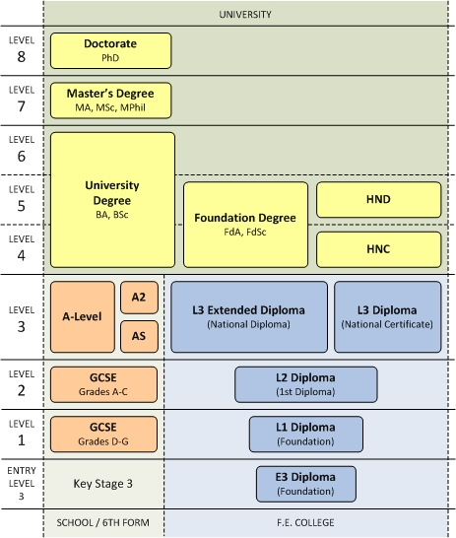
UK Education System

Slide 5
Programme Pathway at Softwarica College
10+2 or A level or
equivalent degree
Diploma in Computing
Equivalent to year 1 of 3 years UK bachelor degree
Taught/delivered by Softwarica College
Advanced Diploma in Computing
Equivalent to year 2 of 3 years UK bachelor degree
Taught/delivered by Softwarica College
Bachelor Degree (Final Year)
Equivalent to year 3 of 3 years UK bachelor degree
Students have various options to complete their final year after completing 2 years at Softwarica College

Slide 6
Programme Description
Diploma in Computing
Overview
The qualification is equivalent to the first year of an IT degree in the UK university system. The qualification will allow you to understand and enter the computing profession with the necessary knowledge expected within the industry and the ability to apply the skills to a range of IT-related functions.
Accreditation Status
NCC Education is regulated by Ofqual (Office of Qualifications and Examinations Regulation) to award the Diploma in Computing (QCF) in England. Ofqual Qualification reference number 600/0406/X.
Units
Skills for Computing
Computer Systems
Computer Networks
Software Development Techniques
Designing and Developing a website
Databases
Designing and Developing Object-Oriented Computer Programs
Office Solution Development
Assessments
Assessments for all units are offered in a number of assessment cycles throughout the year. All units are assessed by both examination and assignments.

Slide 7
Programme Description
Advanced Diploma in Computing
Overview
The qualification is equivalent to the second year of an IT degree in the UK university system. This programme builds upon the knowledge gained during the Diploma in Computing, exposing student to greater detail and more advanced topics in a range of areas including database development, information systems analysis, and network security and cryptography.
Accreditation Status
NCC Education is accredited to award the Advanced Diploma in Computing (QCF) by Ofqual (Office of Qualifications and Examinations Regulation) in England. Ofqual Qualification reference number 600/3055/0.
Units
Professional Issues in IT
Network Security and Cryptography
Information Systems Analysis
Dynamic Websites
Analysis, Design and Implementation
Database Design and Development
Agile Development
Computing Project
Assessments
Assessments for all units are offered in a number of assessment cycles throughout the year. All units, except the project, are assessed by both examination and assignments.

Slide 8
What after 2 years at Softwarica College ??
Option 1
Option 2
Option 3
Enrol on BSc (Hons) in Business Computing and Information Systems delivered/taught online by NCC Education, validated and awarded by the University of Central Lancashire, UK.
Enrol for final year in Nepal at various institutions affiliated to UK universities and approved by the Ministry of Education Nepal.
Credit transfer to various UK universities for the final year or other various universities worldwide.

Slide 9
Details on Option 1
Students can enrol on BSc (Hons) in Business Computing and Information Systems delivered/taught online by NCC Education through UK academics, validated and awarded by the University of Central Lancashire, UK.
This online programme can be studied from ANY WHERE, ANY TIME, as per the student convenient.
  Please note that this programme is neither taught nor delivered at Softwarica College. Softwarica College is only responsible for the pastoral care, administrative support and invigilation support for students.
  Equivalency from Tribhuwan University should be processed by student once the he/she finishes the final year. The equivalency may take few months of time.
  Once its equivalency is provided by Tribhuvan University, students can join Master programmes in Local universities and also can apply for government jobs.

Slide 10
Details on Option 2
Students can complete their final year (3rd year) in Nepal only from other various institutions affiliated to UK universities and approved by the Ministry of Education Nepal.
Some of these UK universities have already been registered in the equivalency list of Tribhuvan University, Nepal.

Slide 11
Details on Option 3
Students can apply for credit transfer to various UK universities for the final year or other various universities worldwide.
More than 50 universities in UK recognize the NCC Education qualification and provide direct entry or exempted entry into their 3rd year (final year) programme.
Students can apply for credit transfer to universities in Australia, New Zealand or USA. The credit transfer may vary depending upon the entry requirement of the concerned university.

Slide 12




Our Affiliations

Slide 13
Facilities at Softwarica College
Expanded to Block A, Block B and Block C
9 ICT enabled lecture rooms
8 IT labs with state-of-the-art computer facilities and high-speed internet connection
7 project/tutorial rooms
Library with collection of 2000+ books and journals
Seminar Hall
Canteen
Plenty of social space for students to unwind, relax, socialize and mingle. During leisure, students can partake in a game of table-tennis, badminton or basketball
Outdoor sports like football and cricket arranged for students

Slide 14
Student Clubs
Events & Sports Club:
Organizes various following extra-curricular activities and not limiting to:
Musical programme,
Refreshment programme/day,
Education tour
Organizes intra-college and inter-college sport events
IT & Editorial Club:
Organizes various following extra-curricular activities and not limiting to:
Releases the college newsletter every semester
Searches for new developments and news in IT industry.
Coordinates with the press for printing.
Youth Club:
Youth Club organizes various extra-curricular activities relating to social initiative and responsibility.

Slide 15
Our Students Success
Mr. Keshav Khadka – Global High Achiever, Sept 2011
Mr. Carol Dhoju – Global High Achiever, June 2013
Mr. Roshan Chaudhary – Regional High Achiever, Sept 2011
Mr. Anand Shrestha – Regional High Achiever, Dec 2011
Mr. Maikal Shrestha – Regional High Achiever, March 2012
Mr. Carol Dhoju – Regional High Achiever, June 2012
Mr. Binaya Subedi – Regional High Achiever, Dec 2012
Mr. Kumar Bhandari – Regional High Achieriver, June 2013
Mr. Hari Krishna Shrestha – Regional High Achiever, June 2013
Mr. Solendra Panjiyar – Regional High Achiever, Sept 2013

Slide 16
Thank You.

