Slide 1


Introduction to git and Github
Where are the workshop materials?

Slide 2
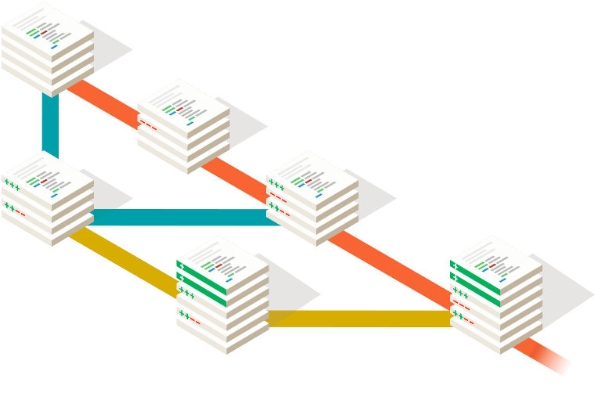

What is Git?
Git is Distributed (Decentralized) version control system that is widely used by a number of open source projects.
Many programmers use git for version control, which means they use it to track any changes to a set of files they are working on.
Distributed revision control or decentralized version control, allows many software developers to work on a given project without requiring them to share a common network

Slide 3
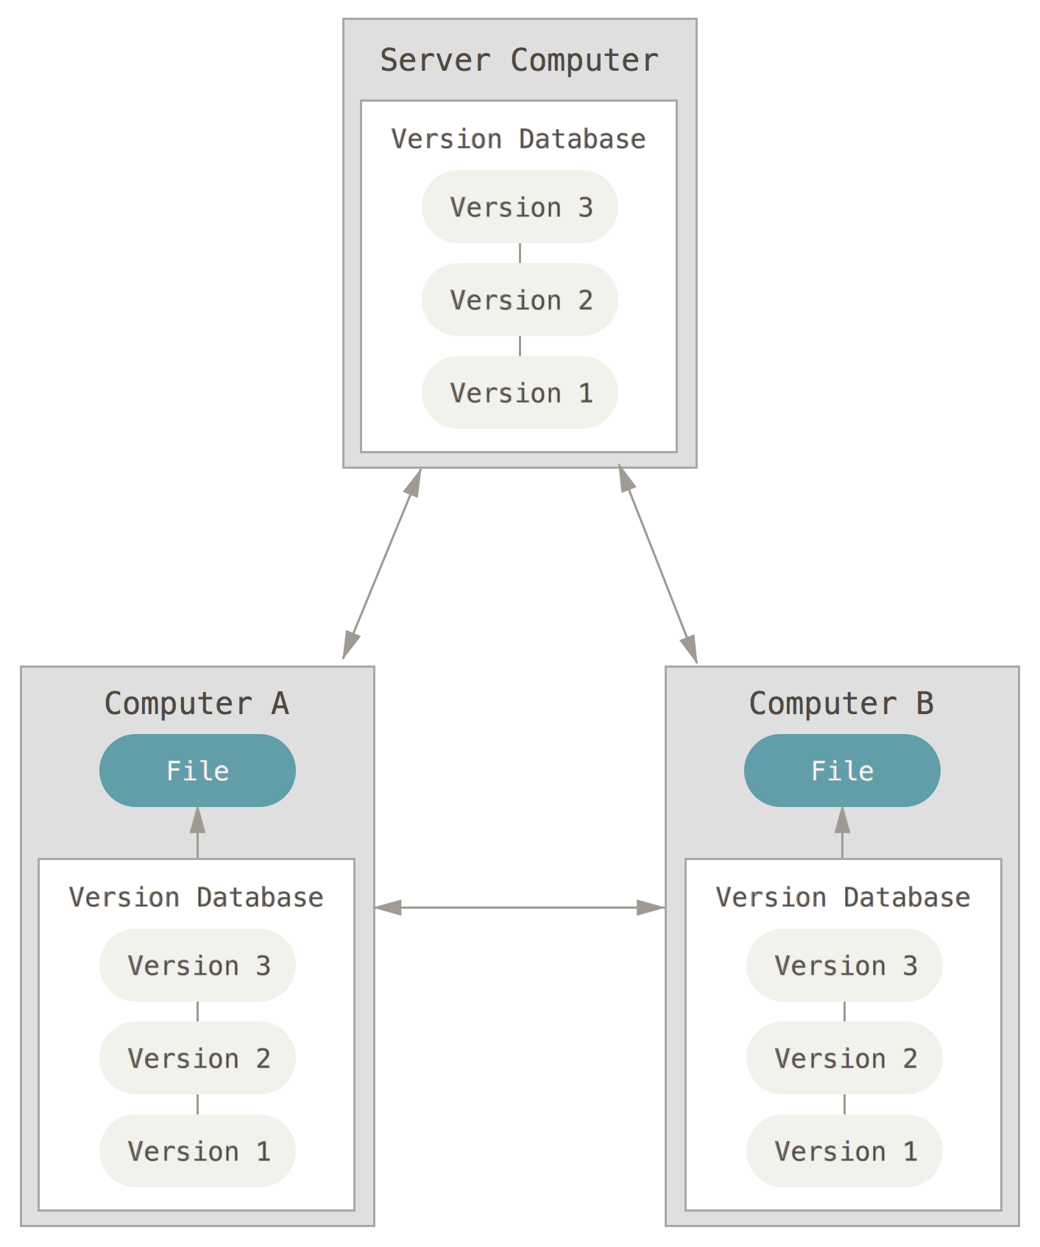
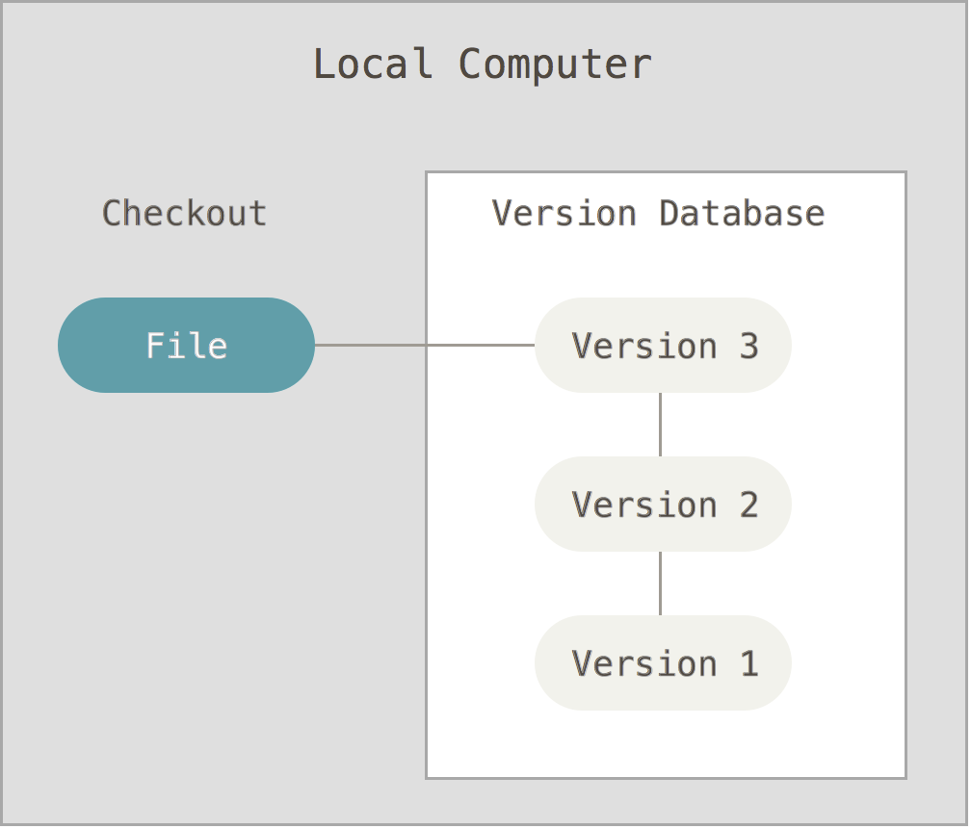
What is version control system (VCS)?
A version control system (sometimes just referred to as a VCS) is a system that tracks changes to files (or groups of files) over time.
File_name_final
File_name_final2
File_name_final3
File_name_final_finala
...

Slide 4
Why we are going to use Git?
Speed - because it’s fast
Simple design - because it’s easy to setup and start using it.
In line with the project - because in every moment we know where are our files and are always in line with the current project status
Collaboration - because we can have strong support for thousands of parallel branches from different users
Scalable - because we can handle both simple or larger projects, documentation or source code

Slide 5
Practical uses of Git
This is all well and good, but how can I (as a non-programmer) use a tool like Git?
Here are a couple examples:
use a Git repository to store the documentation for an project or service;
collaborative writing (documentation or blog etc.);
store configuration files in a Git repository. If a change to a configuration file produces adverse results, you can use the repository’s commit history to go back to a previous version of the file.
Track revisions to automation scripts using a Git repository.

Slide 6

Git workflow

Slide 7
What is repository?
The group of files that a VCS tracks is called a repository.
The basic idea behind a VCS is that you could use it to “roll back” to an earlier version of any file (or group of files) in the repository in the event that the current version isn’t working or isn’t optimal.
Almost all version control systems, including Git, support multiple repositories, and typically each repository would represent a particular project, component, or function.
repository = repo

Slide 8
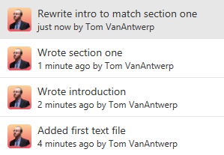
What is commit?
Git works by allowing you to commit a snapshot of your work with a descriptive name.
Each commit should have a name that tells you something about what you've changed since the previous commit.
A list of commits ordered newest to oldest might look like this:
what?
who?
who?
when?

Slide 9
What is commit?
So what is more informative?
File_name_final
File_name_final2
File_name_final3
File_name_final_finala
...
or
By using git commits, we don't need multiple copies of a regularly changed file; there's only the one copy of the files you care about, and all the snapshots you took along the way.
And with meaningful commit messages, you don't have to guess what changes are in what version of your work.

Slide 10
What is Github?
GitHub is a website that lets you store a copy of your git repository online where you can your collaborators can share it and work together.
GitHub allows you and your team to know who is changing what and why. You can be sure that you're working off of the most recent copy of the work by pulling new commits from GitHub.
And when you're done making commits of your own, you can push them back to GitHub for everyone else to use.
You can also use features like GitHub Issues to keep track of problems and to-dos, and discuss them as a team. GitHub also makes it easy to control who can make what changes, and for merging different changes by different people together.

Slide 11
Some of the biodiversity projects on Github
Taxize - https://github.com/ropensci/taxize
Pytaxize - https://github.com/sckott/pytaxize
Biodiversity Visualizations using R - https://github.com/vijaybarve/bdvis
Darwin Core - https://github.com/tdwg/dwc
RGBIF - https://github.com/ropensci/rgbif
Symbiota - https://github.com/Symbiota/Symbiota
GBIF Integrated Publishing Toolkit (IPT) - https://github.com/gbif/ipt

