Slide 1

Getting to know
FOSS software

Slide 2
What is Open Source Software?
The term refers to how the software is licensed.
Open source software is licensed so that:
Everyone can use, copy, study, and change the software in any way;
The source code is available to everyone.
Users are encouraged to voluntarily improve the design and functionality of the software

Slide 3
Proprietary Software
This term also refers to how the software is licensed.
Proprietary software is software licensed so that:
The source code is not available
Use is restricted in some way:
  limiting the number of computers it can be installed on;
  limiting the time period the software can be used;
  limiting the amount of data that can be processed;
  limiting the number of features available;
  limiting the fields of endeavor: educational, non-commercial…

Slide 4
Related Terms
Open Source Software (OSS)?
Free Software (FS)?
FOSS?
What does it all mean?

Slide 5
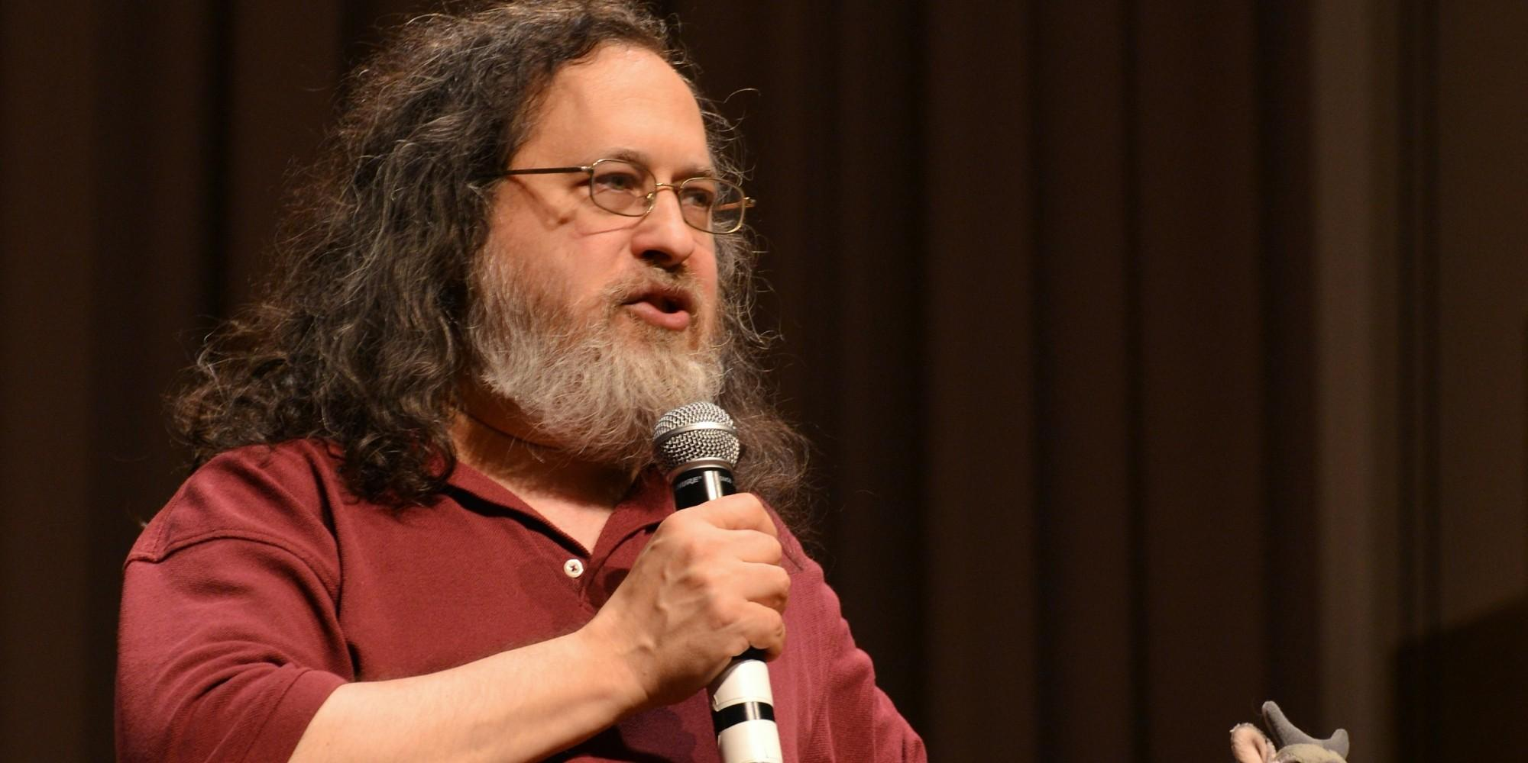

Free Software (FS)
The free software movement was conceived in 1983 by Richard Stallman to give the benefit of "software freedom" to computer users.
Stallman founded the Free Software Foundation in 1985 to provide the organizational structure to advance his Free Software ideas.
CopyLeft - says that anyone who redistributes the software, with or without changes, must pass along the freedom to further copy and change it. CopyLeft guarantees that every user has freedom.
CopyLeft

Slide 6
Free Software License
“Free” is intended to refer to the freedom to copy and re-use the software, rather than the financial cost of the software.
The Four Kinds of Freedom (for the users of the software)
The freedom to run the program, for any purpose.
The freedom to study how the program works, and adapt it to your needs*.
The freedom to redistribute copies so you can help your neighbor.
The freedom to improve the program, and release your improvements to the public, so that the whole community benefits.
* Requires access to the source code

Slide 7

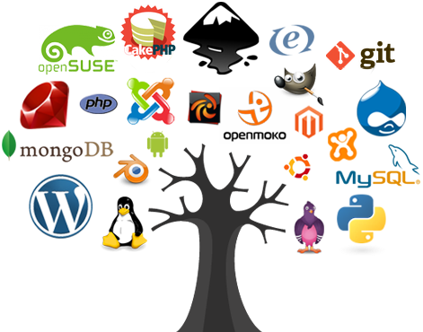
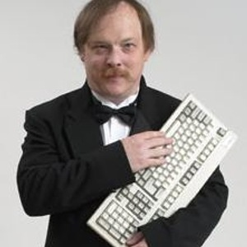
Open Source Software (OSS)
Coined by Eric Raymond in 1998 who thought the Term
“Free” would be misunderstood.
The source code and certain other rights normally reserved for copyright holders are provided under a software license that meets the Open Source Definition or that is in the public domain.
This license permits users to use, change, and improve the software, and to redistribute it in modified or unmodified forms.

Slide 8
Open source software vs. free software
Open Source Software and Free Software are different terms for software which comes with certain rights, or freedoms, for the user.
They describe two approaches and philosophies towards free software.
They are often described as:
Open Source -> a practical development methodology
Free Software -> a social movement
Most Open Source software is “free” and most Free Software is “open source”
FOSS = Free and Open Source Software

Slide 9
Development Community
In the Open Source development community, any skilled individual can contribute to projects in many ways:
Writing code – development;
Testing features & reporting bugs;
Writing user manuals;
Creating training materials.
FOSS development is not purely altruistic.
Developers often earn a living:
Via selling services provided with the software;
Being paid by a third party to develop the software;
Being paid via crowdfunding;
Training others in the use of the software;
Selling repackaged software with support agreements.

Slide 10
Other Related Terms
FreeWare – software available at no monetary cost. It is considered neither Free nor Open Source software.
Source Available/Shared Source - source is available for viewing, but it may not legally be modified or redistributed. Has been used by Microsoft.
Closed Source – Most proprietary software.

Slide 11
FOSS vs. Proprietary
Is one better than the other?
The answer is no. FOSS software must be evaluated in the same ways as proprietary software.
The most important question is: “Will it meet my needs?”
To most of us, the availability of source code isn’t the most important factor.
However, the Freedom to use the software is often very attractive.
The lack of licensing fees may also be important.

Slide 12
Software Examples: FOSS vs. Proprietary
FOSS | Proprietary
Operating systems
Linux | Windows / Mac
Mobile Operating Systems
Android | iOS
Office Software
Open Office / Libre Office | Microsoft Office
Image Manipulation
GIMP | Adobe Photoshop
Web Browser
Chrome / Firefox | Internet Explorer
Databases
mySQL / PostgreSQL | Oracle / SQL Server
Statistics
R | S

Slide 13
GIS Software: FOSS vs. Proprietary
FOSS | Proprietary
GeoSpatial Desktop
QGIS | ArcGIS
gvSIG | Manifold GIS
GRASS GIS | IDRISI
Remote Sensing
GRASS GIS | ERDAS
OSSIM | ENVI
Web Mapping
MapServer | ArcGIS Server
Geoserver | Blue Spatial?
QGIS Server | Various cloud solutions (MapBox)
Spatial Databases
SpatialLite | ESRI Geodatabase
PostGIS w. PostgreSQL | ArcGIS Server (previously ArcSDE)

Slide 14
Why Use Open Source for GIS?
It’s free to try.
GIS is a tool – why not have a full toolbox?
Increase your marketability by learning a new skill set.
Eliminate licensing fees.
QGIS will run on multiple operating systems.
You can have more direct involvement in software development.

Slide 15

The Open Source Geospatial Foundation
The Open Source Geospatial Foundation - OSGeo
Non-profit formed in 2006;
Goal is to support and build the best open source geospatial tools;
Provides financial, organizational and legal support to the broader Free and Open Source geospatial community;
Serves as an independent legal entity to which community members can contribute code, funding and other resources;
Maintains these contributions for the public benefit;
Provides a common forum.
http://www.osgeo.org/

Slide 16

QGIS
In this course you will be using the leading FOSS desktop software: QGIS.
Available for Windows, Mac, Linux, & Android.
Easy intuitive interface
Active Development community:
  Rapid development (quick bug fixes and new features)
  Many user created tools
  Active email listserv

