Slide 1



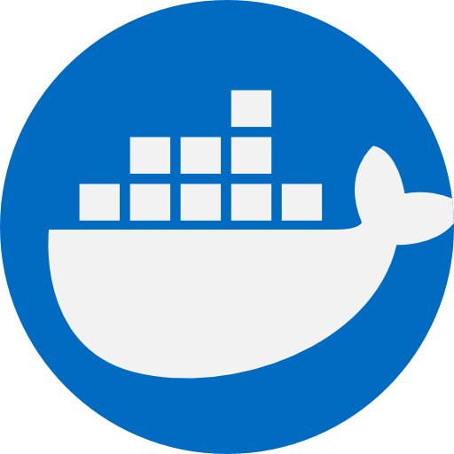
ETL Architecture
Postgres
Extract
Load
Python
containerization
Docker

Slide 2


ETL Architecture
Python
Postgres
Extract
Load
Extract
Airflow
containerization
Docker

Slide 3



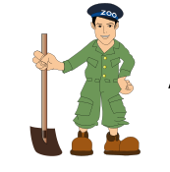
ETL Architecture
Kafka
Spark
Cassandra
Load & Transform
Load
Zookeeper
Docker

