Slide 1
Multi-Class and Structured Classification
Guillaume Obozinski
Practical Machine Learning CS 294
Tuesday 5/06/08

Slide 2




Basic Classification in ML
Input
Output
Spam
filtering
Binary
!!!!$$$!!!!
Multi-Class
Character
recognition
C
[thanks to Ben Taskar for slide!]

Slide 3





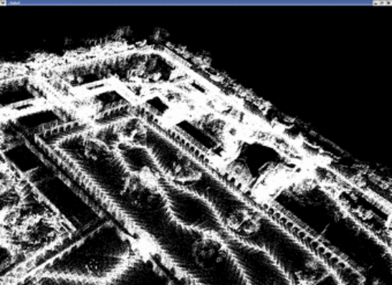
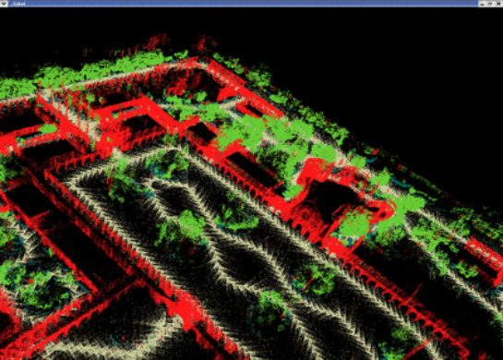
Structured Classification
Input
Output
Handwriting
recognition
Structured output
brace
3D object
recognition
building
tree
[thanks to Ben Taskar for slide!]

Slide 4
Multi-Class Classification
Multi-class classification : direct approaches
  Nearest Neighbor
  Generative approach & Naïve Bayes
  Linear classification:
    geometry
    Perceptron
    K-class (polychotomous) logistic regression
    K-class SVM
Multi-class classification through binary classification
  One-vs-All and All-vs-all
  Calibration
  Precision-Recall curve

Slide 5
Multi-label classification
  Is it edible?
  Is it sweet?
  Is it a fruit?
  Is it a banana?
Is it a banana?
Is it an apple?
Is it an orange?
Is it a pineapple?
Is it a banana?
Is it yellow?
Is it sweet?
Is it round?
Different structures
Nested/ Hierarchical
Exclusive/ Multi-class
General/Structured

Slide 6
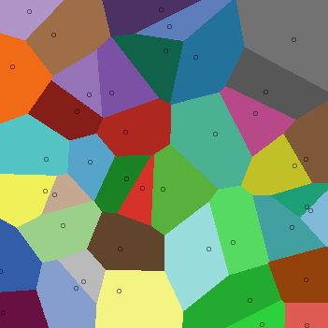
Nearest Neighbor,
Decision Trees
- From the classification lecture:
NN and k-NN were already phrased in a multi-class framework
For decision tree, want purity of leaves depending on the proportion of each class (want one class to be clearly dominant)

Slide 7
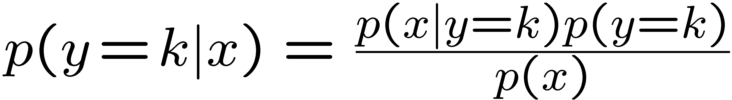
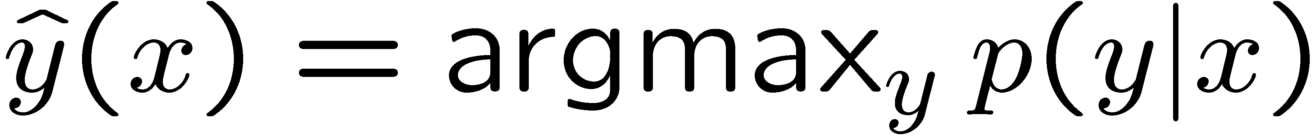
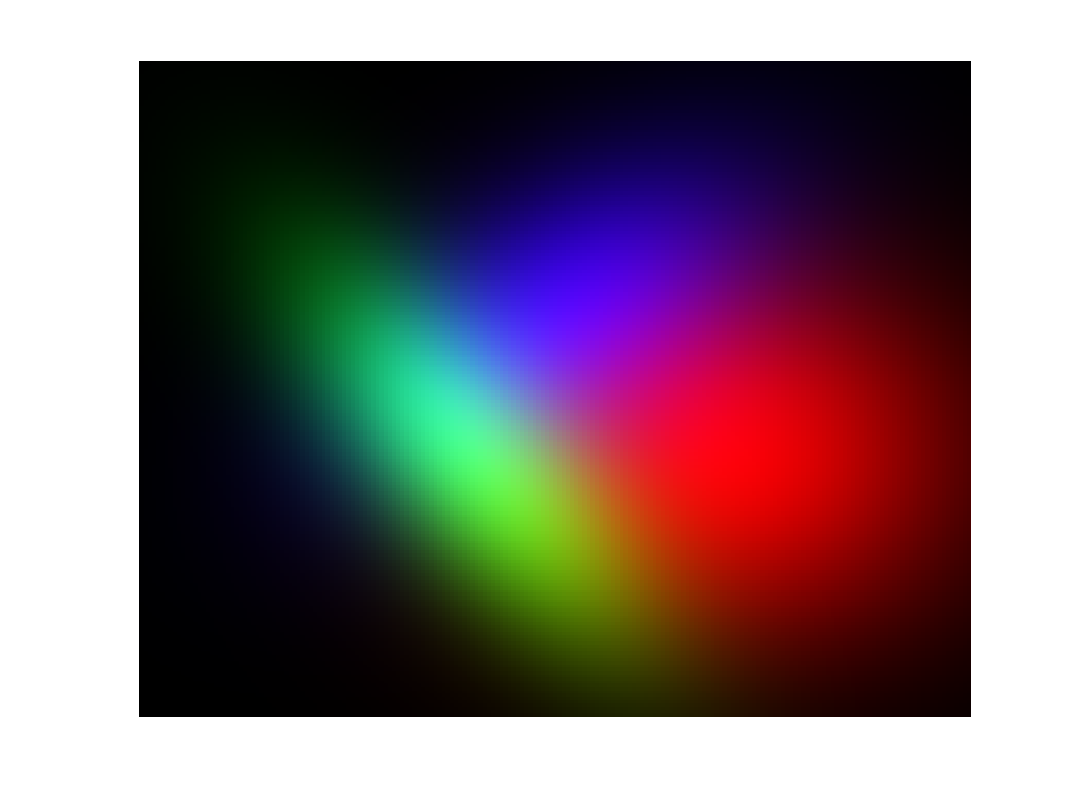
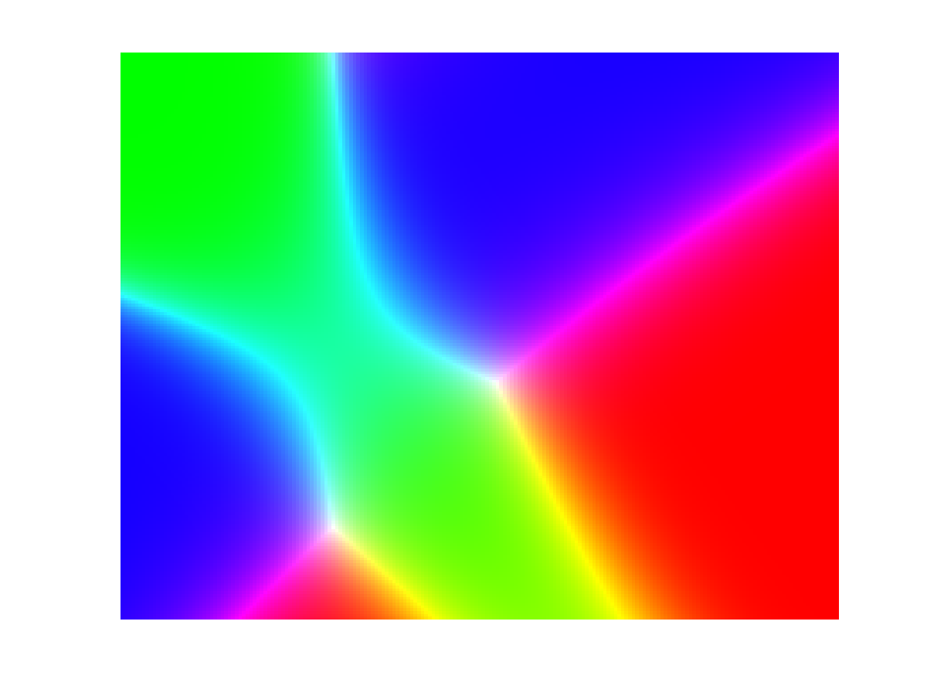
Generative models
As in the binary case:
Learn p(y) and p(y|x)
Use Bayes rule:
Classify as
p(y)
p(x|y)
p(y|x)

Slide 8
Generative models
Advantages:
  Fast to train: only the data from class k is needed to learn the k^{th} model (reduction by a factor k compared with other methods)
  Works well with little data provided the model is reasonable
Drawbacks:
  Depends critically on the quality of the model
  Doesn’t model p(y|x) directly
  With a lot of datapoints doesn’t perform as well as discriminative methods

Slide 9
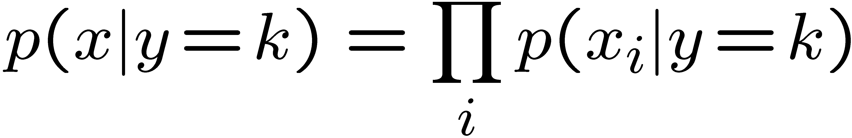
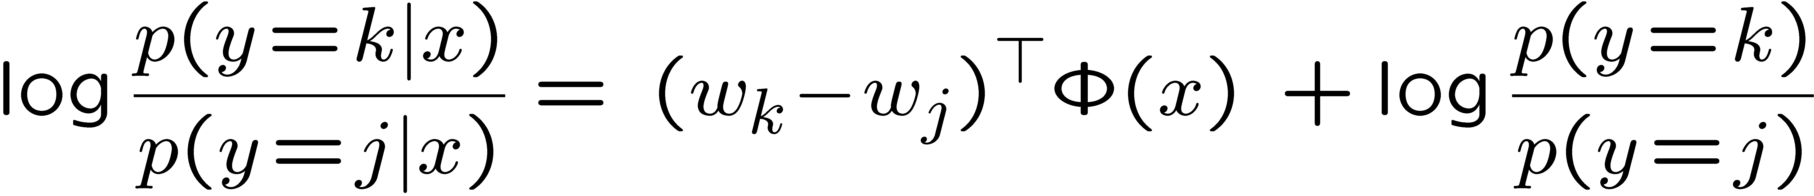
Naïve Bayes
Class
Assumption: Given the class, the features are independent
Y
X₁
X₂
X₃
X₄
X₅
Features
Bag-of-words models
If the features are discrete:
weights
counts

Slide 10
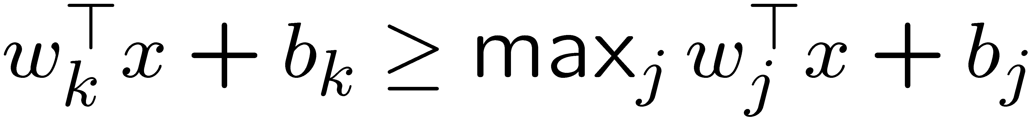
Discriminative linear classification
Each class has a parameter vector (w_{k},b_{k})
x is assigned to class k iff
Note that we can break the symmetry and choose (w₁,b₁)=0
For simplicity set b_{k}=0
(add a dimension and include it in w_{k})
So learning goal given separable data: choose w_{k} s.t.

Slide 11
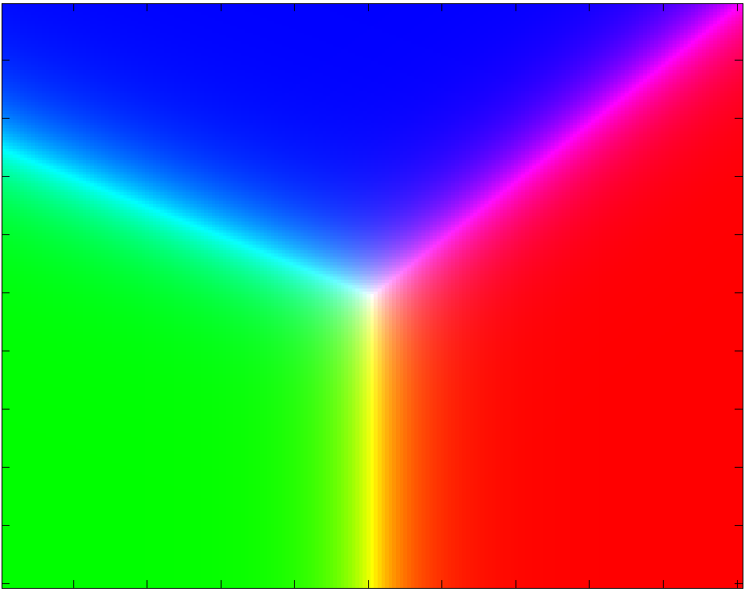
Geometry of Linear classification
Perceptron K-class logistic regression K-class SVM
1
1
1
1
1
1
1
1
1
1
1
1
1
1
1
1
1
1
3
3
3
3
2
3
2
3
2
2
2
2
2
2
2
2
2
2
3
2
3
2
3
2
3
3
3
2
3
3
3
2
3
3
3
2
3
2
3
2
3
2

Slide 12
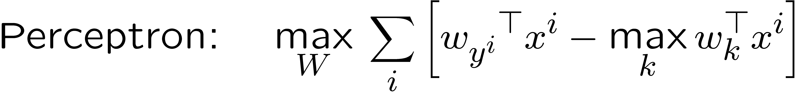
Three discriminative algorithms

Slide 13

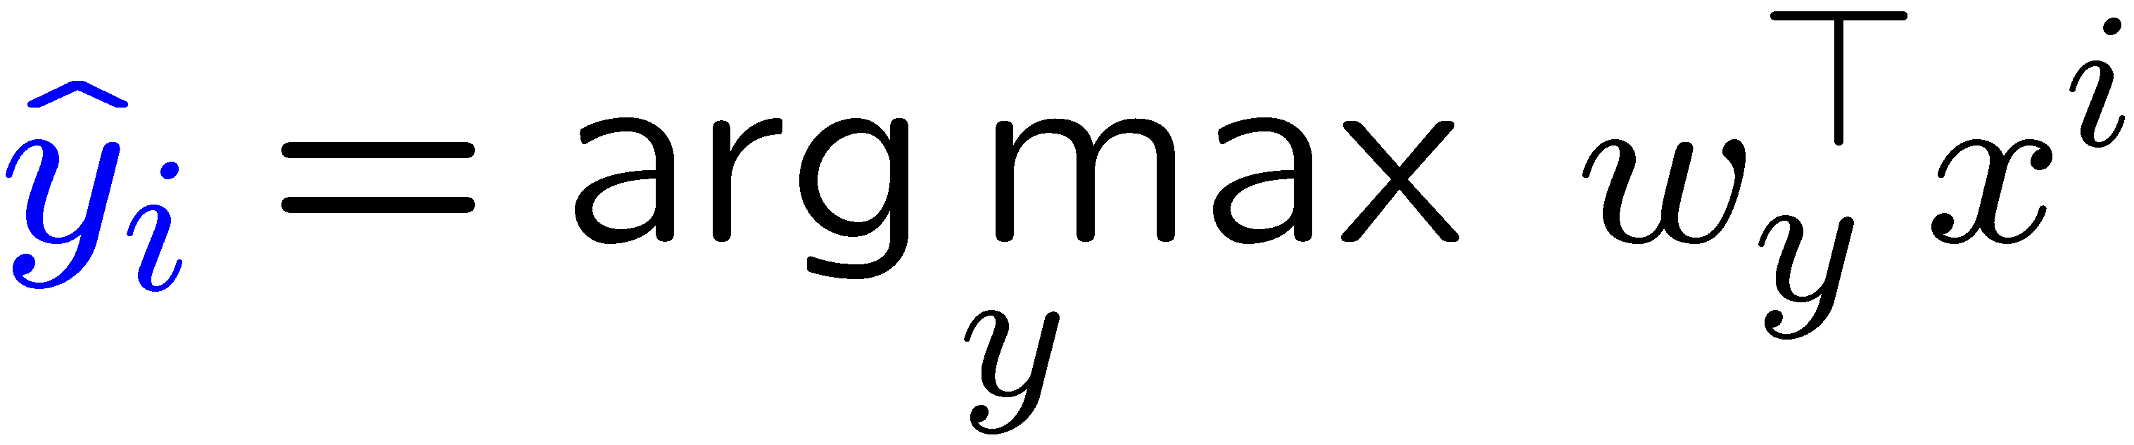
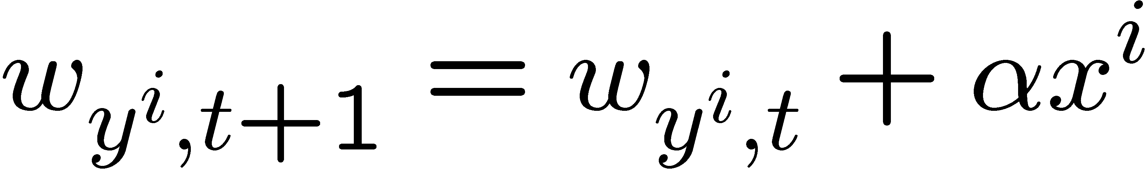
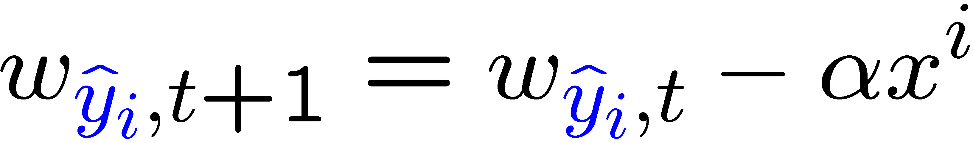
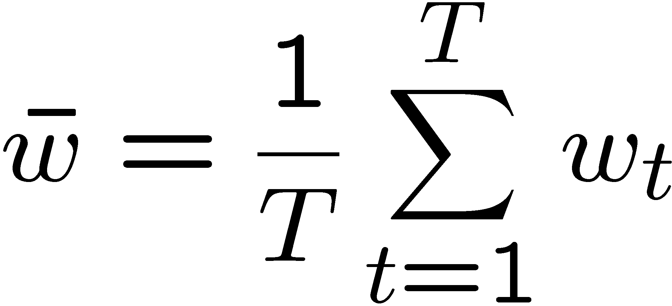
Multiclass Perceptron
Online: for each datapoint
Update:
Predict:
Advantages :
  Extremely simple updates (no gradient to calculate)
  No need to have all the data in memory (some point stay classified correctly after a while)
Solution when the data is not separable
  Decrease α slowly
  randomize the order of the training data
Averaged perceptron:

Slide 14
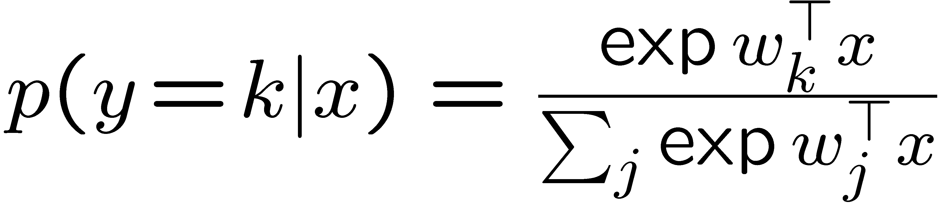

Polychotomous logistic regression
distribution in exponential form
Online: for each datapoint
Batch: all descent methods
Especially in large dimension, use regularization
small flip label probability (0,0,1) (.1,.1,.8)
Advantages:
Smooth function
Get probability estimates
Drawbacks:
Non sparse in the data in kernelized form

Slide 15
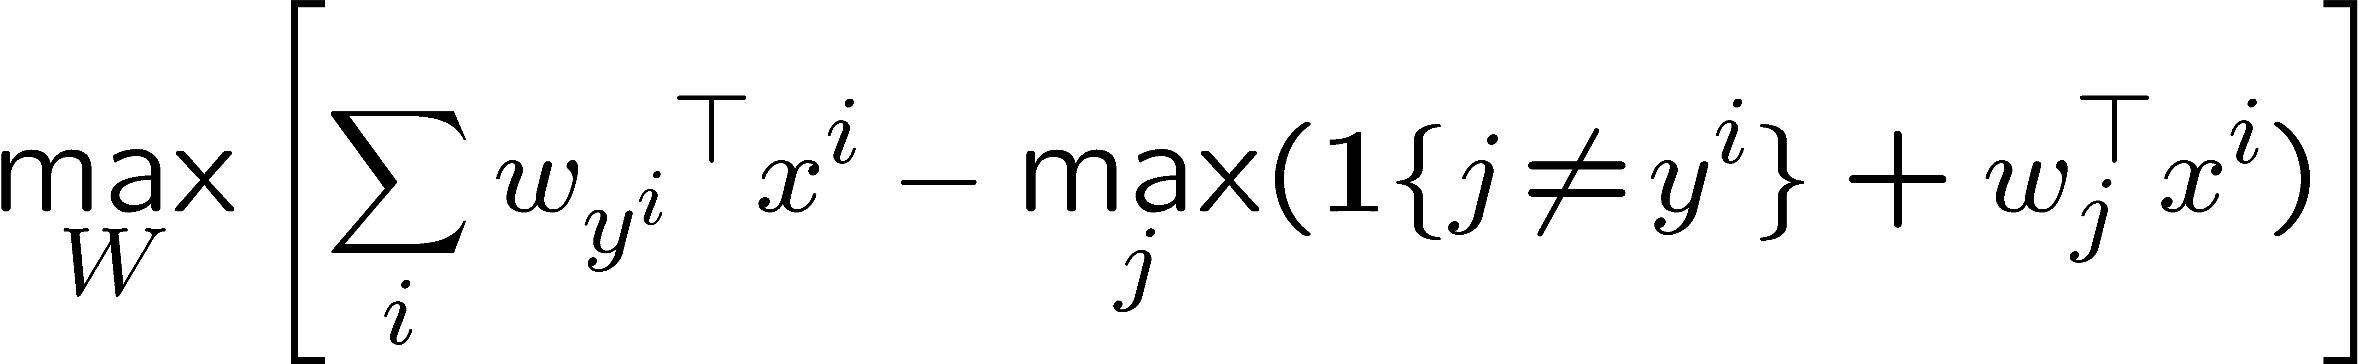
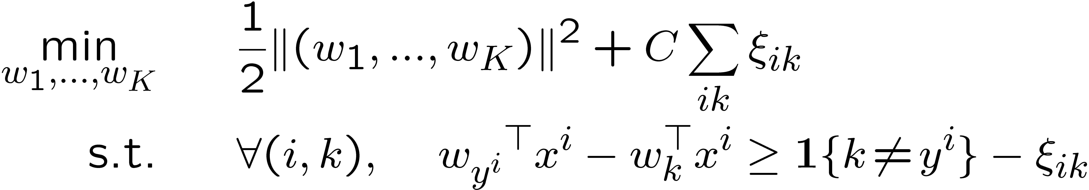
Multi-class SVM
Intuitive formulation: without regularization / for the separable case
Primal problem: QP
Solved in the primal by subgradient descent or in the dual with SMO
Main advantage: Sparsity (but not systematic)
Speed with SMO (heuristic use of sparsity)
Sparse dual solutions
Drawback:
Outputs not probabilities

Slide 16
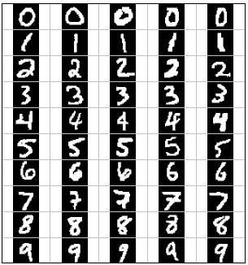
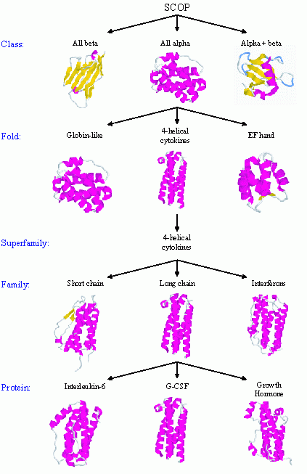
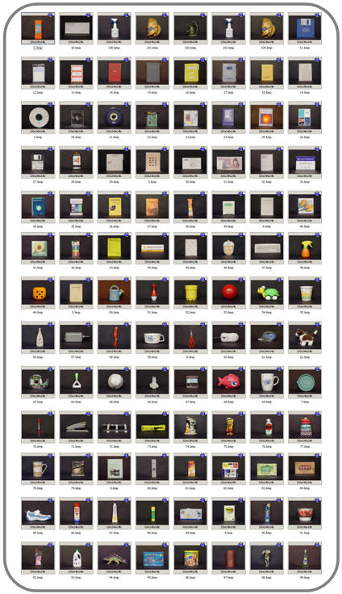
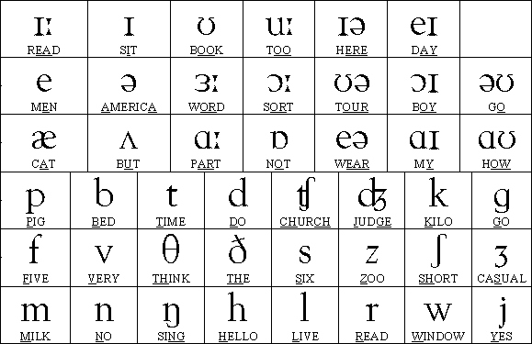
Real world classification problems
Digit recognition
Automated protein classification
Object recognition
http://www.glue.umd.edu/~zhelin/recog.html
10
Phoneme recognition
300-600
100
The number of classes is sometimes big
The multi-class algorithm can be heavy
50
[Waibel, Hanzawa, Hinton,Shikano, Lang 1989]

Slide 17
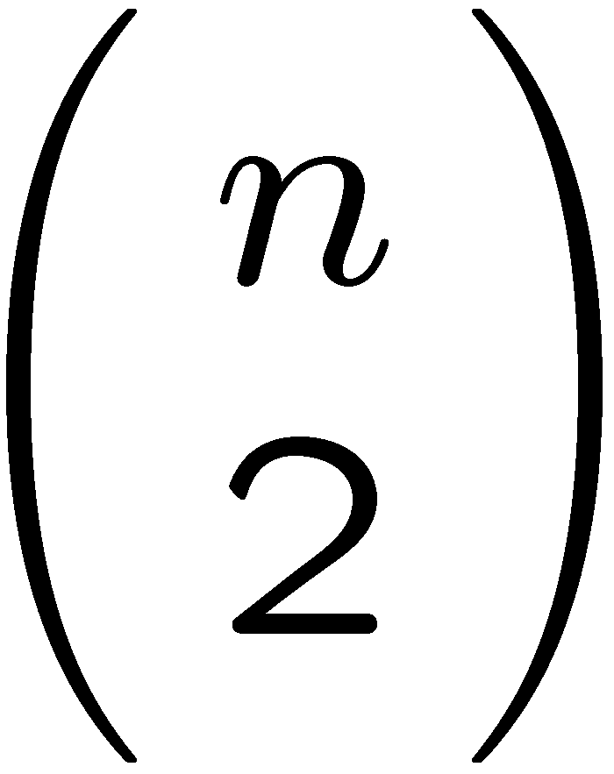
Combining binary classifiers
One-vs-all (OVA)
For each class build a classifier for that class vs the rest
  drawback: Often very imbalanced classifiers (use asymmetric regularization)
All-vs-all (AVA) For each pair of classes build a classifier
A priori a large number of classifiers to build but…
  The pairwise classification are way much faster
  The classifications are balanced (easier to find the best regularization)
… so that in many cases it is faster than one-vs-all [K. Duan & S. Keerthi, 2003]
  How to combine classifiers
    Voting of binary classifiers
    Combinations of calibrated classifiers
(e.g. pairwise coupling for AVA)
Error correcting output codes (ECOC)

Slide 18
Calibration
How to measure the confidence in a class prediction?
Crucial for:
Comparison between different classifiers
Ranking the prediction for ROC/Precision-Recall curve
In several application domains having a measure of confidence for each individual answer is very important (e.g. tumor detection)
Some methods have an implicit notion of confidence e.g. for SVM the distance to the class boundary relative to the size of the margin other like logistic regression have an explicit one.
Notes:
Want universal confidence score for different methods…

Slide 19
Calibration
Definition: the decision function f of a classifier is said to be calibrated if
e.g.: the decision function of logistic regression f(x)=(1+exp(-w.x+b))⁻¹
Informally f is a good estimate of the probability of classifying correctly a new datapoint x which would have output value x.
Intuitively if the “raw” output of a classifier is g you can calibrate it by estimating the probability of x being well classified given that g(x)=y for all y values possible.

Slide 20
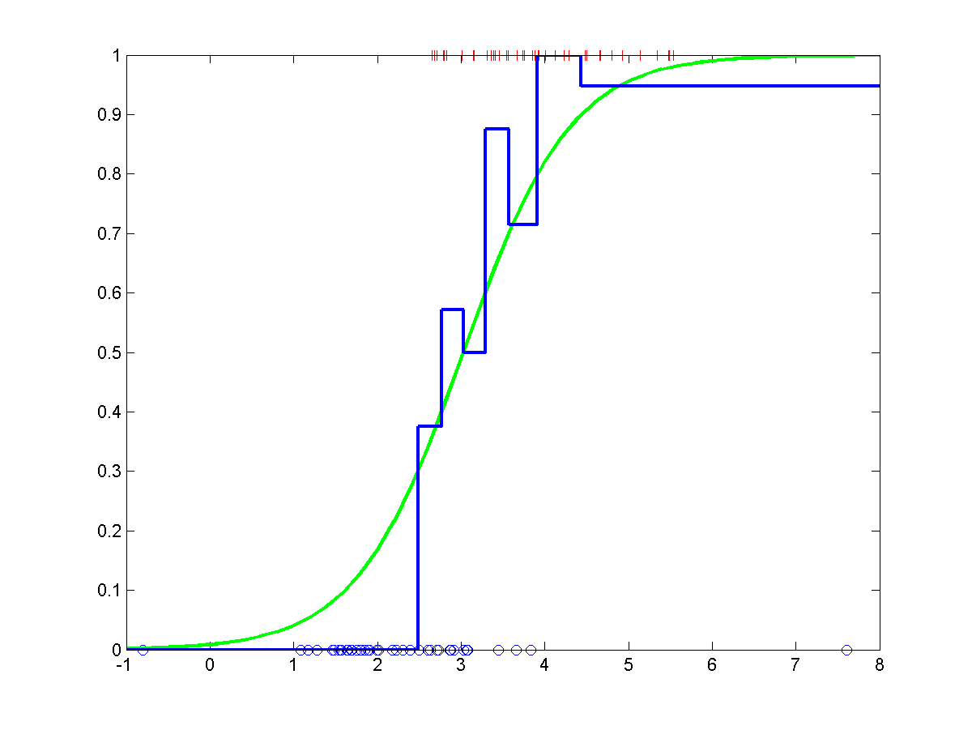
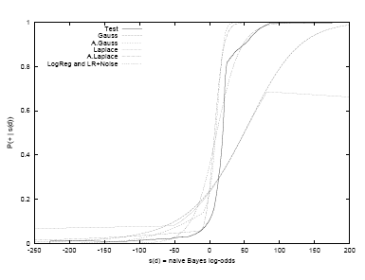
Calibration
Example: logistic regression should yield a reasonably calibrated decision function, with enough data.

Slide 21
Combining OVA calibrated classifiers
Class 1
Class 2
Class 3
Class 4
+
+
+
+
+
+
+
+
+
+
+
+
+
+
+
+
+
+
+
+
+
+
+
+
+
+
+
+
+
+
+
+
+
+
+
+
+
+
+
+
+
+
+
+
+
+
+
+
+
+
+
+
+
+
+
+
+
+
+
+
+
+
+
+
Calibration
p₁
p₂
p₃
p₄
Renormalize
p_{other}
consistent (p₁,p₂,…,p₄,p_{other})

Slide 22
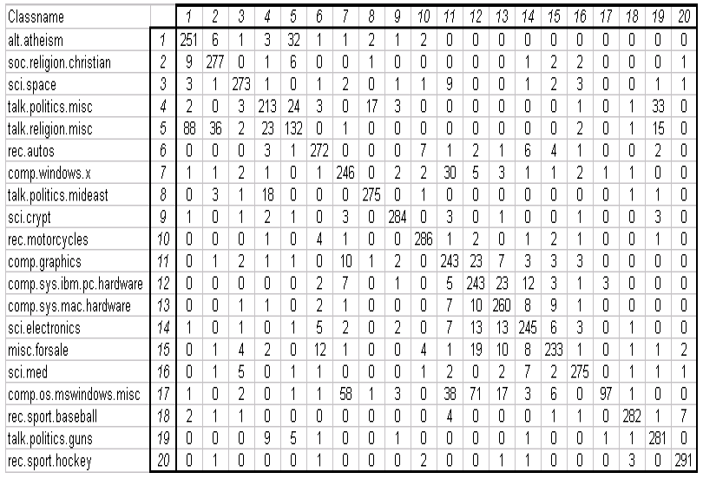
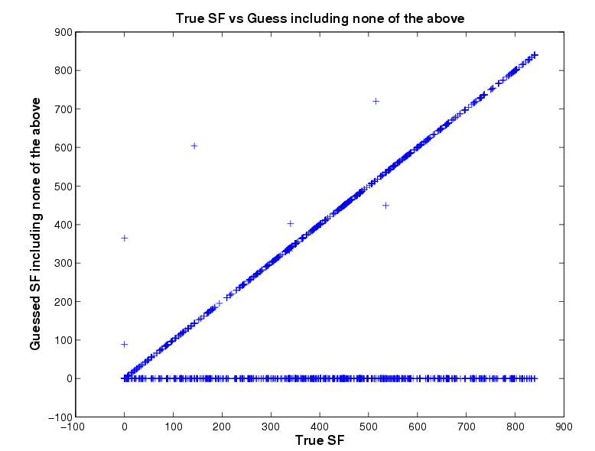
Confusion Matrix
Classification of 20 news groups
Predicted classes
Visualize which classes are more difficult to learn
Can also be used to compare two different classifiers
Cluster classes and go hierachical [Godbole, ‘02]
Actual classes
[Godbole, ‘02]
BLAST classification of proteins in 850 superfamilies

Slide 23
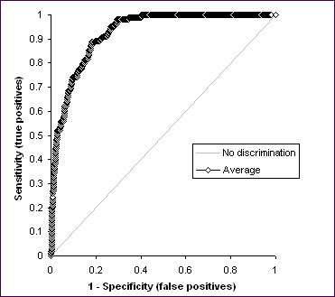
Precision & Recall
Two class situation:
Multi-class situation:
Neyman-Pearson setting
Predicted
Actual
“P”
“N”
FP
P
TP
FN
TP
N
FP
TN
FP
more FP
No FP / FN trade off in multi-class…
more FN
ROC equivalent?
New trade-off?
ROC
Don’t try to classify if it is too difficult!

Slide 24
Precision-Recall
Correct answers
Questions answered
Objects correctly classified
Misclassified objects
Unclassified objects
TP
FP
Recall=
= fraction of all objects correctly classified
Precision=
= fraction of all questions correctly answered

Slide 25
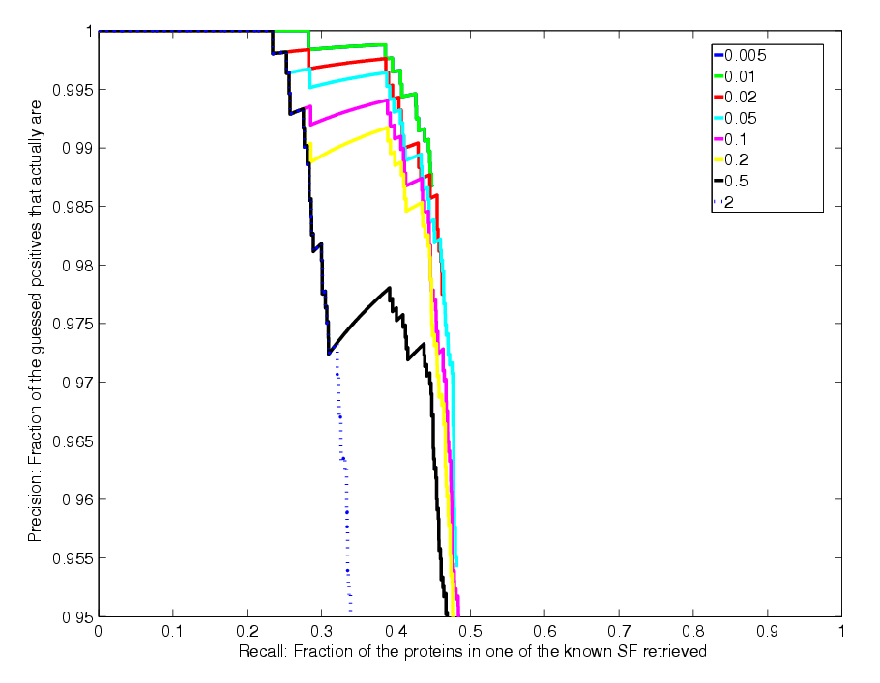
Precision Recall Curve
No questions answered
Precision
Not monotonic!
Doesn’t reach the corner
Recall
All question answered

Slide 26
Structured classification

Slide 27
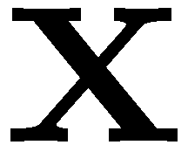

Local Classification
b
r
a
r
e
Classify using local information
⇒ Ignores correlations!
[thanks to Ben Taskar for slide!]

Slide 28
Structured Classification
b
r
a
c
e
Use local information
Exploit correlations
[thanks to Ben Taskar for slide!]

Slide 29
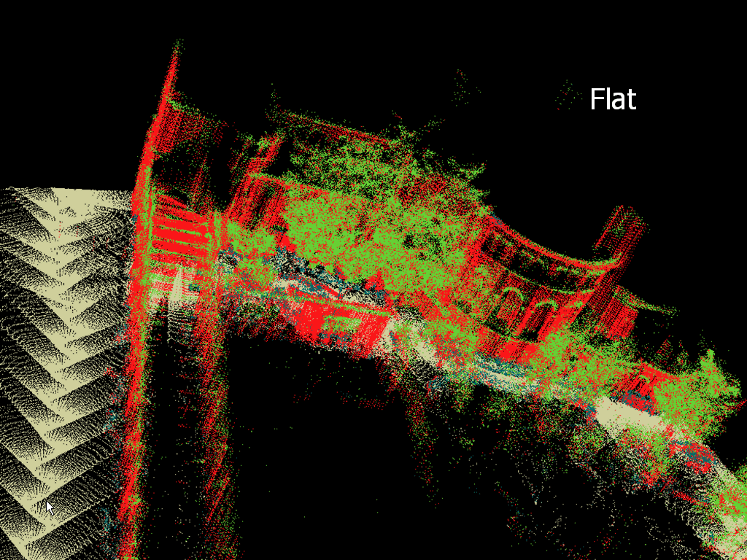

Local Classification
building
tree
shrub
ground
[thanks to Ben Taskar for slide!]
Notes:
Let’s look at the output.
Look at majority of the pixels. Roughly correct. In fact, around 70% accuracy.
However, there are some serious problems

Slide 30
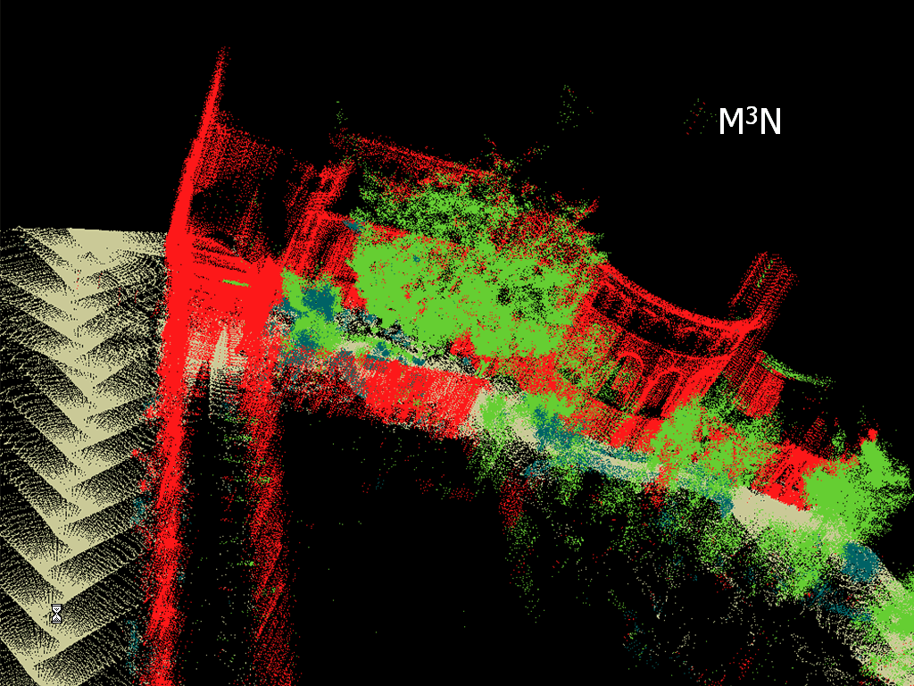

Structured Classification
building
tree
shrub
ground
[thanks to Ben Taskar for slide!]

Slide 31
Structured Classification
  Structured models
    Examples of structures
    Scoring parts of the structure
    Probabilistic models and linear classification
  Learning algorithms:
    Generative approach: (Bayesian modeling with graphical models)
    Linear classification:
      Structured Perceptron
      Conditional Random Fields (counterpart of logistic regression)
      Large-margin structured classification

Slide 32









Structured classification:
What is structured classification?
A combination of regular classification and of graphical models…
From standard classification: Flexibly handling large numbers of possibly dependent features.
From graphical models: Ability to handle dependent outputs.
First example: “Fully observed” HMM
“Label sequence”
“Observation sequence”
b r a c e
Optical Character Recognition

Slide 33




Tree model 1
“Label structure”
“Observations”

Slide 34






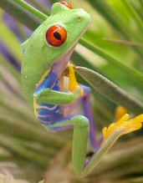
Tree model 1
Eye color inheritance:
haplotype inference
Notes:
Haplotype = genotype + order of strands

Slide 35
Tree Model 2:
Hierarchical Text Classification
Label corresponds to a path in the tree
Root
Arts
Business
Computers
Cannes Film Festival schedule .... .... .... ... .. ...... ..
..... ...........
Movies
Television
Internet
Software
Jobs
Real Estate
Y: label in tree
(from ODP)
X: webpage

Slide 36
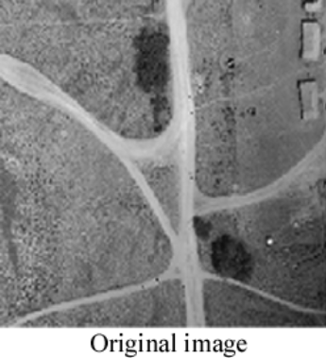
Grid model
Image segmentation
Segmented = “Labeled” image

Slide 37
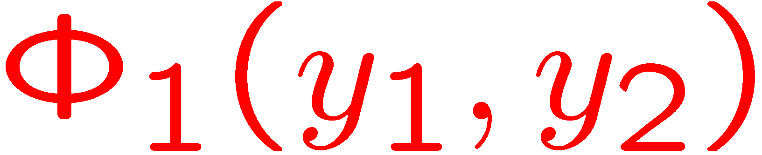
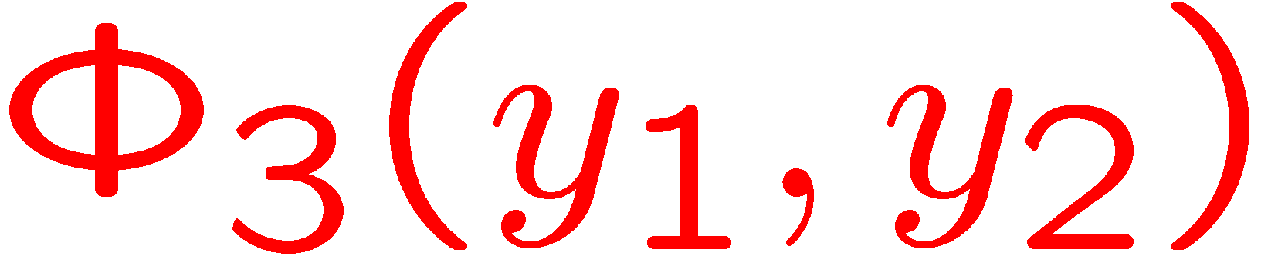

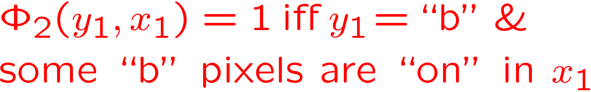
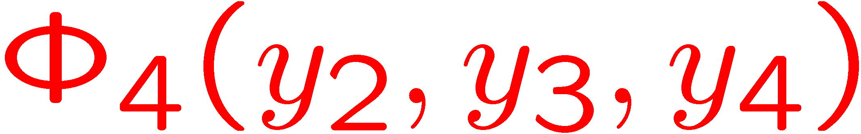
Cliques and Features
b r a c e
b r a c e
In undirected graphs:
cliques = groups of completely interconnected variables
In directed graphs:
cliques = variable+its parents

Slide 38
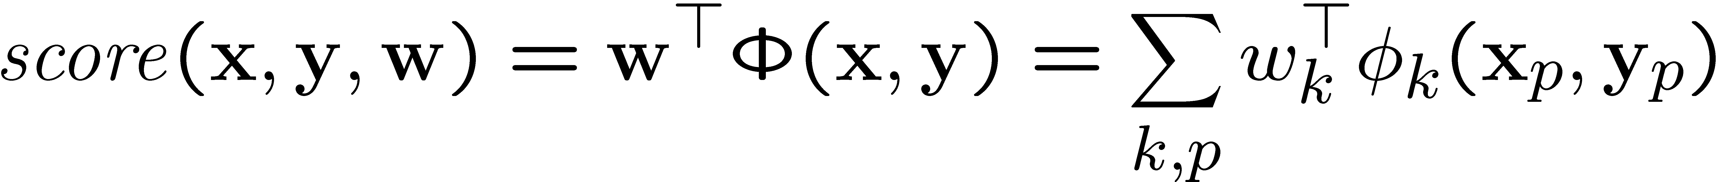
Structured Model
Main idea: define a scoring function which decomposes as sum of features scores k on “parts” p:
Label examples by looking for max score:
Parts = nodes, edges, etc.
space of feasible outputs

Slide 39
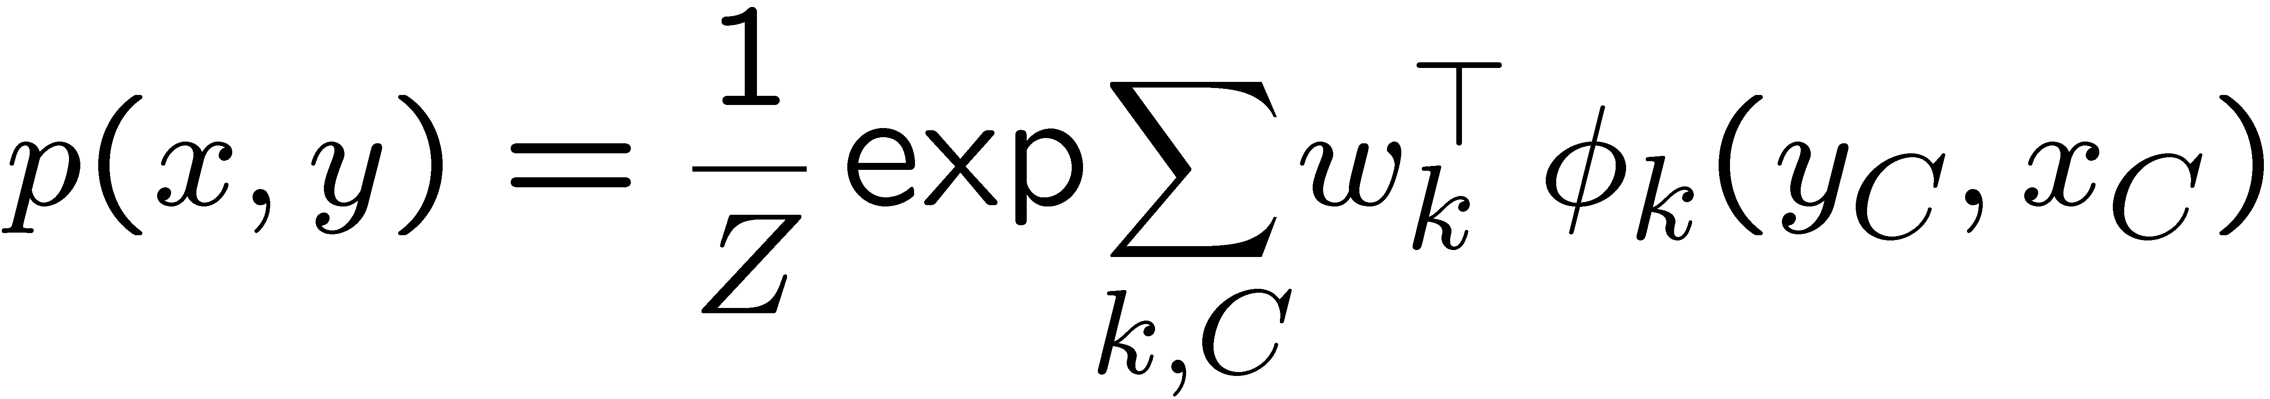
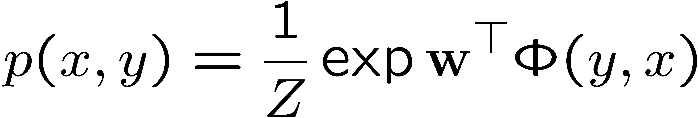
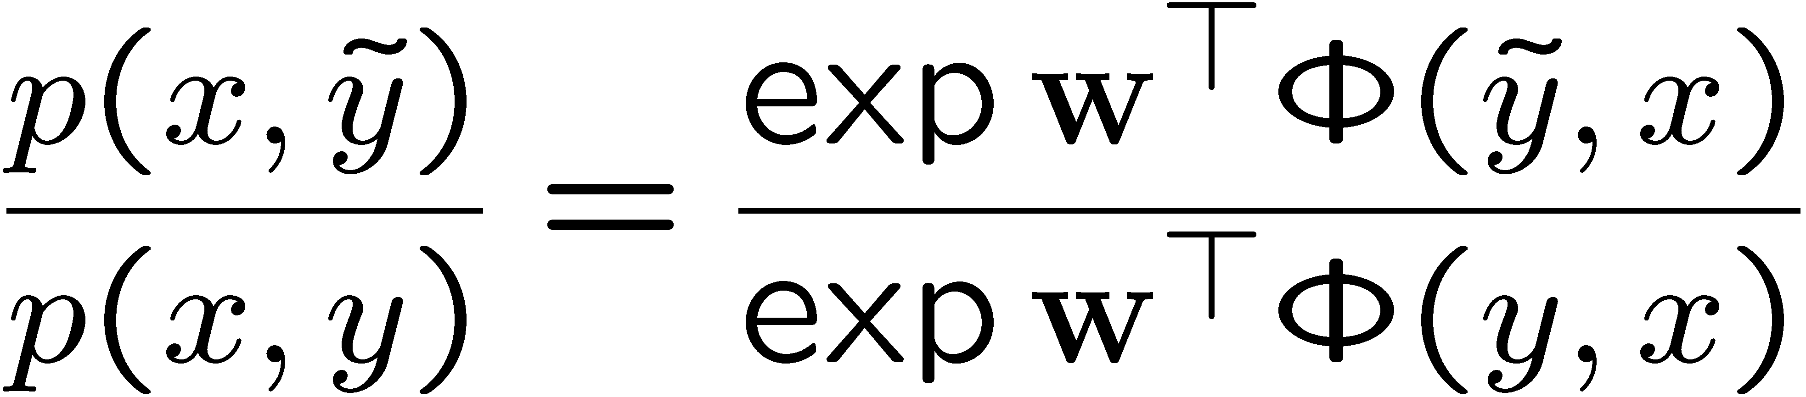
Exponential form
Once the graph is defined the model can be written in exponential form
parameter vector
feature vector
Comparing two labellings with the likelihood ratio

Slide 40
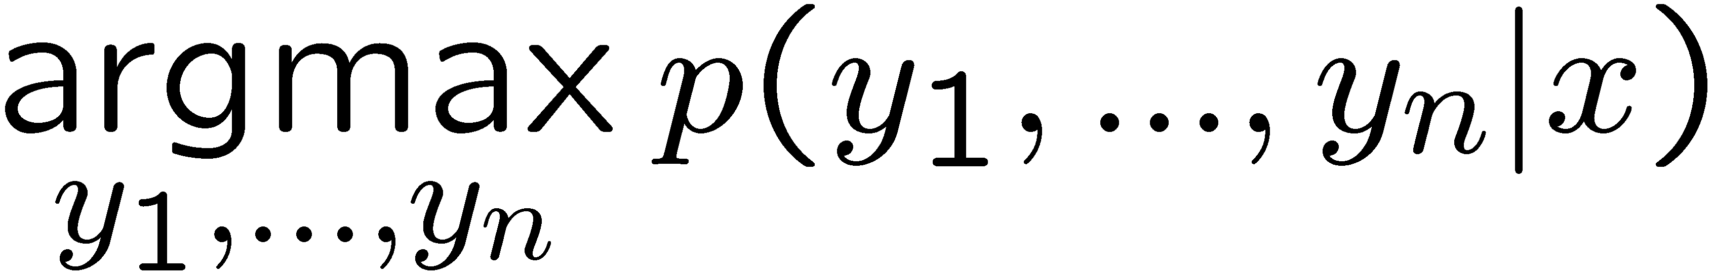
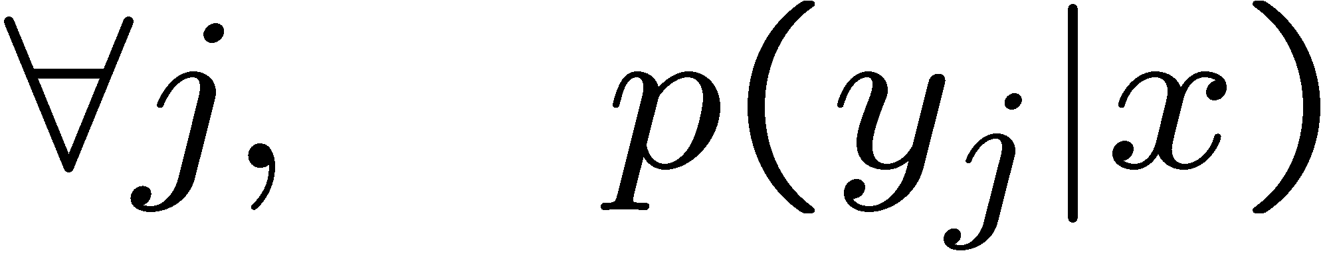
Decoding and Learning
Three important operations on a general structured (e.g. graphical) model:
Decoding: find the right label sequence
Inference: compute probabilities of labels
Learning: find model + parameters w so that decoding works
b r a c e
HMM example:
Decoding: Viterbi algorithm
Inference: forward-backward algorithm
Learning: e.g. transition and emission counts in generative cases, or discriminative algorithms

Slide 41
Decoding and Learning
Decoding: algorithm on the graph (eg. max-product)
Inference: algorithm on the graph (eg. sum-product, belief propagation, junction tree, sampling)
Learning: inference + optimization
Use dynamic programming to take advantage of the structure
Focus of graphical model class
Need 2 essential concepts:
  cliques: variables that directly depend on one another
  features (of the cliques): some functions of the cliques

Slide 42
Our favorite (discriminative) algorithms

Slide 43
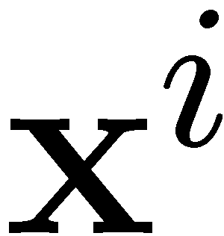
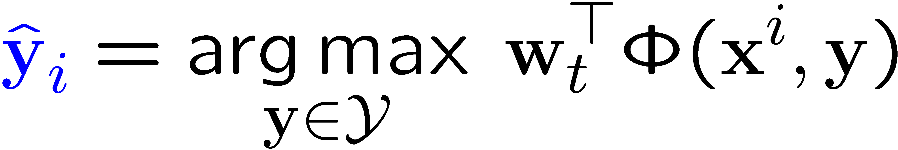
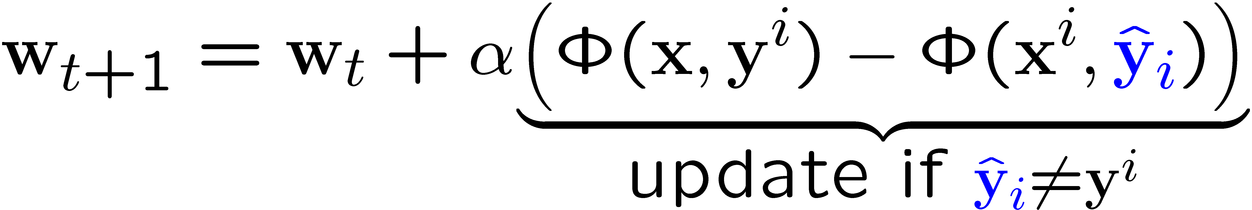
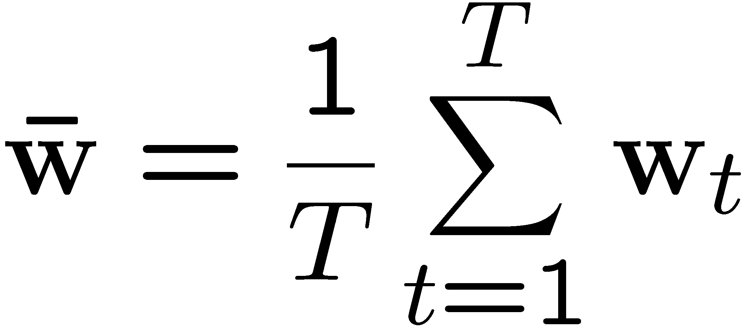
(Averaged) Perceptron
For each datapoint
Predict:
Update:
Averaged perceptron:
Good practice:
Randomize order of training examples
Decrease slowly learning rate

Slide 44
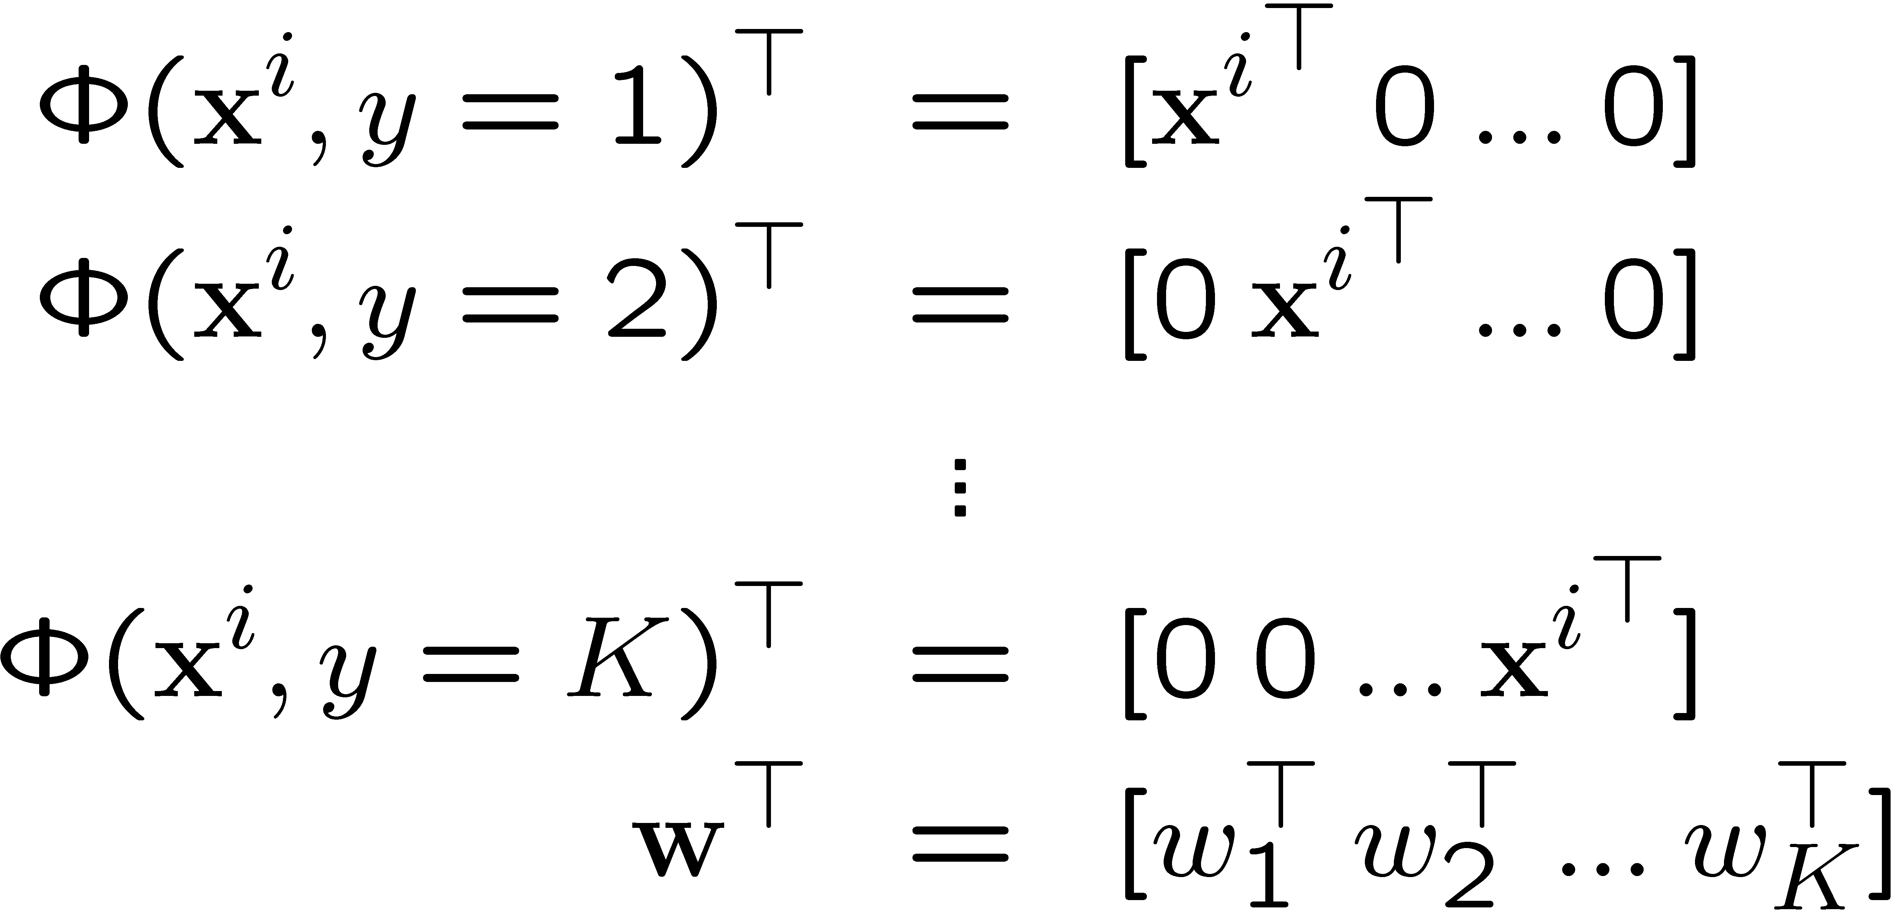
Example: multi-class setting
Feature encoding:
Predict:
Update:
Predict:
Update:

Slide 45


CRF
Z difficult to compute with complicated graphs
Conditioned on all the observations
Introduction by Hannah M.Wallach
http://www.inference.phy.cam.ac.uk/hmw26/crf/
An Introduction to CRFs for Relational Learning
Charles Sutton and Andrew McCallum
http://www.cs.berkeley.edu/~casutton/publications/crf-tutorial.pdf
M³net
No Z …
The margin penalty can “factorize” according to the problem structure
Introduction by Simon Lacoste-Julien
http://www.cs.berkeley.edu/~slacoste/school/cs281a/project_report.html

Slide 46
Summary
For multi-class classification
  Combine multiple binary classifiers
    Logistic regression produces calibrated values
  One-vs-all or All-vs-all (both fast)
For structured classification
  Define a structured score for which efficient dynamic program exist
  Simple start with structured perceptron
  For better performance use CRF or Max-margin methods (M³-net, SVMstruct)

Slide 47

Object Segmentation Results
[thanks to Ben Taskar for slide!]
Data: [Stanford Quad by Segbot]
Trained on 30,000 point scene
Tested on 3,000,000 point scenes
Evaluated on 180,000 point scene
Laser Range Finder
Segbot
M. Montemerlo
S. Thrun
Model | Error
Local learning Local prediction | 32%
Local learning +smoothing | 27%
Structured method | 7%
building
tree
shrub
ground
[Taskar+al 04,
Anguelov+Taskar+al 05]

