Slide 1
IGFL Internship Update
Projects 1 & 2 · Boundary Analysis · Orthogonal Validation
Gricey Rangel Trejo · IGFL · June 2026
Notes:
Welcome everyone. I'll walk through what I've been working on — two projects. Project 1 was exploratory: understanding a parameter of SUPPA using the lab's Nanopore data. Project 2 is the main one: orthogonal validation of the lab's manuscript using public Illumina RNA-seq.

Slide 2
Two Projects
Project 1
Project 2
Boundary Analysis
Orthogonal Validation
Data: Lab Nanopore data, 9 samples, 3 conditions Tool: SUPPA Question: Strict vs variable splice-site boundary — how does relaxing by 1nt affect event detection and PSI quantification?
Data: Public Illumina RNA-seq (GSE130613, n=8) Tools: Salmon · tximport · DESeq2 · SUPPA Goal: Validate the lab's Nanopore manuscript splicing + DE results using independent short-read data
Notes:
Project 1 was practice: I learned SUPPA and explored the boundary mode parameter. Project 2 is the main internship project: use public Illumina data to independently validate the splicing and DE findings of the lab's Nanopore manuscript.

Slide 3
What is Alternative Splicing?
One gene → multiple mRNA isoforms → multiple protein products
E1
E2
E3
E4
E5
PSI (Ψ)
pre-mRNA
Percent Spliced In
Fraction of transcripts
that include the event
0 = always excluded
1 = always included
dPSI = change between
two conditions
E1
E2
E3
E4
E5
Isoform A (E3 included, PSI ≈ 0.8)
E1
E2
E4
E5
Isoform B (E3 skipped, PSI ≈ 0.2)
SUPPA quantifies PSI per event per sample, then computes dPSI between conditions to find differential splicing.
Notes:
Alternative splicing allows one gene to produce multiple mRNA isoforms. PSI is the fraction of transcripts that include a given exon or splice event. dPSI is the difference in PSI between conditions — this is what SUPPA reports as the effect size.

Slide 4
Project 1
Boundary Analysis
Does relaxing the splice-site boundary by 1 nucleotide change event detection and PSI?
Notes:
SUPPA's generateEvents step has a boundary mode parameter. Strict = exact coordinate match required. Variable 1nt = 1 nucleotide tolerance allowed. I tested this on the lab's Nanopore data — 9 samples, WT Day / WT Night / PerKO.

Slide 5
The SUPPA Pipeline
Transcriptome GTF
generateEvents
psiPerEvent
diffSplice
catalogue all
splicing events
PSI per event
per sample
dPSI + p-value
per event
Salmon quant (.sf)
generateEvents Boundary Mode
Strict: splice-site coordinates must match exactly to define an event Variable 1nt: 1 nucleotide tolerance — transcripts off by 1nt at a splice site are still grouped into the event Question: Does this affect how many events are found? Does it shift PSI values?
Notes:
SUPPA takes a GTF and Salmon quant files, then: generates a catalogue of events, computes PSI per event per sample, and calls diffSplice for differential analysis. The boundary mode in generateEvents is the parameter I explored — strict requires exact coordinate match, variable allows a small tolerance.

Slide 6
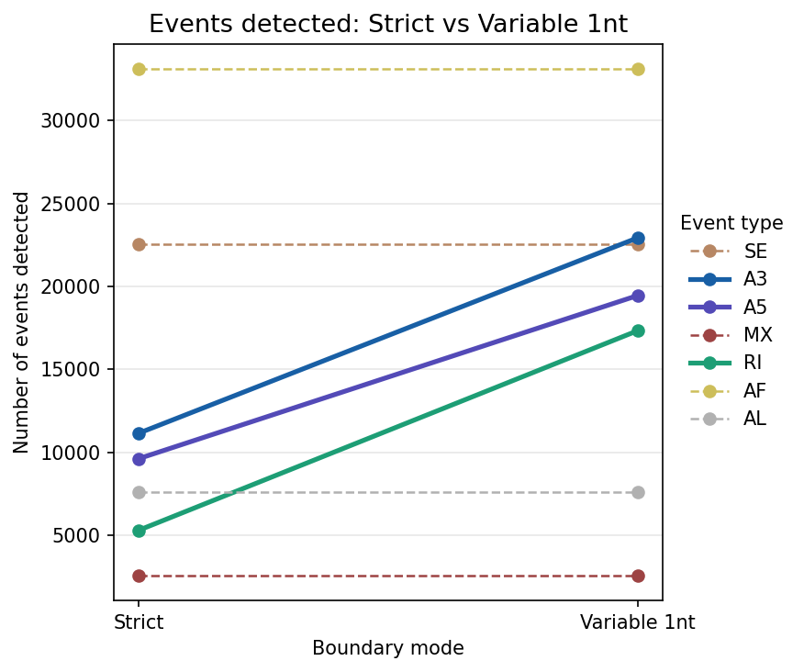
Relaxing the Boundary Finds More Events
A3, A5, RI are boundary-sensitive. SE, AF, AL have fixed ends — they do not change.
Notes:
A3, A5, and RI jump significantly — RI nearly triples. This is because retained intron events are particularly sensitive to exact boundary coordinates — a 1nt shift in any contributing transcript creates or misses an event.

Slide 7
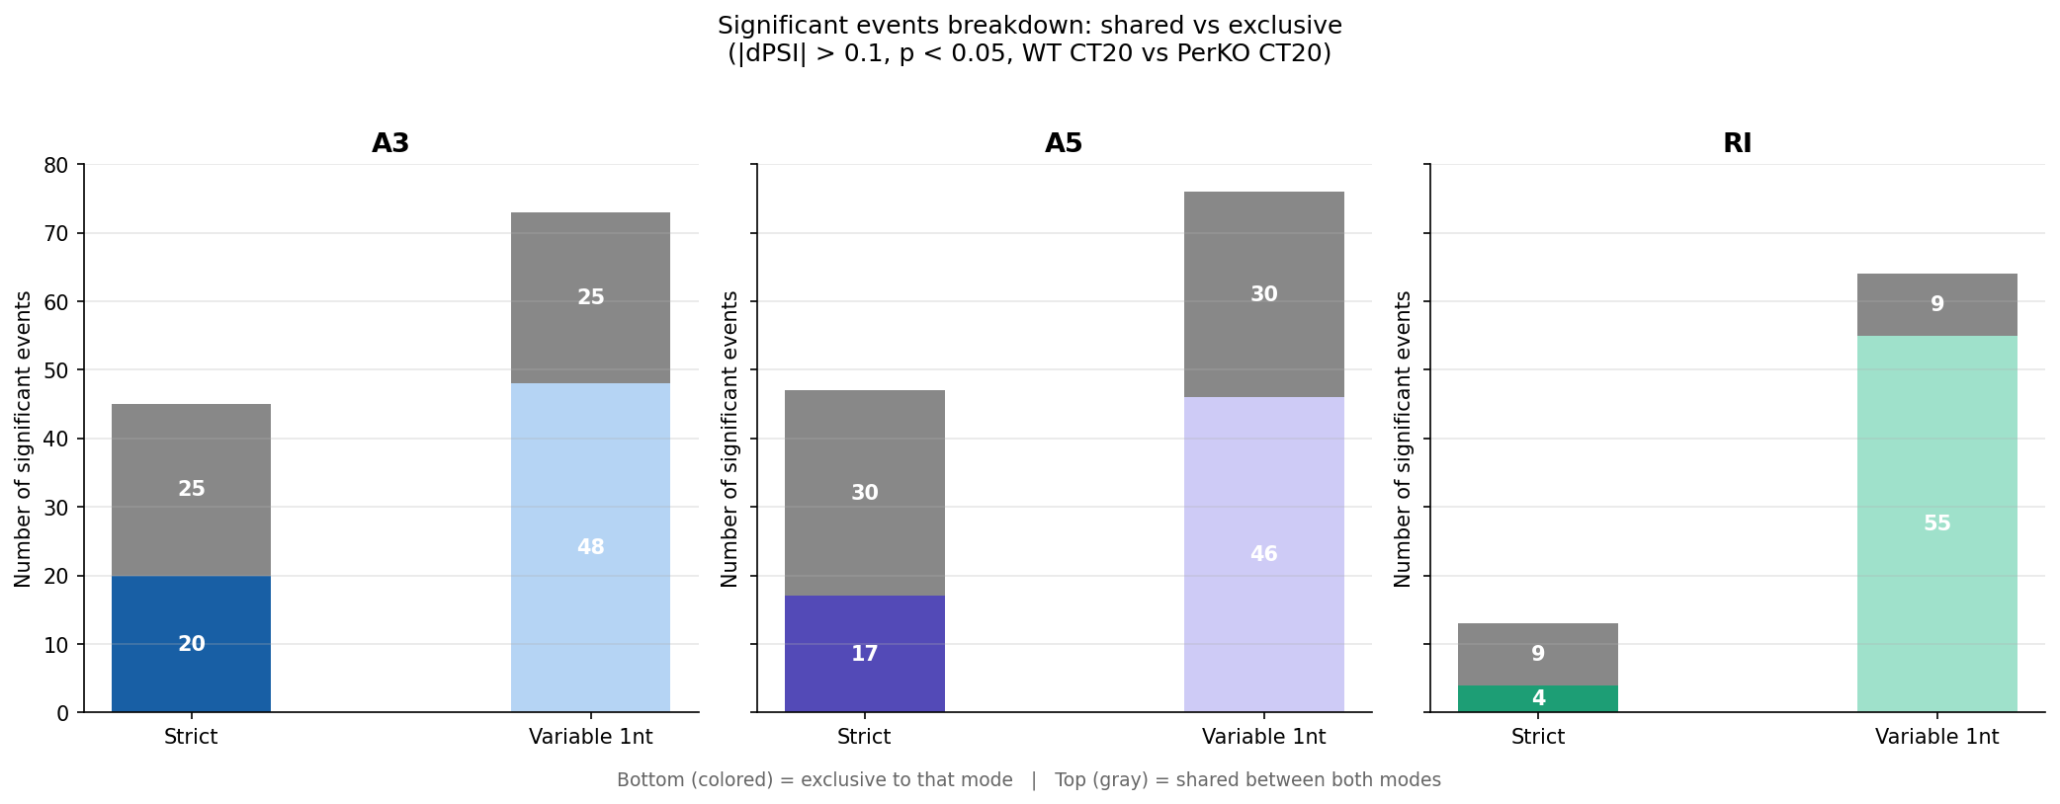
Do the New Events Have Biological Signal?
Significant events (|dPSI| > 0.1, p < 0.05, WT CT20 vs PerKO CT20) · bottom = exclusive, grey = shared
Notes:
Variable 1nt finds ~50–80% more significant events across all boundary-sensitive types. Crucially, the PSI of shared events is not distorted — mean |ΔPSI| between modes is only 0.02–0.03. Conclusion: variable 1nt is strictly better and should be the default.

Slide 8
Project 1 — Key Takeaways
More events detected
PSI is not distorted
More biological signal
Variable 1nt adds ~50–80% more events in A3, A5, RI. RI nearly triples. SE/AF/AL are boundary-insensitive and unchanged.
Mean |ΔPSI| between modes for shared events is 0.02–0.03. Relaxing the boundary doesn't change how existing events are quantified.
New events include real differentially spliced events. Variable 1nt recovers ~50–80% more significant events across all boundary-sensitive types.
Notes:
Variable 1nt mode is a strict improvement. For Project 2 I used the same mode as the original manuscript to stay comparable.

Slide 9
Project 2
Orthogonal Validation
Can public Illumina RNA-seq confirm the Nanopore manuscript results?
Notes:
The lab has an unpublished Nanopore manuscript. Can we see the same splicing changes and DE genes in completely independent Illumina data from a different lab? That's orthogonal validation.

Slide 10
Goal & Dataset
Why this project?
Public dataset (GEO)
The lab has a Nanopore manuscript (Chikhaoui & Mamgain, bioRxiv 2024) Long reads → full isoforms, but fewer reads Question: do independent Illumina short reads show the same splicing and DE results? Overlap = orthogonal validation ✓
Accession: GSE130613 (Manella & Asher, PNAS 2020) Tissue: Mouse liver, constant darkness Comparison: WT vs Period DKO (CT16-20) Samples: n=4 WT + n=4 PerDKO Reads: ~4–7 M per sample (Illumina) Reference: mm39 + lab's custom transcriptome
(same as Nanopore manuscript)
Notes:
Same biological comparison as the manuscript. Crucially, I used the lab's custom transcriptome as reference — so both Nanopore and Illumina analyses speak the same coordinate language. MARS-Seq 3-prime end sequencing confirmed unstranded by Salmon auto-detection.

Slide 11
Analysis Pipeline
Download
& Trim
Salmon
Quant
tximport
+ DESeq2
SUPPA
Results
SRA + cutadapt
quasi-mapping
quant.sf
normalised counts
+ DE
PSI +
diffSplice
Python figures
+ overlap
Key decisions:
Trimming: Illumina adapter + poly-A/T/G (12nt) → mapping improved from 44–70% to 73–88% Salmon: --gcBias --seqBias; custom transcriptome index (same as Nanopore manuscript) DESeq2: transcript-level (txOut=TRUE), stageR two-stage FDR; padj < 0.05, |log₂FC| > 0.5 SUPPA: diffSplice thresholds |dPSI| > 0.1, p < 0.3
Notes:
The pipeline: download SRA → trim adapters and polyA/G/T contamination → Salmon quasi-mapping against the custom transcriptome → tximport + DESeq2 for DE → SUPPA for splicing → Python for cross-referencing Nanopore results.

Slide 12
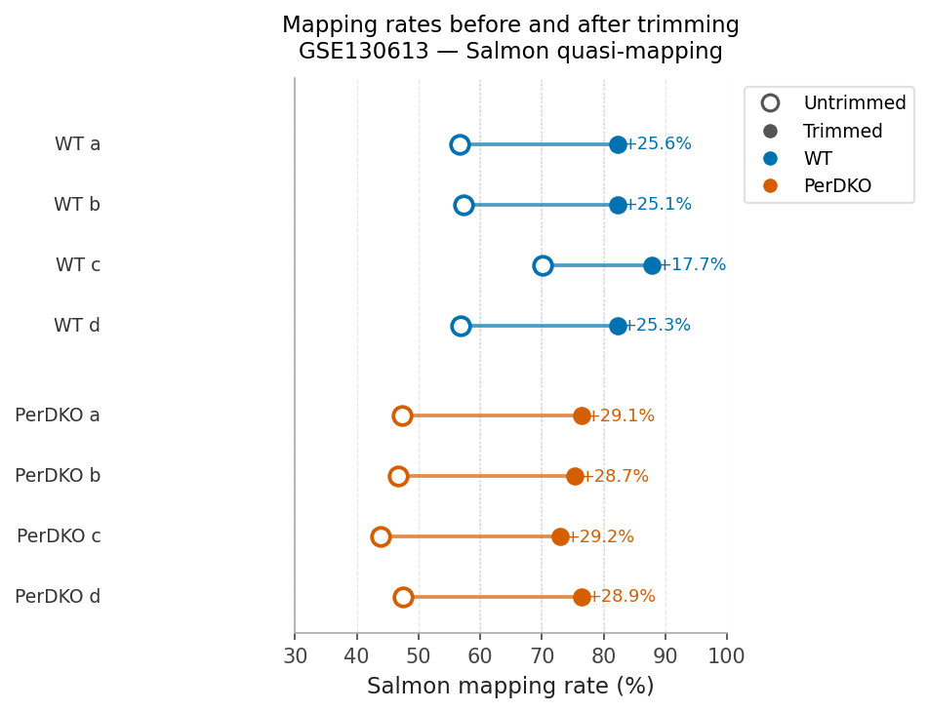
Trimming Improved Mapping Rates Dramatically
MARS-Seq 3′-end sequencing has heavy polyA / polyG contamination (NextSeq 500 two-color chemistry)
Notes:
Without trimming: 44–70%. After trimming: 73–88%. WT maps better than PerDKO — PerDKO has higher GC content. This step was essential and Bharath confirmed the approach during a Zoom call.

Slide 13
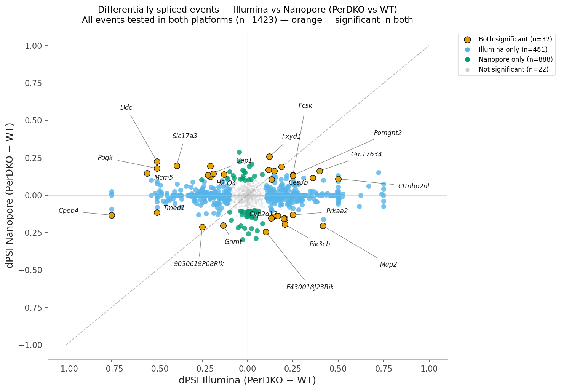
Splicing Concordance: Illumina vs Nanopore
513
32
sig. splicing events
(Illumina)
events in both
Illumina ∩ Nanopore
x: dPSI Illumina · y: dPSI Nanopore · Orange = 32 events significant in both · Background: only Illumina sig events shown
Notes:
513 significant splicing events in Illumina (|dPSI|>0.1, p<0.3). 32 have exact event ID match in Nanopore. Blue box events — high Illumina dPSI, low Nanopore — tend to come from genes with many isoforms, suggesting short-read ambiguity.

Slide 14
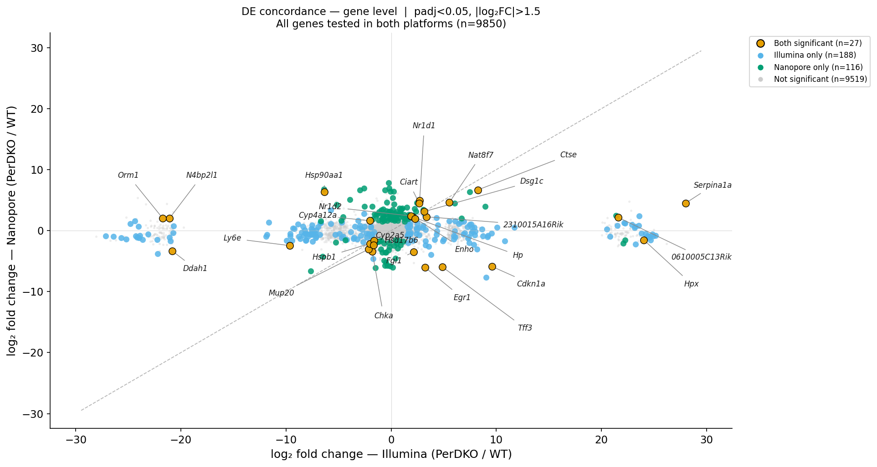
DE Concordance: Illumina vs Nanopore
487
27
sig. DE genes
(Illumina, stageR)
genes in both
Illumina ∩ Nanopore
Gene-level · padj < 0.05 and |log₂FC| > 1.5 on both sides · Orange = 27 genes in both · 9,850 shared genes
Notes:
DESeq2 + stageR: 487 significant DE genes in Illumina. 27 overlap with Nanopore manuscript at matching thresholds (padj<0.05, |log2FC|>1.5). Bharath's comment: 'Tour de force of DE analysis — results are very clear, now we have to weave a story.'

Slide 15
Summary
Project 1 — Boundary Analysis
Project 2 — Splicing
Variable 1nt mode detects more events without distorting PSI. Recommended for all future SUPPA runs.
513 sig. events in Illumina. 32 overlap exactly with Nanopore — confirmed splicing changes.
Project 2 — Expression
Next steps
487 sig. DE genes (Illumina). 27 genes overlap with Nanopore manuscript at matched thresholds.
Finalise figures. Kiran may provide new datasets. Work with Bharath to weave the validation story.
Notes:
Summary: Variable 1nt is better for SUPPA. For orthogonal validation — 32 splicing events and 27 DE genes overlap between Illumina and Nanopore, confirming the manuscript's key findings.

