Slide 1
ORTHOGONAL VALIDATION
GSE130613 (Illumina) vs Nanopore — Progress Tracker
Validating splicing & DE calls from the lab's Nanopore manuscript against public short-read RNA-seq
Gricey Rangel-Trejo · Updated 2026-07-08

Slide 2
PIPELINE OVERVIEW
Workflow: SRA → Salmon → DESeq2/SUPPA → figures
Diagram pending fresh export
Workflow.key (Keynote) has edits newer than the last exported image (Workflow.24:06.png).
Drop the fresh export into this slide once available.
Orthogonal Validation — GSE130613 vs Nanopore
2

Slide 3
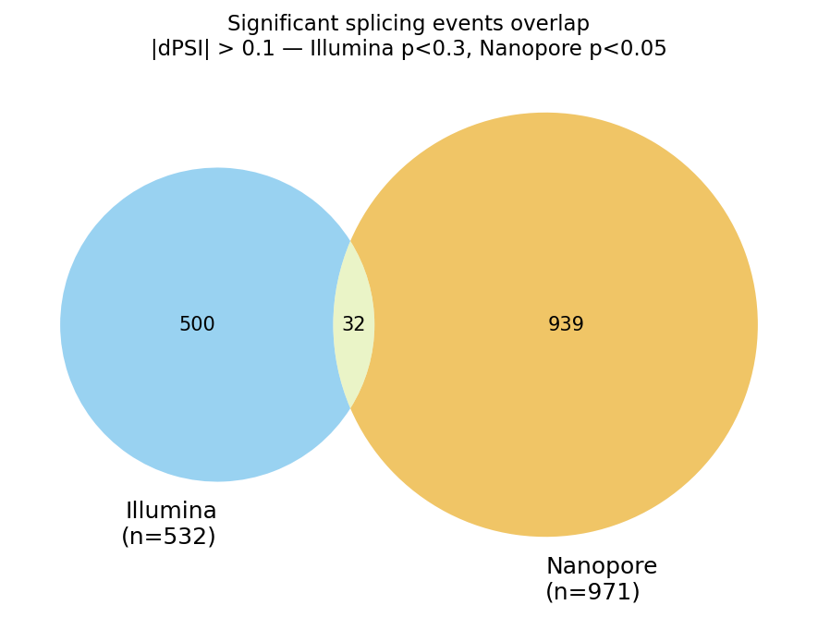
SPLICING EVENTS · ORIGINAL REPRESENTATION
Illumina ∩ Nanopore splicing overlap — venn (original)
32 events
shared between Illumina SUPPA diffSplice and Khushi's Nanopore diffSplice, matched by exact event ID.
Superseded 2026-06 — Bharath asked for a representation that also shows direction and magnitude of ΔPSI, not just overlap count.
Orthogonal Validation — GSE130613 vs Nanopore
3

Slide 4
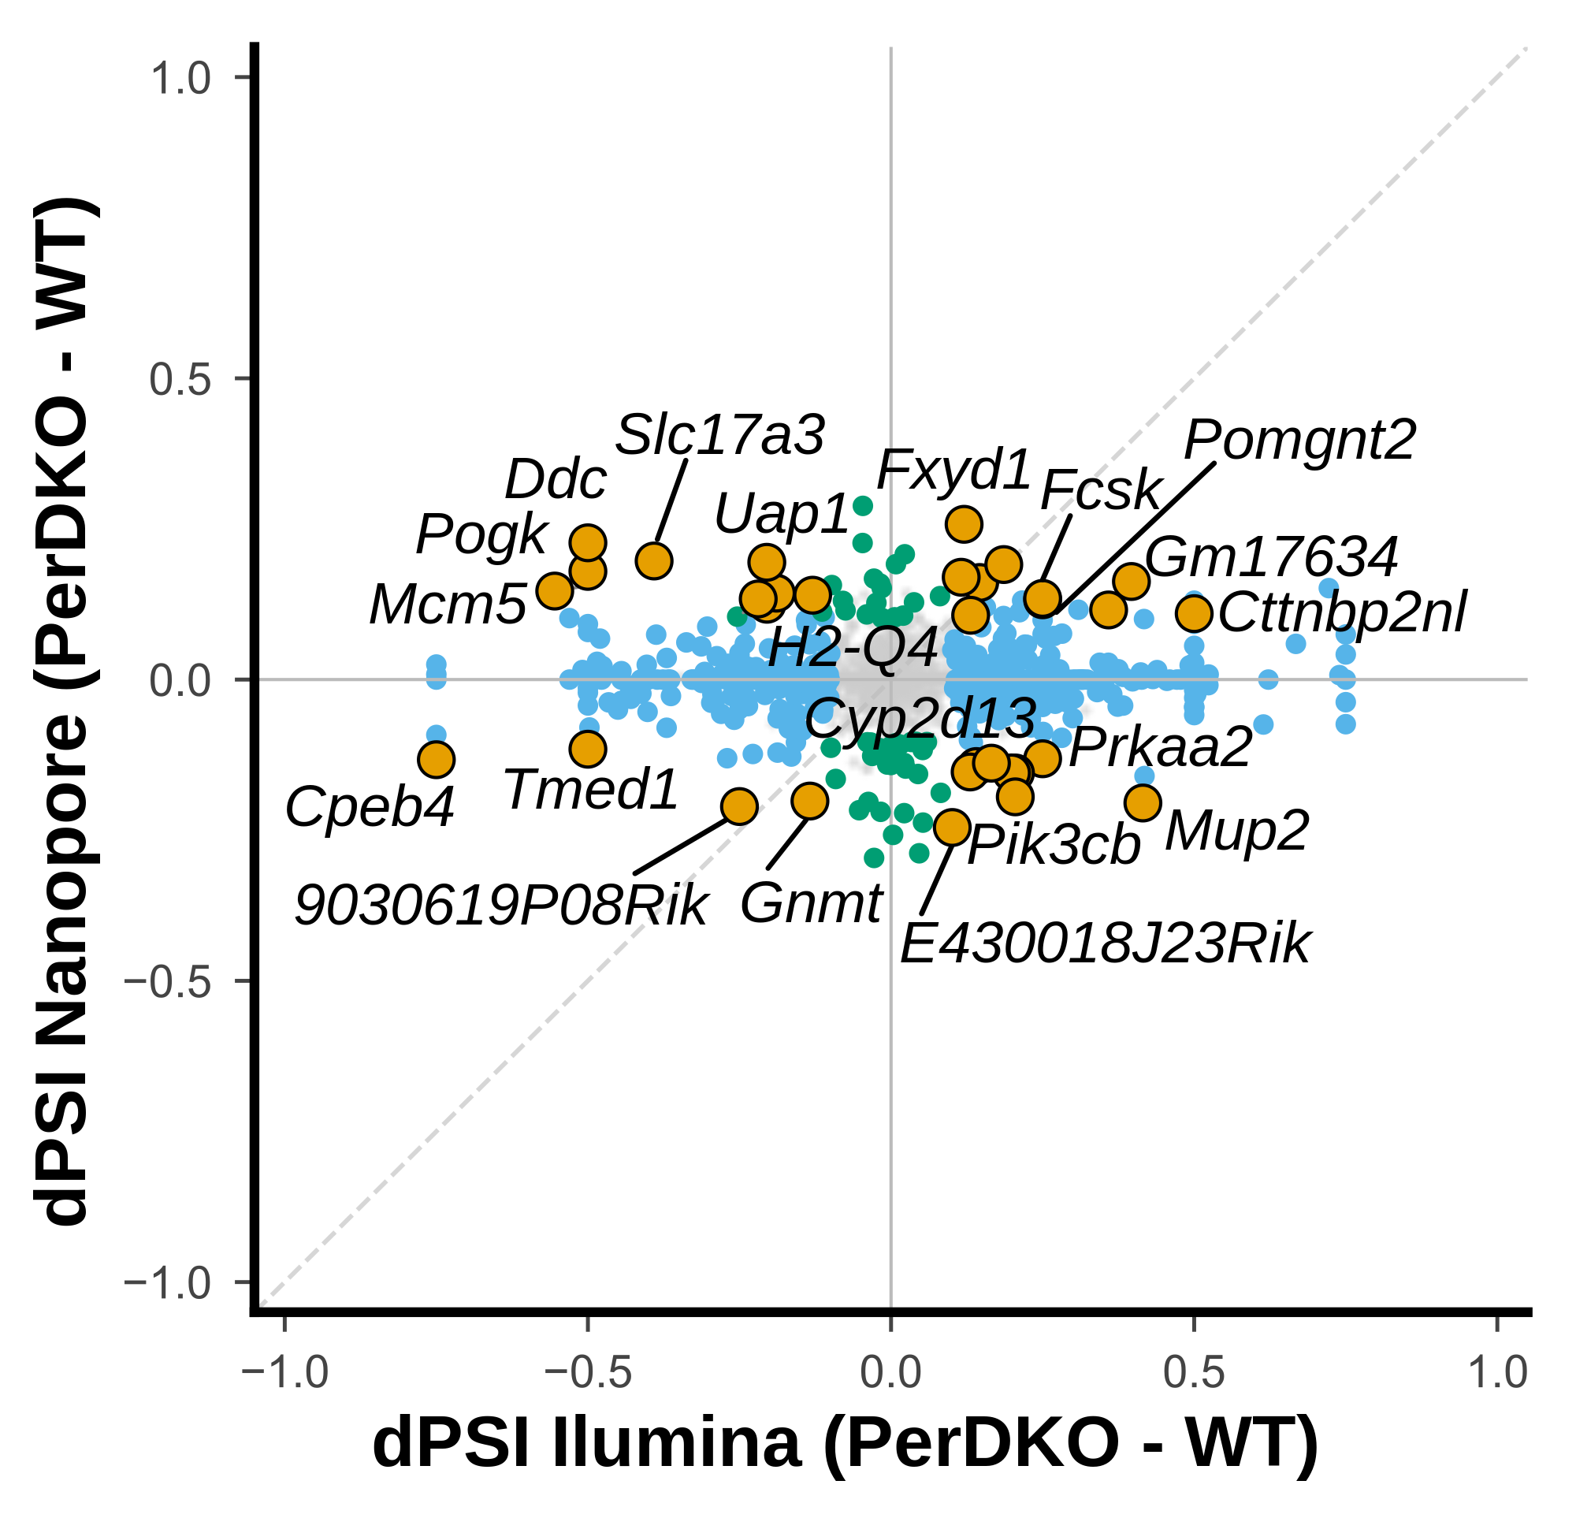
SPLICING EVENTS · CURRENT REPRESENTATION
Illumina vs Nanopore ΔPSI — scatter (current)
513 significant Illumina events
|dPSI| > 0.1 and p < 0.3 (empirical method, relaxed threshold — low power at n=3/4 replicates).
32 orange dots = also significant in Nanopore.
Same 32-event overlap as the venn — this view adds agreement in direction and effect size.
Orthogonal Validation — GSE130613 vs Nanopore
4

Slide 5
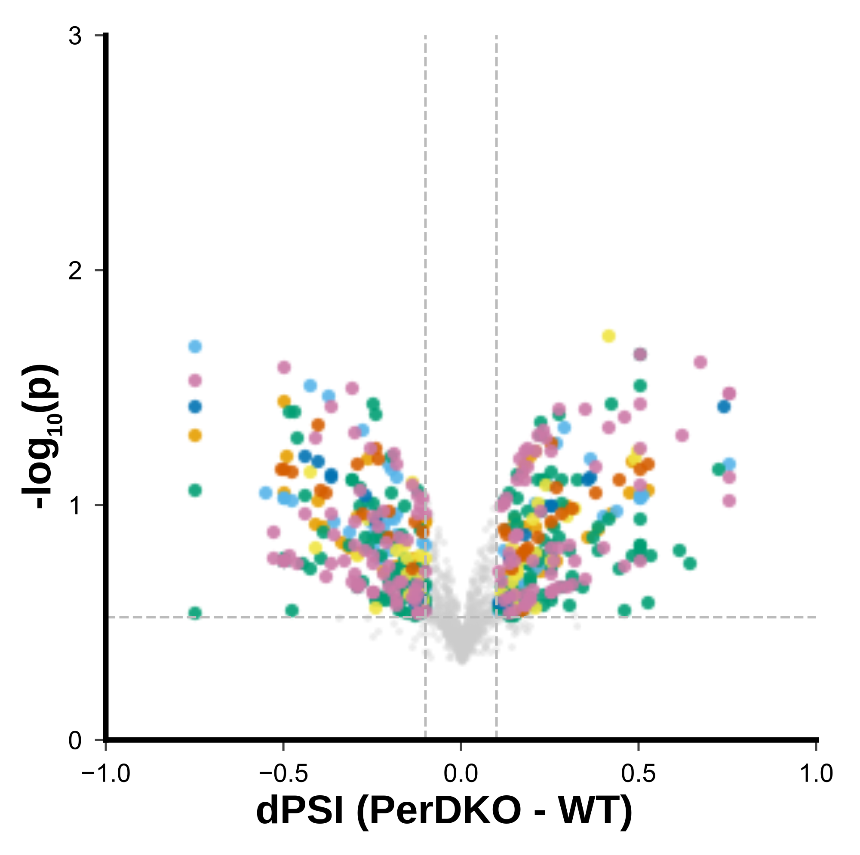
SPLICING EVENTS · ILLUMINA ONLY
ΔPSI volcano — Illumina
All Illumina splicing events tested
before cross-referencing against Nanopore. 513 pass |dPSI|>0.1, p<0.3.
Orthogonal Validation — GSE130613 vs Nanopore
5

Slide 6
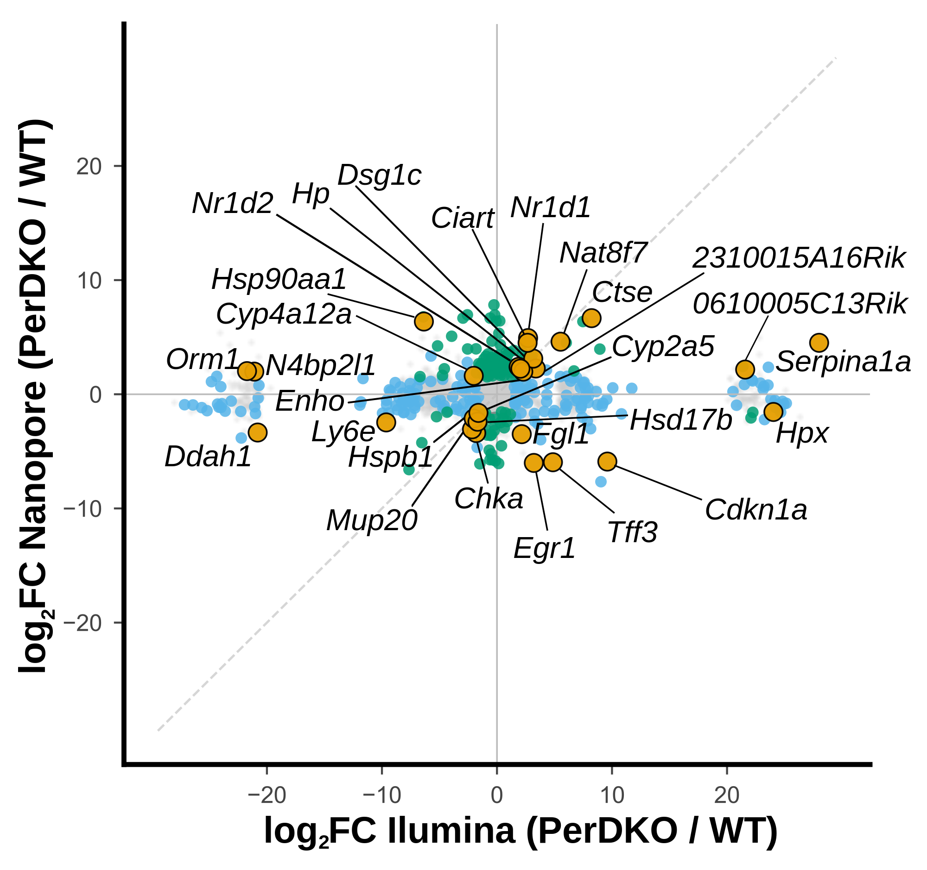
DIFFERENTIAL EXPRESSION · GENE LEVEL
Illumina vs Nanopore DE concordance — genes
27 genes significant in both
of 9,850 shared genes. padj<0.05 and |log2FC|>1.5 on both sides (symmetric, matches Khushi's manuscript threshold).
Bharath's preferred granularity for the DE comparison.
Orthogonal Validation — GSE130613 vs Nanopore
6

Slide 7
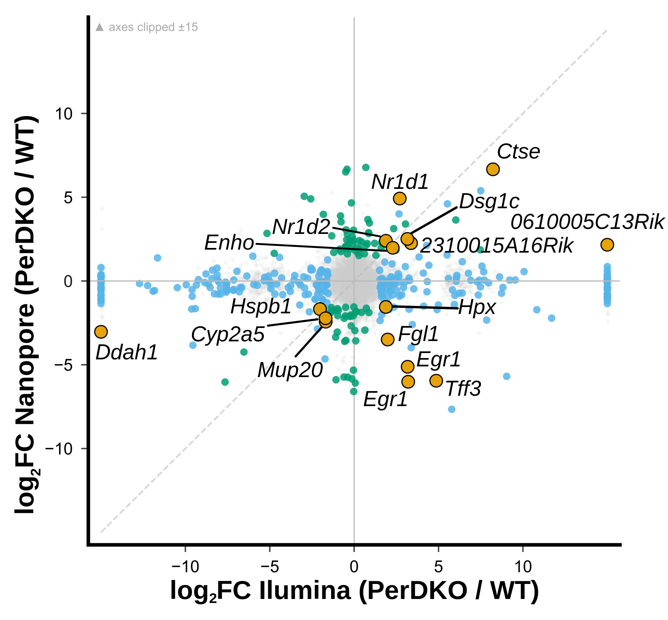
DIFFERENTIAL EXPRESSION · TRANSCRIPT LEVEL
Illumina vs Nanopore DE concordance — transcripts
16 transcripts significant in both
(11 annotated ENSMUST + 5 novel UUID isoforms) of 12,966 shared transcripts. 11/16 agree in direction.
Kiran's requested granularity — transcript, not gene.
Orthogonal Validation — GSE130613 vs Nanopore
7

Slide 8
DIFFERENTIAL EXPRESSION · ILLUMINA ONLY
DE volcano — Illumina, transcript-level (stageR)
~504 significant transcripts
487 genes (stageR stage 1). padj_gene_stageR<0.05, |log2FC|>0.5.
Orthogonal Validation — GSE130613 vs Nanopore
8

Slide 9
SECOND DATASET · IN PROGRESS
GSE133398 (SRSF3 KO hepatocytes) — mapping rate QC
Not yet at the figures stage. Bharath wants everything on mm39 for consistency with GSE130613; mm39 rerun with fixes (explicit -l ISR, corrected paths) submitted to SLURM 2026-07-07, still running.
Sample | Group | mm39 (original) | mm10 (ISR, honest) | mm39 + fixes
SRR9606468 | CRE KO | 53.5% | 58.1% | running
SRR9606469 | CRE KO | 35.3% | 53.1% | running
SRR9606470 | CRE KO | 29.7% | 52.8% | running
SRR9606471 | CRE KO | 39.6% | 57.9% | running
SRR9606472 | GFP ctrl | 53.4% | 69.3% | running
SRR9606473 | GFP ctrl | 26.0% | 53.9% | running
SRR9606474 | GFP ctrl | 69.1% | 73.2% | running
SRR9606475 | GFP ctrl | 23.7% | 52.2% | running
Orthogonal Validation — GSE130613 vs Nanopore
9

Slide 10
Full-resolution files
SVG versions of every figure and the xlsx overlap tables live in the Drive folder next to this deck — GSE130613/ and GSE133398/ subfolders, kept in sync as the pipeline progresses.
Questions or figure requests — comment directly on the slide.

