Slide 1

Rockbuster Stealth Data Analysis Project
File created on: 5/30/2024 6:31:51 PM
By Gavin Ellis

Slide 2


Motivation
Rockbuster Stealth LLC is a movie rental company that used to have stores around the world. Facing stiff competition from streaming services such as Netflix and Amazon Prime, the Rockbuster Stealth management team is planning to use its existing movie licenses to launch an online video rental service in order to stay competitive.

Slide 3
Rockbuster Data Overview
Total number of films in database = 1000
Total revenue generated = $61,312
Number of genres = 20
Number of countries with customers = 109
Number of cities with customers = 600
Total number of customers = 599
Movies available in 6 different languages
Inventory count of rentals = 4,580

Slide 4

Objective & Key Questions
Objective: Provide business strategy that will help increase revenue for all stores.
Key Questions:
Which movies contributed the most/least to revenue gain?
What was the average rental duration for all videos?
Which countries are Rockbuster customers based in?
Where are customers with a high lifetime value based?
Do sales figures vary between geographic regions?

Slide 5
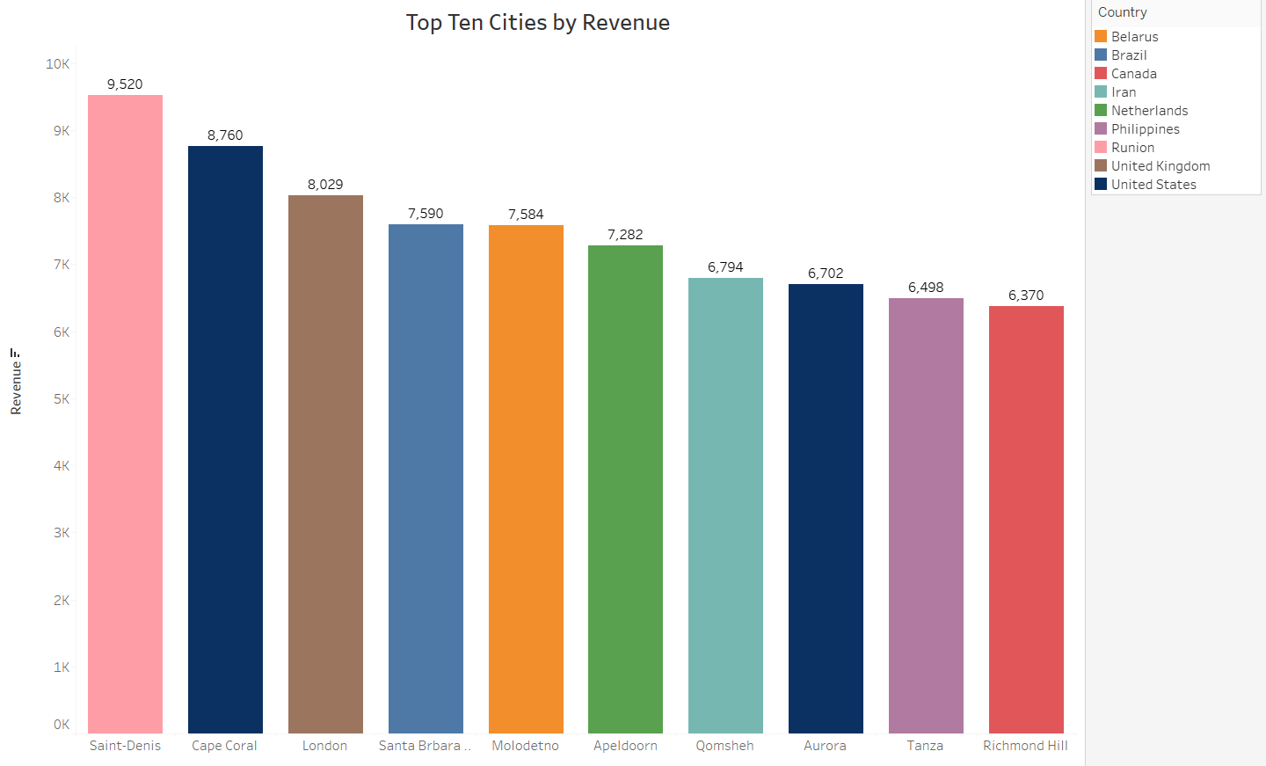
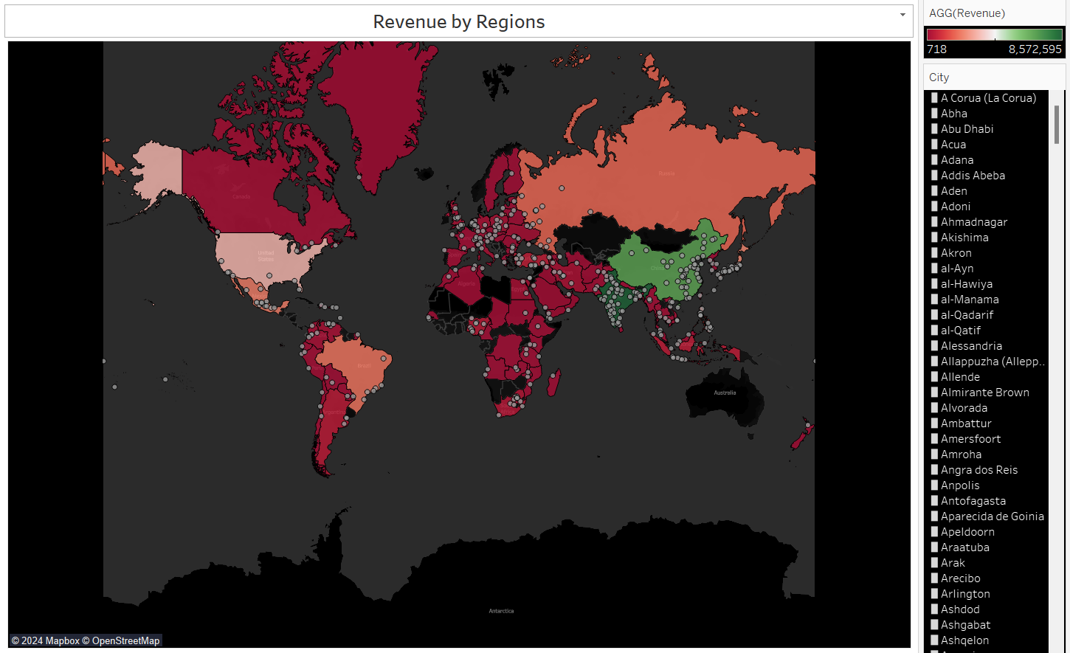
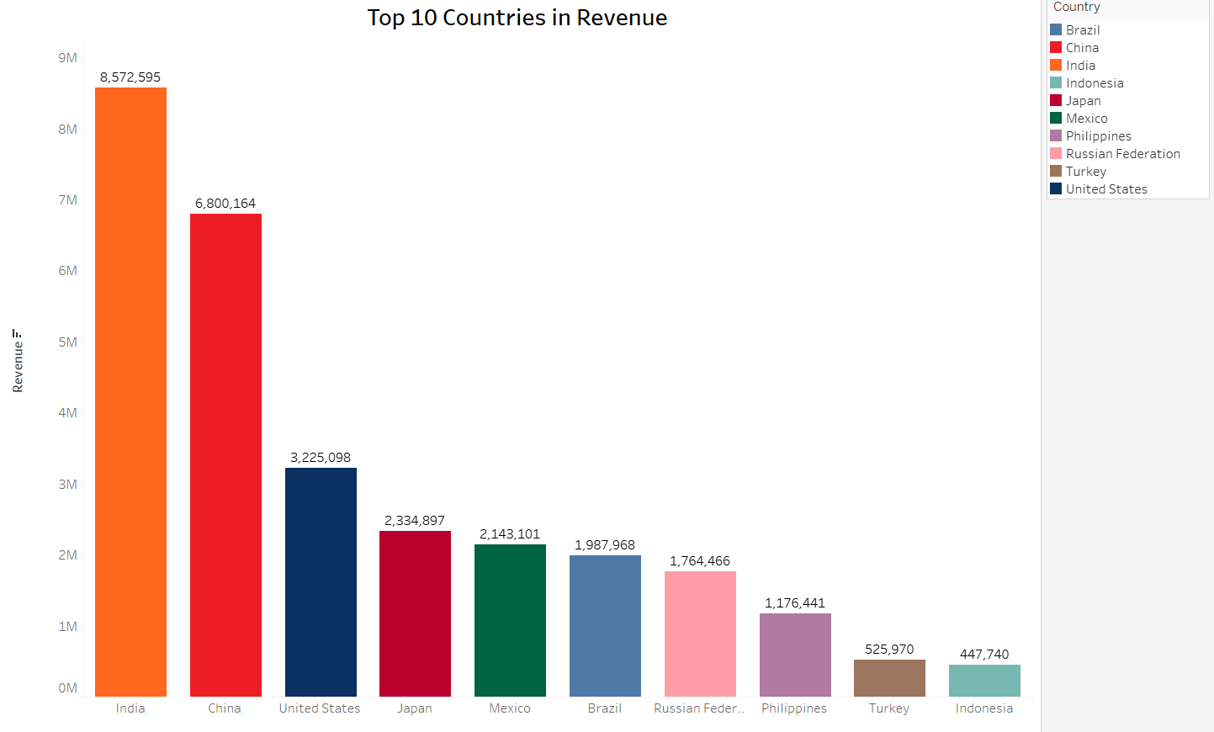
Do sales figures vary between geographic regions?
Based on the map we can identify that majority of sales are coming from the eastern hemisphere.
India & China generate two to three times more revenue than all U.S. stores.
Two of the top ten cities in revenue reside in the United States with Aurora and Cape Coral

Slide 6
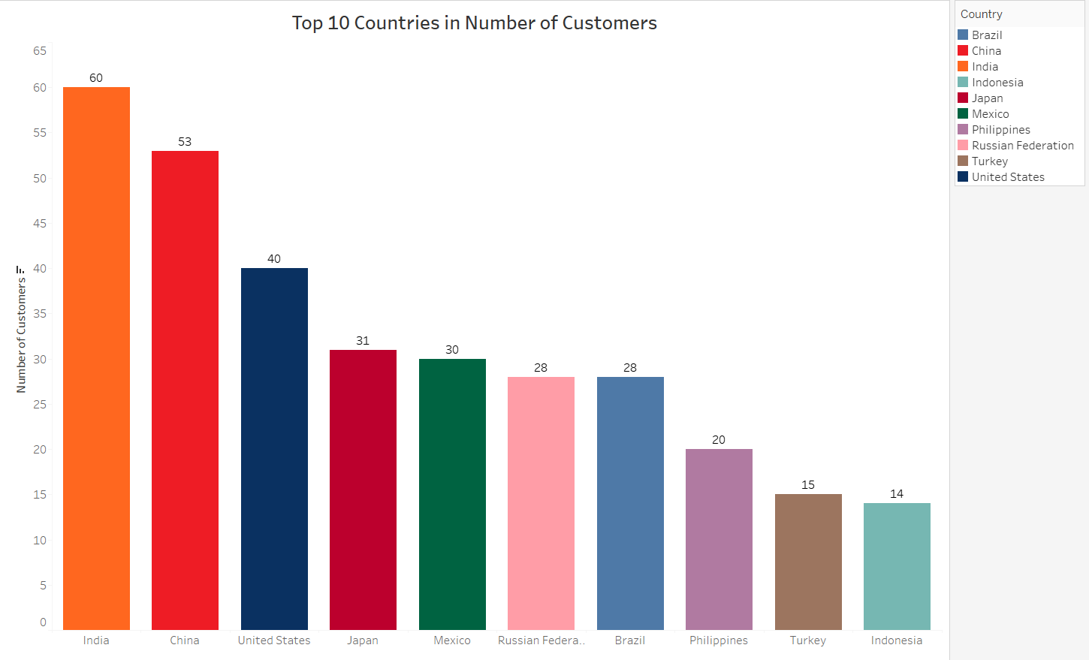
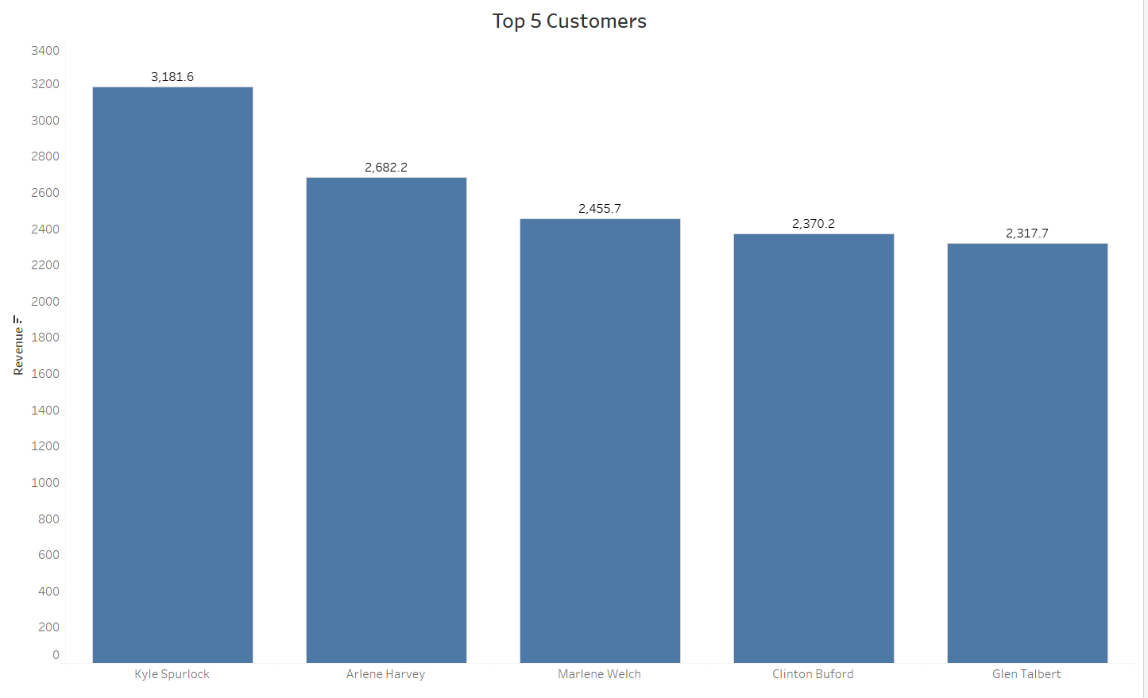
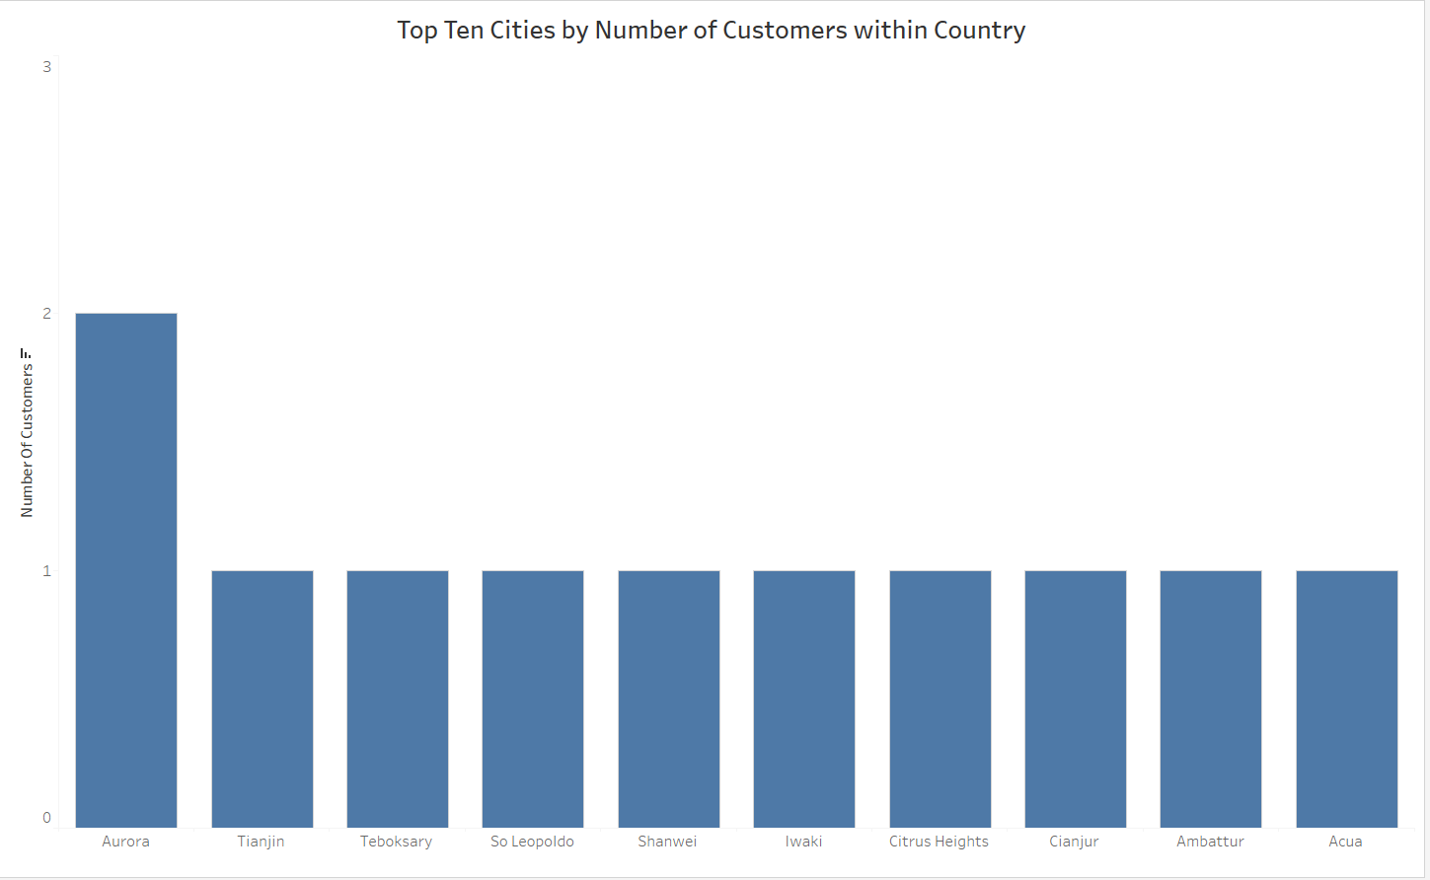
Which Countries are Rockbuster Customers Based In?
The three highest customers in revenue reside in Asia with Kyle, Arlene, and Marlene respectfully
Three of the top 5 countries in number of customers reside in Asia
India nearly has twice as many customers as the U.S.

Slide 7
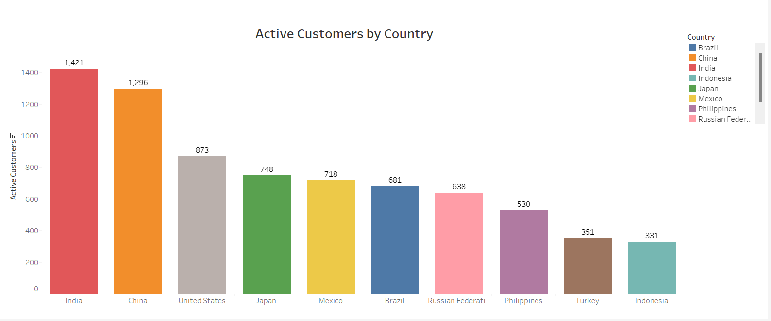
Where are customers with a high lifetime value based?
Five of the active customers by customers with a high lifetime value are based in Asia with India, China, Japan, Philippines, and Indonesia.
Two of the active customers reside in South America with Mexico and Brazil.
India nearly doubles the U.S. in active customers

Slide 8
What was the average rental duration for all videos?
Rental Rate:
MIN: $0.99
MAX: $4.99
AVG: $2.98
Rental Duration:
AVG: 4.99 days
MIN: 3 days
MAX: 7 days
Replacement Cost:
AVG: $19.98
MIN: $9.99
MAX: $29.99
On average customers are renting videos for 4.99 days

Slide 9
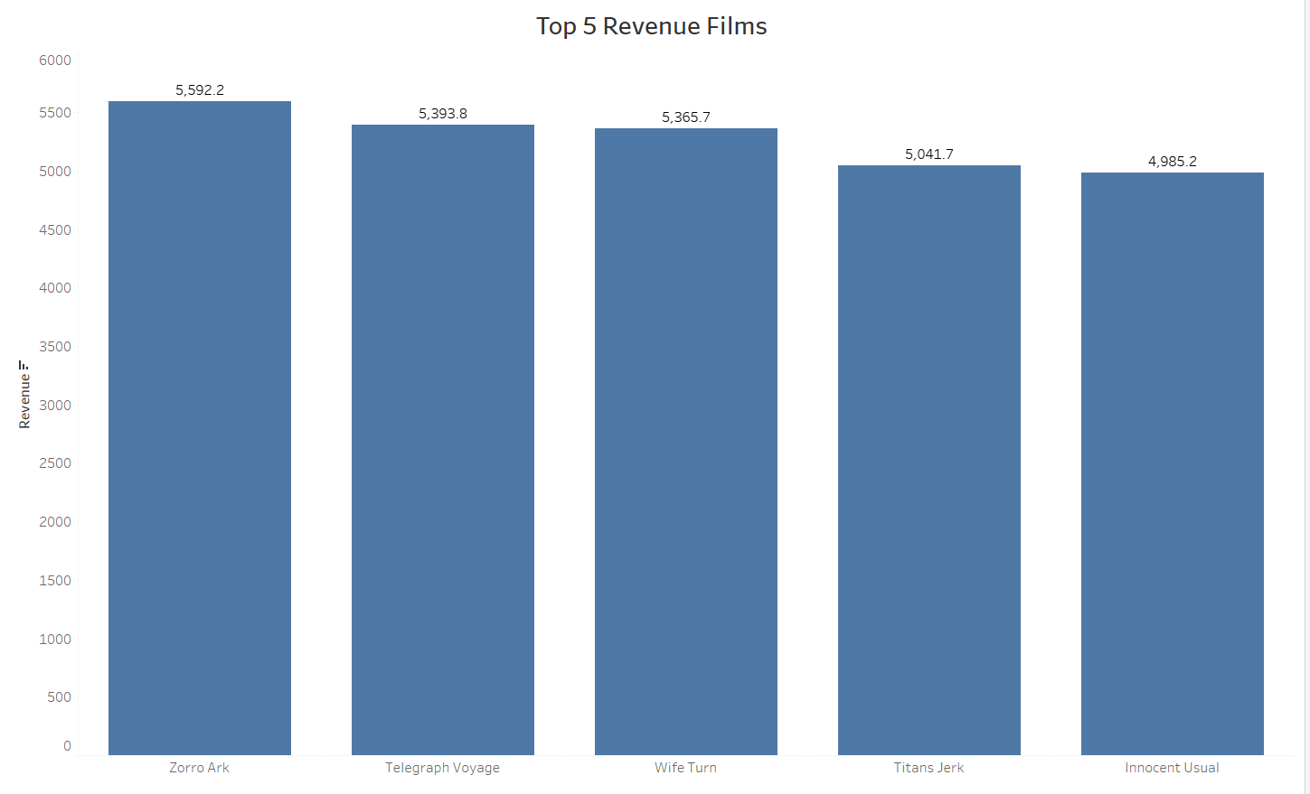
Which movies contributed the most/least to revenue gain?
Zorro Ark is the leading film at $5,592.2
Rockbuster’s Zorro Ark should be the film all stores globally
The top films make roughly $5,000 in revenue.

Slide 10
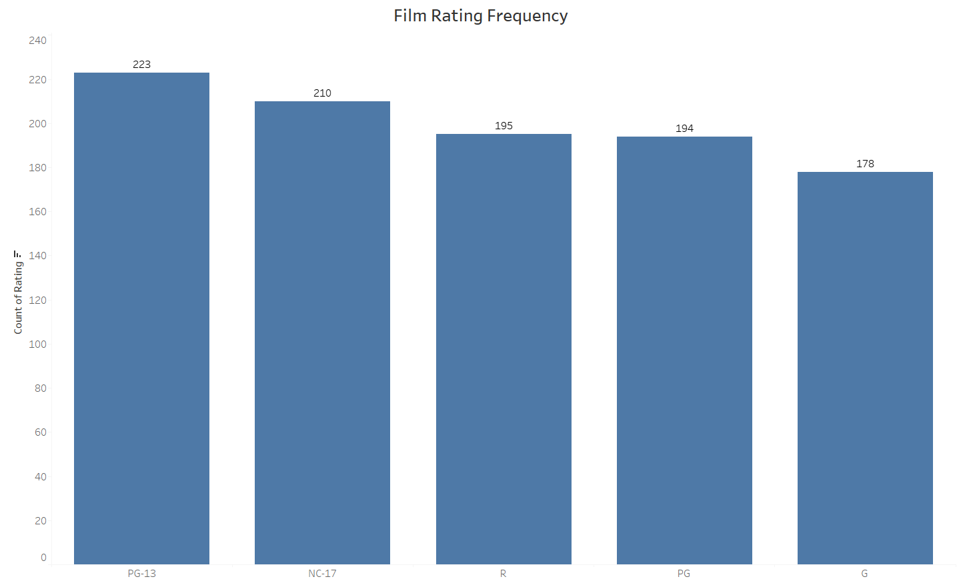
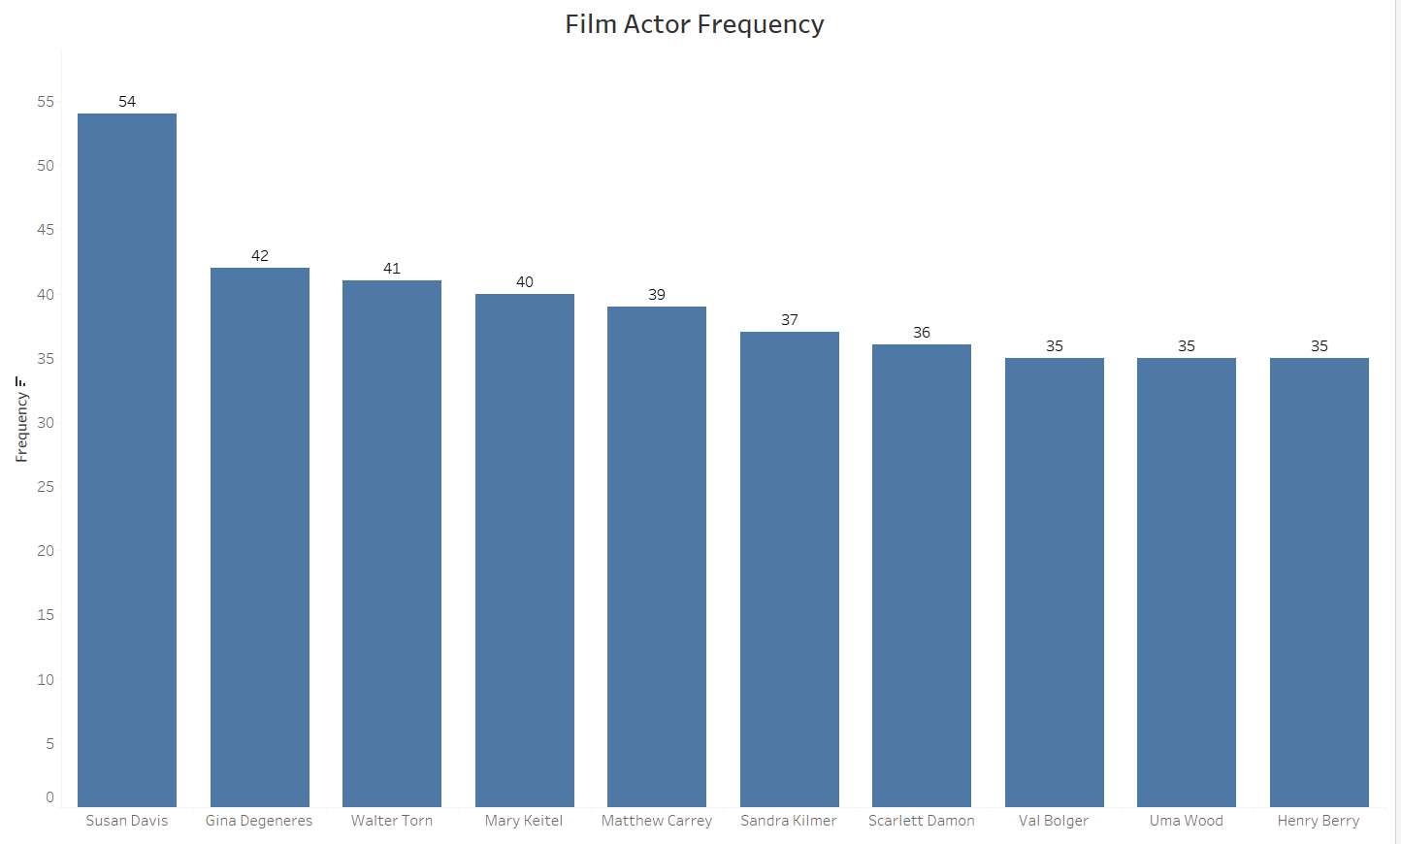
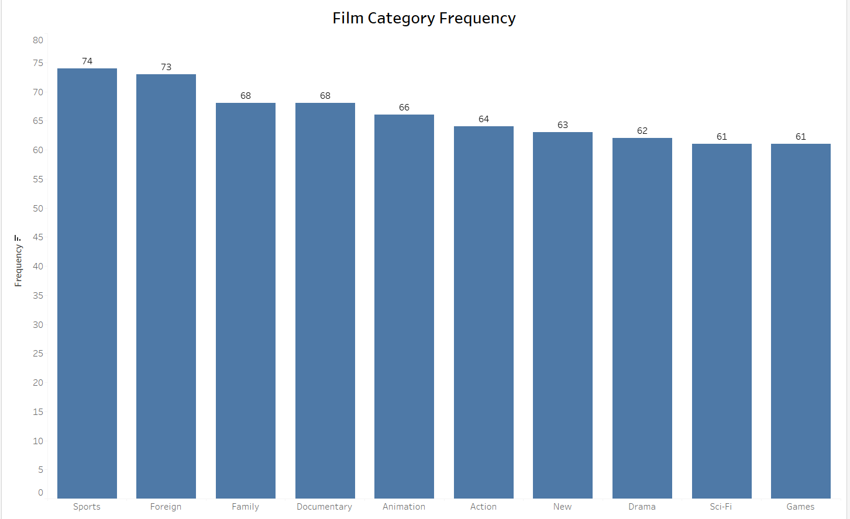
Conclusion & Recommendations
India & China generate the most revenue and should be the markets to prioritize.
Encourage discounts for films so customers rent movies for longer periods to retain activity and loyalty
Focus on a market campaign for Australia since it has larger population, which could lead to increase in revenue.
Limit the least popular film categories to make room for the genres that are top selling in number of purchases.

Slide 11
Questions?
Rockbuster Stealth Data Analysis Project | Tableau Public

