Slide 1
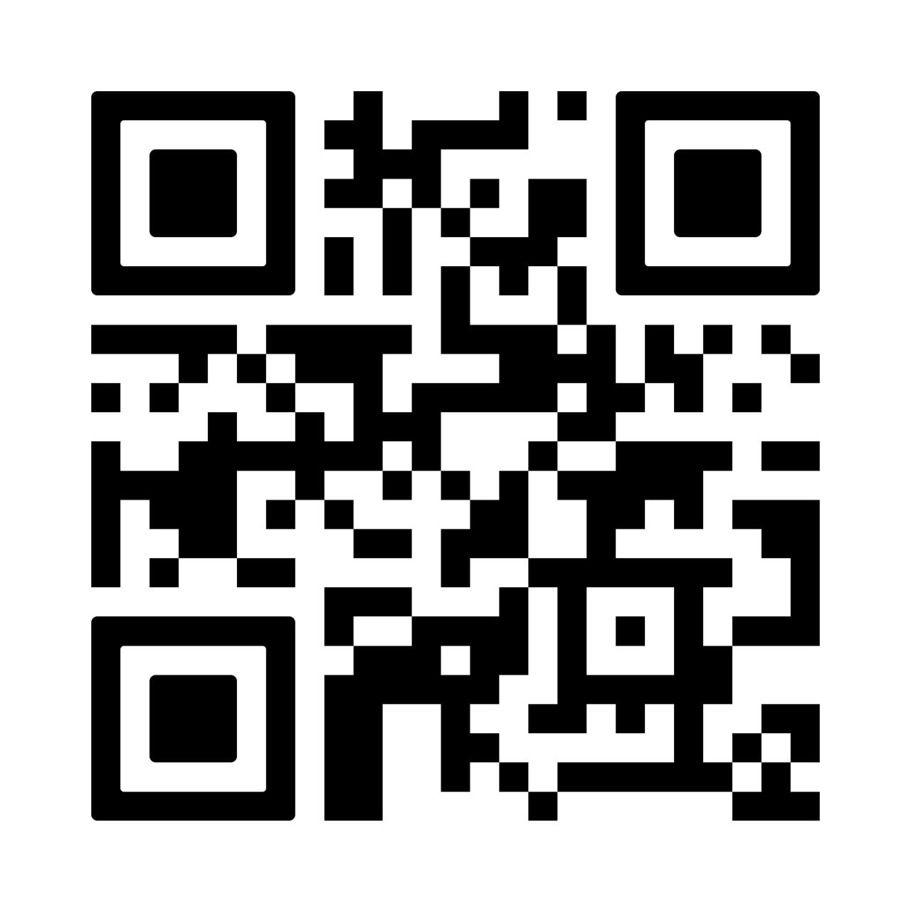
TOSHIBA HACKATHON PROJECT 2026
Richie-Rich
Real-Time Intelligence for Hedge Funds

Slide 2



The Vision
"IoT for Money"
Actionable Speed
Financial markets behave exactly like IoT networks: massive, continuous streams of time-series data. We treat every stock tick like a sensor reading.
We are building a platform that transforms raw financial data into actionable insights in seconds. Latency is the enemy.

Slide 3
Problems with Traditional DB
The Latency Gap
Traditional databases create a bottleneck. Relational DBs are too slow for aggregations, and NoSQL often lacks the consistency required for finance.
> Risk: Stale Data = Bad Trades
> Risk: Volatility > Processing Speed

Slide 4






Why GridDB?
Time-Series Optimized
Data is stored in chronological order using Key-Container-Row structure, making window queries instant.
In-Memory Hybrid
Hot data stays in RAM for sub-millisecond access; historical data tiers automatically to disk.
ACID Transactions
Unlike many time-series DBs, GridDB guarantees consistency—essential for financial audits.

Slide 5
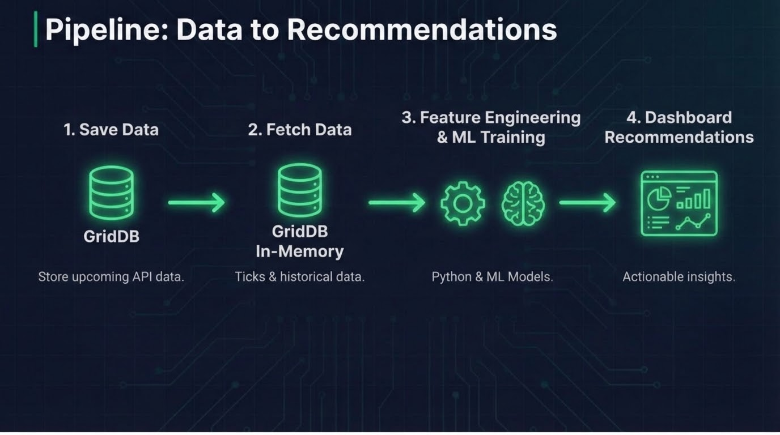

Slide 6

ML Integration
Prediction
Our pipeline doesn't just store data; it understands it and recommends action.

Slide 7
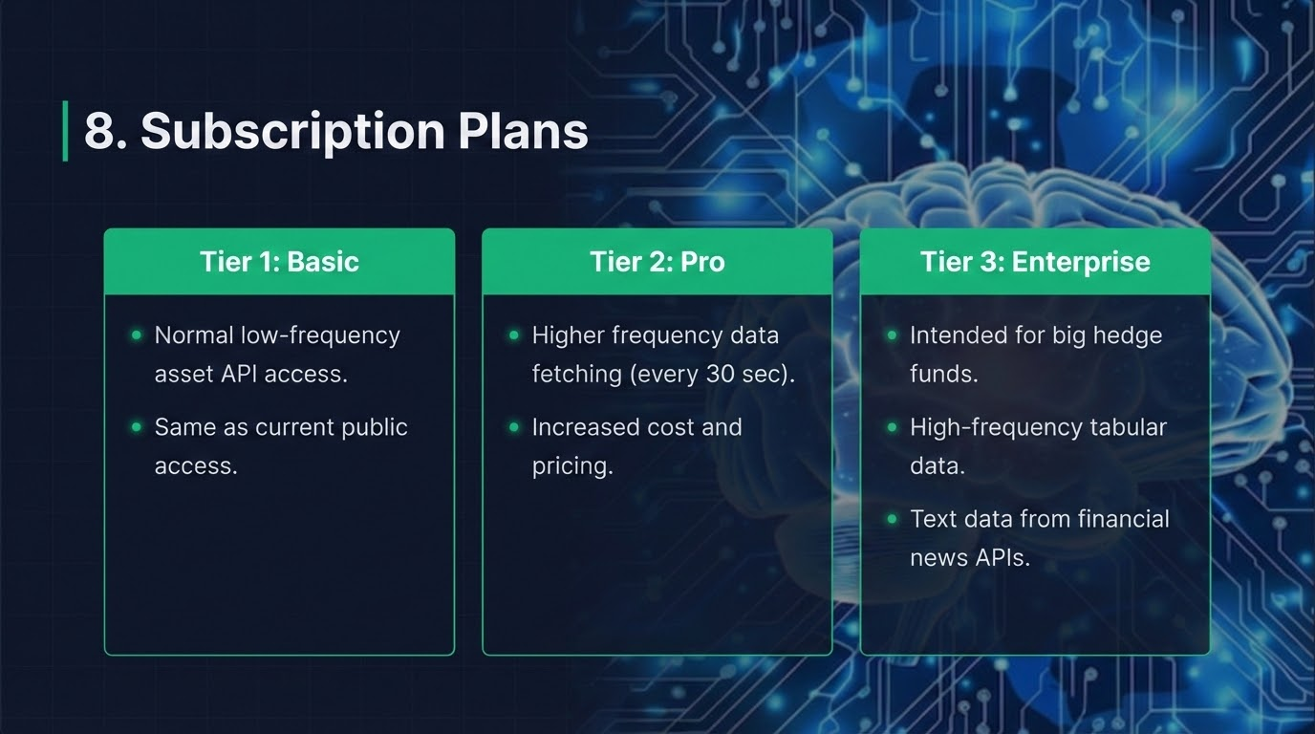

Slide 8
Future Roadmap
Phase 1
Stock Analytics (Complete)
Phase 2
Multi-Asset (Complete)
Phase 3
Natural Language Data Integration with sentiment analysis using LLM;’s.

Slide 9
Questions?
GridDB Financial Analytics Platform
https://github.com/tejas6996/grib | https://hedgevision-fe.vercel.app/

