Slide 1
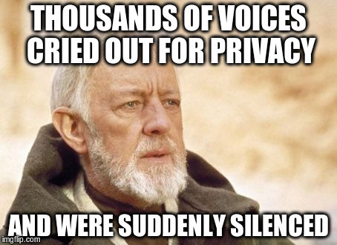
Anti-OSINT…or hiding from The Man

Slide 2


About Me
Husband
Avid scuba diver
Hacker, programmer, and 2nd generation privacy geek ☺
Info Security Analyst
Open source contributor (doona, recon-ng)
https://github.com/griddd

Slide 3
Agenda
Why this talk
Why business and government want to take your privacy
Ways to retain/reclaim/defend your privacy
Audience participation welcome and encouraged ☺
Questions/comments

Slide 4
Why this talk?
Everyone has something they want to hide, so hide if you like :)
A right to privacy is enshrined in our laws & constitution
Privacy isn't dead yet, but as technology advances, many argue that privacy is dying
So, since it's hard to hide & maintain privacy, "drown out" real data with fake data

Slide 5
Why business & government want to take your privacy?

Slide 6
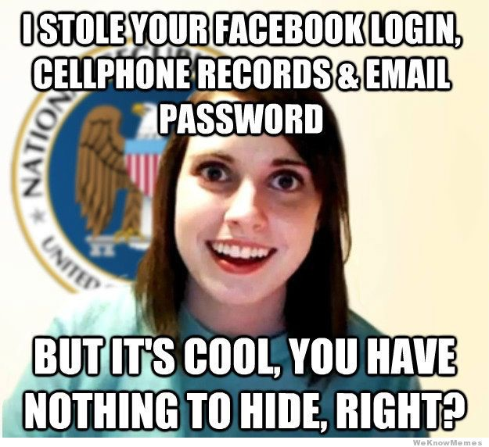

Slide 7
Data is valuable
The average person doesn’t realize how valuable…until it gets lost in a breach!
Data aggregators make TONS of money…look at Facebook, Google, credit bureaus, among many others
Governments use data to keep track of citizens, especially criminals
Black hats like personal data for obvious reasons: identity theft, medical fraud, credit card fraud, etc
White hats use data to make well-targeted attacks on clients

Slide 8
Knowledge + Data = Power
Businesses use targeted ads to entice repeat customers
Notice how you tend to see things you like in Kroger mailings when you have a Kroger card?
Laws mandate that a lot of your data is public record (i.e. house & land transactions)
I got all kinds of crap about mortgage insurance, title searching, etc. when I bought my house
A lot of criminal history is public (e.g. national & local sex offender registries, felony & misdemeanor offenses, etc)

Slide 9
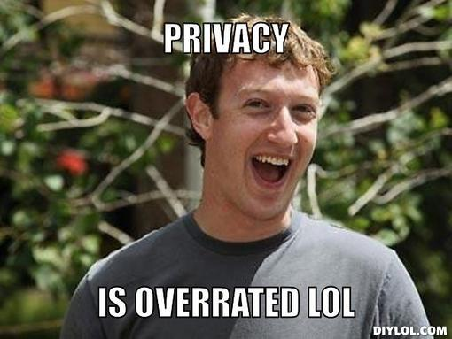

Slide 10
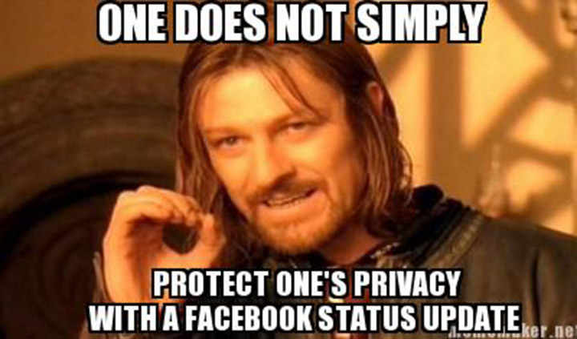
Ways to retain/reclaim/defend your privacy

Slide 11
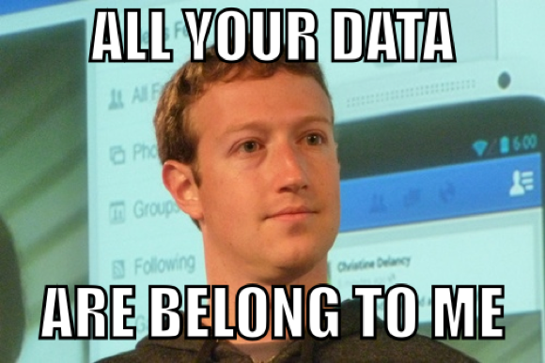
First things first
Don't give up any data on yourself without a good reason!
Does your mechanic really need your correct address?
If you get a paycheck from your employer, it's almost impossible to hide. Be careful when telling strangers where you work.
Don't get arrested...criminal history never really goes away
Social security numbers can be inferred/guessed by criminals who have your birth date, place of birth, and the last 4 digits.
Securely destroy any data (physical or otherwise) you don't need
Freeze your credit at all 4 credit agencies: Equifax, Trans Union, Experian, Innovis
Costs between $8 and $20 at each agency, depending on where you live
September Equifax breach is a good example why
Notes:
First 5 digits correspond to place of birth, and birth date. Social security numbers were randomized in 2011, but people born before then are vulnerable to a "brute force" attack on their SSN.

Slide 12
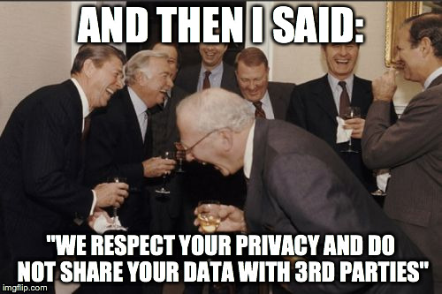
Helpful links
Opt out of pre-approved offers of credit or insurance at http://www.optoutprescreen.com
Reduce junk phone calls by registering at the national do not call list at https://www.donotcall.gov/
Note that there are some organizations which are exempt; see the website for more info.
Removing your house from Google street view: https://sileo.com/google-street-map-remove-house/
Credit freezing: https://krebsonsecurity.com/2015/06/how-i-learned-to-stop-worrying-and-embrace-the-security-freeze/
Block electronic access to Social Security benefits at https://secure.ssa.gov/acu/IPS_INTR/blockaccess
See also http://krebsonsecurity.com/2016/08/social-security-administration-now-requires-two-factor-authentication/#more-35669
Data breach info at haveibeenpwned.com
Can search email addresses, usernames, passwords, even domains (if you own the domain)
Leverage recon-ng modules to make this easier
Notes:
Online fraudsters have begun abusing the Social Security Administration's website to create an account in someone else's name, and siphon benefits from citizens who haven't yet created accounts for themselves.

Slide 13
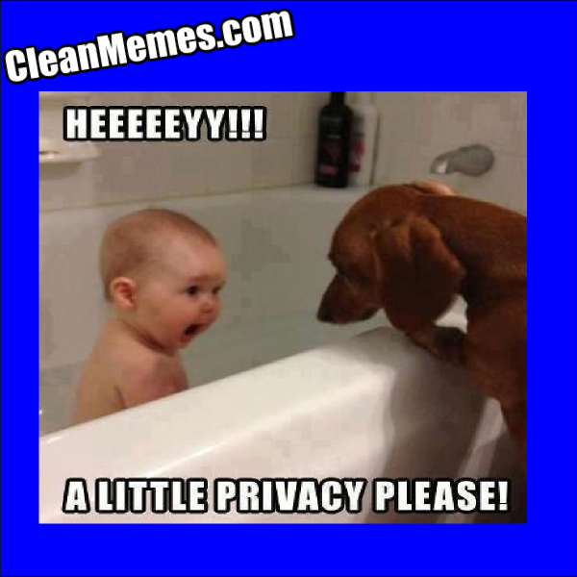
Overflow
Do you use https://informeddelivery.usps.com? Has someone signed up for you?!
This won’t work if you’ve frozen your credit
See the full article at krebsonsecurity.com
Notes:
Informed delivery allows you to “digitally preview your mail & manage your packages”.

Slide 14
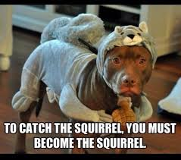
Now for deception
We're all taught to tell the truth at a young age, but truth and privacy can be mutually exclusive. Be a good liar, when you need to be!
Fake Twitter and Facebook profiles
Use TOR, but beware of exit nodes...they can be poisoned to track you anyway
Consider VPN software when working online, but get info on what the VPN provider collects about you
Who does your DNS? DNS history can tell you a lot about any internet user.
When you move, do you really need to notify everyone of your new address? Maintain a P.O. box for privacy
If you need a physical address, try a personal mailbox at a UPS store
Use cash…credit is easily trackable
Notes:
I often give strangers a fake name by which to address me!!
OpenDNS is nice, but don’t be fooled…they collect & sell your data
Always use VPN when working wirelessly!!

Slide 15
Some ways to hide
Politely (or impolitely) ask people not to take your picture or video you
Change your name, if you’re really paranoid
Pick a name similar to a famous person, or a common name…helps you hide on Google
When moving, get copies of your medical records from doctors, and ask they destroy any copies. I’m not a lawyer, but as I understand HIPPA, they must comply with your request.
Ask your friends to keep your privacy private (i.e. don’t post about me on Facebook)
Get a new social security number
https://www.consumer.ftc.gov/articles/0248-do-you-need-new-social-security-number

Slide 16
Things to remember
Often, convenience and privacy are mutually exclusive...take cell phones for instance.
If a product/service is free, then the objective of the provider is to harvest YOUR data!
When you put anything on the internet, someone will try to hack or steal it.
Read end-user license agreements and terms of service.
What is your online footprint? Research yourself with Maltego to find out
Free edition comes with Kali Linux
Notes:
Cell phones are portable tracking devices. Turn off mobile data to prevent precise tracking
Might be surprised at what information is gathered. If EULAs are more than 4 pages long, beware!

Slide 17
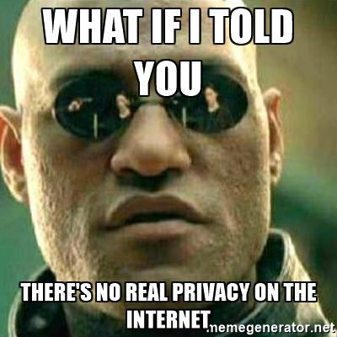

Conclusion
Your personal data & privacy are valuable; guard them appropriately!
It’s very difficult to maintain your privacy
Go to some hacker conferences: DerbyCon and SkyDogCon are local and inexpensive
Check out Tim MalcomVetter’s DerbyCon 2017 talk at https://www.youtube.com/watch?v=bxQSu06yuZc

Slide 18

Questions/Comments?

Slide 19
Thanks for coming!
Slides and notes will be up at https://github.com/griddd/SkyDogCon2017
diverdown10 at gmail.com
I’ll be around…stop and chat ☺

