Slide 1
Introduction to python programming
"Python: Your Key to Mastering AI Fundamentals."

Slide 2
Agenda
Introduction to python programming
An overview on python interpreter
Types of applications built using Python
Installing python (ANACONDA, VSCODE, COLAB)
An overview on Python development tools
Python compared to similar alternatives:
Python Scripting - some basic nuances
An overview of scripting and the pragmatic development approach.

Slide 3
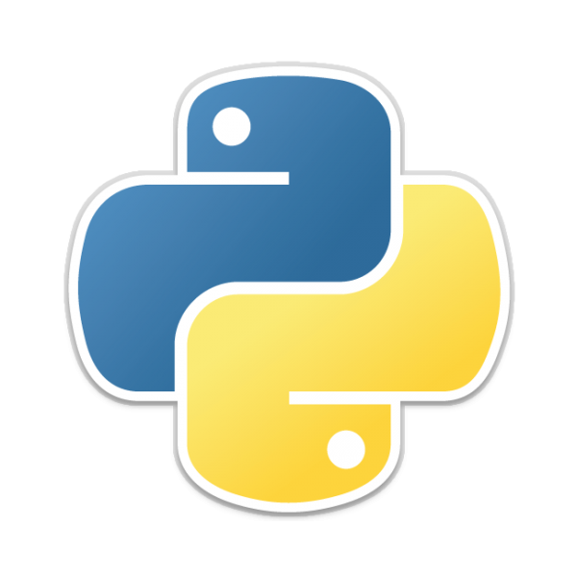
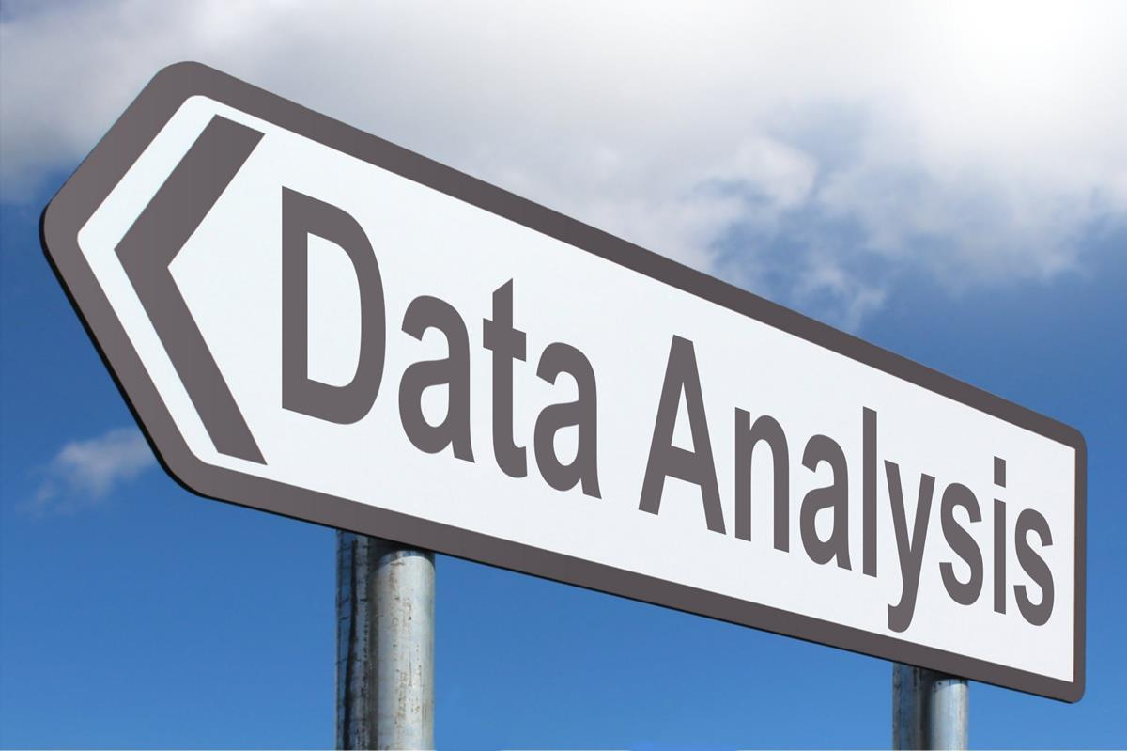
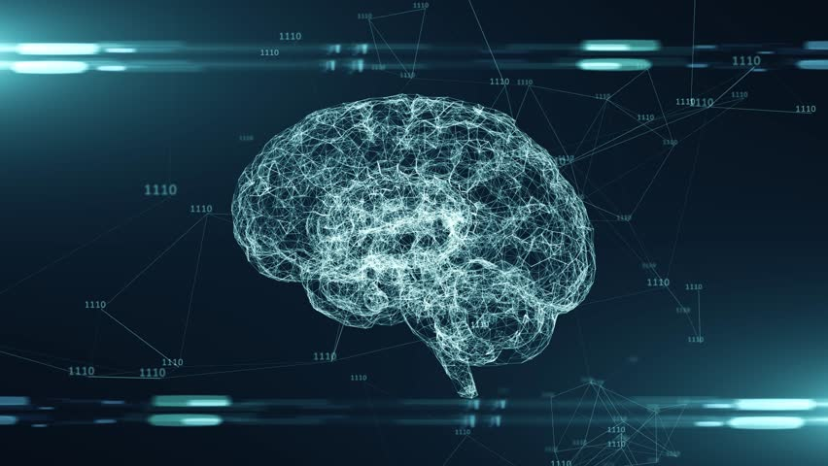
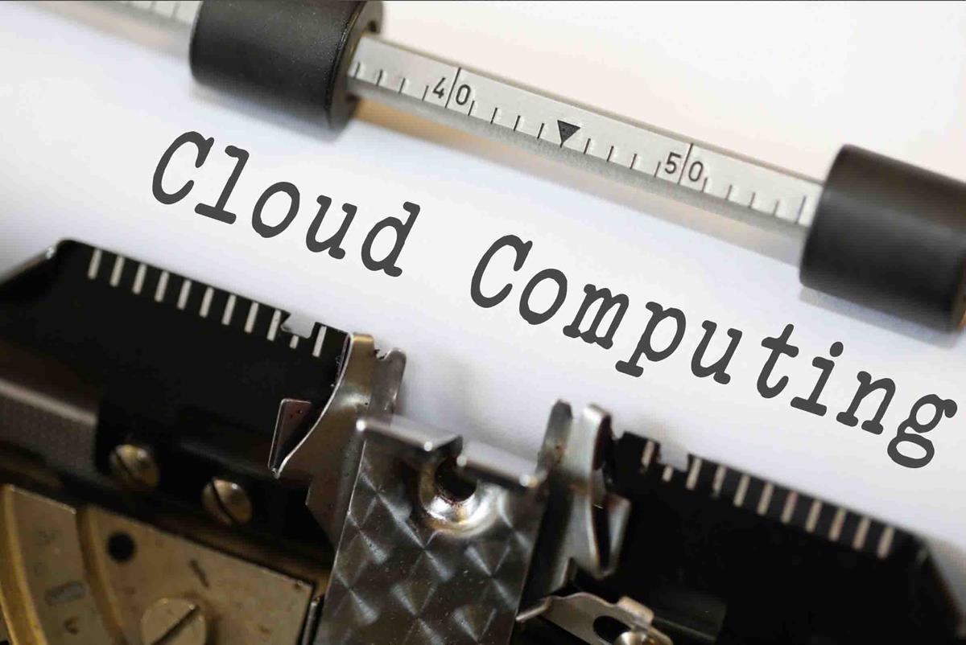
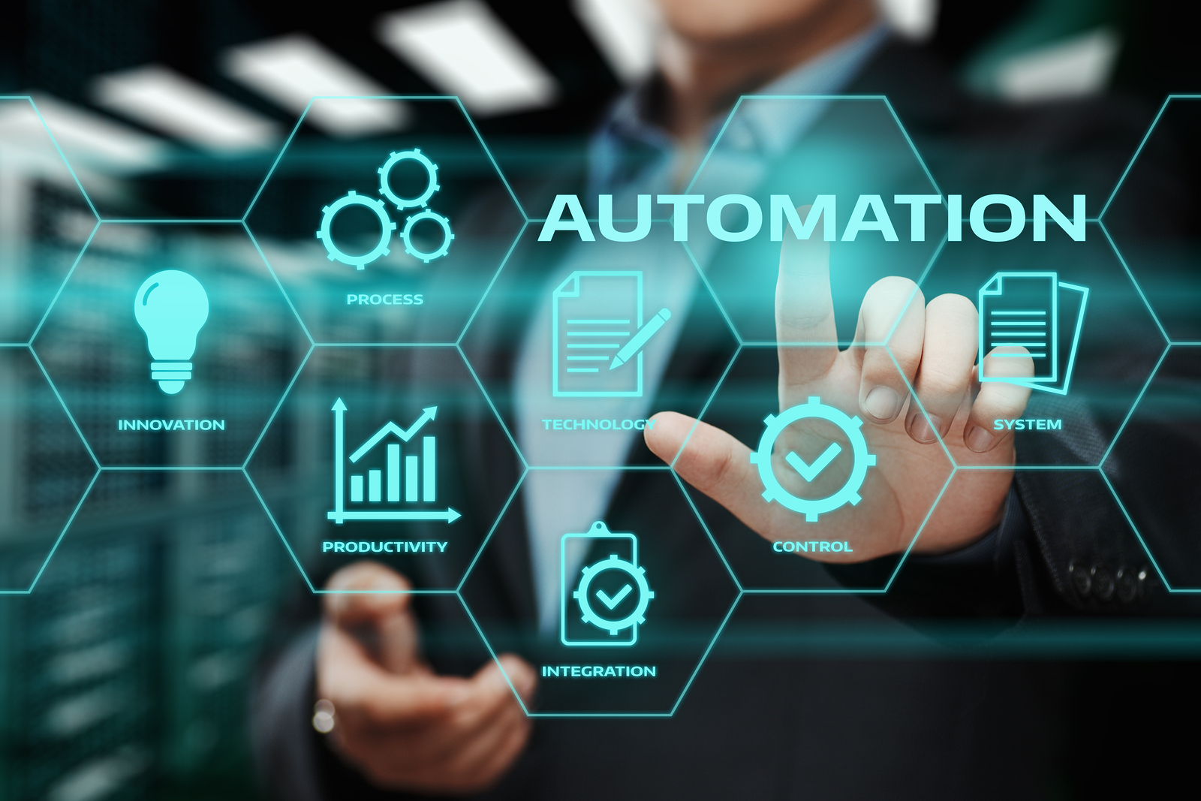
Introduction to Python Programming
a widely-used, high-level programming language
known for its simplicity and readability.
created by Guido van Rossum and was first released in 1991.
emphasizes code readability and a clean, elegant syntax.
is an interpreted language
finds applications in various domains, such as web development, data analysis, artificial intelligence, scientific computing, automation, and more.

Slide 4
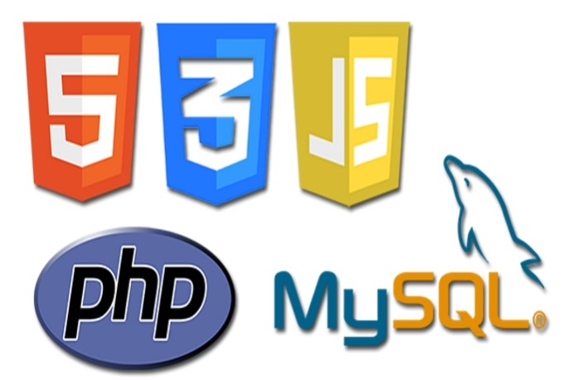
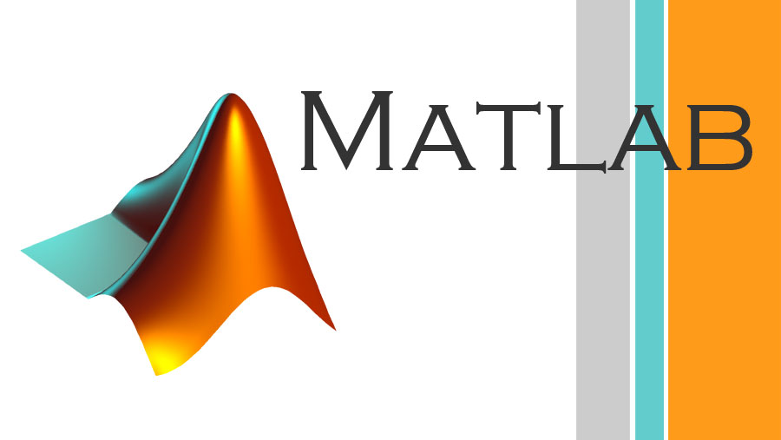
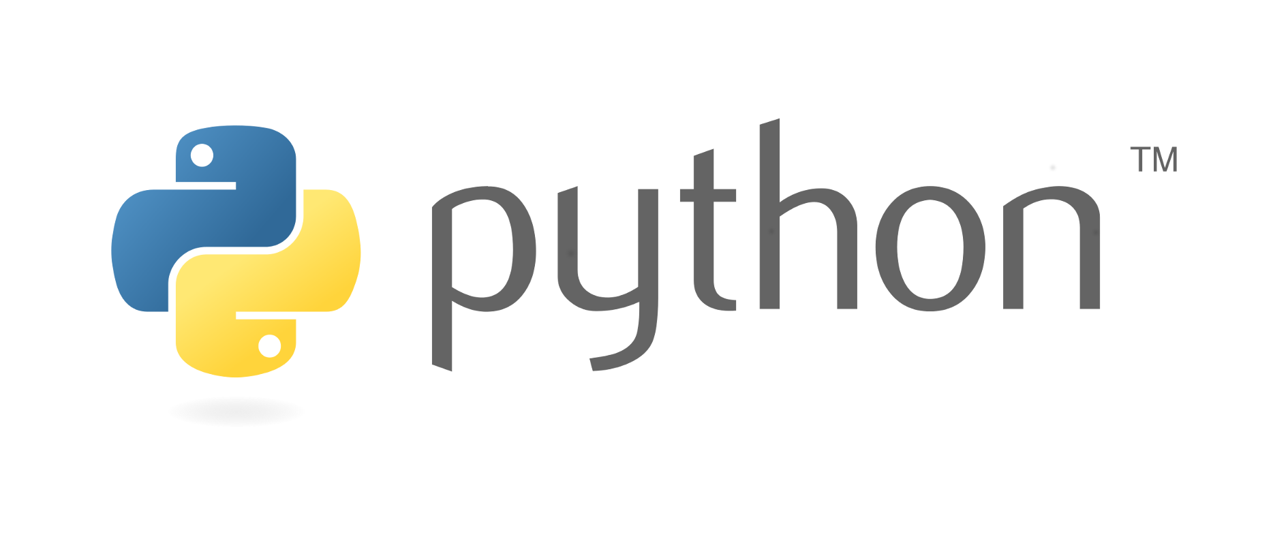

high-level programming language
more user-friendly and easier to understand.
closer to human language
code more quickly and efficiently.
abstract away complex low-level details
widely used for building websites, apps,

Slide 5
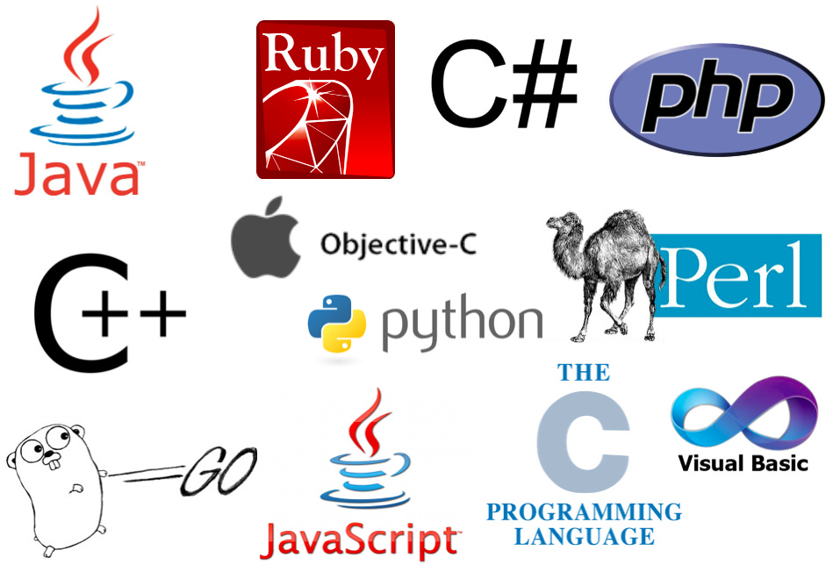

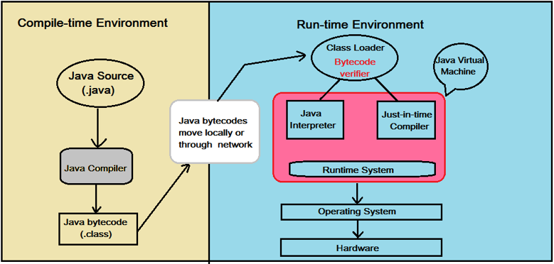
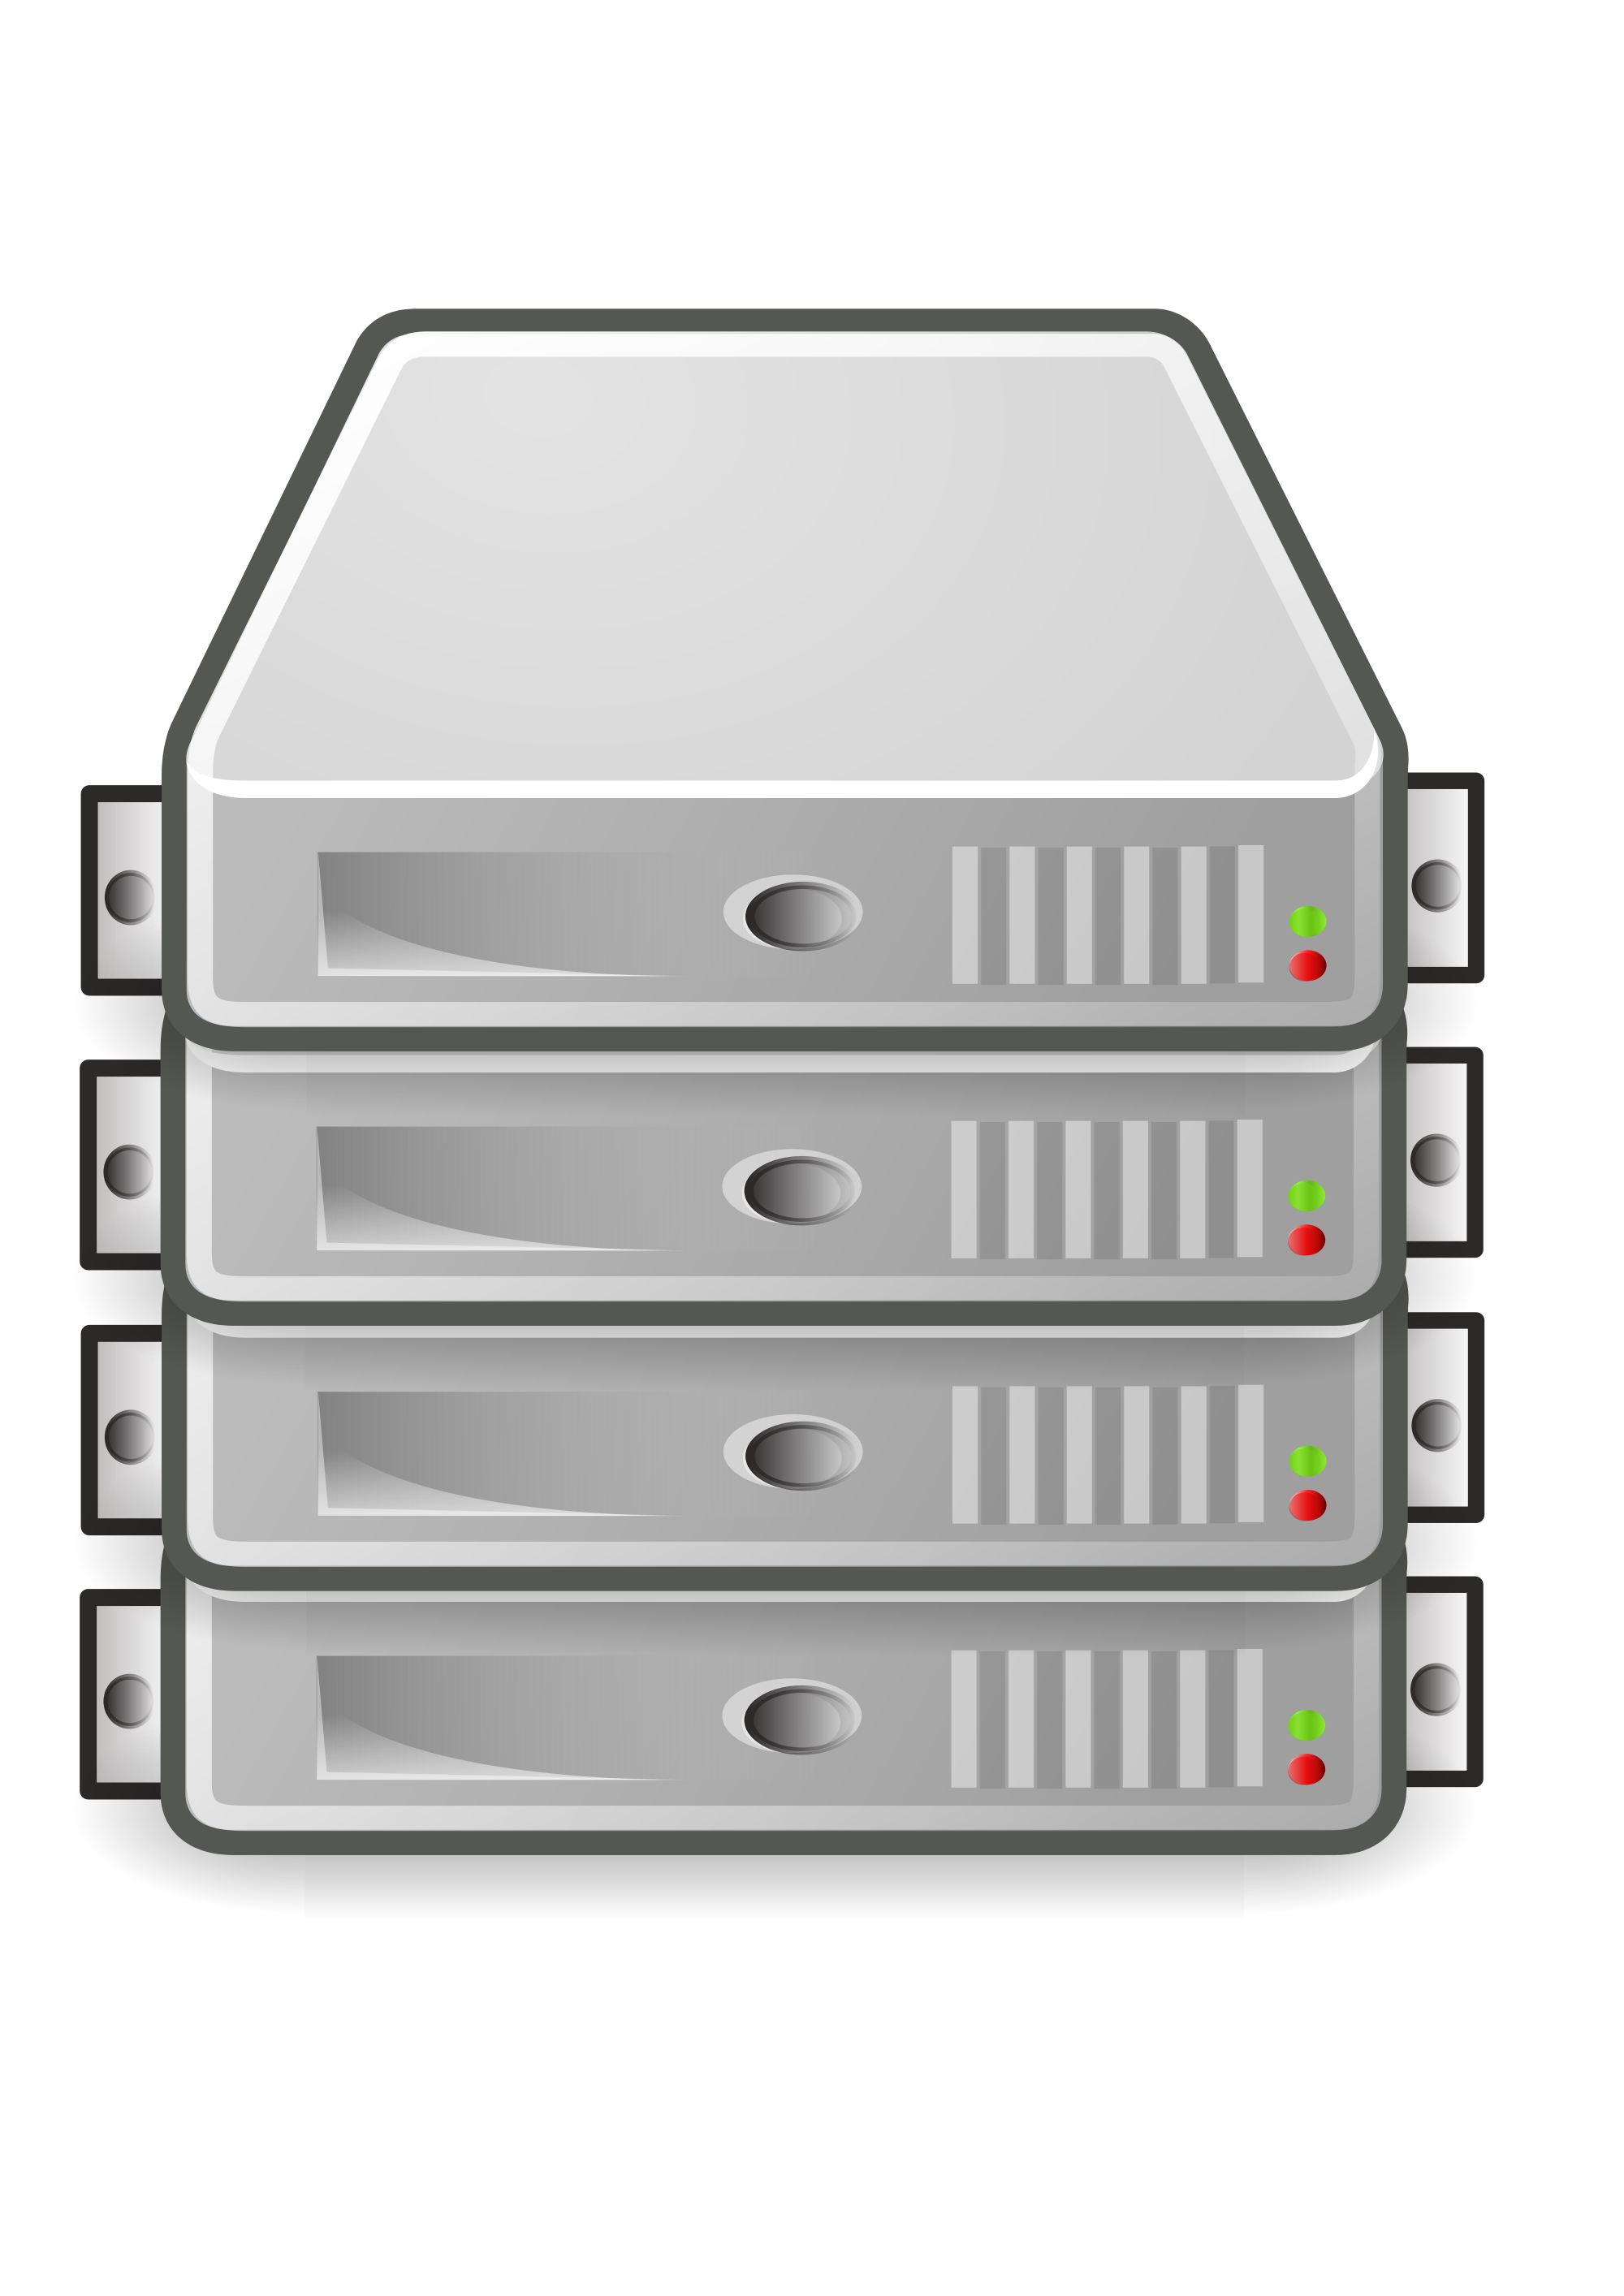
Interpreter
Low level programs
High level programs

Slide 6
Compiled vs. Interpreted
Python is often referred to as an interpreted language because it is executed line by line by the interpreter. However, Python's execution involves a combination of interpretation and compilation.
01
During the initial execution, the Python interpreter generates intermediate bytecode from the source code, which is then executed by the PVM.
02
The PVM compiles the bytecode into machine code on-the-fly using Just-In-Time (JIT) compilation, resulting in faster execution compared to traditional interpretation.
03

Slide 7
Thank You & Happy Learning !!!

