Slide 1
Python interpreter

Slide 2
Agenda
An overview on python interpreter

Slide 3
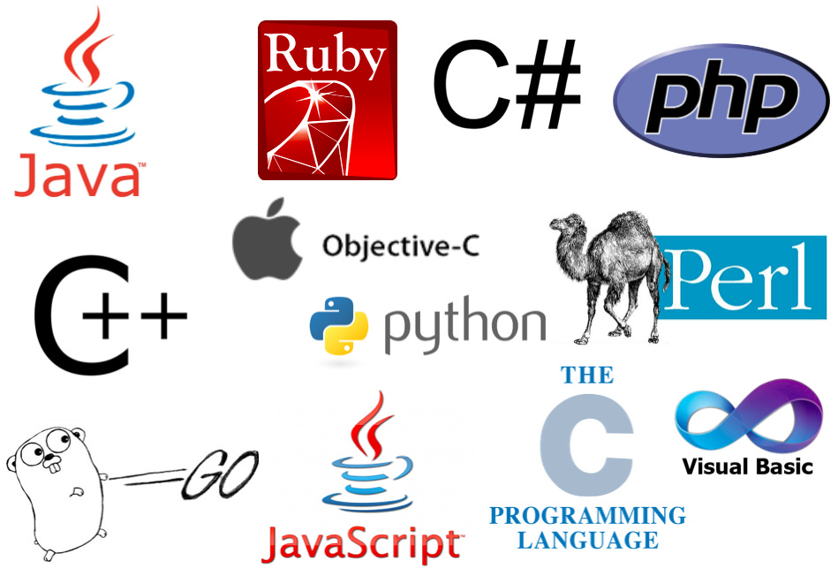

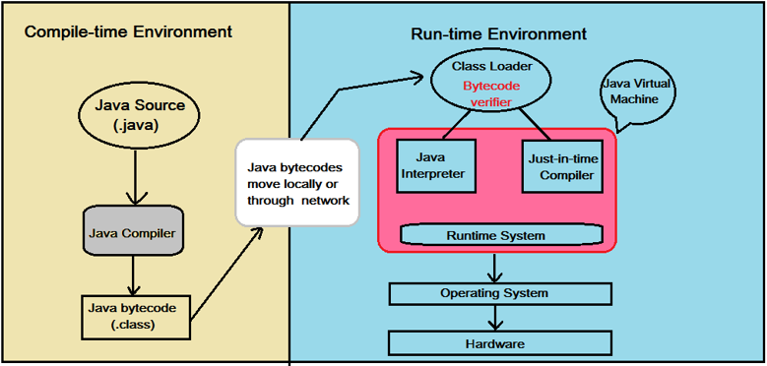
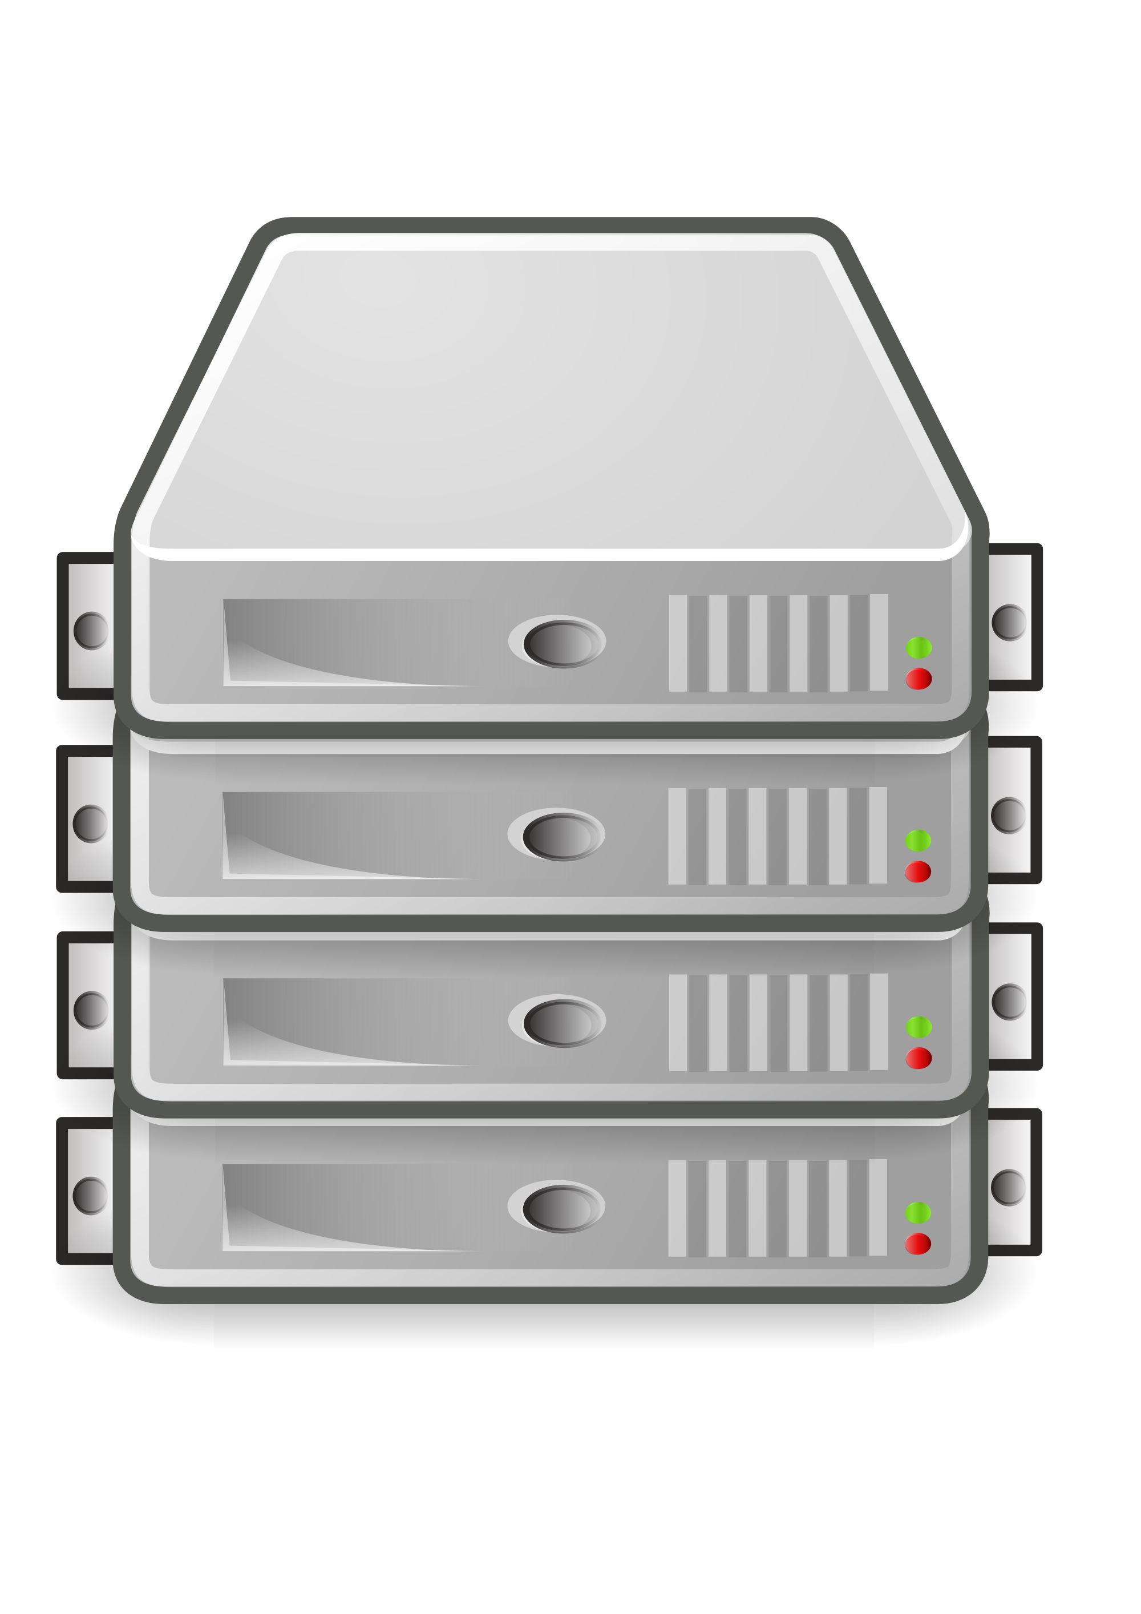
Interpreter
Low level programs
High level programs

Slide 4
Compiled vs. Interpreted
Python is often referred to as an interpreted language because it is executed line by line by the interpreter. However, Python's execution involves a combination of interpretation and compilation.
01
During the initial execution, the Python interpreter generates intermediate bytecode from the source code, which is then executed by the PVM.
02
The PVM compiles the bytecode into machine code on-the-fly using Just-In-Time (JIT) compilation, resulting in faster execution compared to traditional interpretation.
03

Slide 5
An overview on python interpreter
On-the-Fly Execution
Python code is executed directly by the interpreter line by line, without a separate compilation step.
the interpreter converts it into machine code or bytecode on-the-fly.
REPL (Read-Eval-Print Loop)
In the REPL, users can enter Python commands, and the interpreter immediately evaluates and displays the results.
This makes it a convenient tool for quick experimentation, testing code snippets, and learning Python interactively.

Slide 6
An overview on python interpreter
Dynamic Typing:
means that the type of a variable is determined during runtime based on the value assigned to it.
The interpreter automatically infers the type of variables, providing flexibility and ease of use
Easy Integration with Other Languages:
can be easily embedded in applications written in other programming languages
Multiplatform Support:
is available for various operating systems, including Windows, macOS, Linux, and more

Slide 7
An overview on python interpreter
Bytecode Compilation:
uses a bytecode compilation mechanism to improve execution speed.
first compiles the source code into intermediate bytecode,
executed by the Python Virtual Machine (PVM).
bytecode is platform-independent, making Python programs portable across different systems.
Automatic Memory Management:
includes a garbage collector that automatically manages memory allocation and deallocation,
Debugging and Profiling:
comes with built-in debugging and profiling tools,

Slide 8
How the Python Interpreter Works
Lexical Analysis: the interpreter performs lexical analysis, also known as tokenization.
Syntax Analysis: parsing the tokens to create an Abstract Syntax Tree (AST). The AST represents the syntactic structure of the program.
Intermediate Code Generation: From the AST, the Python interpreter generates intermediate bytecode. This bytecode is a lower-level representation of the Python code and is not tied to any specific hardware or operating system.
Bytecode Execution: The bytecode is executed by the Python Virtual Machine (PVM).

Slide 9
Happy Learning !!!

