Slide 1
gridfm-app-distribution
Install, use and evaluate a grid foundation model for voltage-loss detection in distribution networks
New-user tutorial · INESC TEC
github.com/gridfm/gridfm-app-distribution
Notes:
Welcome. This deck walks a new user from a clean machine to an evaluated VLD model, and ends with a hands-on Colab session.

Slide 2
Agenda
1
Repository overview and purpose
6
VLD reconstruction task
2
Input data structure
7
VLD loss function
3
Data generation kit
8
Model evaluation
4
Data loading and normalisation
9
Roadmap
5
Model architecture
10
Google Colab hands-on tutorial

Slide 3
Repository overview and purpose
1 / 10
What the package is, what it ships, and how to install it

Slide 4
A foundation model for distribution networks, with a detection task on top
gridfm-app-distribution trains, fine-tunes and predicts a grid foundation model (GridFM) specialised for electricity distribution
Graph transformer over a heterogeneous grid graph: bus and generator nodes, branch edges, physics feedback at every layer
Base tasks carried over from gridfm-graphkit: power flow, optimal power flow, state estimation
Distribution task added here: Voltage Loss Detection (VLD) — which buses lose supply after a contingency
Two command-line applications in one repository: the model (gridfm_app_dist) and the data generator (contingency_data_gen)
gridfm_app_dist
train · finetune · evaluate · predict
Lightning + MLflow, YAML-configured
contingency_data_gen
pandapower networks → N-k contingencies → datakit parquet
examples / docs / tests
scenario config, Colab tutorial, mkdocs site, pytest suite with a tiny dummy model

Slide 5
Repository layout
gridfm-app-distribution/
├── gridfm_app_dist/ model application
│ ├── datasets/ parquet → HeteroData, masks, normalisers
│ ├── models/ GNS_heterogeneous
│ ├── tasks/ Lightning tasks: pf, opf, se, vld
│ ├── training/ losses (VLDTopologyLoss), callbacks
│ ├── io/ configs, registries, vld_evaluation
│ └── cli.py, __main__.py train | finetune | evaluate | predict
├── contingency_data_gen/ data application
│ ├── generation/ scenarios, extractors, parquet writer
│ ├── netlib/ YAML network builder, std types
│ ├── configs/ job configs, networks, netbuilder
│ └── __main__.py contingency_data_gen --config ...
├── examples/ scenario config, tutorial_vld/, datakit/
├── docs/ mkdocs site
└── tests/ pytest suite, tiny dummy model
Everything is registered by name (losses, tasks, models, transforms), so a YAML config selects the pieces
Both applications install from the same pyproject.toml and expose console scripts
Generated data lives in data/ (git-ignored); runs in mlruns/

Slide 6
Installation
# Python 3.10 – 3.12
python -m venv .venv && source .venv/bin/activate # Windows: .venv\Scripts\activate
pip install gridfm-app-distribution # or, for development:
git clone https://github.com/gridfm/gridfm-app-distribution
pip install -e ".[dev,test]"
# torch-scatter must match your torch / CUDA build
TORCH=$(python -c "import torch;print(torch.__version__+('+cpu' if torch.version.cuda is None else ''))")
pip install torch-scatter -f https://data.pyg.org/whl/torch-$TORCH.html
# check
gridfm_app_dist --help
contingency_data_gen --list-configs
Dependencies
torch, torch-geometric, lightning, mlflow, pandas/pyarrow, scikit-learn, pandapower (data kit)
Only manual step
torch-scatter is a compiled PyG wheel; the index URL must match torch and CUDA
The four CLI commands: train · finetune · evaluate · predict — all take --config <yaml> --data_path <dir> and log to MLflow (--log_dir).

Slide 7
Input data structure
2 / 10
What the model reads, column by column

Slide 8
One folder per network, three partitioned parquet tables
data/<network>/raw/
├── bus_data.parquet/ scenario_partition=0/ batch_*.parquet (one row per bus per scenario)
├── branch_data.parquet/ scenario_partition=0/ ... (one row per branch)
└── gen_data.parquet/ scenario_partition=0/ ... (one row per generator; may be absent)
scenario_partition = scenario // n_scenario_per_partition (Hive partitioning, read back as one frame)
table | identifies | physical columns | VLD columns
bus_data | scenario, bus | Pd Qd Pg Qg Vm Va, PQ/PV/REF, Vm limits, GS BS, vn_kv | BUS_BASE_STATUS, BUS_CONTINGENCY, BUS_STATUS (target)
branch_data | scenario, from_bus, to_bus | pf qf pt qt, Y-matrix entries, tap, angle limits, rate_a, br_status | BRANCH_BASE_STATUS, BRANCH_CONTINGENCY
gen_data | scenario, gen, bus | p_mw, limits, cost coefficients | status (inactive generators are removed)
A network with only an external grid (e.g. case33bw) has no generator table; the loader builds an empty gen node set.

Slide 9
How the tables become tensors
tensor | width | layout (indices in datasets/globals.py)
bus x | 17 | Pd Qd Qg Vm Va · PQ PV REF · Vm min/max · Qg min/max · GS BS · vn_kv · BUS_BASE_STATUS · BUS_CONT
branch edge_attr | 13 | P Q · Yff/Yft real+imag · tap · angle min/max · rate_a · B_ON · BRANCH_BASE_STATUS · BRANCH_CONT
gen x | 6 | Pg · Pg min/max · c0 c1 c2
bus y (target) | 7 | Pd Qd Qg Vm Va · BUS_STATUS · Pg
bus output (VLD) | 5 | Vm Va Pg Qg · status_logit
The four VLD inputs
The VLD target
Base status and contingency flags on buses and branches. Base status = pre-contingency topology; contingency = what this scenario removes. The loss rebuilds reachability from exactly these.
BUS_STATUS: 1 energised, 0 de-energised after the contingency, from the power-flow solver. Vm is 0 on de-energised buses.

Slide 10
Data generation kit
3 / 10
contingency_data_gen: from a network model to training parquet

Slide 11
From a network to N-k contingency scenarios
1
Network
2
Enumerate
3
Solve
4
Write
Excel workbook, YAML (netlib builder), MATPOWER file, or a pandapower.networks factory
N-1 … N-k combinations of bus and branch outages
post-contingency power flow per scenario, in parallel worker batches
datakit parquet, partitioned by scenario, plus summary and validation
flag | network source | key
1 / 2 / 3 | Excel workbook (three import methods) | network_file_path: networks/case33radial.xlsx
9 | YAML definition built by netlib | builtin_network: netbuilder/urban_LV.yaml
10 | MATPOWER .m file | builtin_network: networks/<case>.m
null | pandapower.networks factory | builtin_network: case33bw

Slide 12
One YAML, one command
# examples/tutorial_vld/configs/tutorial_datagen.yaml
defaults:
flag: null # pandapower.networks factory
max_n_level: 2 # N-1 and N-2
max_size: 200 # max memory per worker batch (MB)
n_scenario_per_partition: 200
run_summary: true
run_validation: true
scenarios:
- name: tutorial_case33bw
builtin_network: case33bw
output_dir: data/tutorial_case33bw
contingency_data_gen --list-configs
contingency_data_gen --config tutorial_datagen.yaml --dry-run
contingency_data_gen --config tutorial_datagen.yaml
contingency_data_gen --config data_gen_1.yaml --only case33radial
# then, with the same folder:
gridfm_app_dist train --config scenario.yaml --data_path data
Relative network paths resolve against the config folder, then the package configs/ (networks/, netbuilder/)
output_dir resolves against the working directory: data/<name> is what --data_path data expects
Worker count follows SLURM_CPUS_PER_TASK (default 8)
Validation checks column completeness, scenario alignment and admittance consistency

Slide 13
Data loading and normalisation
4 / 10
Parquet → heterogeneous graphs → per-unit tensors

Slide 14
The loading pipeline
HeteroGridDatasetDisk
reads raw/ once, builds one HeteroData per scenario, caches to processed/
Task transforms
RemoveInactiveBranchesKeepTopology · RemoveInactiveGenerators · AddVLDHeteroMask · ApplyMasking
LitGridHeteroDataModule
train / val / test split by scenario (val_ratio, test_ratio), loaders, split JSON saved to the run
HeteroDataMVANormalizer
fit on the training scenarios only; stats saved as normalizer_stats.pt and reused at predict time
Normalisation: powers are divided by a baseMVA taken as the 95th percentile of non-zero power values in the training data (falls back to data.baseMVA); voltages stay in p.u.

Slide 15
What the VLD mask hides, and what it keeps
node / edge | hidden (to be reconstructed) | always visible
PQ bus | Vm, Va
PV bus | Va, Qg | bus type flags, Pd Qd, shunts,
REF bus | Vm, Qg | BUS_BASE_STATUS, BUS_CONT
all buses | Vm limits, Qg limits, vn_kv
generators | Pg limits, cost coefficients; Pg of REF-connected generators | Pg of other generators
branches | P, Q flows | admittances, ratings, B_ON, BRANCH_BASE_STATUS, BRANCH_CONT
Why topology stays visible
The status and contingency flags are the question the model is asked; masking them would remove the problem statement.
Why the physics mask stays
The same PF-style mask keeps the physics decoder well-posed: Vm/Va reconstruction plus Pg/Qg completion per bus type.

Slide 16
Model architecture
5 / 10
GNS_heterogeneous: a graph transformer with physics feedback and a status head

Slide 17
GNS_heterogeneous in one picture
Inputs
Encoders
L × layer
Heads
bus x [17] · gen x [6]
branch edge_attr [13]
mask dicts
linear projections to hidden_size per node type
HeteroConv of TransformerConv over
bus–bus, gen→bus, bus→gen
+ physics residual (P,Q mismatch → MLP → gated add)
bus: Vm Va (+ Pg Qg via physics decoder)
gen: Pg
bus status logit (VLD)
option | default | meaning
head_mode | split | d_model split across heads (stream width = hidden_size); concat is the legacy, much wider form
norm_position / residual_mode | pre / always | pre-norm transformer blocks, residual at every layer
physics_gate | true | per-layer LayerScale gate on the physics correction; starts as a no-op (gate 0)
topology_gating | none | message_mask drops unavailable branches before message passing (opt-in)

Slide 18
Configuring the model
model:
type: GNS_heterogeneous
hidden_size: 128 # 32 for the tutorial / tests
attention_head: 8 # 2 for the tutorial / tests
num_layers: 24 # 2 for the tutorial / tests
dropout: 0.1
input_bus_dim: 17 # fixed by the data
edge_dim: 13 # fixed by the data
input_gen_dim: 6 # fixed by the data
output_bus_dim: 5 # Vm Va Pg Qg + status logit (VLD)
output_gen_dim: 1
Depth matters for VLD: reachability after a contingency must be representable in num_layers message-passing hops (or use topology_gating: message_mask)
The physics residual gives every layer the nodal P/Q mismatch of its current voltage estimate — a feedback loop, not a post-hoc check
Base tasks emit 6 bus outputs (…, Pd, Qd); VLD emits 5 with the status logit at column 4. Code guards on the output width so the logit is never read as a load
The tests ship a 32 / 2 / 2 dummy (~0.2 M parameters); the paper model is 128 / 8 / 24

Slide 19
VLD reconstruction task
6 / 10
VoltageLossDetectionTask: training step, test metrics, prediction export

Slide 20
What the task does at each stage
training_step / validation_step
forward → MixedLoss (VLDTopologyLoss, optionally with MaskedMSE and PBE) → every VLD metric logged per epoch
test_step
same forward; classifies with the threshold the loss derived; adds OFF Vm MAE and ON Vm RMSE; writes <net>_vld_predictions.csv
on_test_end
runs io.vld_evaluation on the collected predictions → figures, metrics.json, summary.md, logged to MLflow
predict_step
exports scenario, bus, vm_pred, vm_true, status_prob, status_pred, status_true, threshold → parquet; evaluation runs automatically
The decision threshold is never a config value: VLDTopologyLoss.decision_threshold() returns 1 / (1 + w_off) from its checkpointed EMA buffer, and the task applies it at test and predict time.

Slide 21
A training config for the VLD task
training:
losses: ["MaskedMSE", "PBE", "VLDTopologyLoss"]
loss_weights: [0.05, 0.15, 0.80]
loss_args:
- {}
- {}
- topology_weight: 1.0 # lambda_reach
target_anchor_weight: 0.5 # lambda_anc
off_vm_weight: 1.0 # lambda_off
on_vm_weight: 0.5 # lambda_on
unreachable_l1_weight: 1.0 # lambda_1
unreachable_pos_weight: auto # w_off = n_on / n_off
max_pos_weight: 10.0
pos_weight_momentum: 0.99
reachability_sources: ref # or ref_and_gen
input_state_threshold: 0.5
topology_confidence_gamma: 0.0
task:
task_name: VoltageLossDetection
evaluation:
enabled: true
n_boot: 1000
Losses, weights and loss_args are aligned lists; MixedLoss sums the weighted terms and passes every other metric through
For the VLD task the best state dict is selected on Validation VLD Balanced Accuracy, not on the total loss
Everything a checkpoint needs is saved under the MLflow run: model/best_model_state_dict.pt, stats/normalizer_stats.pt, stats/<net>_scenario_splits.json
PBE on de-energised buses: confirm loads are zeroed in the data, or mask/lower PBE, otherwise it fights the voltage collapse

Slide 22
VLD loss function
7 / 10
Reachability, two BCE terms, two voltage terms, and a derived threshold

Slide 23
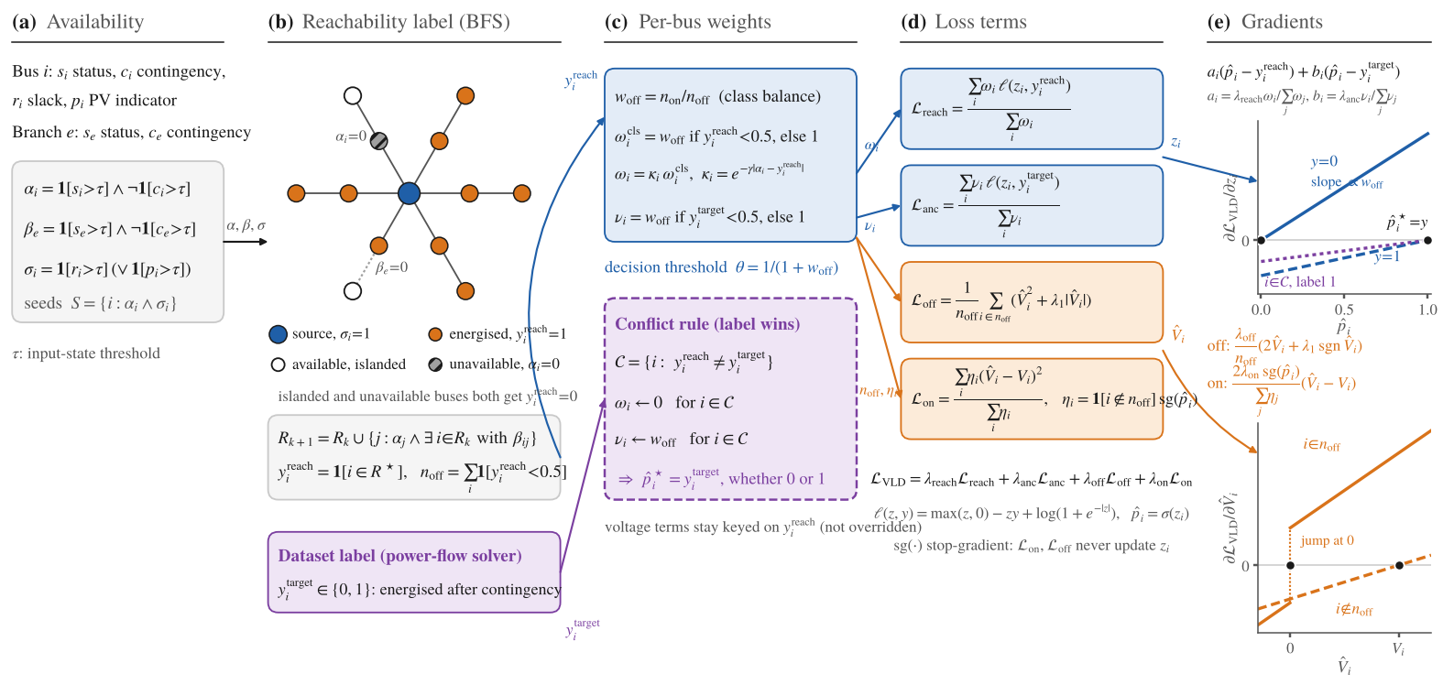
The formulation at a glance

Slide 24
Four terms, one objective
term | supervises | target | per-bus weight
L_reach (topology BCE) | status logit z | y_reach from a BFS over available buses and branches | ω = w_off on de-energised buses, 1 otherwise; 0 on conflict buses
L_anc (anchor BCE) | status logit z | y_target from the solver | ν = w_off on label-0 buses, 1 otherwise; w_off on conflict buses
L_off | V̂ → 0 | buses with y_reach = 0 | V̂² + λ₁ |V̂| (constant pull closes the last millivolts)
L_on | V̂ → V | buses with y_reach = 1 | η = sg(p̂): the model's own confidence, stop-gradient
L_VLD = λ_reach L_reach + λ_anc L_anc + λ_off L_off + λ_on L_on, each term a weighted mean, so the λ compare like with like.
Gradient on the logit (eq. 19): ∂L/∂z = a (p̂ − y_reach) + b (p̂ − y_target), a = λ_reach ω / Σω, b = λ_anc ν / Σν
Stationary point (eq. 20): p̂* = (a y_reach + b y_target) / (a + b) — the label itself wherever the two labels agree
The voltage terms never reach z: the status head is trained only by the two BCE terms

Slide 25
Class balance and the derived decision threshold
The weight
θ = 1 / (1 + w_off)
De-energised buses are the minority. w_off = n_on / n_off (EMA-smoothed across batches, clamped by max_pos_weight) gives them the same total gradient as the majority.
restores the boundary q = 0.5, follows w_off during training, is reported as VLD Decision Threshold, stored in the loss's EMA buffer with the checkpoint, and applied by the task at test and predict time.
The side effect
A BCE weighted by w on the 0-class is minimised at p̂ = q / (q + w (1 − q)), not at the true posterior q. At a fixed 0.5 threshold a bus is called energised only when q ≥ w/(1+w): systematic over-prediction of outages.
Not a tuning parameter. A hard-coded 0.5 (or 0.9) anywhere in an inference path re-introduces the bias toward de-energisation — the evaluator checks for exactly this.

Slide 26
When the two labels disagree: the label wins
Conflict set C = { i : y_reach ≠ y_target } — the BFS misses a path the solver found, or vice versa (source assumptions, mis-flagged branches)
Original formulation: w_off sat on whichever term said 0, so every conflict was resolved toward de-energised; labelled-energised buses were learned as outages
Current rule on C: ω ← 0 and ν ← w_off. The topology term vanishes and the anchor carries the minority-class weight in both directions
Stationary point on a conflict bus: p̂* = y_target, whether 0 or 1
The voltage terms stay keyed on y_reach: the status head follows the data, the voltage head follows the physical topology
bus | ω | ν | p̂*
agree, on (1,1) | 1 | 1 | 1
agree, off (0,0) | w_off | w_off | 0
conflict (reach 0, label 1) | 0 | w_off | 1
conflict (reach 1, label 0) | 0 | w_off | 0
Watch: VLD Topo-vs-Target Disagreement and the two VLD Conflict Rate metrics on the validation curves.

Slide 27
Tuning: what each parameter moves
parameter | moves | when to change it
topology_weight (λ_reach) | a_i | keep at 1; it is the reference scale
target_anchor_weight (λ_anc) | b_i | raise if conflict buses learn slowly or Target Accuracy lags Topology Accuracy (0.25 → 0.5 → 1.0)
off_vm_weight (λ_off) | ∂L/∂V̂ on off buses | raise if de-energised Vm MAE plateaus; lower if On Vm Loss deteriorates
on_vm_weight (λ_on) | ∂L/∂V̂ on on buses | keep below λ_off; energised buses also get MaskedMSE / PBE supervision
unreachable_l1_weight (λ₁) | constant pull near V̂ = 0 | lower to 0.25–0.5 if off-bus voltages oscillate around zero
unreachable_pos_weight / max_pos_weight / pos_weight_momentum | w_off and θ | auto; cap ~10 (50 lets one rare bus take ~9 % of a batch gradient); momentum 0.99 keeps θ stable
reachability_sources | BFS seeds | ref for DG that trips on loss of mains; ref_and_gen only for grid-forming DG
topology_confidence_gamma (γ) | ω on islanded buses | 0; down-weighting islanded buses works against the objective
Suggested sweep: target_anchor_weight ∈ {0.25, 0.5, 1.0} × on_vm_weight ∈ {0.25, 0.5}, selected on validation VLD Balanced Accuracy. Full reference: docs/applications/VLD_loss_parameters.md

Slide 28
Model evaluation
8 / 10
io.vld_evaluation: the model's predictions at its own threshold

Slide 29
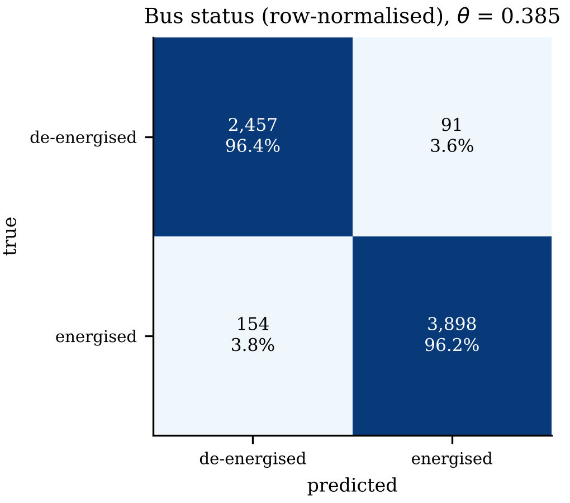
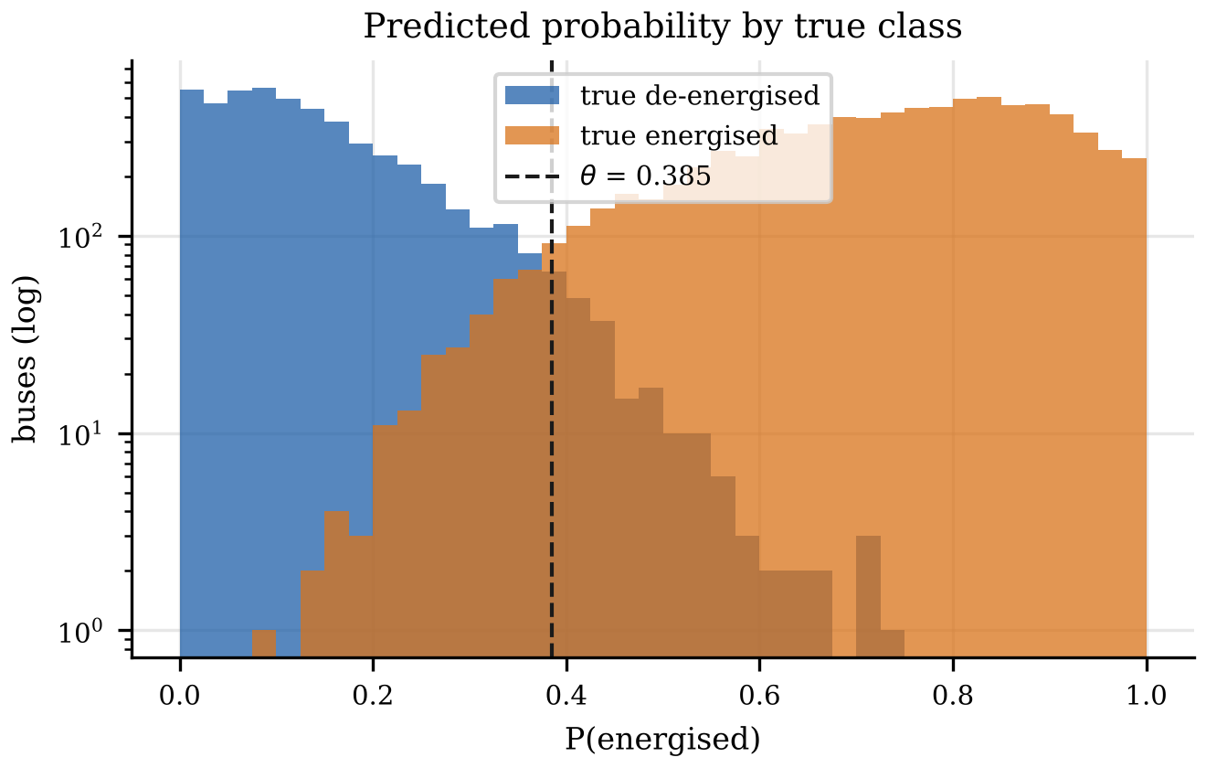
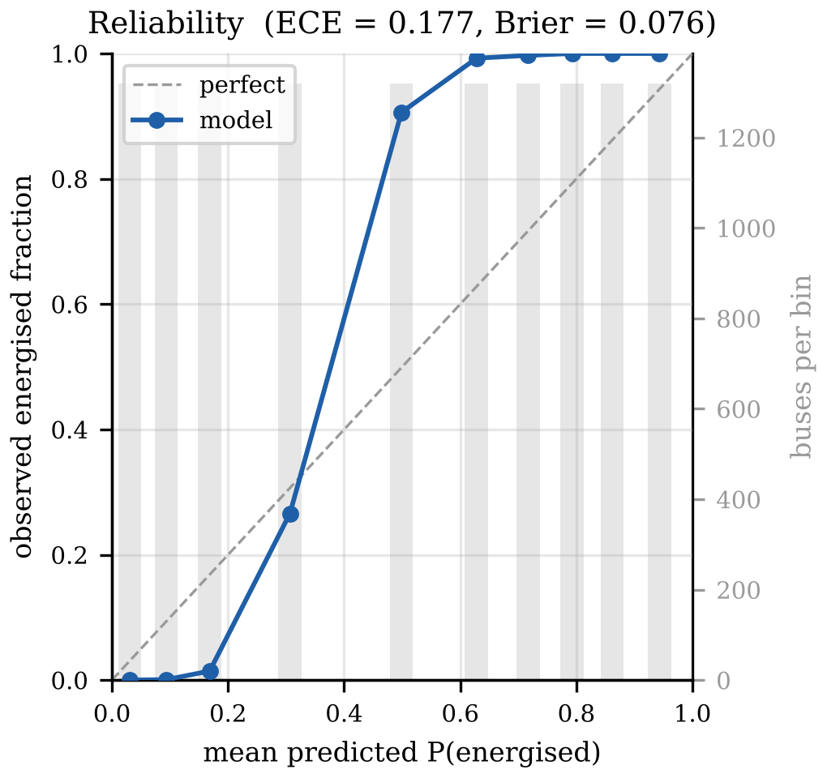
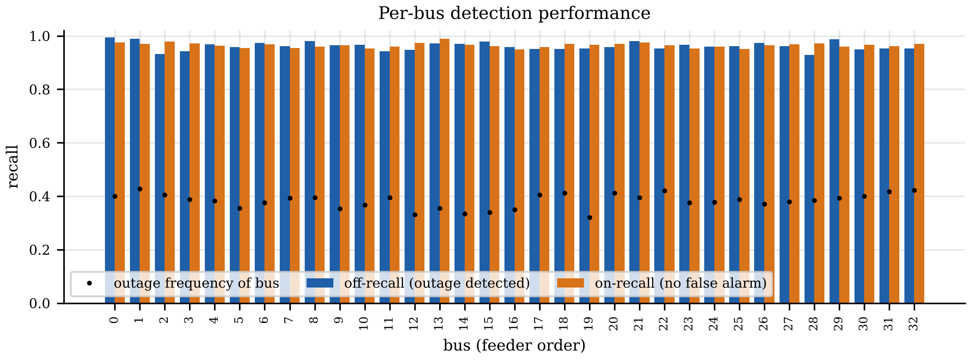
What the evaluator produces, automatically
Example output on synthetic predictions (not a trained model)
Runs after every train / finetune / evaluate test pass and after predict (--no-evaluate or evaluation.enabled: false to skip)
Writes confusion_matrix, roc_pr, probability_separation, reliability, scenario_errors, per_bus, voltage_status, plus metrics.json and summary.md
Logs every scalar as eval/<name> to MLflow with the figures as artifacts
Standalone: python -m gridfm_app_dist.io.vld_evaluation preds.parquet --outdir figs

Slide 30
Reading the report
evaluator metric | mirrors (loss / task) | what it tells you
accuracy, balanced_accuracy, mcc | VLD Target / Balanced Accuracy | headline; balanced accuracy is the one to select on
off_recall / off_precision / off_f1 | VLD Off Recall / Precision / F1 | outage detection rate and its purity
on_recall | VLD On Recall | 1 − false-de-energisation rate — the metric that exposes a bias toward outages
mean_prob_label_on / _off | VLD Mean Prob (reachable & label 1) | calibration in the shifted sense; near 1/(1+w_off) on label-1 buses means the class weight is pulling
roc_auc, ap_deenergised, brier, ece | — | threshold-free quality; AP on the minority class moves when the detector improves
vm_mae_true_off, vm_rmse_true_on | OFF Vm MAE, ON Vm RMSE | voltage head on each class
status_pred_threshold_mismatch | — | must be 0: exported hard predictions were made with the derived threshold
scenario_* and *_ci95_* | — | exact-match and per-scenario errors; cluster-bootstrap 95 % intervals over scenarios
Diagnosing a bias toward de-energisation: on_recall low → check VLD Off Class Weight (clamp binding?) → Conflict Rate (reach 0, label 1) (BFS missing paths?) → target_anchor_weight.

Slide 31
Roadmap
9 / 10
Draft — to be confirmed by the maintainers

Slide 32
Roadmap (draft)
Now
Next
Later
Reproduce paper results with the refactored loss (label-wins, derived threshold)
Release a pre-trained 33-bus checkpoint with the Colab tutorial
PyPI release with the data kit; docs site published
More feeders: meshed networks, European LV, IEEE-342; multiple load scenarios per topology
Grid-forming DG and intentional islanding (reachability_sources: ref_and_gen validated)
PBE masking on de-energised buses; joint-loss pre-training then VLD fine-tuning
Benchmark suite and reference metrics per network
Unknown-topology variants: topology_gating, learned switch states
Integration with reliability-assessment workflows (customer-interruption indices)
Notes:
These roadmap items were drafted from the paper's conclusion and the current state of the code; replace with the maintainers' plan.

Slide 33
Google Colab hands-on tutorial
10 / 10
examples/tutorial_vld/Tutorial_vld_colab.ipynb

Slide 34
What you will do in the next hour
1
Setup
4
Tune it
clone + pip install from GitHub, matching torch-scatter wheel (T4 runtime)
vary target_anchor_weight and on_vm_weight and watch the per-bus gradients
2
Generate data
5
Train a dummy model
contingency_data_gen on pandapower's case33bw, N-1 and N-2; inspect the parquet
gridfm_app_dist train, 32 / 2 / 2 for 6 epochs; read the four loss terms, class weight and threshold curves
3
Derive the loss
6
Pre-trained inference
five-bus example through the real VLDTopologyLoss: BFS labels, w_off, gradients, stationary point, threshold, conflict rule
gridfm_app_dist predict with the shipped checkpoint; read the automatic evaluation report; inspect one scenario
Open examples/tutorial_vld/Tutorial_vld_colab.ipynb in Colab → Runtime → T4 GPU → run top to bottom. Everything is computed live; nothing is pre-baked.

Slide 35
Let's build one
github.com/gridfm/gridfm-app-distribution → examples/tutorial_vld
Paper: Topology-Aware Graph Transformers for detecting voltage loss after distribution network failures (Kisuule, Bessa, Hernando-Gil)
Docs: install · CLI · YAML · applications (VLD task, loss parameters, data generation)

