Slide 1

Emotion-based recommendation system
Team 10 - Renaissance

Slide 2
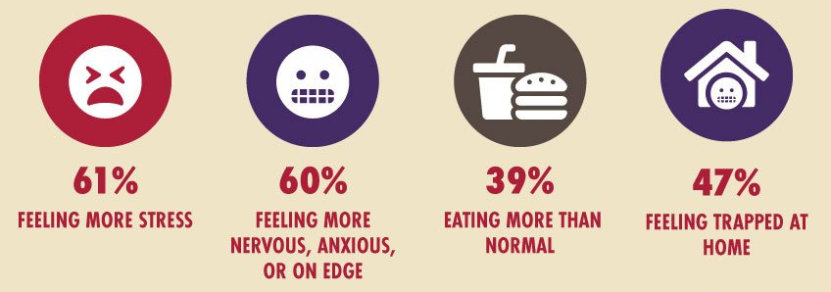
Problem statement
People are feeling stressed and depressed after staying inside for too long during the pandemic. It is important to find suitable remedies to aid their negative emotions.

Slide 3
2. Why this problem?
We want to raise awareness and address issues related to mental health because it is a crucial aspect of everyone’s life

Slide 4




3. Technical solution
Xception - Image
Google speech recognition - Voice
EmoRoBERTa - Text Sentiment Analysis
Emotion detector
Happy
Sad
Angry
XGBoost Classifier

Slide 5
4. Feasibility & Scalability
Feasibility:
Data availability: Face images, voice samples, Spotify playlists, Goodreads books, etc
Technical tools: Emotion detection, sentiment analysis models
Scalability: Used in cameras of households to monitor the emotion of users and recommend corresponding remedies

Slide 6
5. Future Work
More remedies: Food that can improve your mood, activities, therapy sessions, etc
Multimodal data analysis: Gestures and text messages for emotion detection
A system to record emotions through time

