Slide 1
TACTILES
TEAM-16
CHICKEN TENDERS
Team Members:
Nimisha Mittal
Veer Singh
Parth Singh
Aditya Kishore

Slide 2
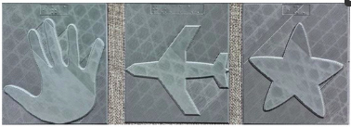
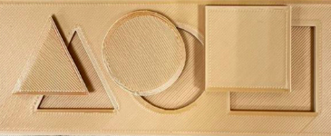
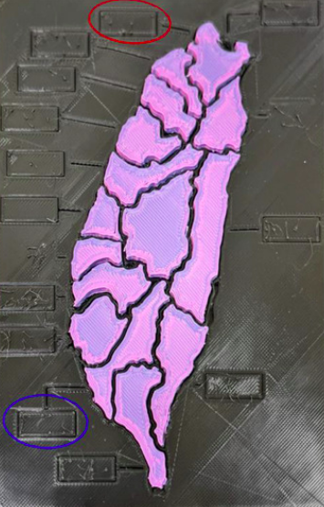
Problem Statement
The aim of tactiles is to create viable tactile models of given 2D images to enable the visually impaired in their pursuit of accessible and inclusive education.
Tactile models are education materials which utilize sense of touch and help the visually impaired perceive the world around them. Educators use tactile models to teach young children and those who are visually impaired about our world.
Examples of tactile models:
Screenshot from 2022-04-16 13-35-41

Slide 3
Motivation
World Health Organization data indicates that about 2.2 billion people have vision impairment, of which 11.5% (253 million people) are severely visually impaired or blind (VIB), and about 24.5 million are students
Current state of the art solutions are not aimed at creating tactiles for the visually imparied.
Tactile models have to be created manually which is time consuming and exorbitant process
Stl files are used for 3D printing, we aim to create these files without manual intervention
Cost of creating a tactile model of thickness 0.2 - 0.3 mm, is around $1,750 and upwards. Lack of technical skill to create tactile models aggravates the cost
Rural areas and isolated communities are at a great disadvantage

Slide 4
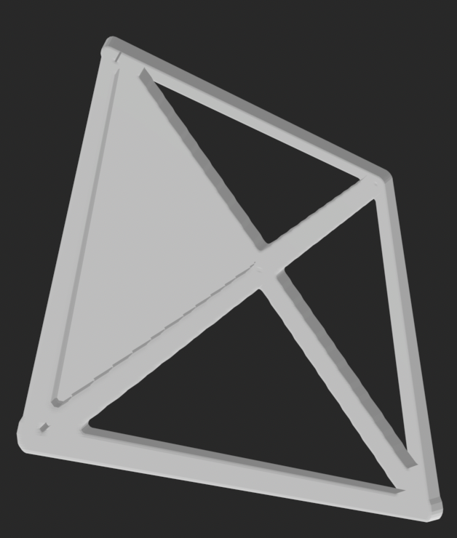

PIPELINE
READ IMAGE
Preprocess
Image
LM Filter
+
KMeans
3D Voxel
+
Marching Cubes
SAVE STL FILE

Slide 5
Technical Solutions
Images are uploaded on the website
Download and add to the repository
Let the algorithm do its magic
Upload Image
Tactiles created
3D voxel and marching cubes algorithms are used to create stl files for the segmented image
The created stl file will be available for download and will be added to the already existing library of stl files which can be used by other users
K-means with LM filters is used to segment image according to textures and patterns which is more suitable to the visually impaired

Slide 6
Social Impact
Vastly brings down the cost of 3D printing by removing the middleman for the visually impaired educational institutions
Cost of entry level 3D printers are only in the range of $100-$500
Easily navigable and intuitive website which can host a library of stl files
Also, provides options to create new stl file aimed for visually impaired for free
A library will be created for all the previously generated stl files and a new user can directly fetch from the library
Potential reach out to 24.5 million visually impaired students, educators and volunteers.

Slide 7
FUTURE WORK
Categorizing dataset of stl files for easy access
Optimize algorithms to improve preprocessing leading to tactile materials
Automate process to select number of clusters required using algorithm

