Slide 1
Developing future with solar solutions
Avacoders: Apurva Gupta
Asmita Chotani
Saurabh Koshatwar
Unnati Singhal

Slide 2
Problem Statement
As of 2020 Research, 3% of total US electricity comes from solar energy
Installation of solar panels are dependent on the weather condition and geospatial factors of the region.
It can be costly to install solar panels with wrong geographical conditions without analysing it first.
Are you ready to go green?
Is your location feasible and efficient to install a solar panel?

Slide 3
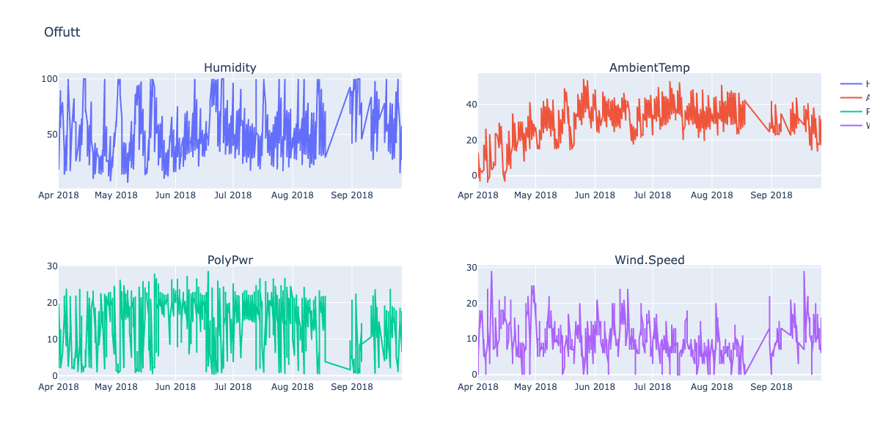
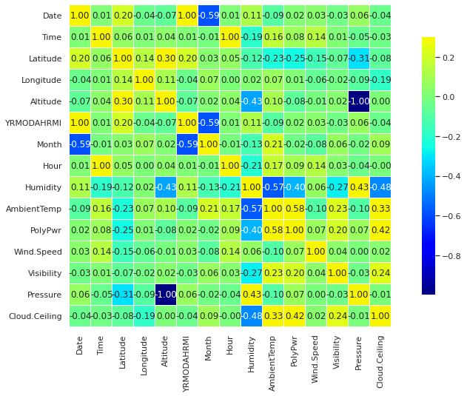
KNOW THE DATA
In our dataset, we have multiple factors that we are accounting to calculate the power output for the solar.
The factors are:
Longitude,Latitude,Altitude
Humidity
Ambient Temperature
Wind Speed
Visibility
Season
Pressure
Cloud Ceiling

Slide 4
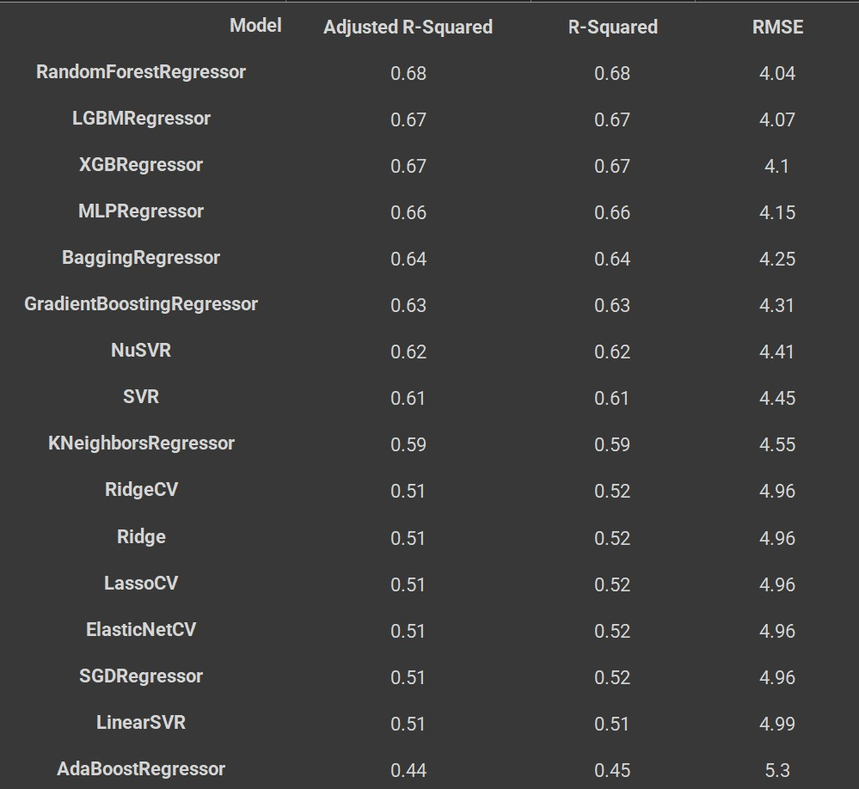
Technical Solution
Performed a Comparative study on numerous tree-based regression models, linear models and Time series models to predict the average power generated by the solar panel for 30 days.

Slide 5
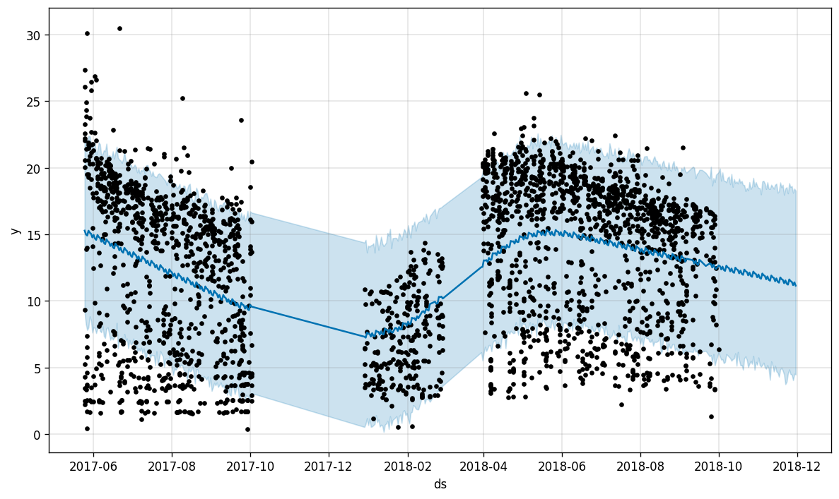
Analysis Support
LOCATION | FbProphet (RMSE value)
Camp Murray (WA) | 5.57
Grissom (IN) | 6.98
Hill Weber (UT) | 6.10
JDMT (FL) | 6.64
Kahului (HI) | 7.08
Malmstrom (MT) | 5.83
March AFB (CA) | 3.90
MNANG (MN) | 6.33
Offutt (IA) | 6.25
Peterson (CO) | 5.32
Travis (CA) | 5.16
USAFA (CO) | 4.20
Performed Prediction using FbProphet
Computed the efficiency of the model based on Root Mean Square Error.
The RMSE value for predicting average power over the numerous locations is 4.20
Prediction of Solar Power Supply using in USA

Slide 6
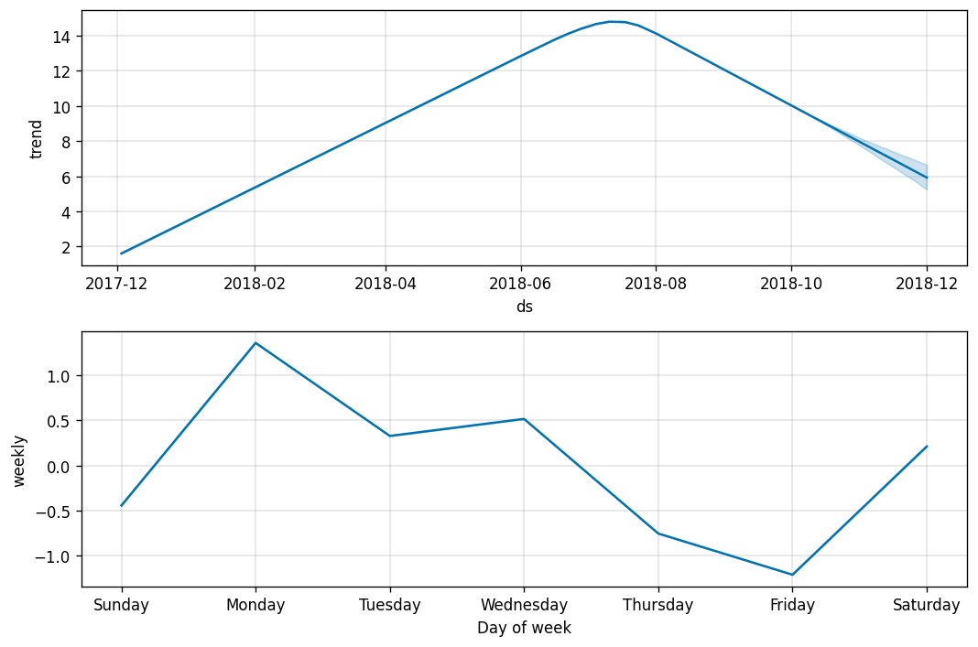
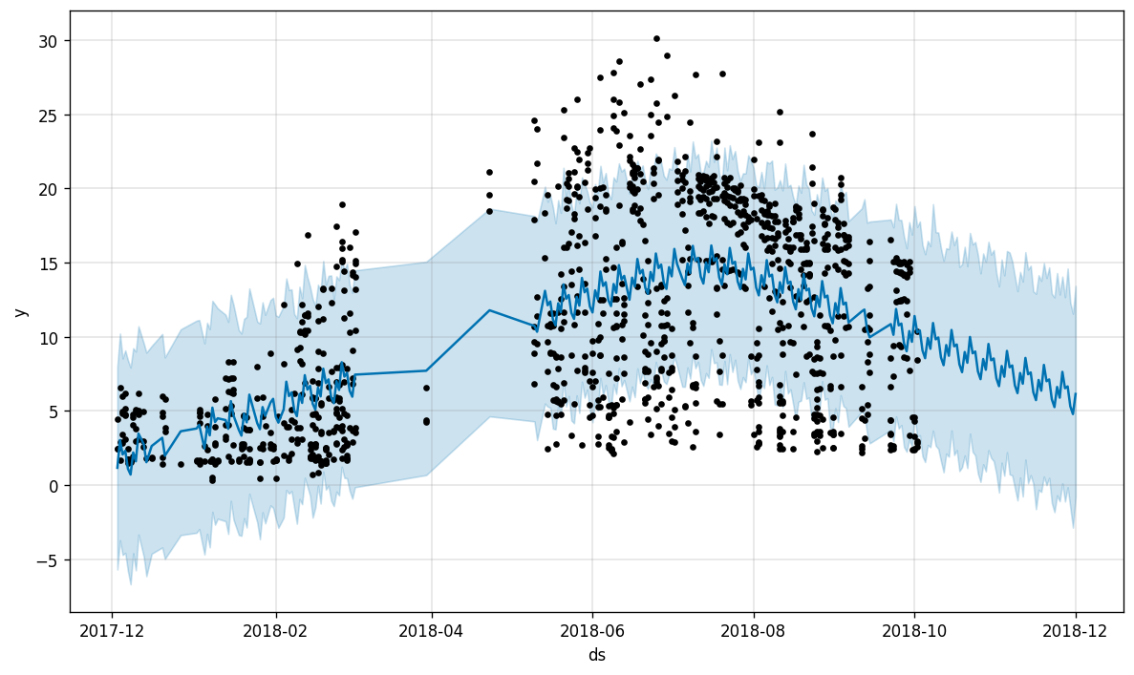
CAMP MURRAY POWER PREDICTION

Slide 7
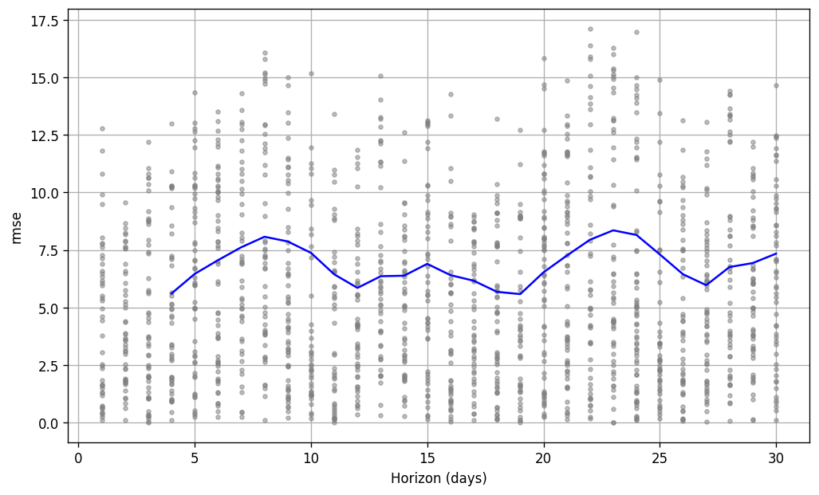
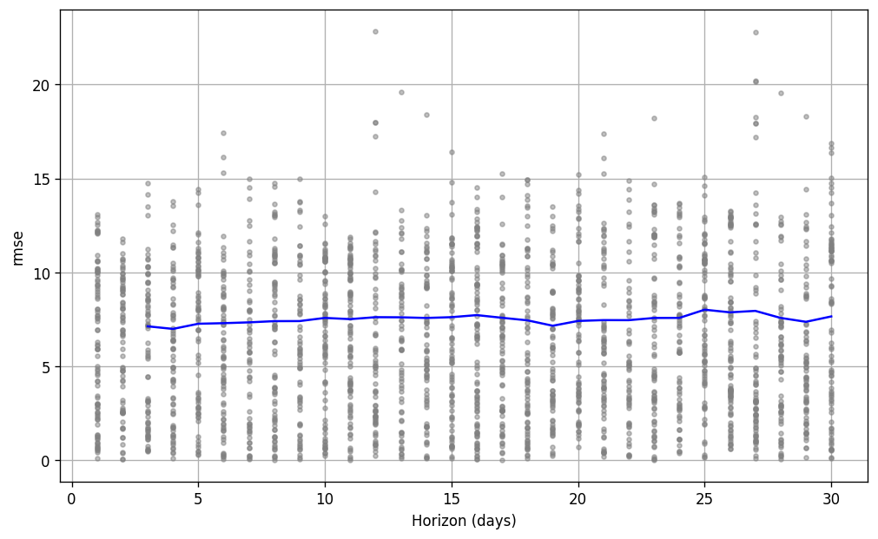
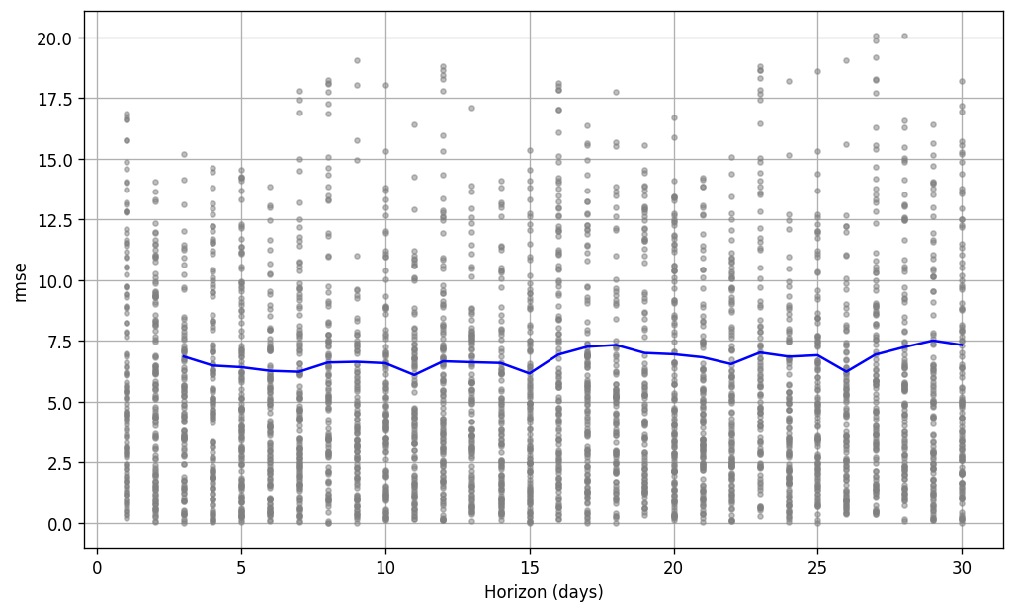
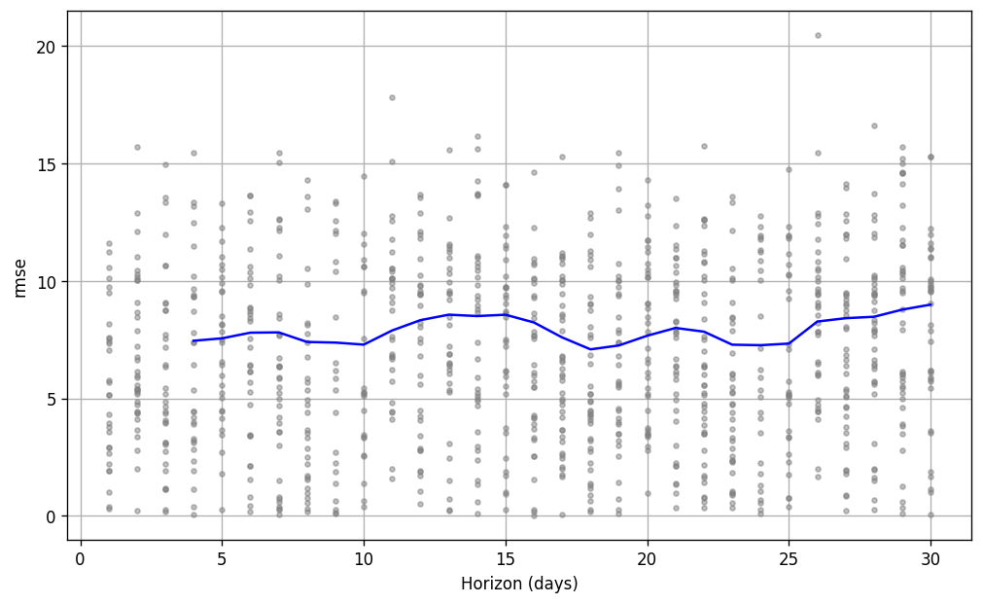
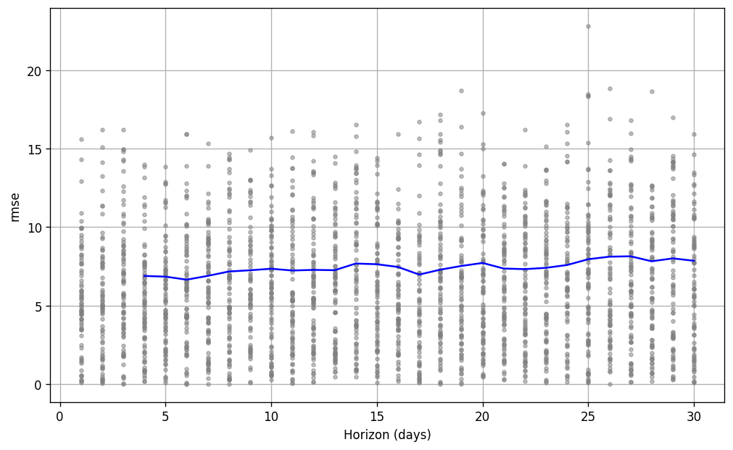
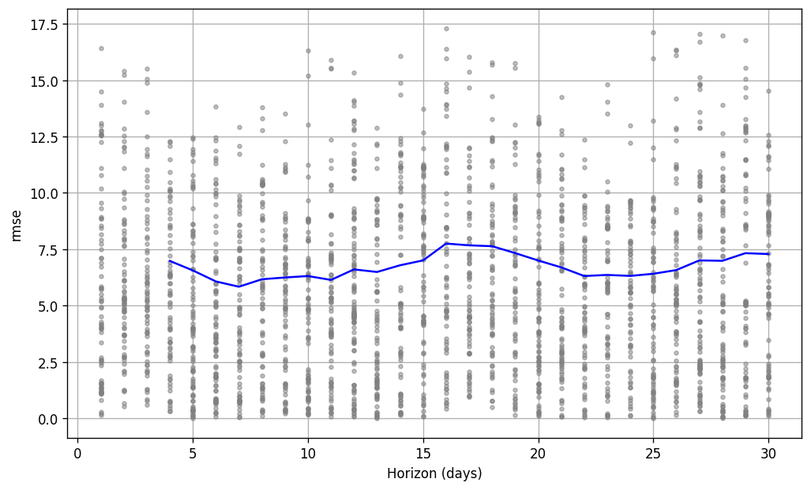
CAMP MURRAY
GRISSOM
HILL WEBER
RMSE TRENDS at various locations
JDMT
KAHULUI
MALMSTORM

Slide 8
Social Impact: We can now find feasible locations to install the solar panels which is a clean and carbon-free renewable energy.
Feasibility: The overall installation cost of the solar panels can be minimised over a span of 10 years in comparison to using electricity. Additionally, once installed, it has a very low maintenance cost.
Scalability: We have used geospatial data from 10 states around United States to find the feasibility of solar panel installation. It can be scaled to other countries creating an eco-friendly solution.

Slide 9
Future work
Having calculated the feasible locations to install solar panels, we can create awareness to people of that region to install solar panels as it is a greener and more sustainable source of energy. Moreover, the costs of installing the panels can be break-evened between 9 to 12 years propelling us towards a clean and carbon-free future!

