Slide 1
Computer Science 20
Brief introduction to LIsts

Slide 2
Variables
So far, we have been working with the idea that variables are containers that hold one piece of information at a time.
We also know that there are different types of information. Some basic types are: String, Boolean, Int, Float

Slide 3
The Need for More
However, this system is not always the best way to model information. Take, for instance, a system that is keeping information on a high school class:
student1 = “Jason”
student2 = “Skender”
student3 = “Chase”
student4 = “Wilson”
student5 = “Kolten”
student6 = “Yekta”
student7 = “Kade”
student8 = “Dakota”
student9 = “Shirley”
student10 = “Corbin”
student11 = “James”
and so on….
Using a separate variable for each student’s name requires a large number of variables.
Imagine a condition that checks to see if “Tristen” is part of the class:
If (student1 == “Tristen” OR student2 == “Tristen” OR student3 == “Tristen” OR student4 = “Tristen” OR student5 == “Tristen” OR…etc…):

Slide 4
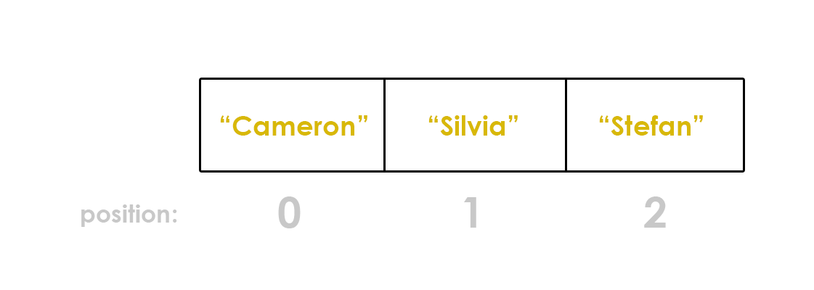
Compound Data Structures
Computer Scientists have developed several more complex structures for organizing information. In Python, one powerful option is the list.
A List is a sequential collection of (ordered) data elements.
names = [“Cameron”, “Silvia”, “Stefan”]
-3 -2 -1

Slide 5
Accessing Elements
Each element in the list names has an index, which can be used to access it:
print(names[1]) #prints “Silvia”
print(“Hello, “ + names[2]) #prints “Hello, Stefan”
To see the contents of a list, you can print the entire list:
print (names) #prints [“Cameron”, “Silvia”, Stefan”]

Slide 6
Adding Elements
Lists can be created as empty lists: favourite_food = [] #creates an empty list called favourite food
Elements can be added to a list by using the .append() list function
List functions can be used on any List
favourite_food.append(“Perogies”)
favourite_food.append(“Eggs Benedict”)
print(favourite_food) #prints [“Perogies”, “Eggs Benedict”]
Exercise:
Create a list called favourite_places
Add six different elements (Strings) to this list
Print out the list.

Slide 7
Removing Elements
The pop() method can be used to remove an element at a specific index position: my_list = [“Banana”, 5, True, True, 3.14] my_list.pop(1) my_list.pop(3) my_list.pop(-1) print (my_list)
#prints [“Banana”, True]

Slide 8
List Exercise
ADD AND REMOVE
LISTS CHEAT SHEET
my_list = [] creates an empty list called my_list my_list.append(“apple”) adds something (like a string) to the end of a list.
my_list.pop(index) removes the item stored at position index in an array. all trailing items will be shifted left. len(my_list)
returns the number of items in a list
Design a program that does the following:
Creates an empty list called things
Using input, ask the user to enter 5 strings and append them to things
Print the list
Using input, ask the user to enter 2 different numbers between 0 and 4
With the pop function, remove the elements at the indices of those two numbers.
Print the modified list.

Slide 9
Slicing
There will be times that we want to access a sub-list (part of a list).
In python, we can achieve this through the slicing operator.
sub_list = original_list[ start : end ]
Up to (but not including) this index.
New list to store the resulting sublist.
Start at this index.
Source list from which to get the sublist.
Square brackets – the index operator

Slide 10
Slicing
my_list = [“a”, “f”, 99, “apple”, True, “c”]
0 1 2 3 4 5
-6 -5 -4 -3 -2 -1
my_list[1:4]
Gives us: [“f”, 99, “apple”]
my_list[-4:-1]
Gives us: [99, “apple”, True]
my_list[:2]
Gives us: [“a”, “f”]
If first value is omitted, the slice will begin at the start of the list.
my_list[4:]
Gives us: [True, “c”]
If second value is omitted, the slice will go up to (and include) the last list element.

