Slide 1
Computer Science Coding and Robotics
Getting Started
Welcome to the course; let’s get started!

Slide 2
Why study computing?
Develop new set of problem solving skills
Improve logical thinking
Strengthen mathematical abilities
Gain deeper fluency with technology
Not just use, but to create
See how we can use computing to accomplish some amazing things!

Slide 3
What will we be doing?
In this course we will investigate the potential of computing:
Software → by learning a few Programming Languages
Electronics → circuit-building and electricity
Physical Computing → combining coding and electronics to create more sophisticated projects and robotics applications.

Slide 4

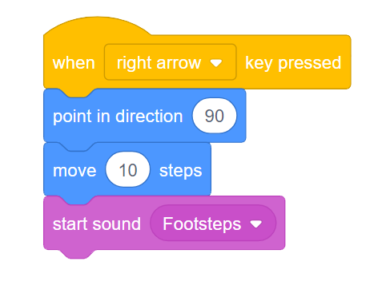
Visual Programming
Scratch
We’ll begin the class by learning block-based (or visual) programming, using Scratch
This tool was developed at the MIT media lab
Programming instructions are represented as blocks, which can snap together
Large community with an emphasis on sharing and collaboration
High ceiling and low floor
An excellent starting place for novices
However, is aIso capable of creating quite complex projects

Slide 5
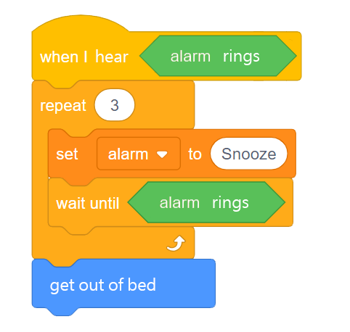
Big Idea: Algorithms
When we are trying to solve a problem, typically we can do so by constructing an algorithm.
With algorithms, we take the idea of how to solve a problem, and break it into a list of individual steps
You already use algorithms, for day-to-day tasks like making lunch, how to wrap a present, or getting ready in the morning.

Slide 6
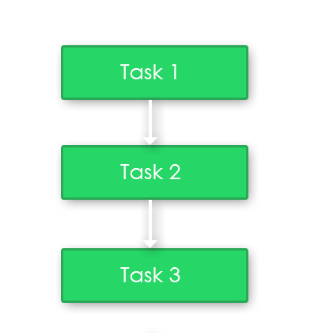
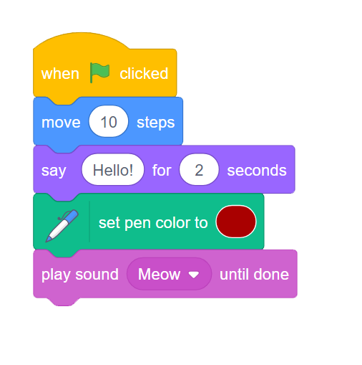
Sequential Instructions
Algorithms for completing a task often include a sequence of instructions that are completed one after another.
The program will move on to the next instruction only when the current one is ‘complete’.
Most instructions will happen almost instantaneously. Notable exceptions are:
Blocks that last for a certain number of seconds.
Blocks that have the “until done” modifier. In this case the program will wait until the sound file has played through fully before moving on.

Slide 7
First Scratch Program
Lead through very simple demo using:
Move If on edge, bounce (forever loop)
Color change / wait / in a forever loop
Pressing left/right → turn left/right (events)
-could have a little video showing playback
Let’s jump right in and create a first program in Scratch
Notes:
Lead through very simple demo using:
Move If on edge, bounce (forever loop)
Color change / wait / in a forever loop
Pressing left/right → turn left/right (events)
-could have a little video showing playback

Slide 8
Computer Science Coding and Robotics
More about Motion
Location, Direction, Data

Slide 9
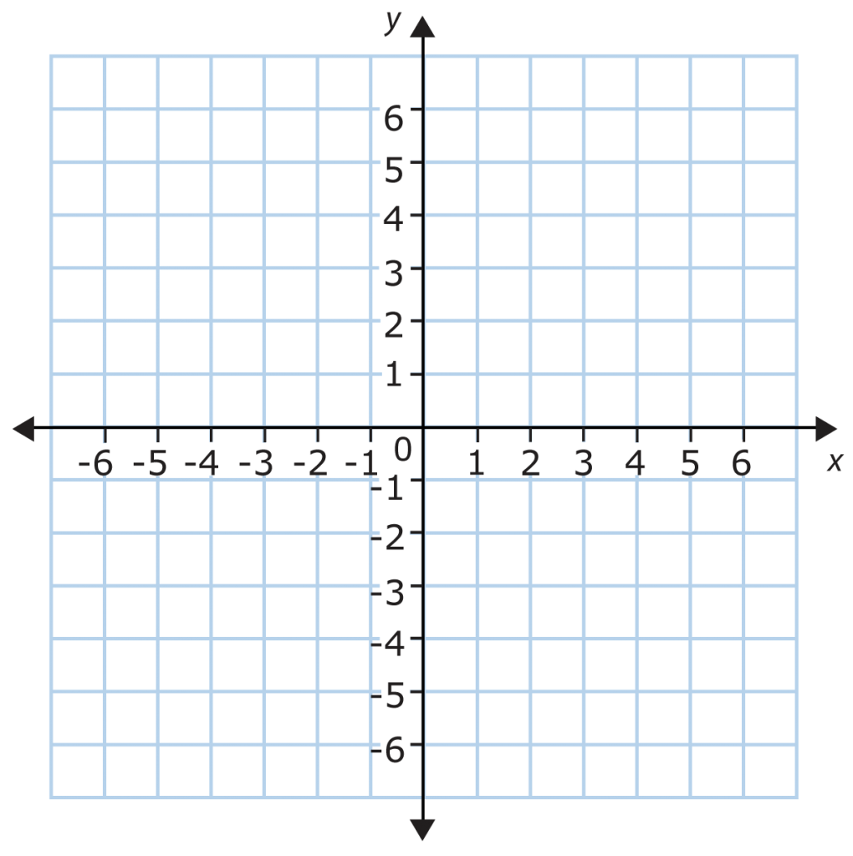
Coordinate Systems
+180
There are several different systems for describing a visual location in space.
Scratch uses the Cartesian Coordinate System, where the origin (0,0) is located in the very middle of the stage.
Stage size is 480x360 pixels.
-240
+240
-180
Notes:
After this slide, jump to Scratch and show moving a sprite around by just using the X,Y fields in the sprite info palette
Also, how to toggle visibility and modify size

Slide 10
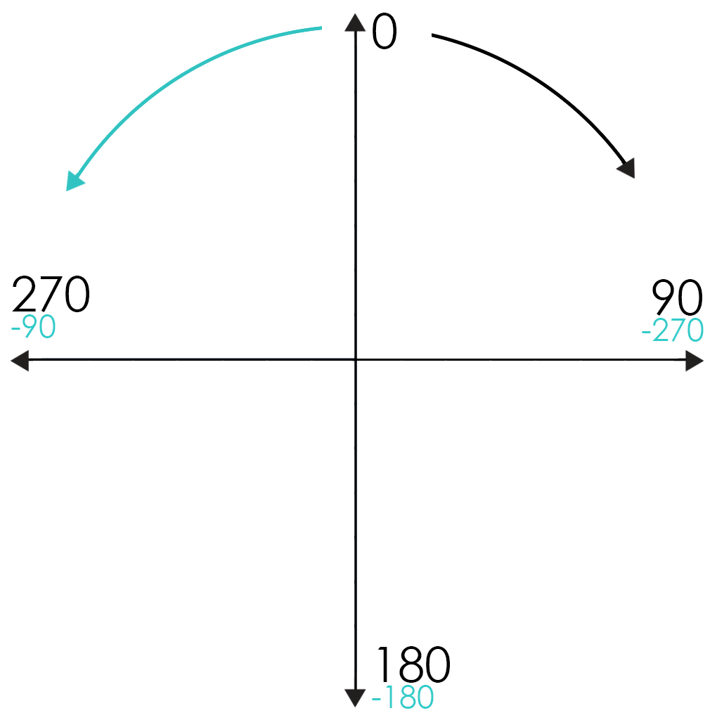
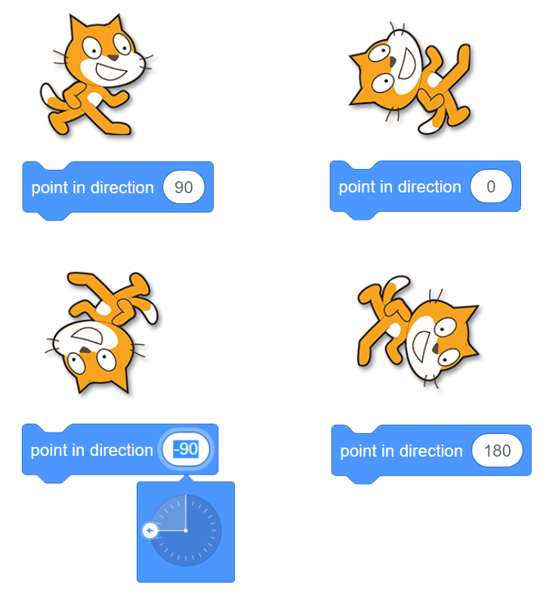
Directions
Directions in Scratch are described using the following compass angles:
When setting angles, this tool helps to visually determine appropriate values

Slide 11
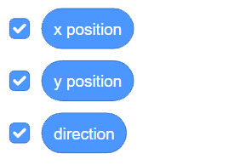
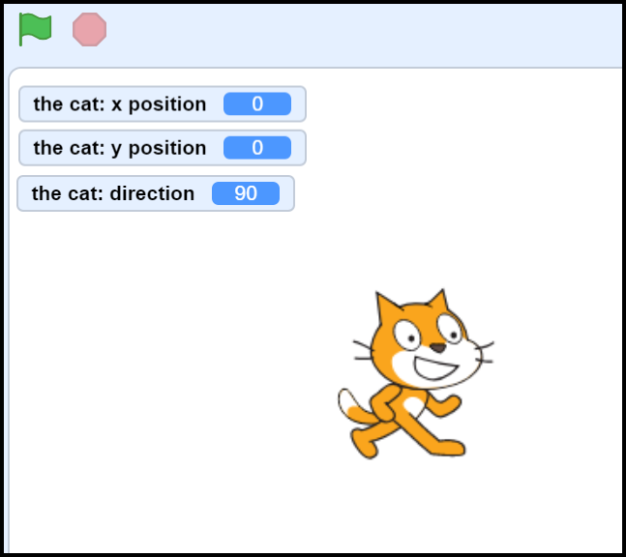
Knowing where a sprite is
Each sprite has the following motion properties:
X position – the sprite’s horizontal location.
Y position – the sprite’s vertical location.
Direction – the current way that the sprite is facing.
Toggling the checkbox will display the current value on the stage
Good for debugging!
These blocks can also be used inside certain other blocks…

Slide 12
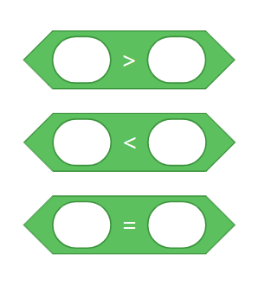
Is it True?
Many times we will want to compare two pieces of data. Scratch provides some basic comparison operator blocks which are perfect for this:
You can either type values into the empty fields, or drag in data blocks like these:

Slide 13
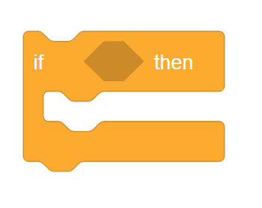
Shrinking the sides
Comparison blocks are hexagonal in shape. Look through the different blocks and see where this shape can fit in.
Typically these are used in Scratch for making decisions.
One example is an IF statement.
Let’s try a simple demo where instead of bouncing off the walls, we have a sprite that bounces off of a smaller, invisible boundary.

