Slide 1
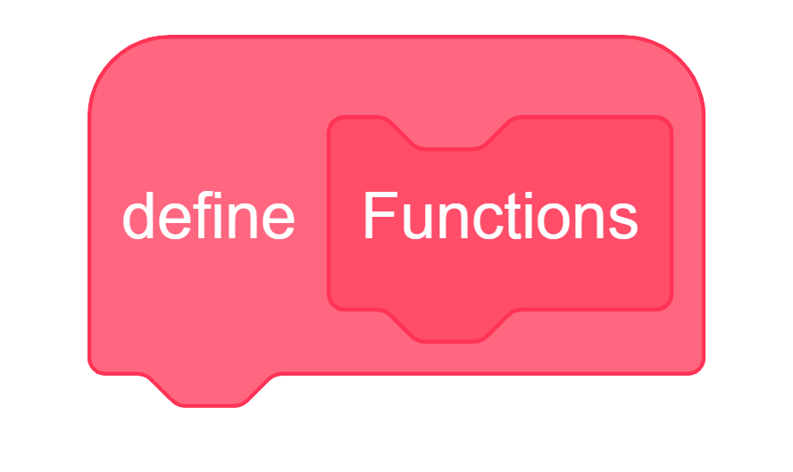

Slide 2
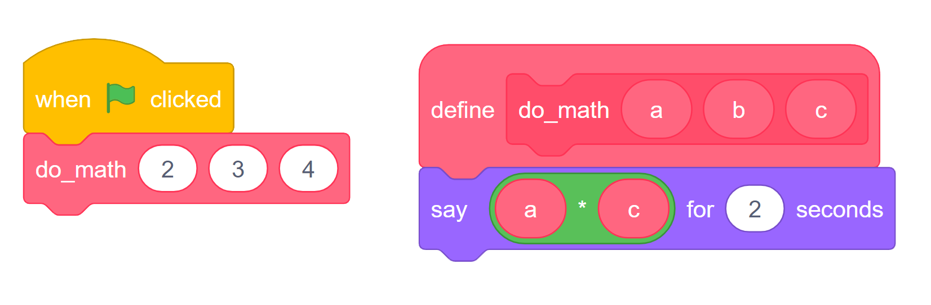

Slide 3
2
3
4
2
4
Notes:
8

Slide 4
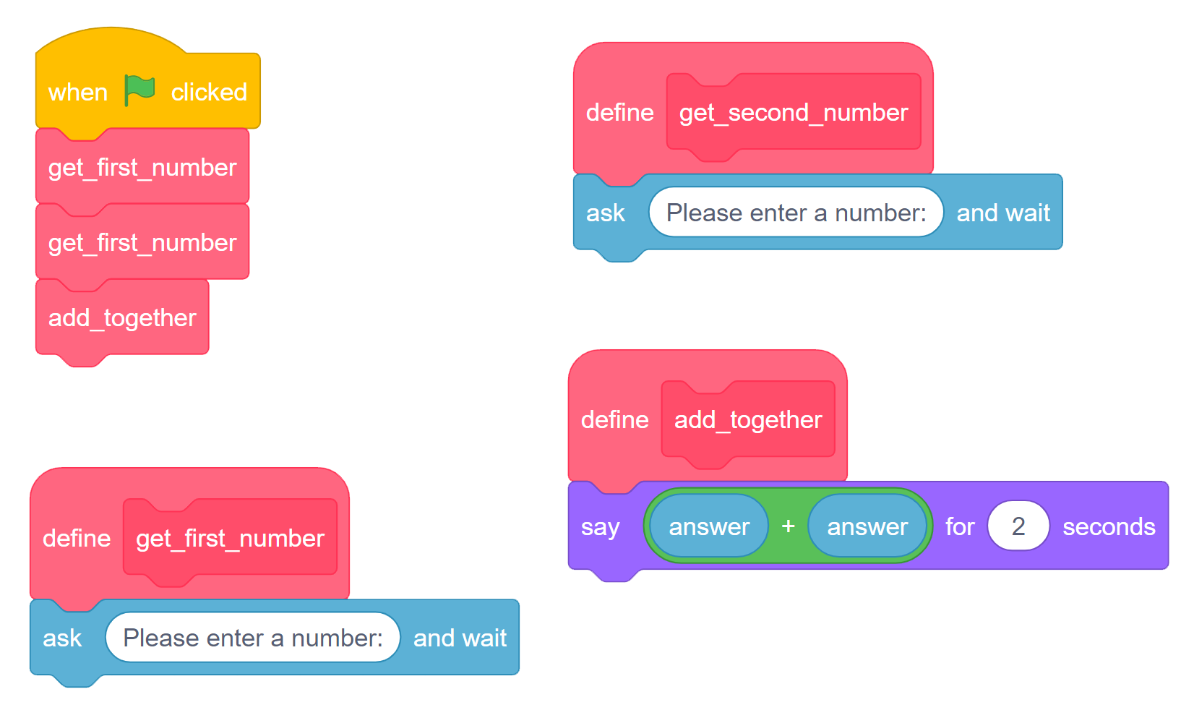
user enters: 7
user enters: 5

Slide 5
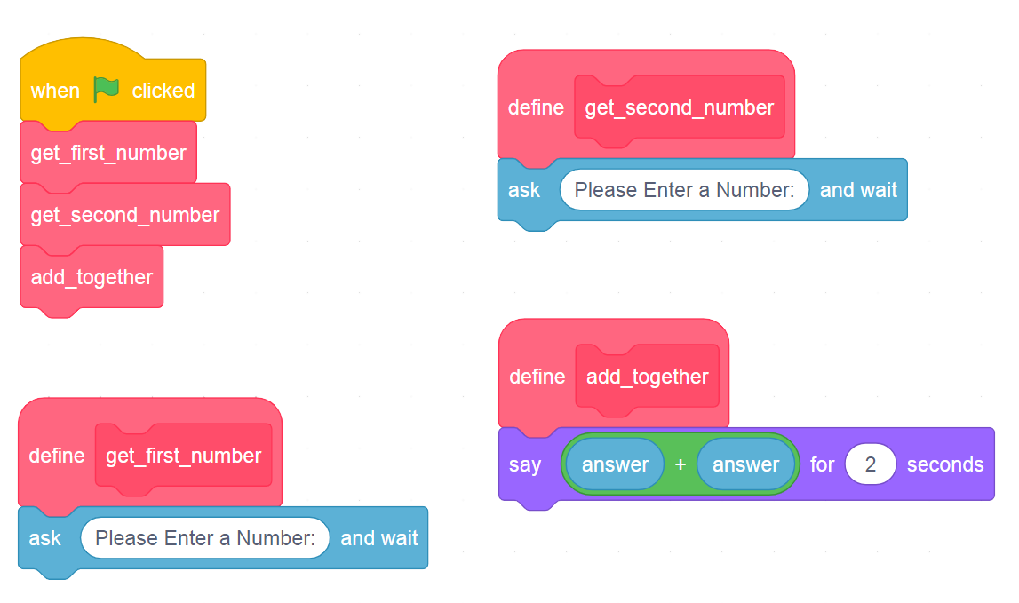
user enters: 7
7
7
user enters: 5
Notes:
Answer only holds most recently entered user input value

Slide 6
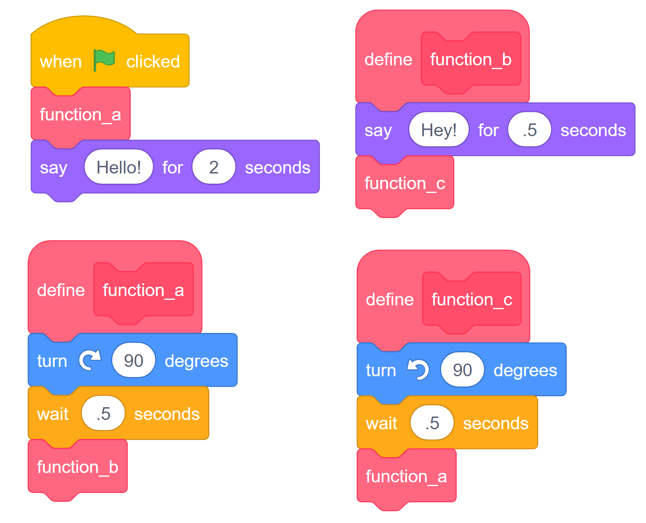
What will happen when the green flag is pressed?
Notes:
The code called in a function must complete before the next block will occur, so the “Hello” block will unreachable.
Functions a, b, and c cycle in continuous loop.

