Slide 1
Computer Science 20
FUNCTIONS AND INFORMATION SHARING

Slide 2
Functions
Functions allow us to build reusable code in our programs.
We’ve had some preliminary experience in working with functions in Reeborg. Setting them up in Python is very similar:
def greeting():
name = input("What is your name?")
print("Hi there, " + name + "!")
Immediately after the def keyword comes the function name. Make sure not to use any reserved words.
def keyword signifies we are about to create a function.
function body is indented. First line of code not indented signifies the end of the function.

Slide 3
Functions
RULES AND BEHAVIOURS
Code in a function body is only run when the program encounters a function call (not when the function definition is first seen).
def greeting():
name = input("What is your name?")
print("Hi there, " + name + "!")
print(“Welcome to this program“)
greeting()
Print(“Nice to meet you! “)
The first time the computer sees this code, it does not execute it, but makes record that this code may be called at some point(s) later in the program.
When this line is reached, it will jump the current location of execution to the function above. Once the function is completed, program flow will return here and proceed to the next line.

Slide 4
Functions
RULES AND BEHAVIOURS
Function definitions should occur early in a program. A function call will not work if it occurs before the definition is encountered.
print(“Welcome to this program“)
greeting()
def greeting():
name =input("What is your name?")
print("Hi there, " + name + "!")
Python programs are interpreted by the computer one line at a time, top to bottom.
In this case, the computer will have no knowledge of the greeting() function, as the definition hasn’t been encountered yet!
Error on this line

Slide 5
Functions
EXERCISE
Create a program with three user-defined functions:
fortune_one()
fortune_two() each of these functions should print out
fortune_three() a ‘fortune’ for the user.
When the program is run, tell the user that they are going to be told three fortunes. Call each of the user-defined functions.

Slide 6
Functions
VARIABLE SCOPE
When information is stored in a variable, it is only visible in certain locations in your code. This is called variable scope. Variables also may exist for differing amounts of time, this is called variable lifetime.
a = 2
b = 3
def my_function():
c = 4
print(c)
print(b)
print(b)
Variables declared in the main body of the program are global variables and are accessible throughout the main body of the program by default. Their lifetime will be the whole execution of the program.
Program Output:
4
3
3
Variables declared within a function are local variables to that function. They are created when the function is called, and then cease to be stored once the function execution is complete.

Slide 7
Functions
VARIABLE SCOPE
It is possible to have multiple variables with the same name if their scope is different:
b = 3
def my_function():
b = 4
print(b)
def function_two()
b = “apple”
print(b)
my_function()
function_two()
print(b)
Global variable
Program Output:
3
4
apple
Local to my_function()
Local to function_two()
Python will always assume reference to local variable over global if there is one.

Slide 8
Functions
EXERCISE
Create a program that will allow three different individuals to be greeted. Create one user-defined function called greeting().
In the main body of your program, ask the user to supply a first name and store it in a global variable called name.
After the user input is gathered, call the greeting() function. This function should reference the global variable name and print out “Nice to meet you, ________”
Have your program repeat this sequence 3 times. Only use one variable (just overwrite it) and one function.
Sample Run Example:
>>> Enter a name: Mr. Scott
>>> Nice to meet you, Mr. Scott
>>> Enter a name: Francis
>>> Nice to meet you, Francis
>>> Enter a name: Martha
>>> Nice to meet you, Martha
>>> Program complete.

Slide 9
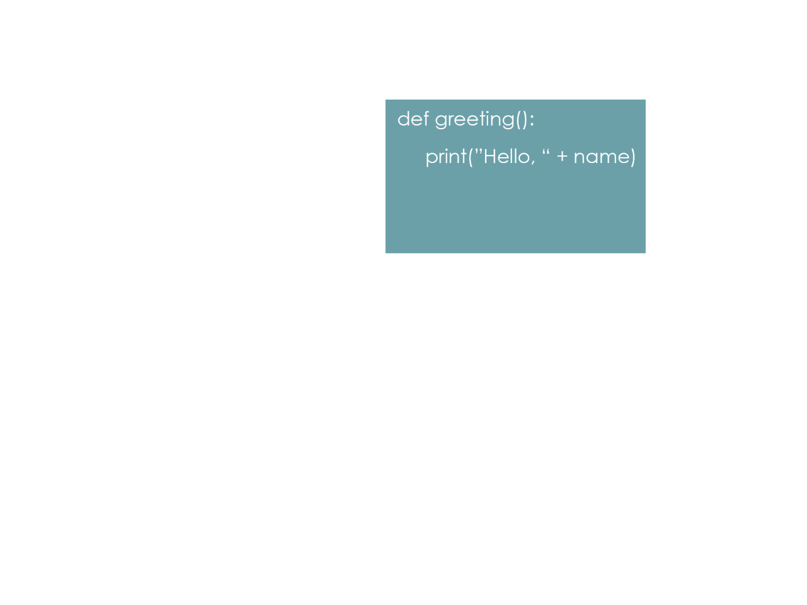
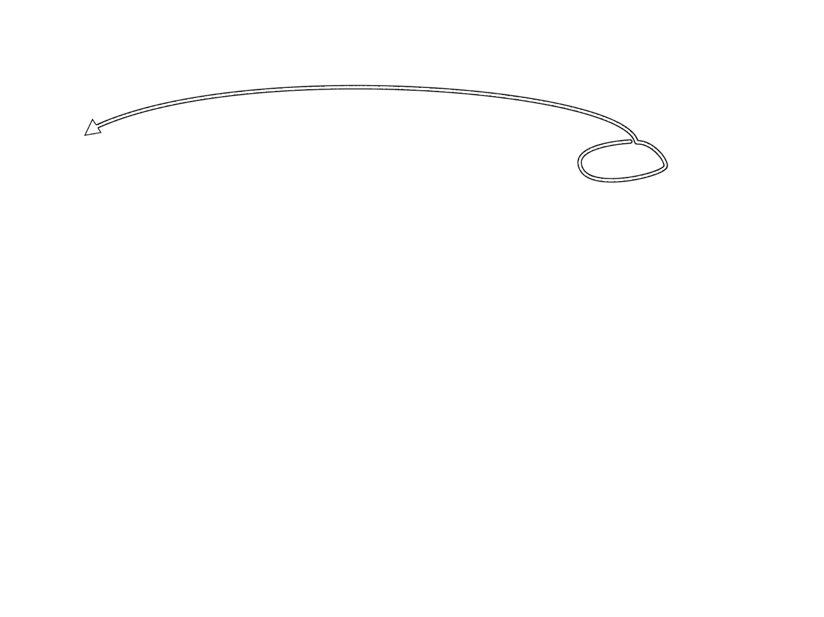
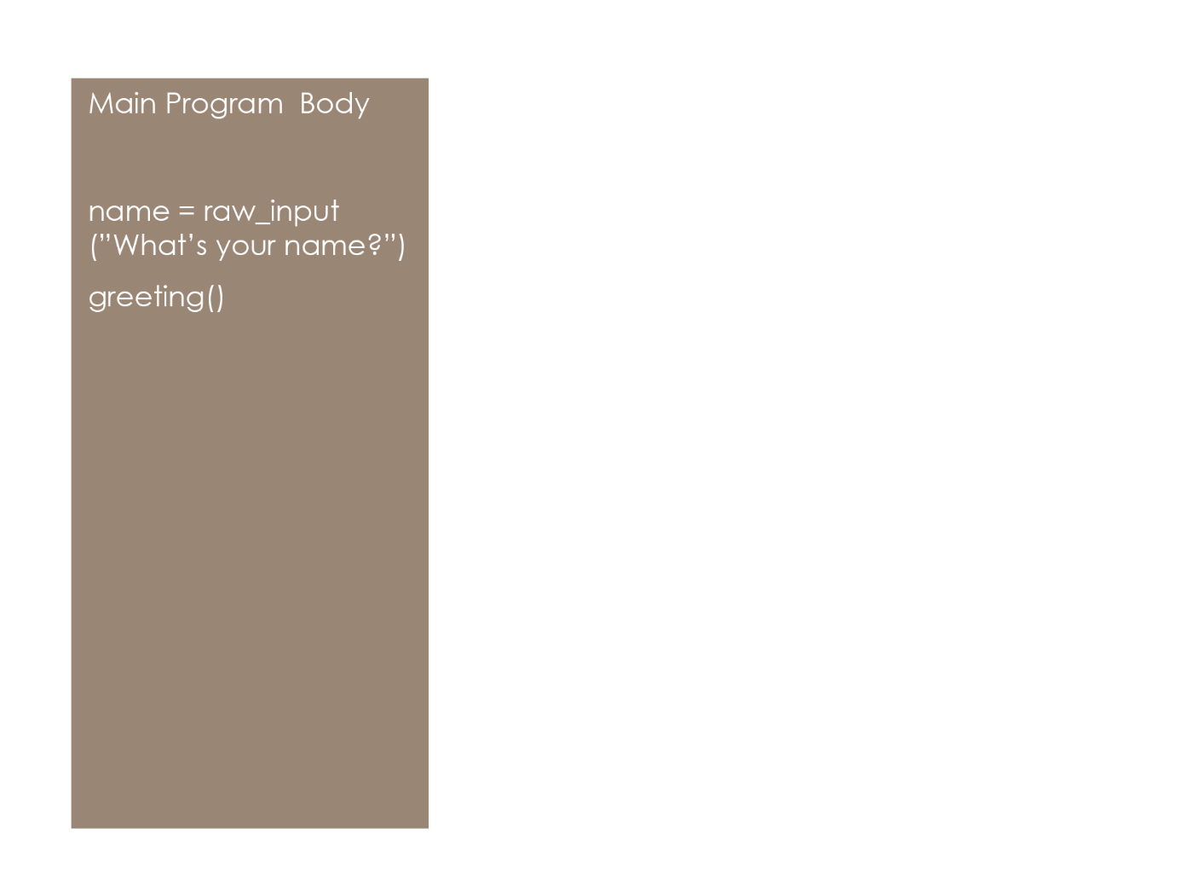
Functions
INFORMATION SHARING BETWEEN GLOBAL AND LOCAL SCOPE
When referencing a global variable from a function, the actual memory location is addressed.
However, if you want to modify the contents of a global variable from a function, you must take one additional step.

Slide 10
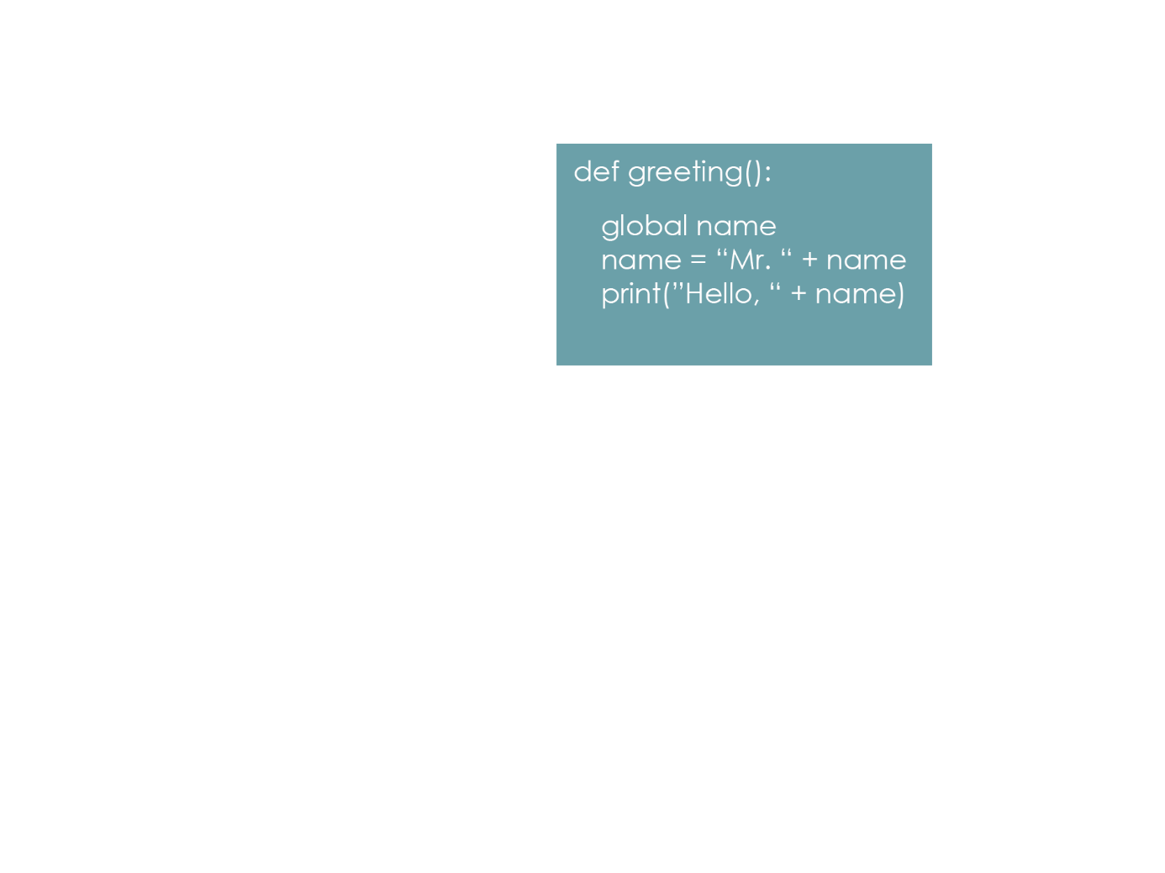

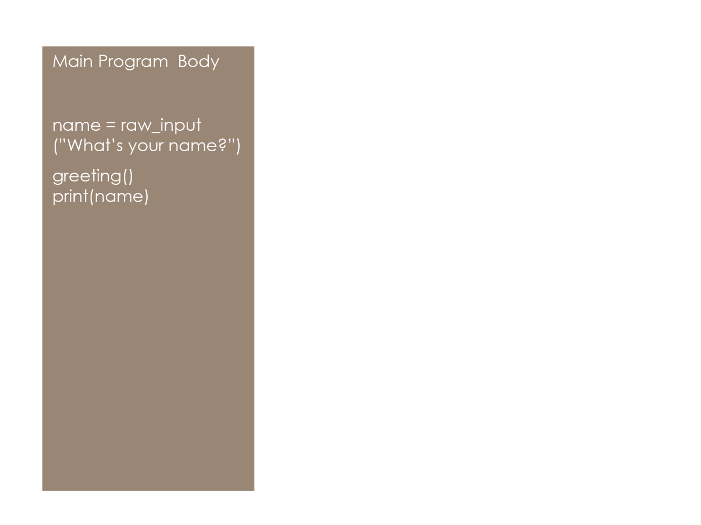
Functions
INFORMATION SHARING BETWEEN GLOBAL AND LOCAL SCOPE
Using the global keyword in a function indicates that the global variable will be used in the function, and may be modified.
When this line is reached, the value stored in name will have been modified (with “Mr. “ prepended to it)

Slide 11
Functions
EXERCISE AS A CLASS
Create a program that asks the user for two numbers, store this input in two variables: num1 and num2
Create a third variable – sum – and give it an initial value of 0.
Create a function called add_numbers() which will access the global variables num1 and num2, add them together and store the result in sum.
Call the add_numbers() function. After this function is complete, have the program print out the updated value in sum.
Sample Run Example:
>>> Enter a number: 13
>>> Enter a number: 11
>>> Computing…
>>> The sum is: 24
>>> Program complete.

Slide 12
Functions
EXERCISES ON YOUR OWN
Create a program that asks the user for three numbers, store this input in three variables: num1, num2 and num3
Create another variable called result, and initialize it to 0
Create a function called strange_math that will multiply the first two numbers, then divide the result by the third number. Store this value in the global variable result.
After the function call, print out the updated value of result.
Sample Run Example:
>>> Enter a number: 6
>>> Enter a number: 7
>>> Enter a number: 21
>>> Computing…
>>> Strange Math is: 2
>>> Program complete.

