Slide 1
Computer Science 20
FUNCTIONS AND INFORMATION SHARING

Slide 2
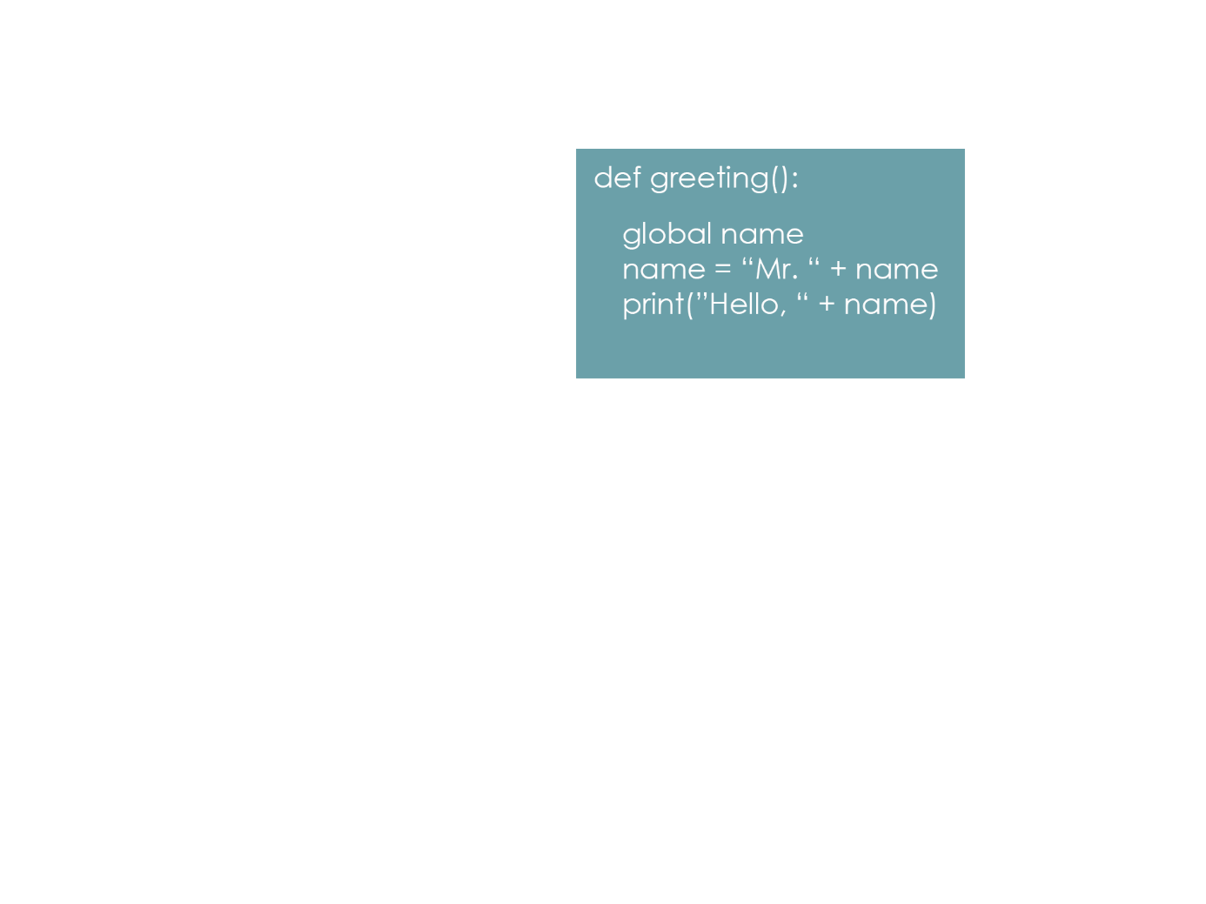

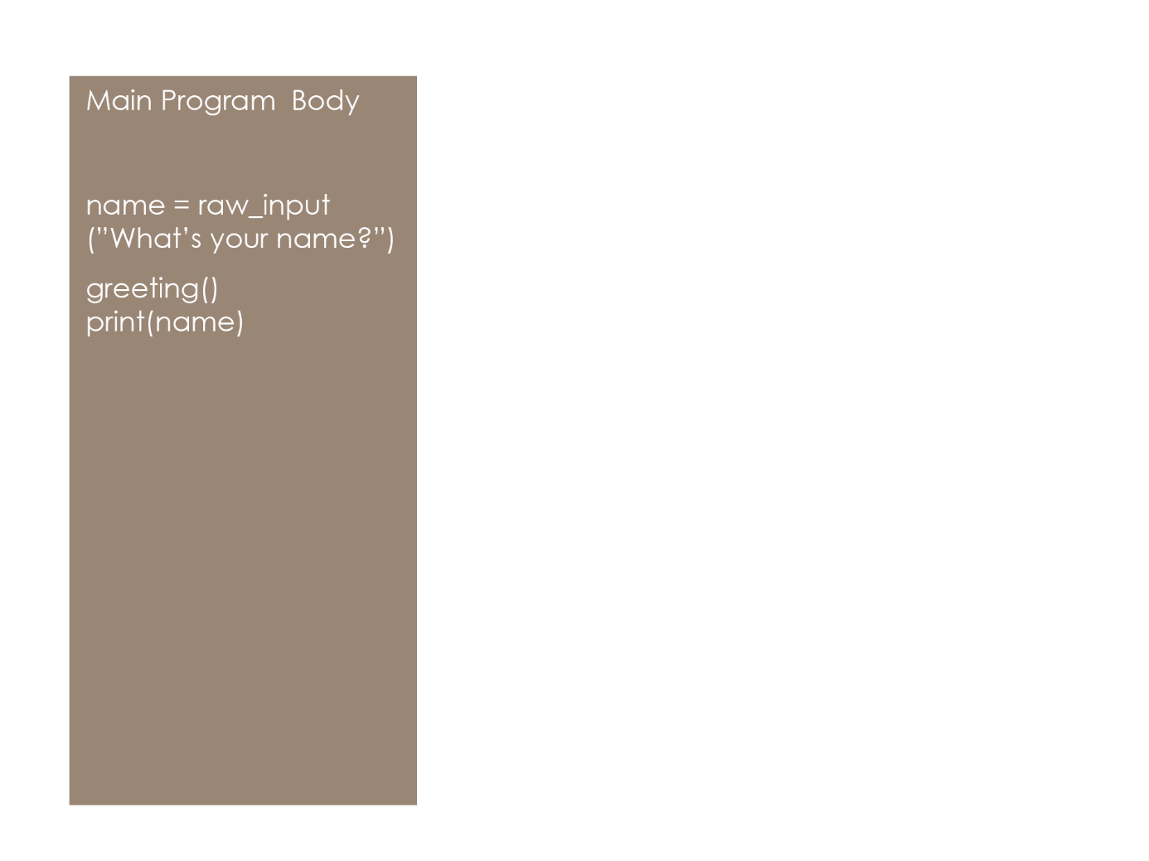
Functions
ARGUMENTS, PARAMETERS, RETURN VALUES
Recap: Accessing and Modifying global variables
Using the global keyword in a function indicates that the global variable will be used in the function, and may be modified.
When this line is reached, the value stored in name will have been modified (with “Mr. “ prepended to it)

Slide 3
Functions
GLOBAL ISSUES
Although using and modifying global variables is simple, their usage is generally considered bad practice! Why?
Being able to access and modify global variables from anywhere in the code makes readability and maintainability much more difficult.
In larger-scale programs (possibly with several developers), the possibility of mixing up local and global references increases drastically.
(Advanced) For more information, see here.

Slide 4
Functions
INFORMATION PASSING
There is another technique for accessing and modifying data in different program scopes, called information passing.
To pass information into a function, we send it in as arguments:
def greeting(name):
print(“Hello, “ + name)
greeting(“Mr. Scott”) n = “Francis” greeting(n)
Parameter
Program Output:
Hello, Mr. Scott
Hello, Francis
Arguments

Slide 5

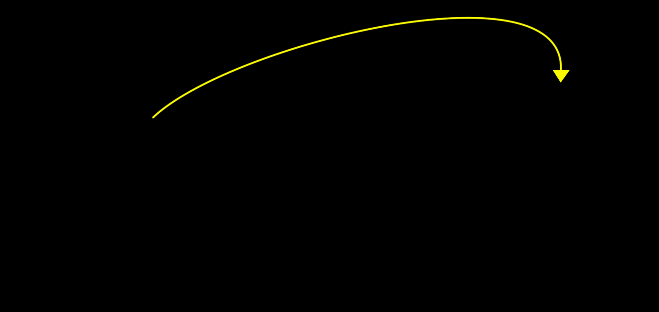
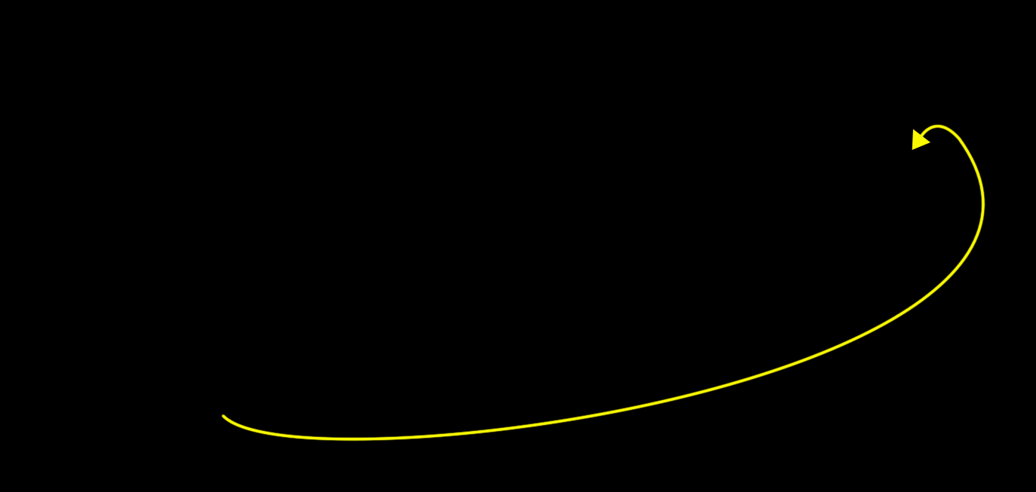
Functions
Argument values inside the parenthesis () on a function call are copied into the corresponding parameter local variable in the function.
INFORMATION PASSING
one = 15
two = 10
add_10(one)
add_10(two)
add_10(25)
def add_10(num):
print(num + 10)
Note: When a variable is passed in as an argument, only the value contained in the variable is communicated.
There is no reference to the variable itself passed in, so the source variable can’t be modified from inside the function.

Slide 6
Functions
EXERCISE AS A CLASS
Create a program with a function called multiplier() that has two parameters: num1 and num2. The function should multiply the two values passed into those arguments and print the result to the screen.
Ask the user to input two values, and store these values in two variables, input1 and input2.
Call multiplier() three times, with the following argument values:
literal integer values – 13 and 23
variables – input1 and input2
string and integer values – “Hey!” and 5
Sample Run Example:
>>> Enter a number: 13
>>> Enter a number: 23
>>> Result: 299
>>> Enter a number: Hey
>>> Enter a number: 5
>>> Result: ???
Predict:
What do you think will happen when using the * operator with a string and an integer?

Slide 7
Functions
RETURN VALUES
Information can be passed into functions through use of arguments.
To send information back to the main program from inside functions, we use the return keyword.
Return stops the function, and sends information back to the line of code that called the function.
result = add_10(40)
print (add_10(4))
add_10(25)
def add_10(num):
return (num + 10)
# stores 50 in result
# prints 14 to screen
# nothing is done with return value, so no output
When a function has a return statement, the actual function call gets replaced with the return value:
print (add_10(5) * add_ten(0)) becomes print (15 * 10) print (150)

Slide 8
Functions
EXERCISE AS A CLASS
Create a function called larger_than_10(num) that takes one integer argument.
If the value of num is greater than 10, return True. Otherwise, return False.
Ask the user for a number and print out the result of passing it into larger_than_10().
Sample Run Example:
>>> Enter a number: 13
>>> Is it larger than 10: True
>>> Enter a number: 2
>>> Is it larger than 10: False
Note: IF statements in Python use the following syntax:
if test: #test is any valid Boolean Expression
code #code to run if the test is True must be indented one level code

Slide 9
Exercise
ALARM CLOCK PROBLEM
PYTHON CHEAT SHEET
def function_name (var1, var2, …) : creates a user-defined function
input(String) get user input from keyboard print(String) displays a String on screen 35 % 24 (35 % 24 == 11) mod gives remainder on division return ______ (value or variable) ends function and returns result
int(String) Converts a String to an Integer
Create a general solution for the alarm clock problem:
Define a function called alarm(cur_time, alarm_length) that will return the time of day that the alarm will go off.
Ask the user for the current time and store it in a variable.
Ask the user for how many hours later the alarm should go off and store it in a variable.
Call your alarm() function and pass in the user input as arguments. Print out the value that is returned.
HINTS
Using modulus division can be very handy: x % 24 will always result in a value between 0 and 23.
Once you know what the time is on a scale of 0 to 23, use an IF statement to determine AM or PM.
0-11: AM 12-23: PM

