Slide 1
Computer Science 20
Conditionals

Slide 2
Conditionals
Boolean values: True or False (note: Capitalization is important!)
A Boolean Expression is an expression that evaluates to a Boolean Value.
For example, the equality operator (==) can be used to compare two values and produce the appropriate Boolean value (True or False)
print (3 == 3) #prints True
print (5 == 3) #prints False

Slide 3
Comparison Operators
There are six common comparison operators available to use:
x==y # x is equal to y
x != y # x is not equal to y
x > y # x is greater than y
x < y # x is less than y
x >= y # x is greater than or equal to y
x <= y # x is less than or equal to y

Slide 4
Self-check
Consider the following: which are Boolean expressions? (Evaluate to a Boolean Value)
True
BOOLEAN STATEMENT
3 == 4
BOOLEAN STATEMENT
4 + 4
NOT A BOOLEAN STATEMENT
4 + 4 < 5
BOOLEAN STATEMENT
“False”
NOT A BOOLEAN STATEMENT

Slide 5
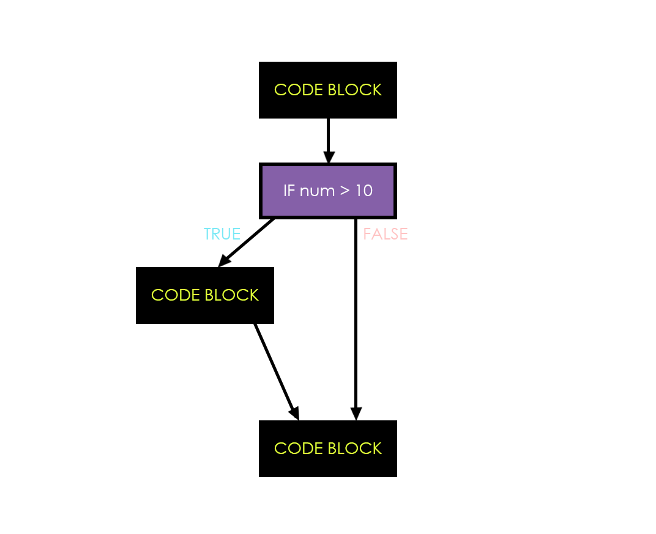
Conditionals
IF, IF/ELSE, IF/ELIF/ELSE
Decisions (branches) can be built into programs by using an IF statement. If the Boolean Condition evaluates to True, the code block for the IF is run.
num = 15
if num > 10:
print (“Larger than 10”)
print (“This gets printed no matter what!”)
Boolean Condition
Exercise:
Ask the user to enter their favourite day of the week.
If it is equal to “Wednesday”, print out “Mine too!”
Lastly, print “Thanks for the chat!” regardless of their input.

Slide 6
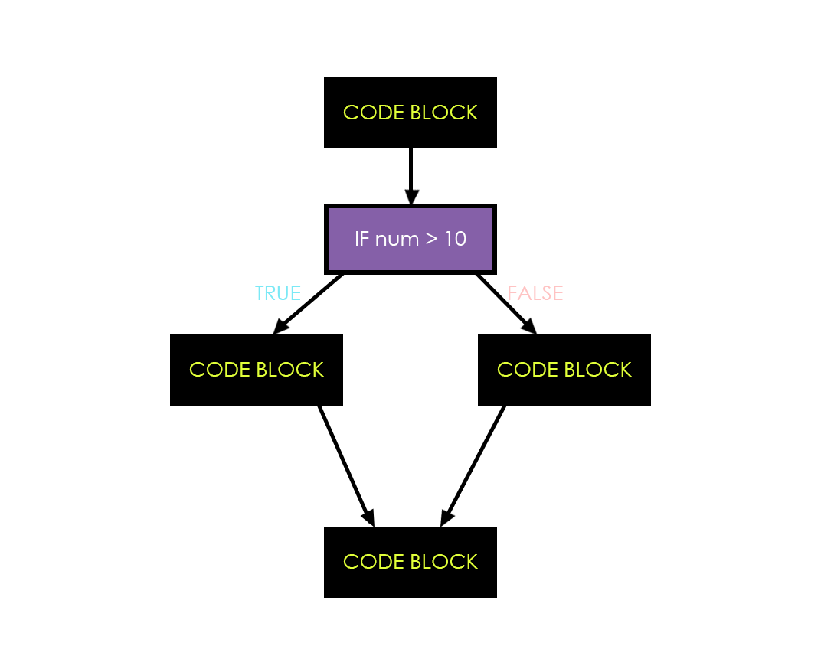
Conditionals
IF, IF/ELSE, IF/ELIF/ELSE
The ELSE block creates a new path to follow if the Boolean condition ends up being False.
num = 5
if num > 10:
print (“Larger than 10”)
else:
print (“Less than 10”)
print (“program complete”)
Exercise:
Modify your favourite day of the week program:
If the user enters “Wednesday”, still print out “Mine too!”.
If the user enters anything else, print out “I guess that day is alright…”

Slide 7
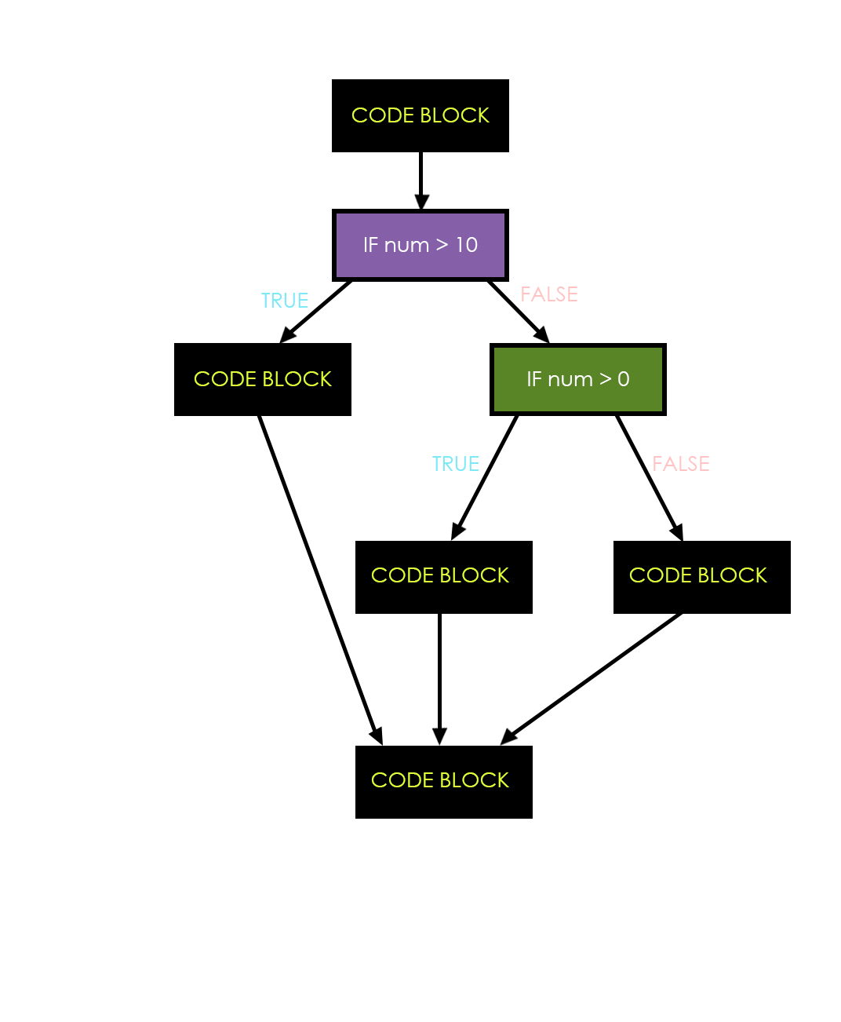
Conditionals
IF, IF/ELSE, IF/ELIF/ELSE
Conditionals can be nested to create more complex decisions.
num = 5
if num > 10:
print (“Larger than 10”)
else:
if num > 0:
print (“between 1 and 9”)
else:
print (“0 or lower!”)
print(“program complete”)

Slide 8
Exercise One:
1. Write a function which is given an exam mark, and it returns a string — the grade for that mark — according to this scheme:
Mark Grade
>= 90 A
[80-90) B
[70-80) C
[60-70) D
< 60 F
The square and round brackets denote closed and open intervals. A closed interval includes the number, and open interval excludes it. So 79.99999 gets grade C , but 80 gets grade B.
Test your function by printing the mark and the grade for a number of different marks.

Slide 9
Exercise Two:
Step One:
Write a function called is_even(n) that takes an integer as an argument and returns True if the argument is an even number and False if it is odd.
Step Two:
Now write the function is_odd(n) that returns True when n is odd and False otherwise.
Step Three:
Modify is_odd so that it uses a call to is_even to determine if its argument is an odd integer.

