Slide 1
Computer Science 20
For LOOPS

Slide 2
Loops so far…
We’ve looked at while loops, which loop as long as a loop condition is True.
num = 0 while num < 5 :
print (num)
num += 1
print(“All Done!”

Slide 3
For Loops
Another type of loop. The for keyword allows us to loop (iterate) over the items in any sequence (such as a list or a string)
Temporary variable
my_list = [“Celery”, “Carrots”, “Broccoli”, “Zucchini”]
for item in my_list:
print(“Time for a snack. Maybe I’ll have some “ + item)
4 items in list…. Loop iterates 4 times!
Iteration | Value of a | What is printed out?
1 | “Celery” | Time for a snack. Maybe I’ll have some Celery.
2 | “Carrots” | Time for a snack. Maybe I’ll have some Carrots.
3 | “Broccoli” | Time for a snack. Maybe I’ll have some Broccoli.
4 | “Zucchini” | Time for a snack. Maybe I’ll have some Zucchini.
Notes:
Have students code this program so they have a reference for next exercise

Slide 4
Exercise
1. Write a program that uses a for loop to print:
One of the months of the year is January
One of the months of the year is February
One of the months of the year is March
etc…
2. Write an alternate program that does the same thing using a while loop.

Slide 5
Number of iterations
What if we want to build a loop that iterates a certain number of times.
Do we have to first build a list with that particular number of elements?
Answer: Yes…
but thankfully, it’s easy!
range(n) is a function that generates a list of n integers:
range(8) creates the following list: [0,1,2,3,4,5,6,7]
range(4,6) creates the following list: [4,5]
range(1,10,2) creates the following list: [1,3,5,7,9]

Slide 6
As a class:
Iteration | Value of i | What is printed out?
1 | 0 | Hello
2 | 1 | Hello
3 | 2 | Hello
4 | 3 | Hello
After loop | n/a | Class!
for i in range(4):
print (“Hello”)
print(“Class!”)
Iteration | Value of i | What is printed out?
1 | 3 | My Fav number is: 3
2 | 4 | My Fav number is: 4
3 | 5 | My Fav number is: 5
4 | 6 | My Fav number is: 6
for i in range(3,7):
print (“My fav number is: ” + str(i))
Notes:
Have students quickly write the loop, predict the output, and then run it, then bring up table to talk through the iterations in detail.

Slide 7
Exercise
FOR LOOPS
Detention! Write a program that prints out “I will not text in class…” 1000 times.
Create the following list: numbers = [ 10, 17, 4, 55, 23, 96 ] For each element in the list:
Print out the number AND its square
Output should look like: number: 10 square: 100 number: 17 square: 289
…and so on
Extra for experts: Create a new version of the above programs that use while loops rather than for loops.
Hint: remember that len(my_list) returns the number of elements in an array my_list[i] allows you to access (and modify) the element stored at position i

Slide 8
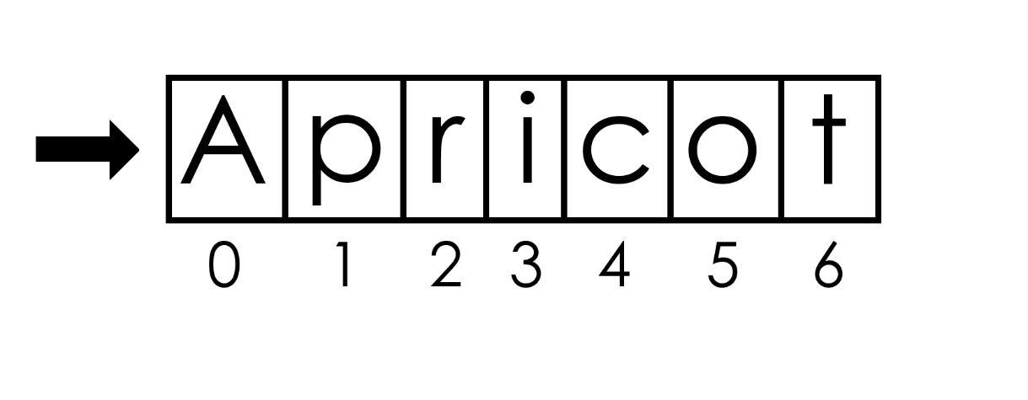
Strings as Lists
LOOP ITERATION
Recall that in Python, all String variables can also be treated as a list of characters.
fruit = “Apricot”

Slide 9
For loops and Strings
fruit = “Apricot”
for i in fruit:
if i == “a” or i == “A”:
print (“Ah – what a great letter!”)
else:
print (“..ho-hum”)
Iteration | Value of i | What is printed out?
1 | “A” | “Ah – what a great letter!”
2 | “p” | (“..ho-hum”)
3 | “r” | (“..ho-hum”)
4 | “i" | (“..ho-hum”)
5 | “c” | (“..ho-hum”)
6 | “o” | (“..ho-hum”)
7 | “t” | (“..ho-hum”)

Slide 10
Exercise:
Vowel Counter
Ask the user to enter a word, and store it in a String variable.
Using a for loop, count how many vowels (a, e, i, o, u) are in the word.
Print a message to the user reporting how many vowels were in that word.
Then ask if the user would like to try again. If yes, repeat the steps above. If no, end. May use a while loop for this step.
For Loops
for i in list:
# Loop once for each item in list. Store each item temporarily in i.
if condition or condition #Logical operator combines multiple conditions. If at least one condition is True, whole statement is True.
if condition and condition #Logical operator combines multiple conditions. If all individual conditions are True, the whole statement is True.
Extra for experts:
Implement a solution that utilizes a while loop rather than a for loop.
Notes:
After time has been given to working on this problem, show concise solution using in keyword.

Slide 11
Exercise
Vowel Counter
Ask the user to enter a word, and store it in a String variable.
Using a for loop, count how many vowels (a, e, i, o, u) are in the word.
Print a message to the user reporting how many vowels were in that word.
Then ask if the user would like to try again. If yes, repeat the steps above. If no, end. May use a while loop for this step.
Sample For Loop code:
word = “apricot”
total_vowels = 0
for i in word: #will loop once for each element in word
if test: #build a condition to see if the current letter (i) is a vowel
total_vowels = total_vowels + 1
#once the loop is done, use print() to report how many vowels were found!

Slide 12
Solution One:
while True:
count = 0
word = input("Please enter a word")
for i in word:
if i=="a" or i == "A" or i=="e" or i == "E" or i=="i" or i == "I" or i=="o" or i == "O" or i=="u" or i == "U":
count += 1
print ("There were " + str(count)+ " vowels in that word!")
repeat = input("Would you like to try again? (Y/N)")
while(repeat != "Y" and repeat != "N"):
repeat = input("Would you like to try again? (Y/N)")
if repeat == "N":
break

Slide 13
Solution Two:
in keyword:
Looks through the list (“AaEeIiOoUu”) to see if item i (each individual letter in word) is contained within.
If it is, it must be a vowel.
while True:
count = 0
word = input("Please enter a word")
for i in word:
if i in “AaEeIiOoUu”:
count += 1
print ("There were " + str(count)+ " vowels in that word!")
repeat = input("Would you like to try again? (Y/N)")
while(repeat != "Y" and repeat != "N"):
repeat = input("Would you like to try again? (Y/N)")
if repeat == "N":
break

