Slide 1
Computer Science 20
Choose your Own Adventure

Slide 2
Class Demo
CHOOSE YOUR OWN ADVENTURE
A choose-your-own-adventure story is a narrative that has a number of possible branches, which are chosen by the user. The story changes depending on their decisions.
As a class, we will construct a simple example that utilizes logic and decision-making structures.

Slide 3
Planning Process
FLOW CHARTS
Recall that good development begins with planning processes:
Flow Charts
Pseudo-code
For this demo, we’ll construct a flow chart to use as a guide when building our program.

Slide 4
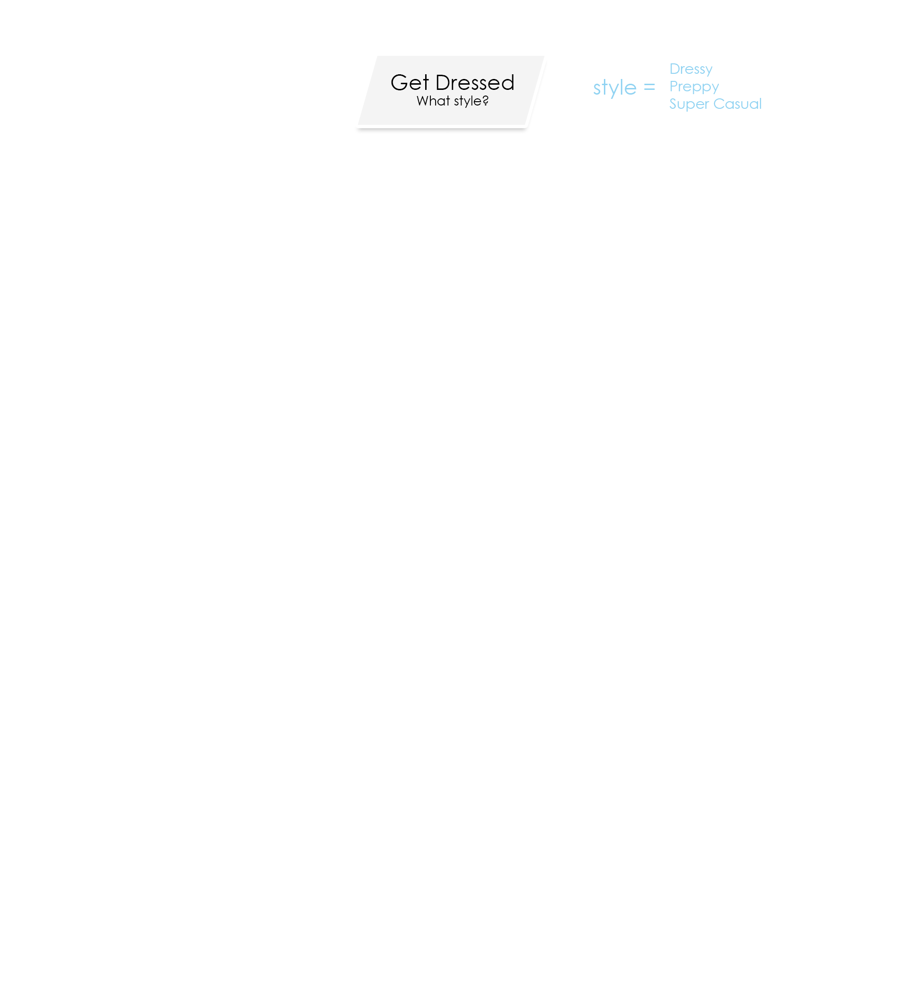

Slide 5
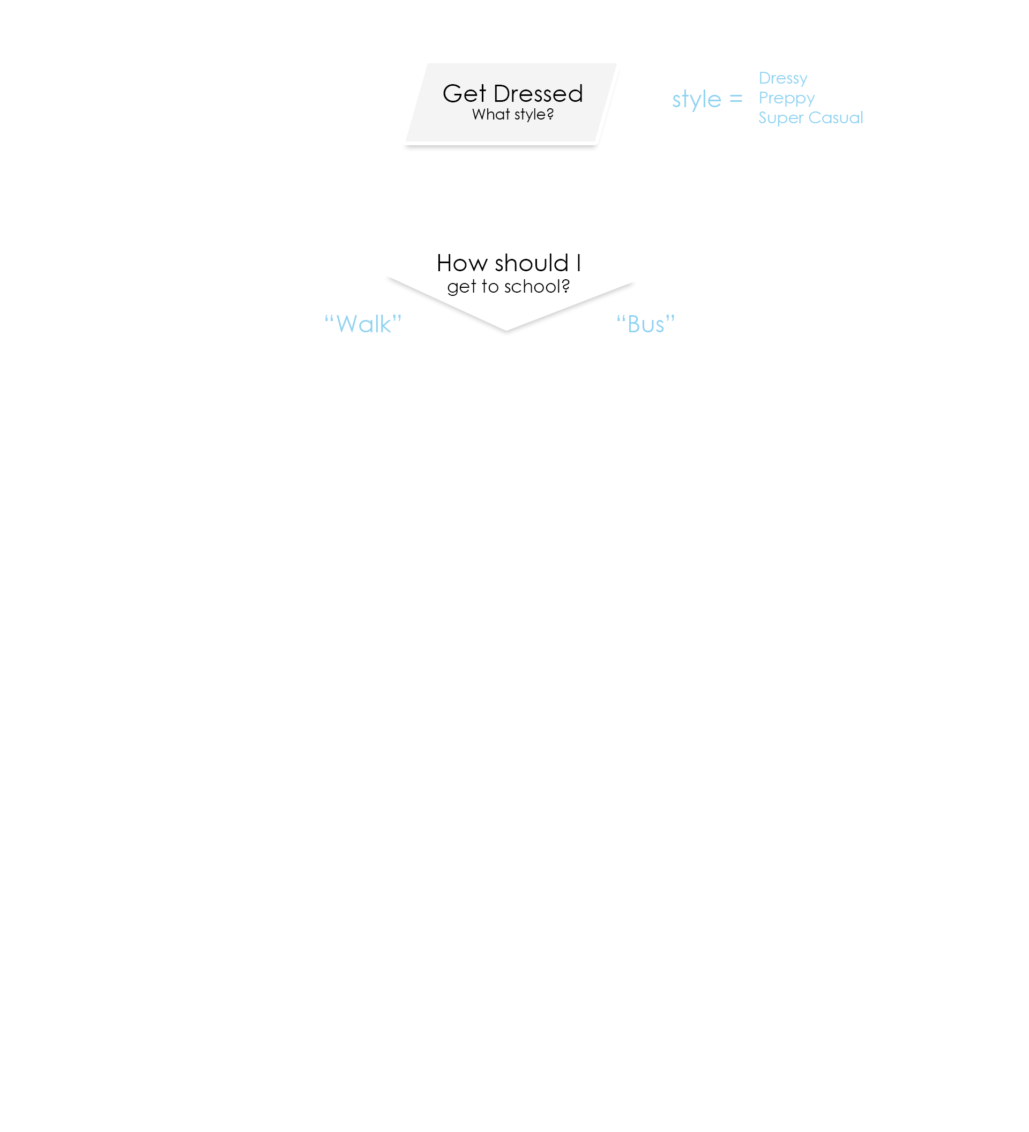

Slide 6
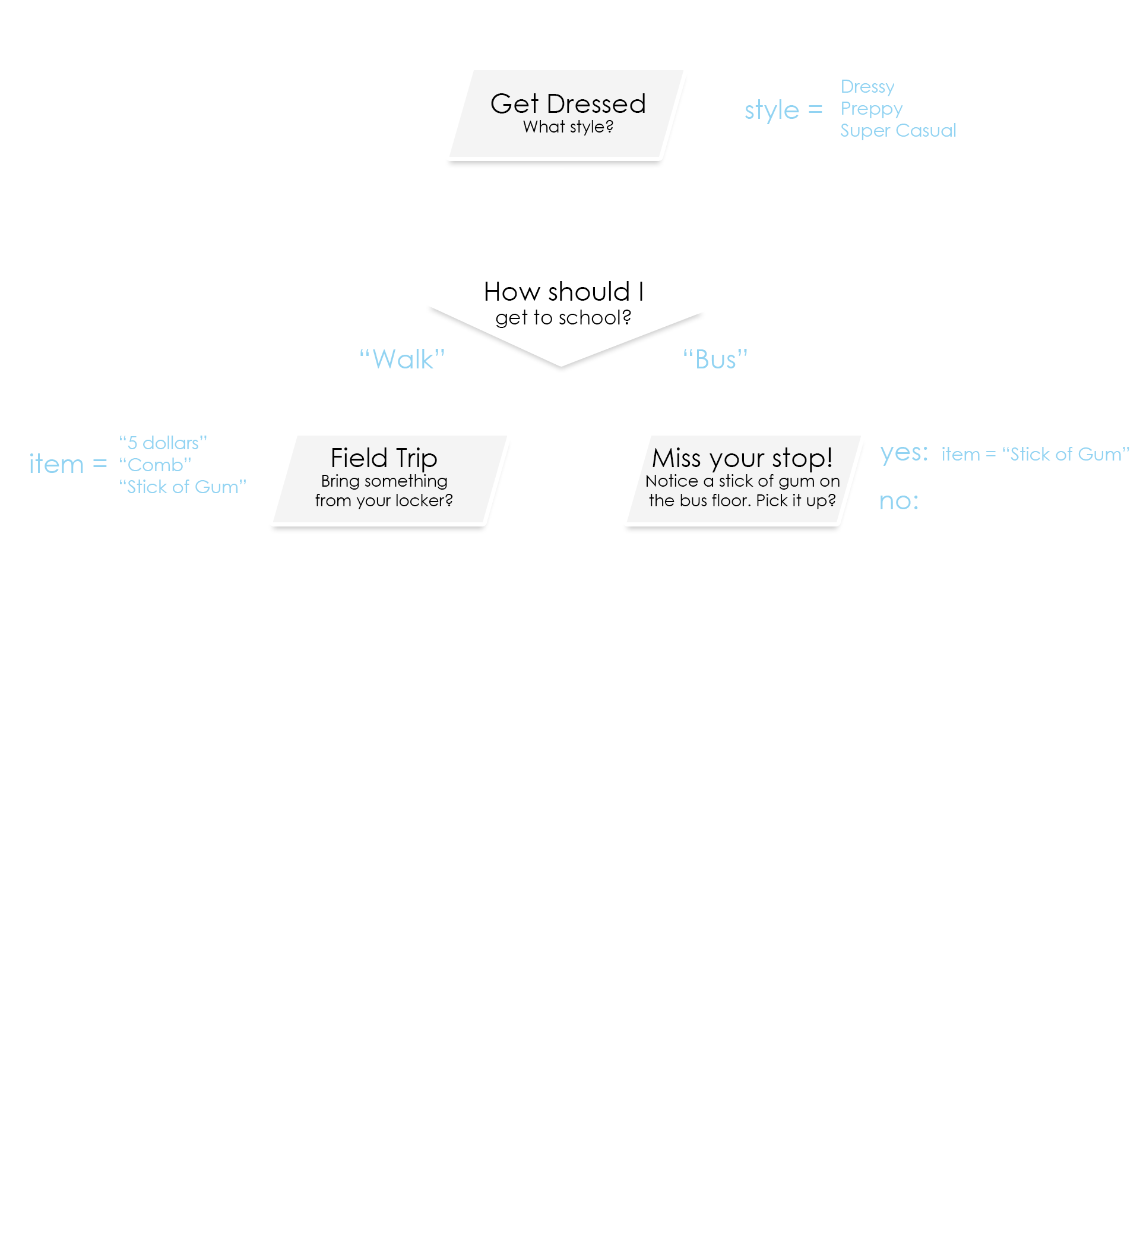

Slide 7
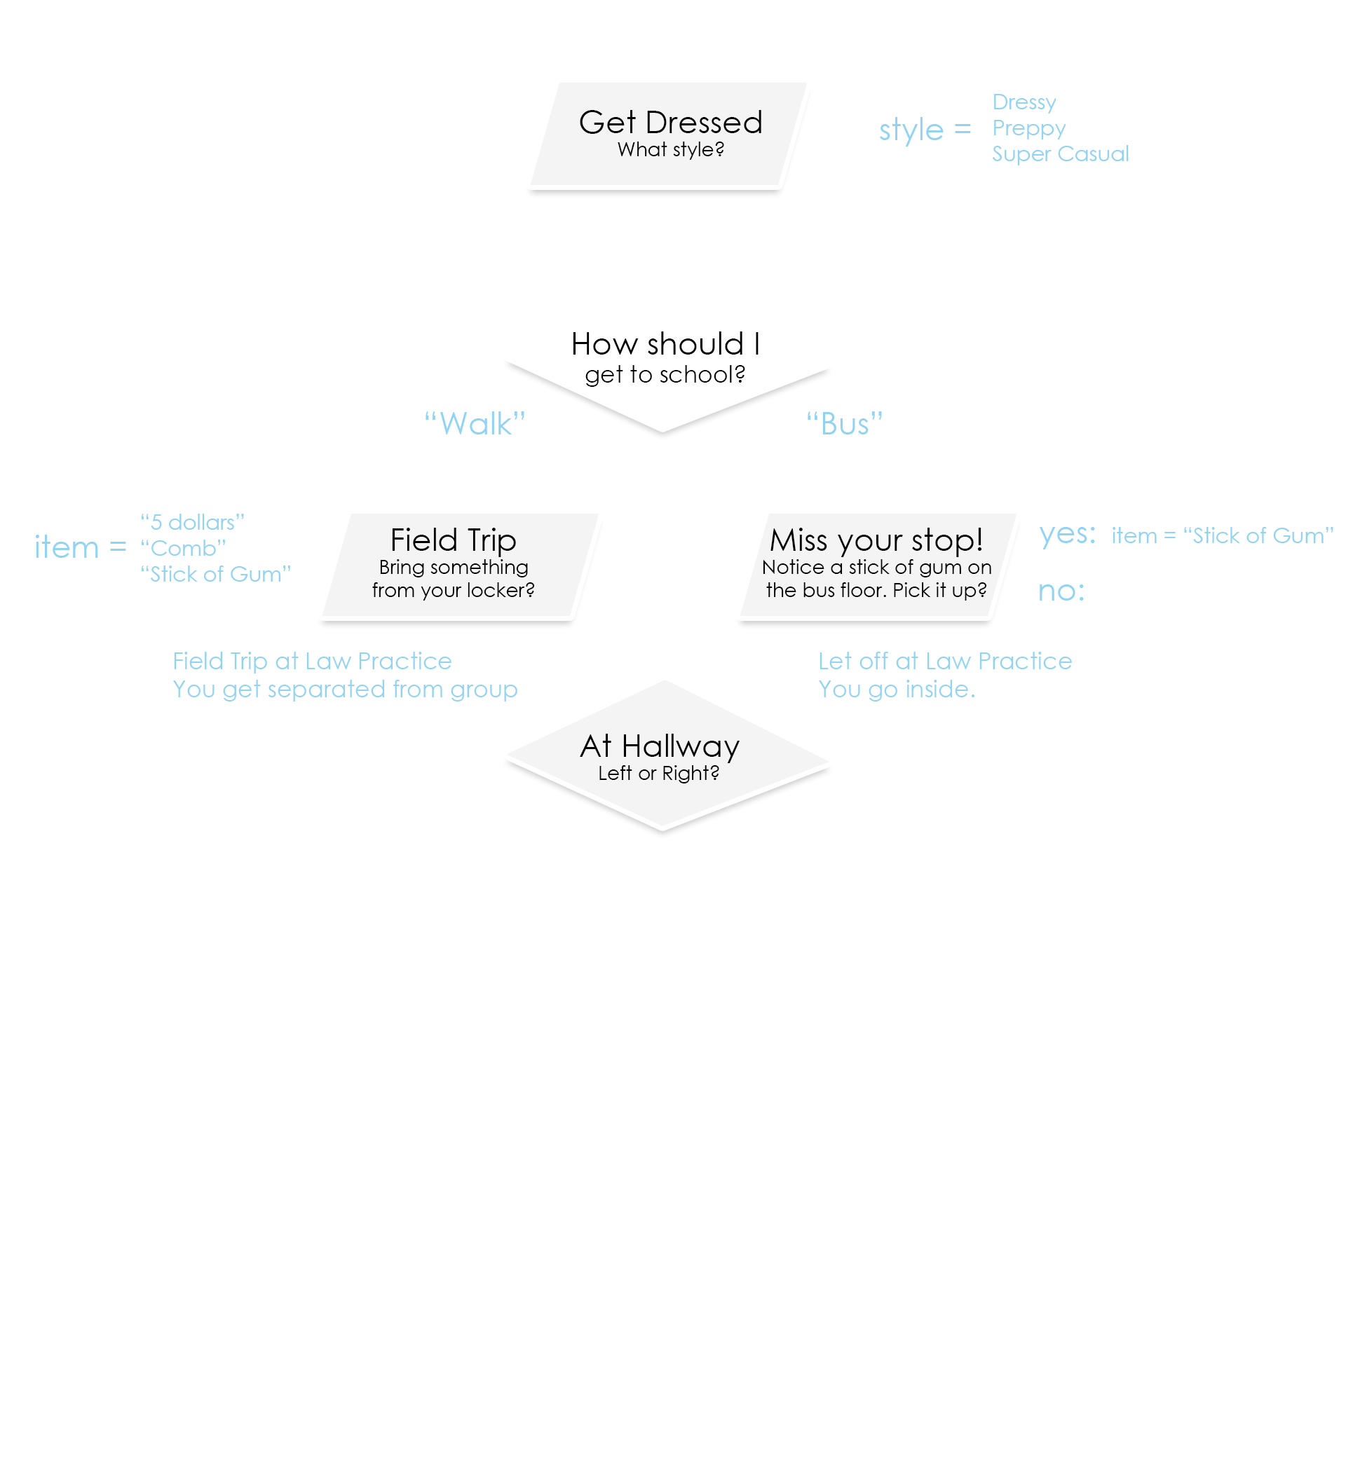

Slide 8
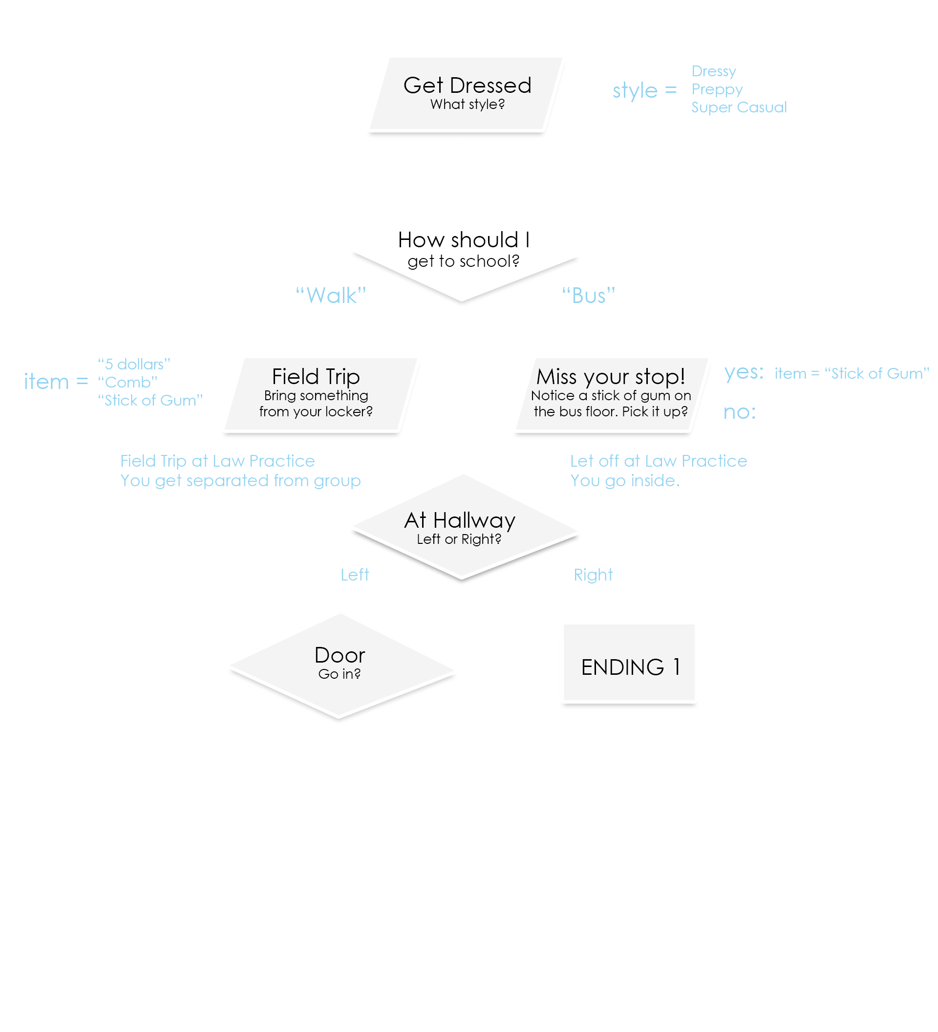

Slide 9
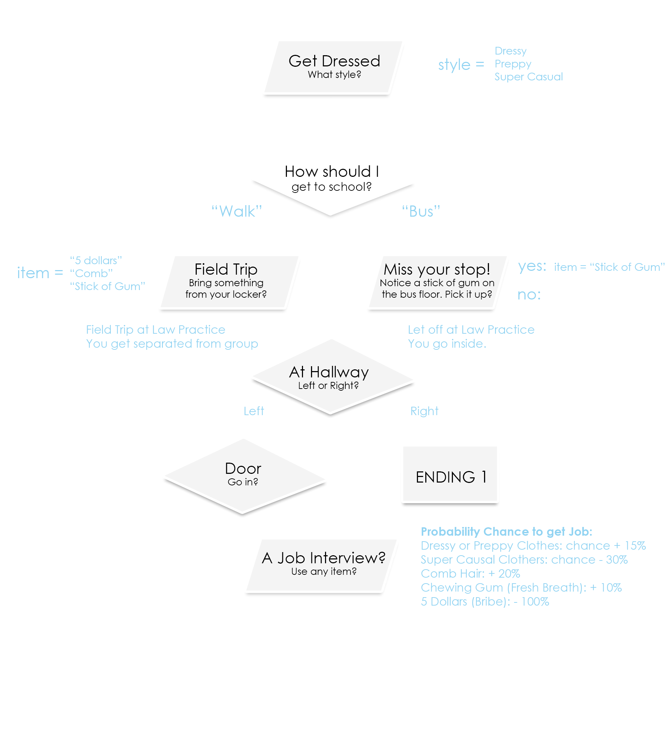

Slide 10
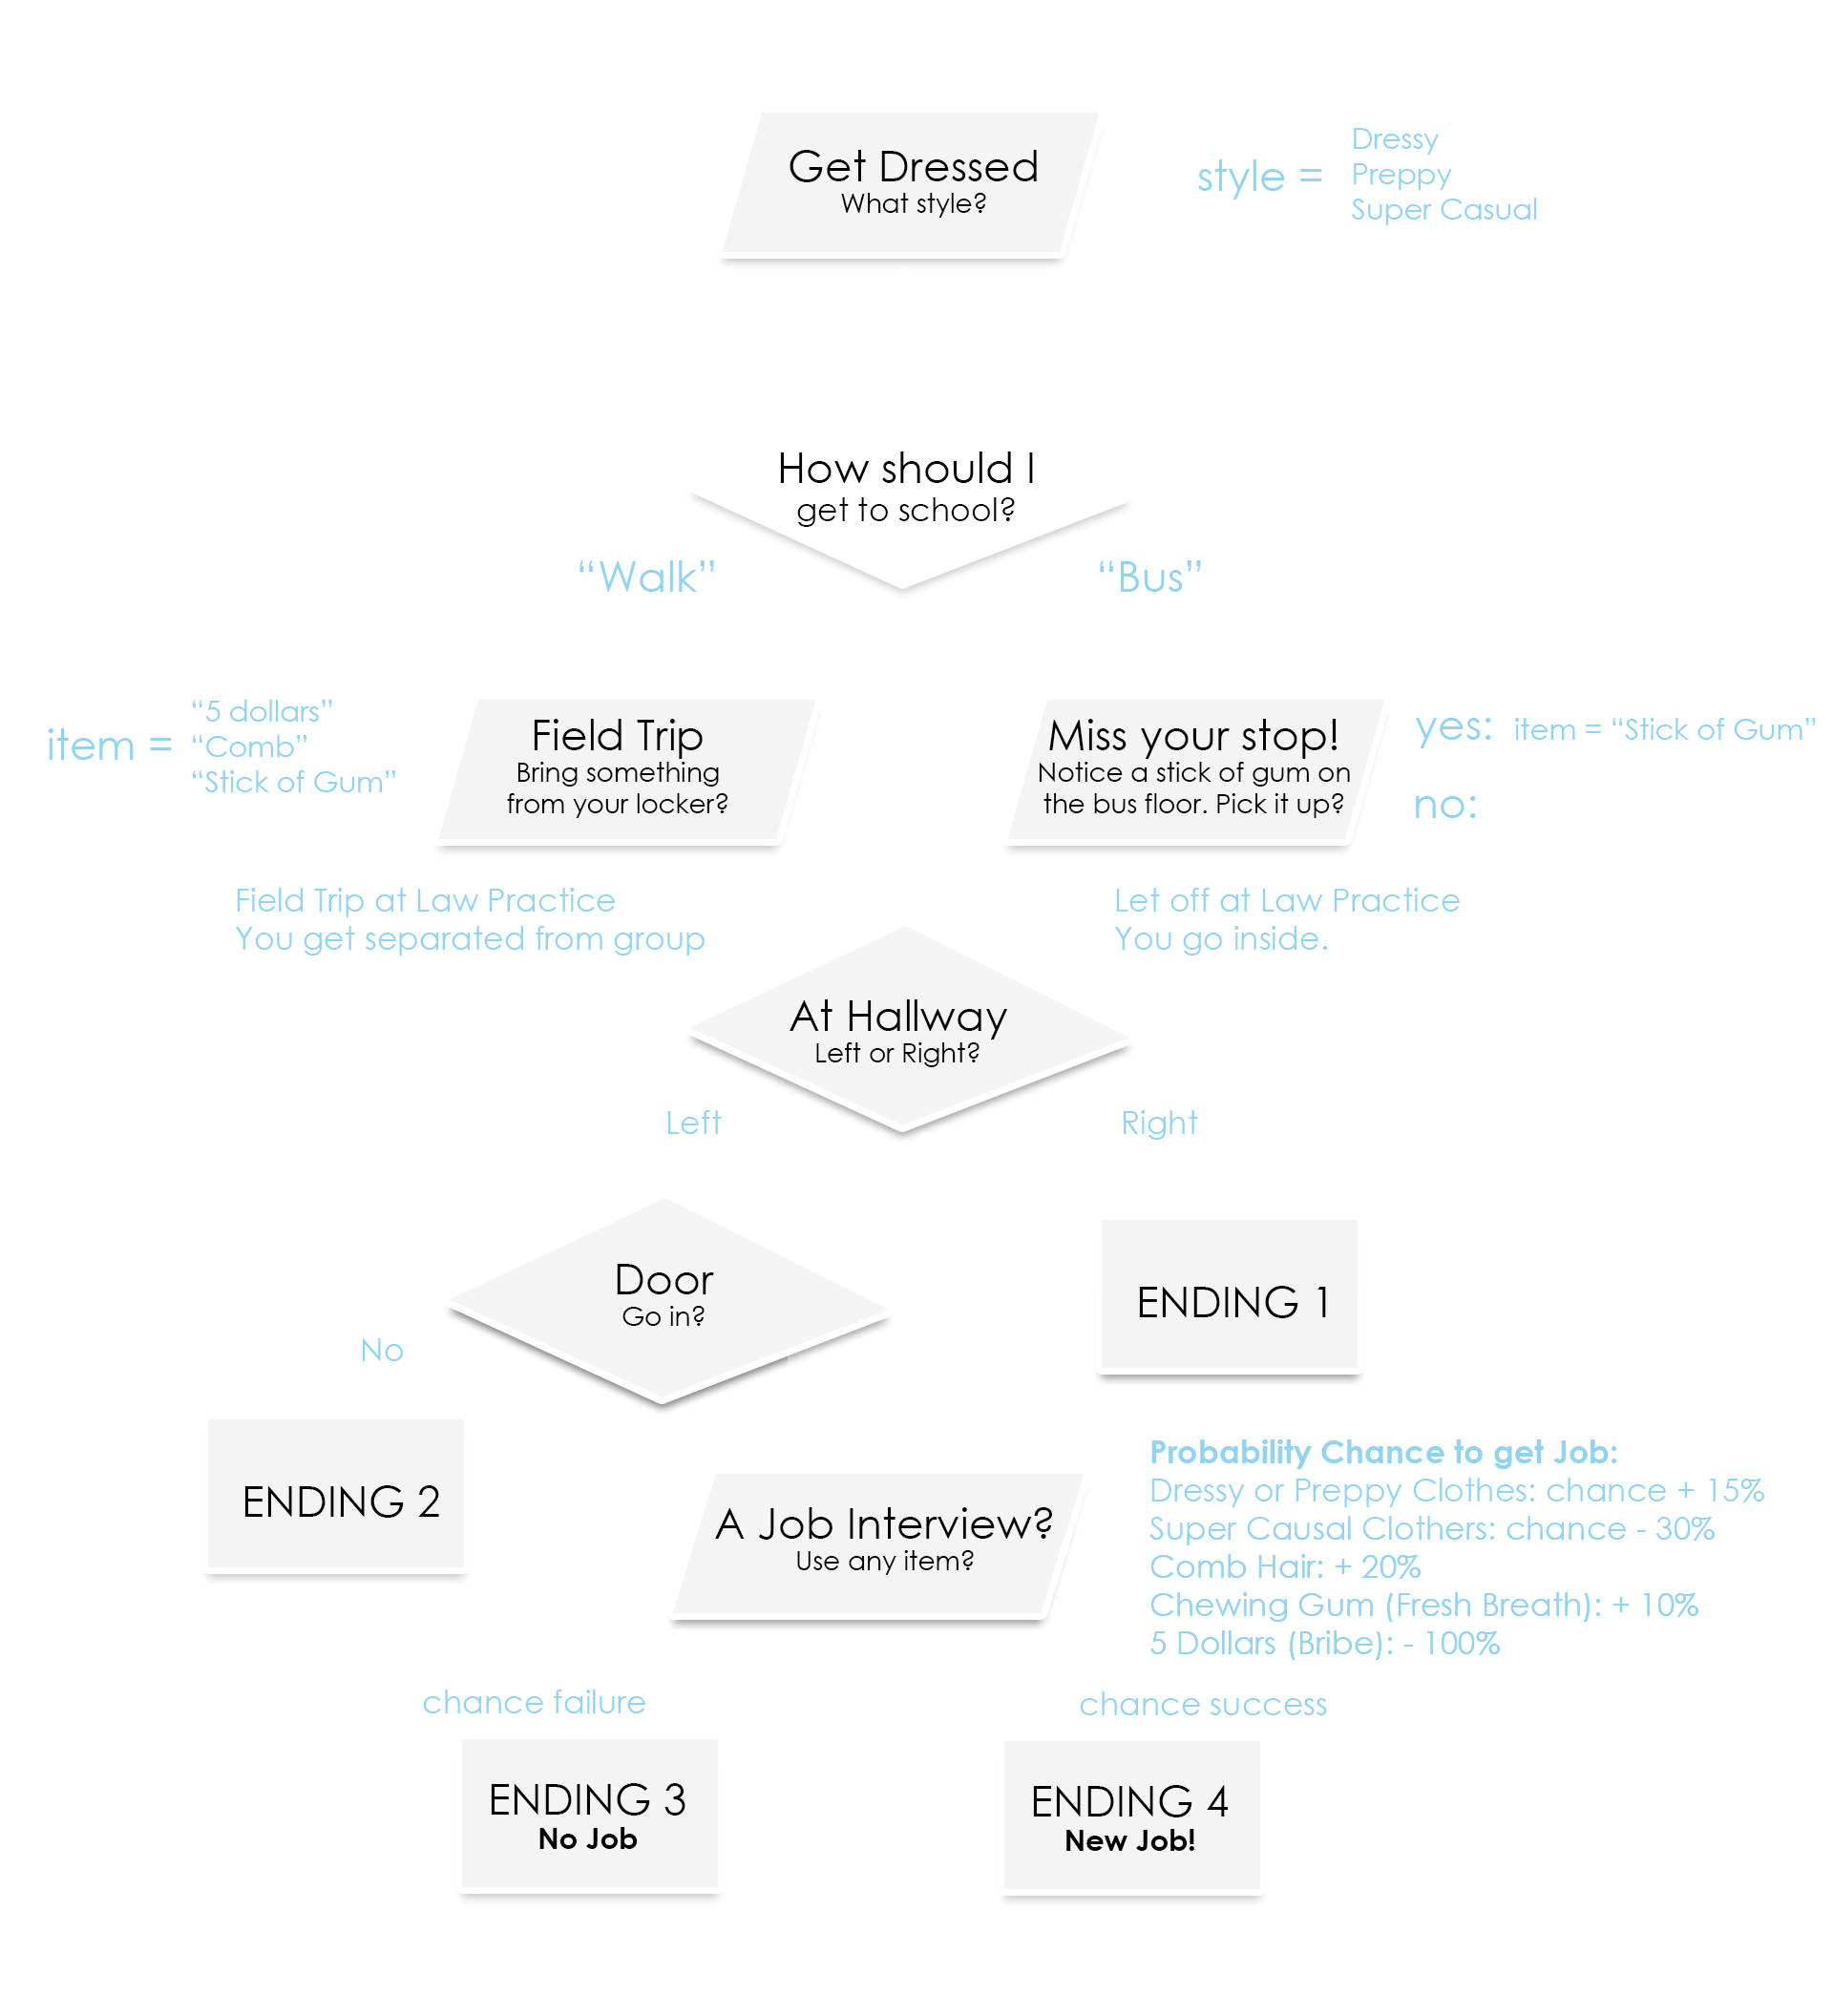
Notes:
There should be some base probability of success. We figured the average high school student should have 45%. Have some fun by asking your students what they think is reasonable.

Slide 11
Weighted Probability
Consider the chance variable. Possible Values: -90 to +80
If 0 or less: Guaranteed failure condition
Otherwise, to simulate weighted probability we could generate a random number between 0 and 99 (100 equally likely numbers)
rand = 45
0
100
0
Chance
If random number < chance: success otherwise: failure
Notes:
Given a base chance of 45, the max possible value would be 80 and the min possible value would be -90

Slide 12
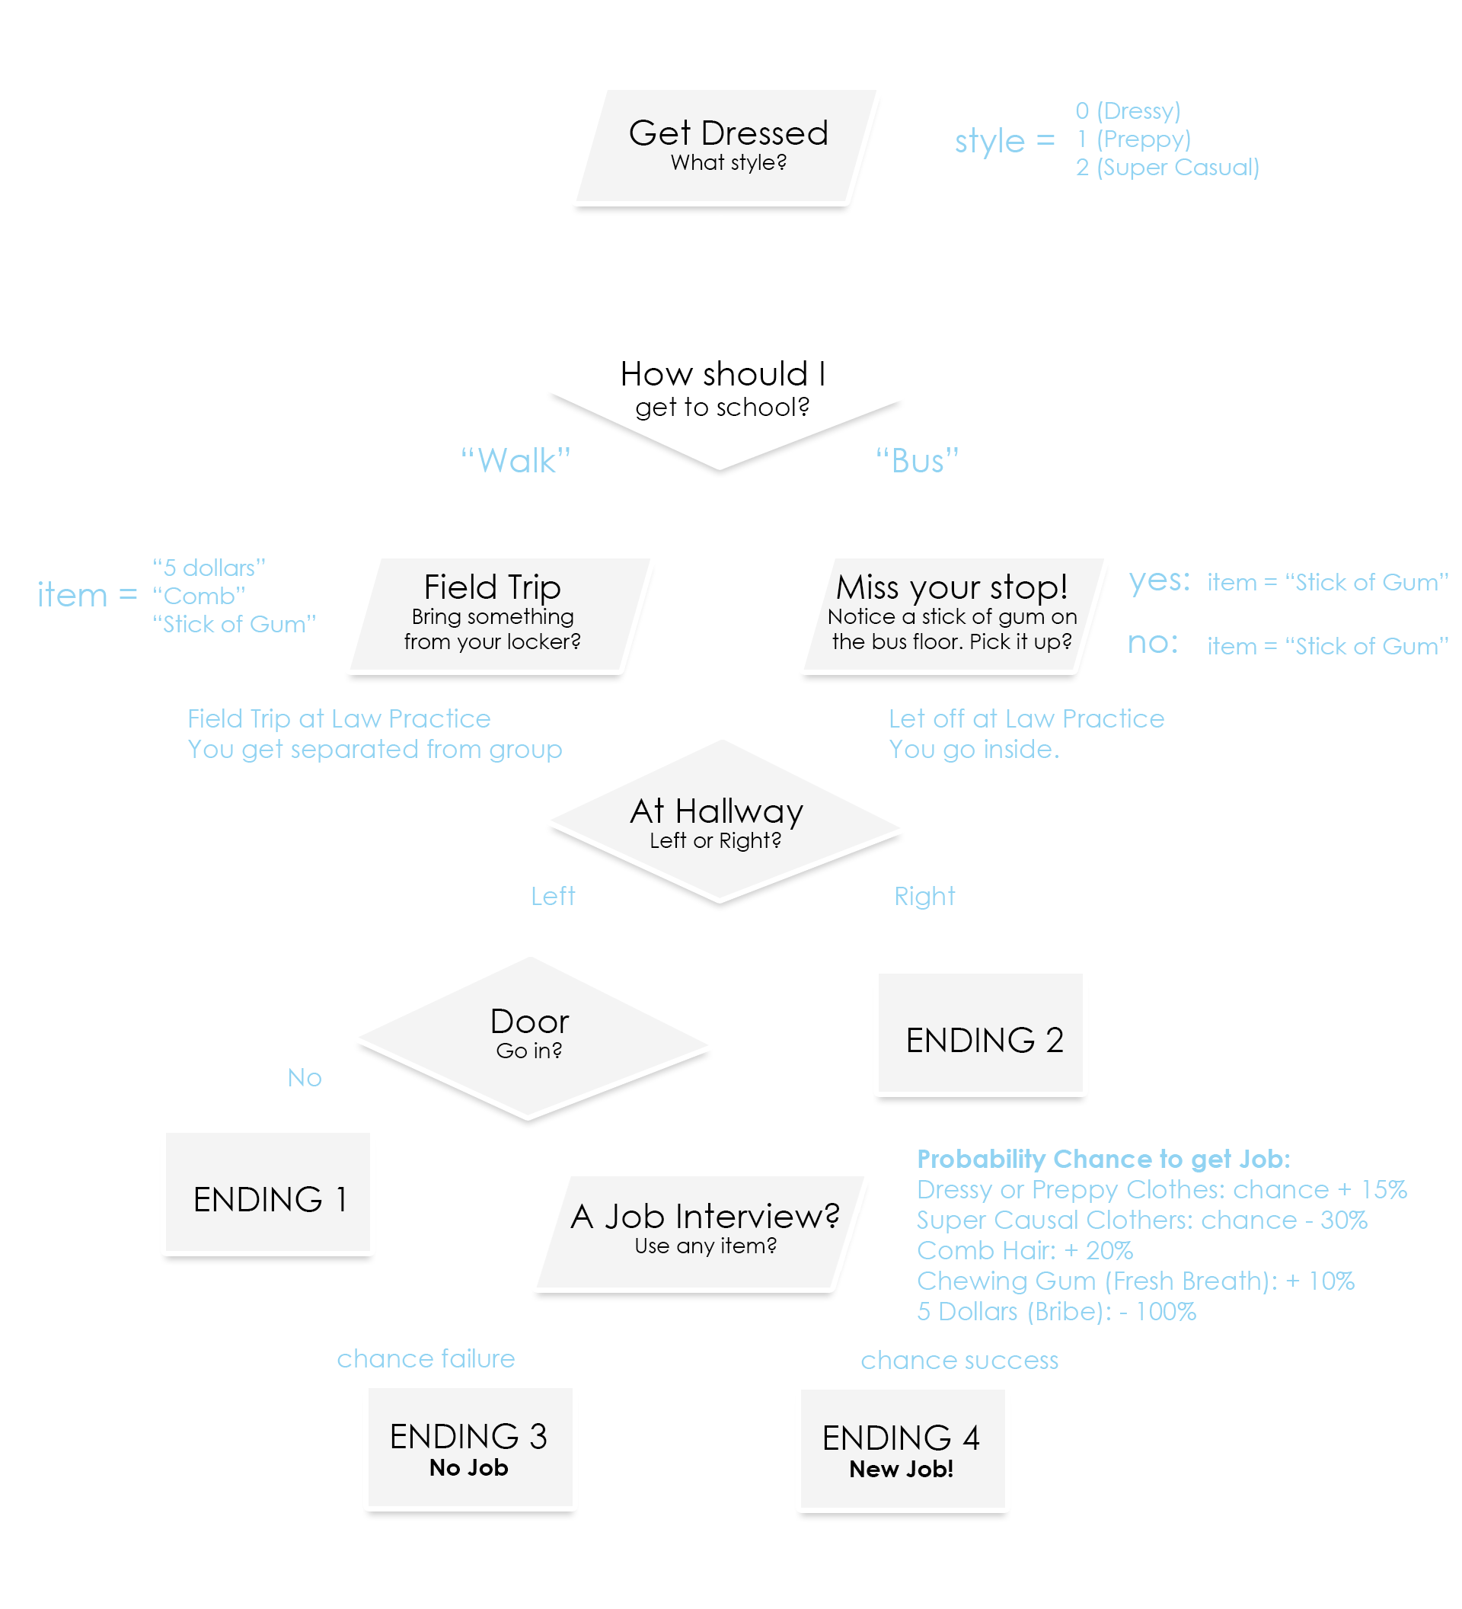
Planning Process
FULL FLOW CHART

