Slide 1
Computer Science Coding and Robotics
Making Decisions
We are constantly making decisions, big and small. Some possible examples are:
IF the walk light turns on, THEN I cross the street
IF I see a really good deal advertised THEN I go to the store (or the webpage)
IF you have your passport AND you have your boarding pass THEN you can get on the airplane ELSE look in your bag again
Conditions Statements framed as yes/no questions. Evaluate to true or false.
Actions Statements or commands that may or may not happen depending on if the associated condition is true or false.

Slide 2
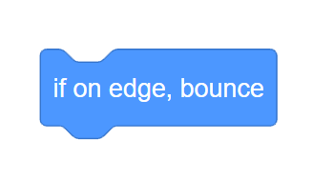
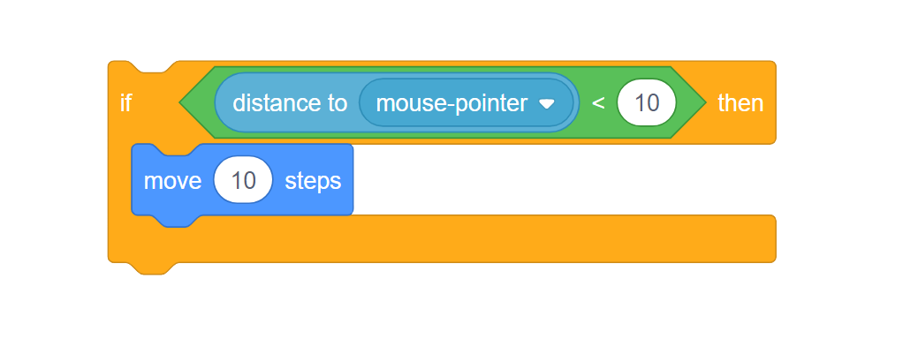
Decisions so far:
We’ve seen a few examples of decision-making (or selection) structures already:
Condition - evaluates to true or false
Action - will be run if the condition is true

Slide 3
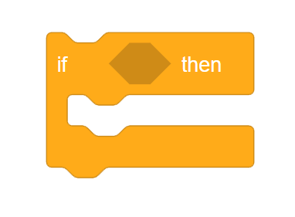
IF - THEN Structure
IF - THEN blocks are C-Shaped, and comprise two sections:
Condition - Hexagonal blocks. These must always be yes/no or true/false questions.
Action(s) - One or more blocks (statements) go on the inside of the C-Shape. These instructions are only run if the condition is true.

Slide 4

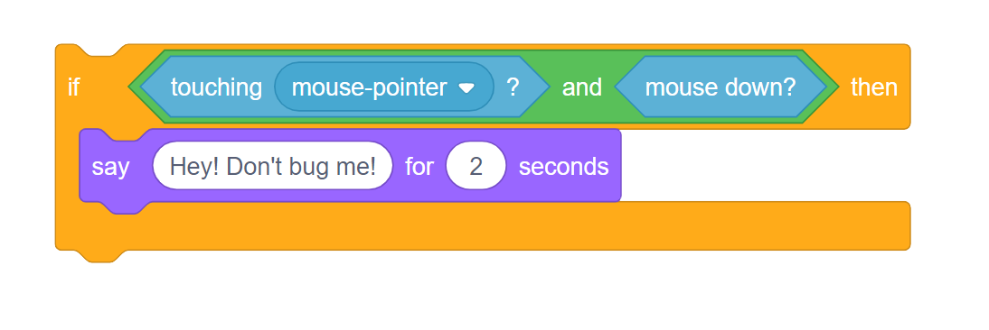
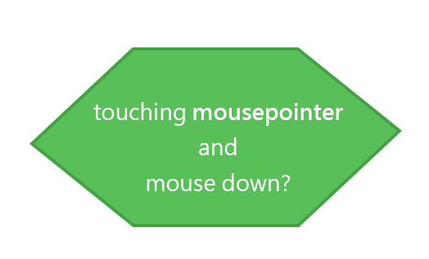
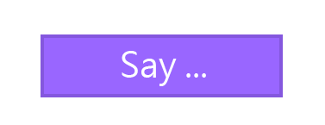
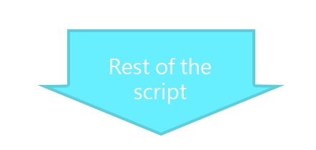
What if it’s false?
True
False
We’ve seen that if the condition is true, that the action(s) inside the IF statement C-Shape are run.
What happens if the condition is false?
In this case, the decision is to not run the actions.
Instead, that code is skipped and if there is more to the script after the IF statement, the script continues running.

Slide 5
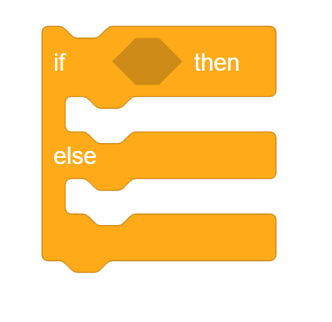
IF - ELSE Structure
IF - ELSE blocks are similar, but have two separate inside sections:
Condition - Hexagonal blocks. These must always be yes/no or true/false questions.
Action(s) [If the condition is TRUE]- One or more blocks (statements) go on the inside of the C-Shape.
The
“Then”
Action(s) [If the condition is False] - One or more blocks (statements) go on the inside of the C-Shape.
The
“Else”

Slide 6
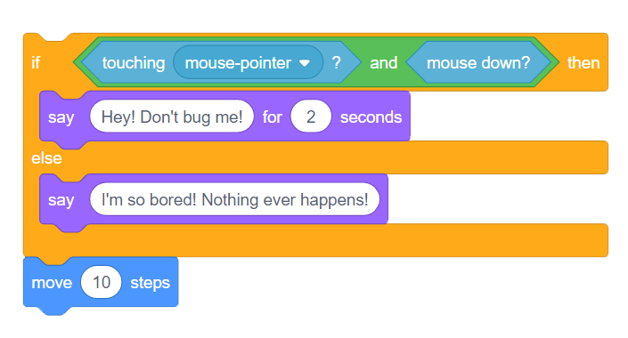
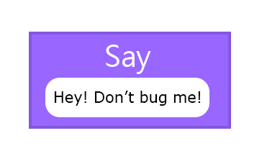
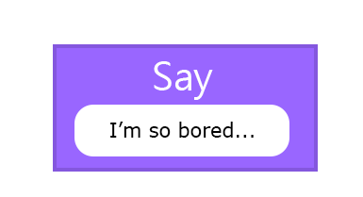
One branch only
True
False
IF / ELSE statements provide two options:
The “Then” code and the “Else” code.
One of these branches will always be chosen and run.
Only one can be chosen, though. There is no scenario where both will run!
The
“Then”
The
“Else”

Slide 7
Demos
Notes:
At this point, some demos will lead through basics of using conditional statements
Also broadcasts
And boolean expressions

Slide 8
Make it Repeat
Many Tasks are repetitive in nature. In real life, can you think of some examples?
Twist the lightbulb until it comes free.
Do push-ups until you are too tired to continue.
Practice your free throws 100 times.

Slide 9
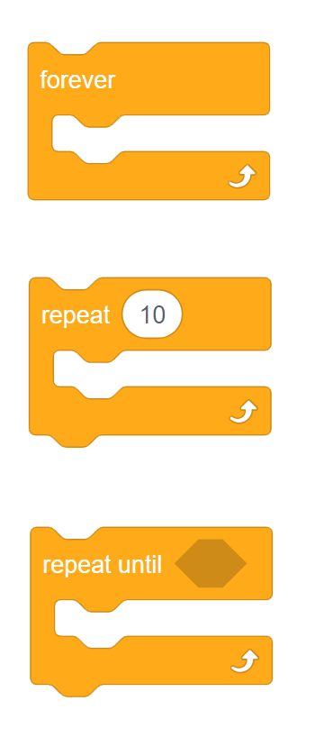
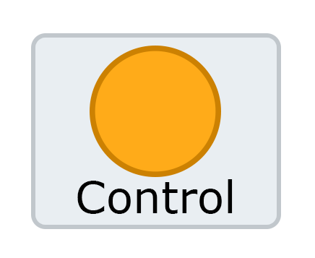
Loops in Scratch
Forever
We’ve already had to use some repeating structures in Scratch, but now we’ll look at them in finer detail.
Loops can be found in the control palette:
Counting
Conditional
Notes:
Lead through very simple demo using:
Move If on edge, bounce (forever loop)
Color change / wait / in a forever loop
Pressing left/right → turn left/right (events)
-could have a little video showing playback

Slide 10
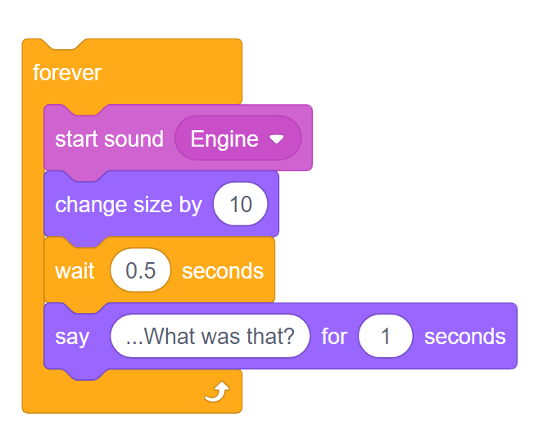
Loop Structure and Behavior
LOOP
LOOP BODY
Two distinct components in the anatomy of a loop:
Loop – Structure that causes execution flow to repeat a number of times.
Loop Body – Code encapsulated within the loop; this is what is repeated.

Slide 11
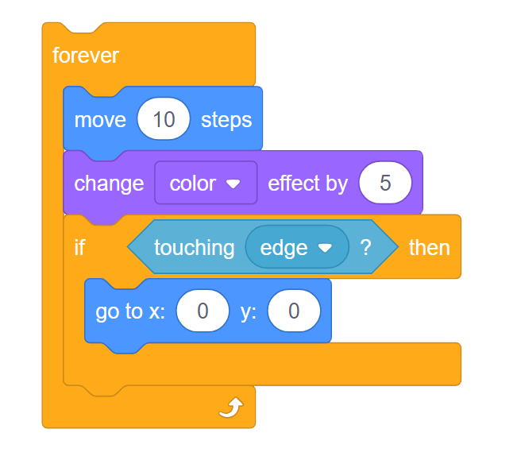

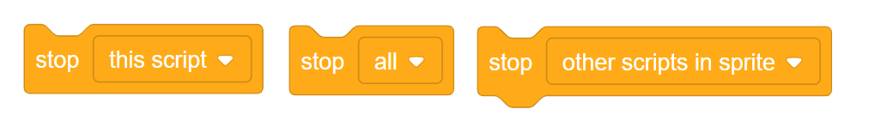
Forever Loops
Forever loops repeat indefinitely. Once they begin they can only be stopped by:
User pressing the stop button
A “stop” block being used elsewhere in the program
Scratch is closed down by the user
Notice how there is no tab to connect a block to the bottom? Since forever loops are not intended to end during your program’s execution, any blocks down here would never be reached!
Notes:
After this slide, jump to Scratch and show moving a sprite around by just using the X,Y fields in the sprite info palette
Also, how to toggle visibility and modify size

Slide 12
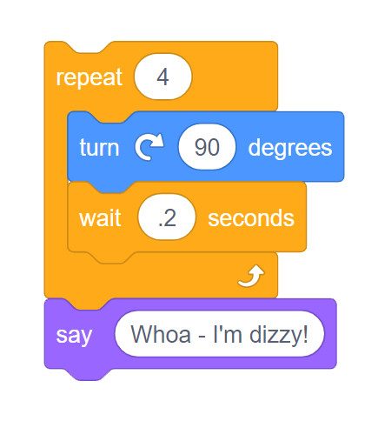
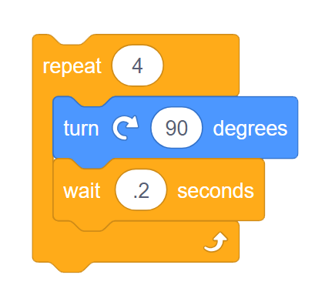
Counting Loops
Counting (Repeat) loops repeat a fixed number of times.
Any number of repetitions can be specified (0, 4, 100…)
The loop will continue running until it has iterated exactly that many times.
Afterwards, the script will continue on to execute any blocks connected to the bottom.
In this case the loop repeats 4 times, which spins the sprite in a full circle. Once the loop has executed the loop body for the fourth time, the sprite carries on to say “Whoa - I’m dizzy!”

Slide 13
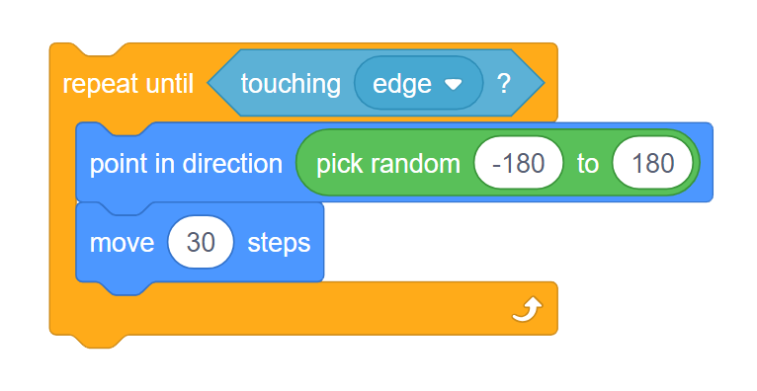
Conditional Loops
Conditional loops repeat until a certain Boolean Expression is true.
This sort of loop is useful when it is difficult to predict how many times a loop needs to iterate to accomplish a task.
If the condition is true, the loop ends
If the condition is false, run the loop body and repeat
It is possible for conditional loops to not run the body at all!
If the sprite is already touching the edge when the loop is first run, for instance.
Condition is false:
- Run loop body once
- Repeat back to loop statement
Condition is true:
- End loop immediately

Slide 14
Demos
Notes:
At this point, some demos will lead through basics of the three kinds of loops
Forever - changing color effect, rotation
Counting - get bigger by an amount? Oscillate up and down or bigger/smaller (counting inside a forever)...bubbles moving up?
Conditional - turning fastest direction to up?

