Slide 1
Computer Science Coding and Robotics
Patterns and Pattern Recognition
When working on increasingly complex programs, there are some useful workflow patterns that we can use to increase efficiency and improve correctness.
One area of Computational Thinking that is incredibly useful for solving problems is pattern recognition.
Notes:
Liken workflow patterns to ‘common practices’

Slide 2
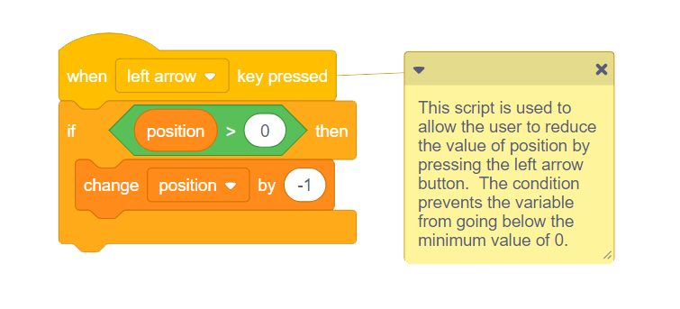
Workflow Patterns
Commenting
When programs grow in scale and complexity, it becomes difficult to remember all the details.
To address this, we add comments into our programs.
These are notes to ourselves (or others) that we leave throughout the code
Comments are only for humans; the computer will ignore them

Slide 3
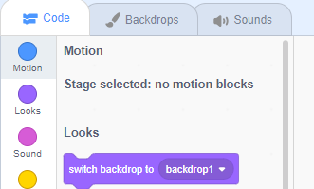

Workflow Patterns
Code Organization
Some instructions in our code apply to the whole program rather than a specific sprite.
Play background music while the program is running
If the timer runs out, stop the program
If a certain score is reached, signal the winning screen
In these instances, build these scripts for the stage rather than for a sprite.
Click on the stage icon to make it active, and a scripts area will appear for it.
Notes:
‘centralizing’

Slide 4
Workflow Patterns
Testing
Ensuring that a program works correctly is difficult. An important part of this process is testing.
Think carefully about all the things your program is supposed to do
Individually test each one to verify it does actually work
Also as important is to think all the ways a user could possibly break your program
As the creator of the program, you know how to use your program properly
Think about all the potential mistakes a user to make, and how your program would react
Test often!
Be careful to test frequently. Each time you add a new script, spend some time testing before moving on to the next task.
If the program no longer works the way you’d expect, it will help narrow down what scripts to look through for the problem.

Slide 5
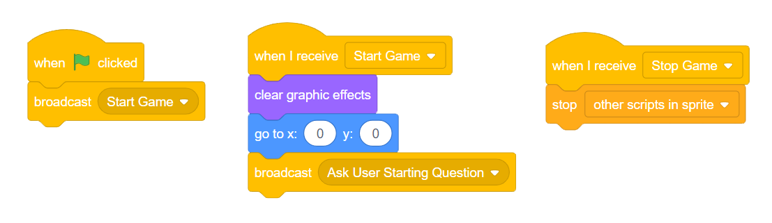
Workflow Patterns
Control Flow
As programs increase in scale, often these will be more sprites and coordinating them all can become a major challenge.
If the level or scene changes, how do all the sprites know this change has occurred?
When the program is done, how do you stop all the sprites
If you want to play again, can you restart the program without using the green flag?
Using Broadcasts effectively is a very powerful way to control what scripts happen, and when!
Notes:
Since scripts can run concurrently, it can be tricky to verify what code is happening when. Race condition...

Slide 6
Demos
Notes:
Control Flow Demo - using broadcasts to allow the program to be repeated based on user choice...mimic the type of pvp cvc in RPS.
Have we shown the backpack yet?

Slide 7
Pattern Identification
Generalization
One of the main goals of this course is to look at different ways to solve problems.
Solving one problem is good
Solving all types of similar problem is better!
The skill of Identifying Patterns in a problem can allow us to find relationships between similar problems, and often create a general solution that can be reused in different contexts.

Slide 8
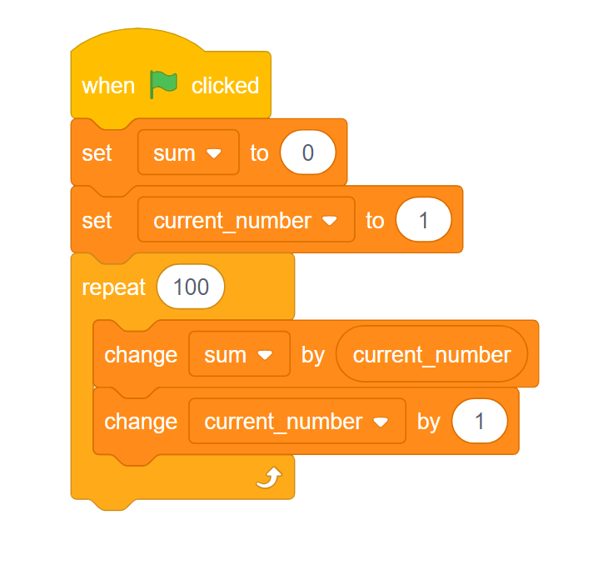
Pattern Identification
Generalization
Story of Carl Friedrich Gauss, asked as a child to sum up the values from 1 to 100
Solved it very quickly: 5050
If Scratch was around, it would have helped:
But instead, Gauss saw a pattern:
sum = 1 + 2 + 3 + … + 98 + 99 + 100
sum = 100 + 99 + 98 + … + 3 + 2 + 1
2*sum = 101 + 101 + 101 + … + 101 + 101 + 101
2*sum = 100 * 101
sum = 100 * 101 → 5050
2

Slide 9
A Second Pattern
Generalization
Gauss’ solution was great for that one problem (sum 1 to 100), but in fact there was another pattern that could be observed to allow the solution to be generalized.
sum (100) = 100 * 101
2
1 + 2
100 + 99
Value of item to sum will be one more than the number of items
These values are connected! (number of items to sum)
101 + 101
sum (n) = n (n+1)
2

Slide 10
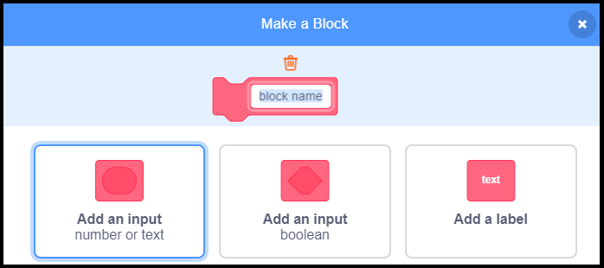
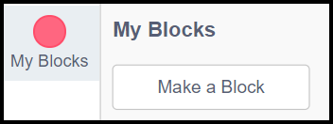
Creating Reusable Solutions
Functions
The previous example was a mathematics problem, but the idea of generalization can be applied in all sorts of problem domains.
Generalized solutions are typically created as functions. In Scratch, we can implement functions with My Blocks.
Notes:
Stop here to demonstrate creating a function block for Gauss’ sum of a series.

Slide 11
Demos
Notes:
Spirographs - use pattern of regular polygon to generate a function block

Slide 12
Demos
Notes:
Clones Demo - raincatcher
Show the situation where clones make clones
Better process - one hidden sprite to spawn all clones

