Slide 1
Python QuickREF
Comp Sci 20 – Running Through the Basics

Slide 2
Whitespace
Always remember: Whitespace Matters!
If you do not indent your code correctly, it will not work.
a = 5
if a > 3:
print(“Yeah, it’s bigger”) # this will work just fine
----------------------------------------------------------------------------
a = 5
if a > 3:
print(“Yeah, it’s bigger”) # this will not work!

Slide 3
Variables and Data Types
Variables can’t be keywords, and should start with a letter
The fundamental data types we need to know are:
int (integer)
float (floating point)
str (string)
bool (boolean)
Can check the data type of a variable like this:
>>> a = 5.4
>>> type(a) #would return ‘float’

Slide 4
Convert Between Data Types
You can convert between data types using:
str(x)
int(x)
float(x)
>>> a = 4
>>> b = str(a) #b is now the string ‘4’
>>> c = float(b) #c is now the float 4.0

Slide 5
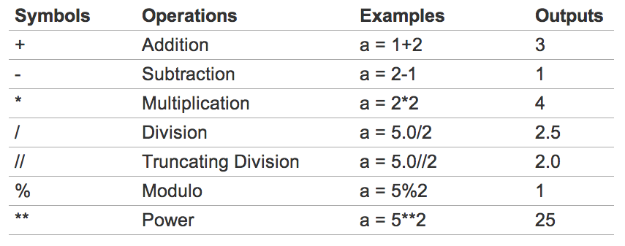
Summary of Math Operators

Slide 6
Math Shortcuts
There are some handy shorcuts you can use, seen below:
>>> a = 5
>>> a = a + 1 # a is now 6
>>> a += 1 # a is now 7
>>> a = a - 2 # a is now 5
>>> a -= 2 # a is now 3
>>> a = a * 2 # a is now 6
>>> a *= 2 # a is now 12
>>> a = a / 2 # a is now 6
>>> a /= 3 # a is now 2

Slide 7
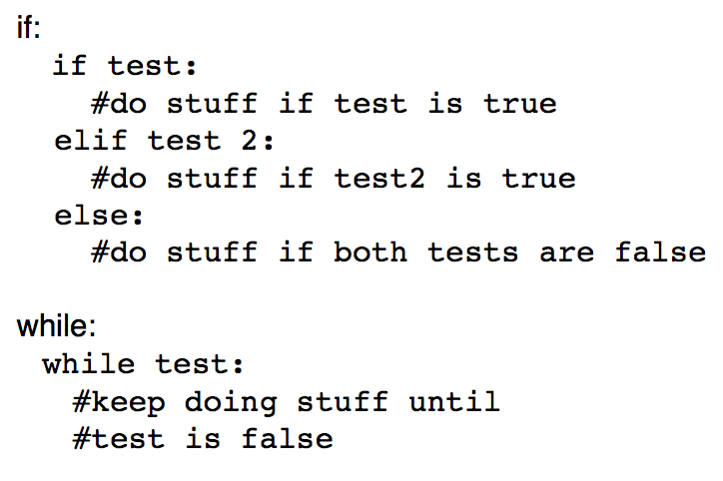
Python Control Structures

Slide 8
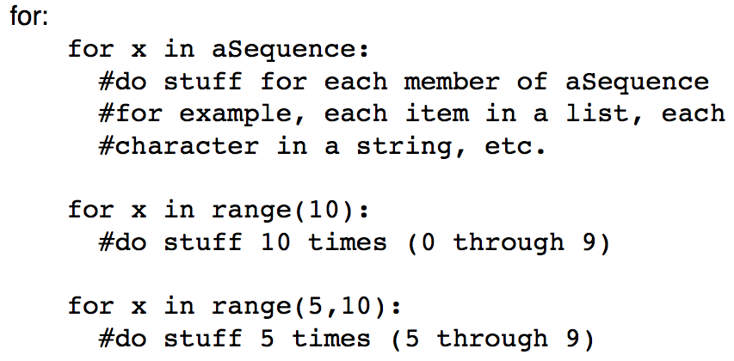
Python Control Structures - Cont.

Slide 9
Python Functions
Just like you were able to teach Guido new instructions, you can teach Python new instructions (called functions)
def addingFunction(parameter1, parameter2):
”””A function that takes two parameters and adds them together”””
result = parameter1 + parameter2
return result
addingFunction(4, 3) #would equal 7

Slide 10
Standard Python Functions/Modules
Some things are done so often, it seems like a waste for everyone to continually write the same code over and over. This is where Python modules come in…
>>> import math
>>> math.sqrt(16) #would return 4
>>> math.cos(0) #would return 1
>>> import webbrowser
>>> webbrowser.open(“http://wmcicompsci.ca”)
>>> import random
>>> random.randint(1,10) #an int from 1 to 10

Slide 11
Python Input/Output
Standard Input
input(“Put your string prompt here: “)
will always return a string as the result – you will need to convert it to an int or a float if you are expecting a number
Standard Output
print(“Whatever it is you want to print. Any data type is fine.”)
will print to the standard output (usually the python console/interpreter)
Can also read/write to files on disk, on the web, etc. but we’ll check that out a bit later.

Slide 12
A bit more Python
Going slightly beyond the basics…

Slide 13
Python Strings
A string is a sequence of characters, usually used to store text.
creation:
the_string = “Hello World!”
the_string = ‘Hello World!’
accessing particular character(s):
the_string[4] # returns ‘o’
the_string[1:3] # returns ‘el’
the_string[:5] # returns ‘Hello’
the_string[8:] # returns ‘rld!’
the_string[-2] # returns ‘d’

Slide 14
Python Lists
More Details @ PySchools
creation:
thelist = [5,3,‘p’,9,‘e’] thelist is now [5,3,’p’,9,’e’]
accessing:
thelist[0] returns 5
slicing:
thelist[1:3] returns [3, ‘p’]
thelist[2:] returns [‘p’, 9, ‘e’]
length:
len(thelist) returns 5
add:
thelist.append(37) thelist is now [5,3,’p’,9,’e’,37]
remove:
thelist.remove(‘e’) thelist is now [5,3,’p’,9,37]
del thelist[0] thelist is now [3,’p’,9,37]
finding:
9 in thelist returns True

Slide 15
Python and Text Files
Can read/write to text files quite easily:
Read
thisfile = open(“datadirectory/file.txt”, ‘r’)
thisfile.read() #reads entire file into one string
thisfile.readline() #reads one line of a file
thisfile.readlines() #reads entire file into a list of strings, one per line
for eachline in thisfile: #steps through lines in a file
Write
thisfile = open(“datadirectory/file.txt”, ‘w’)
thisfile.write(“something”) #adds ‘something’ to the end of the file

