Slide 1
Computer Science Coding and Robotics
Variables / Data
So far we have looked at several key building blocks used in designing solutions through computation:
Sequences of Instructions
Decision-making structures (Branching)
Repetition (Looping)
One thing we are missing so far, however, is a way for our programs to store and retrieve (remember) information.

Slide 2
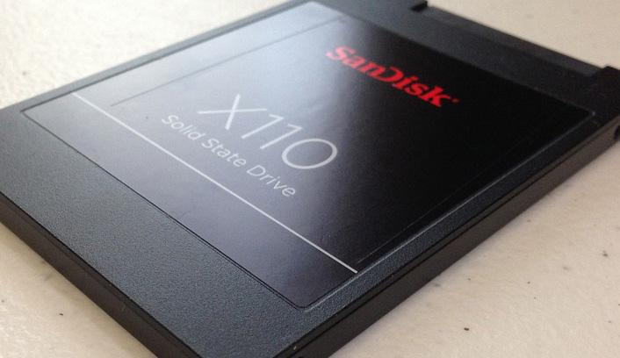
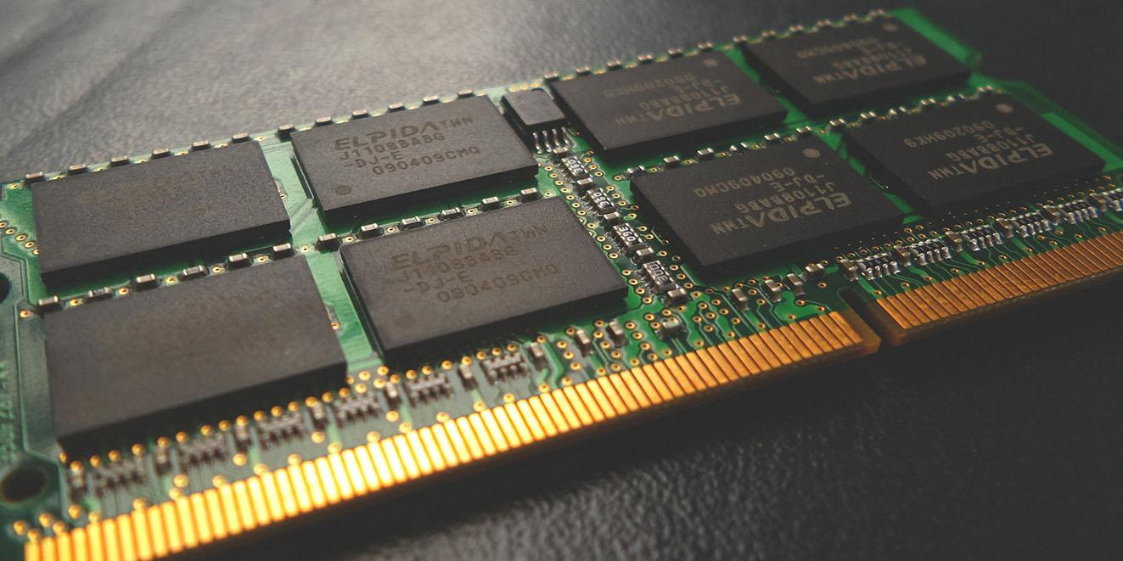
Computer Memory
Computers need to store a lot of information in order to operate, and typically do so in two separate ways:
PERSISTENT MEMORY
This type of storage keeps track of the information even when your device is turned off. Long term storage (SSD, external HDD, memory cards)
Useful for documents, photographs, music, etc…
VOLATILE MEMORY
This memory is more temporary, and is wiped whenever the power is turned off.
Not typically used directly by user, but instead by applications. (RAM, Cache)

Slide 3
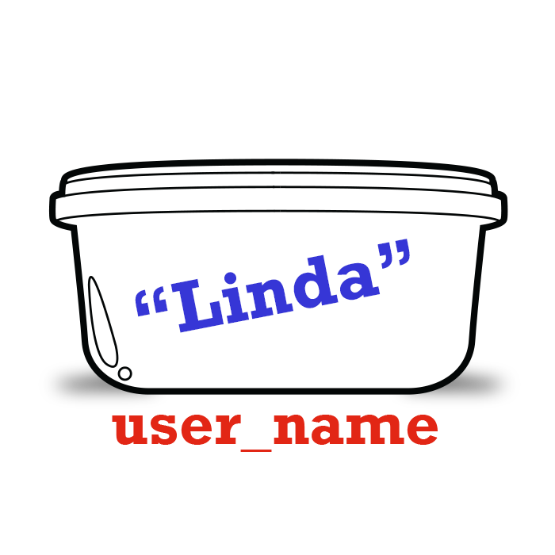
Variables
Memory you can use!
When you are designing programs, Variables are memory that you can make use of.
A variable is a container that can store a piece of information.
We might want to use a variable to:
Store the value of a user’s name
Keep a running tally of the score in a game
Compute a value to be outputted to the screen
In Scratch, variables use persistent memory.
Values are not lost when the program is over!
A variable container can only hold one piece of information at a time!

Slide 4
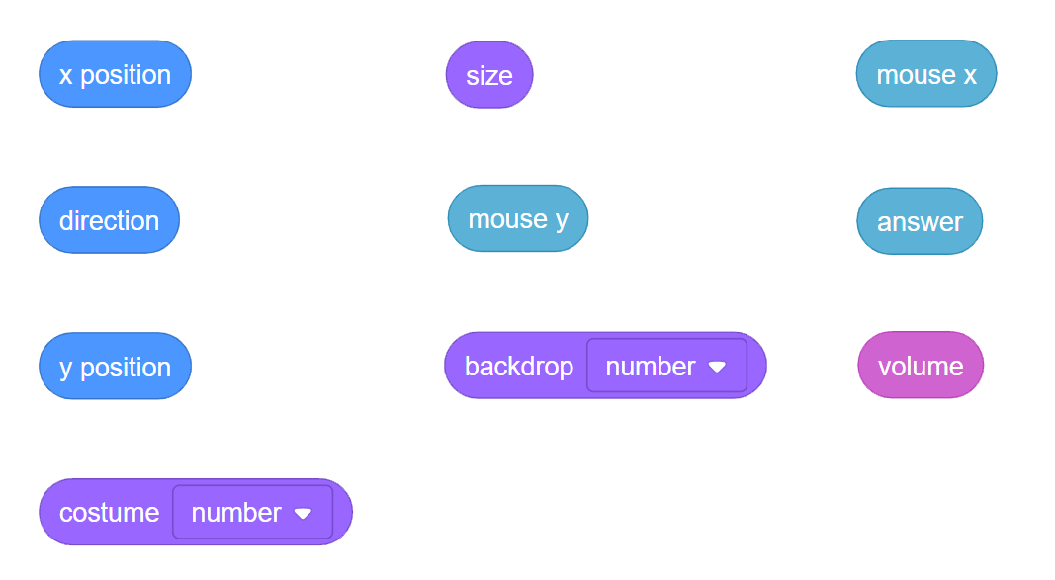
Built-in Variables
We’ve already seen and used some of the built-in variables in Scratch:

Slide 5
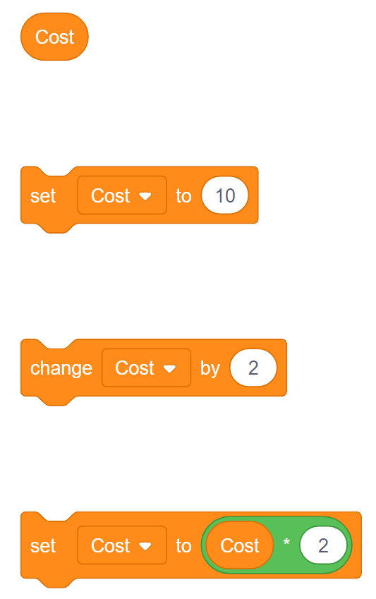
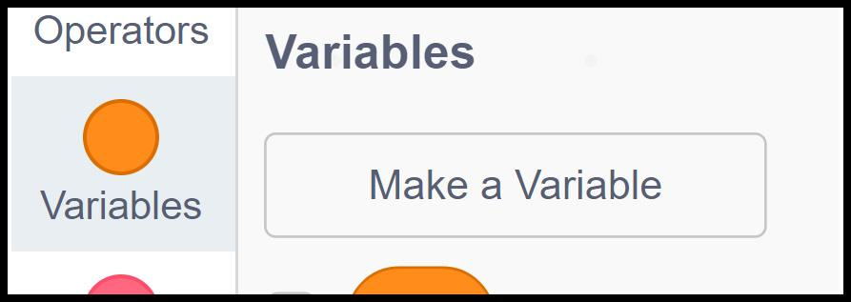
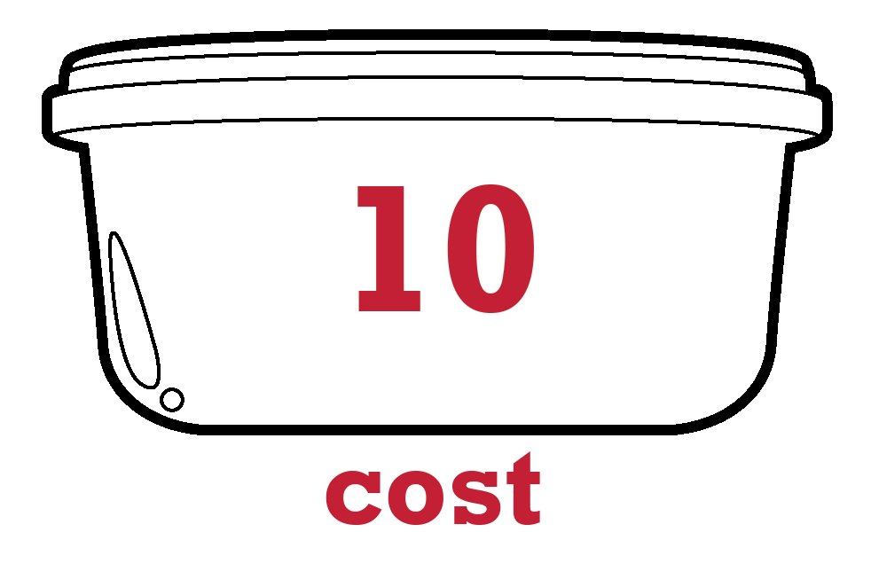
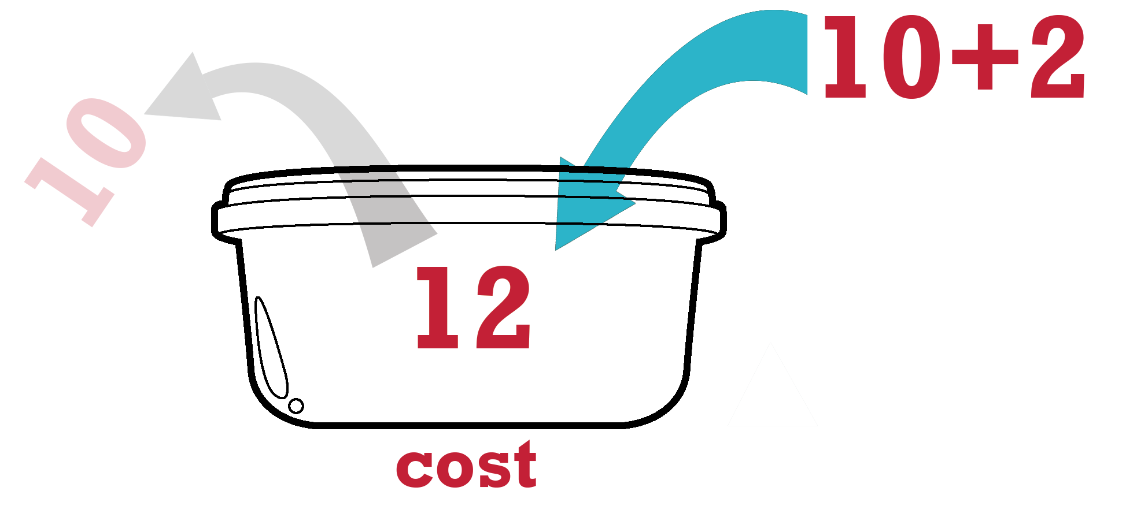

User-defined Variables
We can use the “Make a Variable” button in the Variables palette to create one of our own.
Setting a variable puts a value into it. If there was a previous value, that is discarded.
Changing a variable creates a new value by adding to what is currently into it. The old value is discarded and the new value takes its place.
Set can also be used to modify the existing value with other operations (multiplication, division, subtraction) in this way.

Slide 6
Not Just Numbers
Information – or data – can take many forms. Although in computer science we typically group types of information into several categories, in Scratch there are only two to worry about:
Numeric: Any values that are comprised entirely of numbers. Can be modified arithmetically ( + - * / )
1 15 2.3 -200.9
String: Any values that contain some (or all) non-numeric characters. Can include letters, numbers, and symbols.
“Hello World” “Greetings123”
“Go!!!” “me@mail.com”
Note: In scratch, you won’t actually include the quotation marks (“”). However, in most languages this is common, and allows there to be a distinction between 5 and “5”

Slide 7
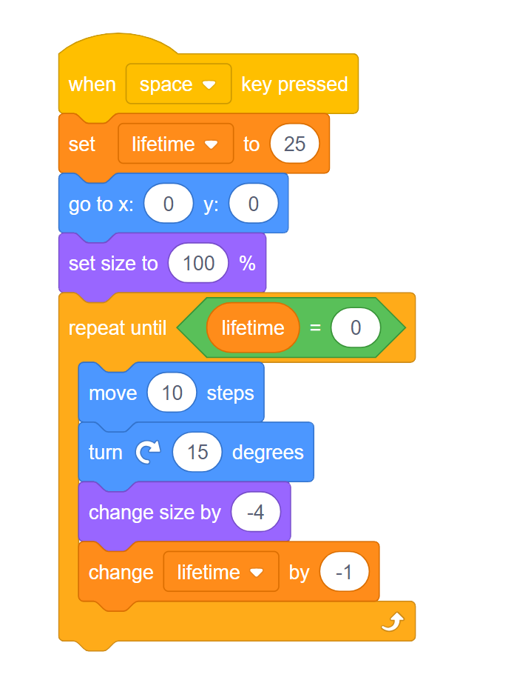
A Few Other Points
Variable names should be descriptive and relevant to their intended use.
Typically you will create one variable for each piece of information we want to keep track of.
Values stored inside variables can be modified during the time that a program is running.
Variables hold the value 0 by default. Remember that variables remember what they were storing the last time the program was run. You may need to reset them at the start of your program!

Slide 8
Demos
Notes:
Data Collector Demo:
Create a script that uses the ASK block to ask the user a series of questions. Store each answer in a separate appropriately named variable. What is your name? How old are you? What is your favourite class? Create another variable called days_old Set this variable to be equal to how old the user is in days. Recall that there are 365.25 days in a year Have the sprite summarize the information stored in all four variables.

Slide 9
Demos
Notes:
Variables Demo 2:
Maybe a Math flashcards type demo

Slide 10
Demos
Notes:
Clones Demo - raincatcher?...Maybe save that for W4 since the dot game will be then. Need something else.
Show the situation where clones make clones
Better process - one hidden sprite to spawn all clones

