Slide 1
Rubik’s cube visual solver
Alfie Griffin u2002767

Slide 2
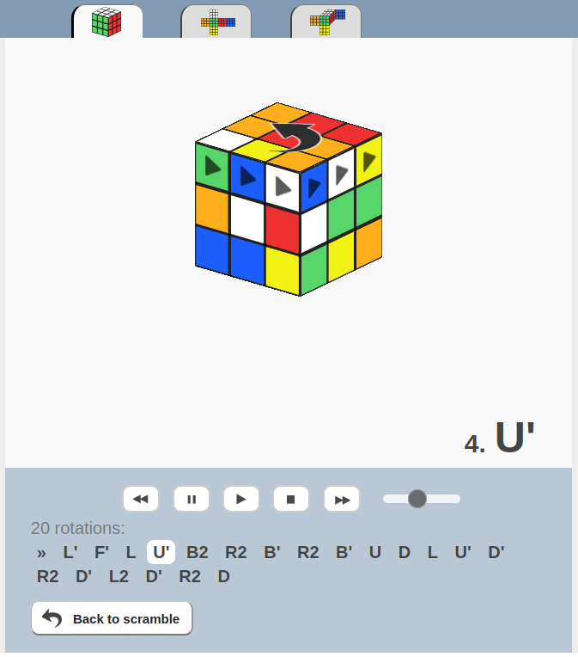
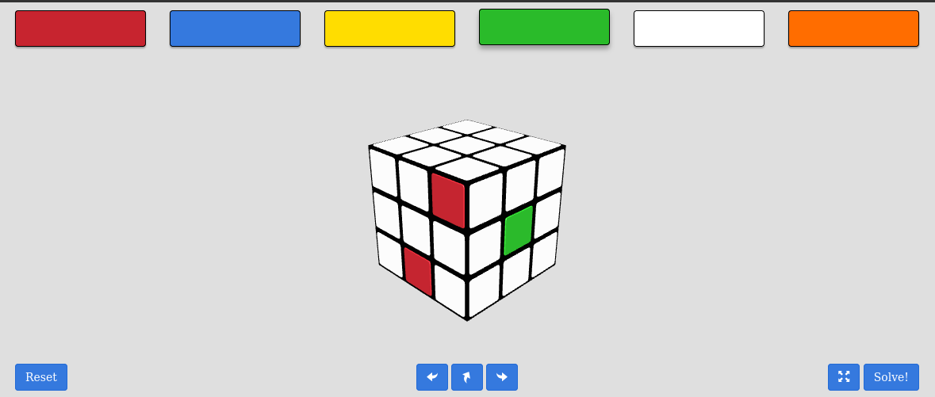
Motivation
Solve cube without complex terminology/notation
Gives an easy way to input the state of the cube
Moves shown on model
Paint on colours

Slide 3
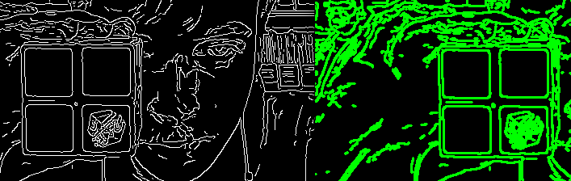
Method – Cube detection
Canny edge detector – edges detected using gradient of image contrast
Max and min threshold
Potential cubie chosen by:
  Area
  Squareness
  Closed shape
Converted to contours

Slide 4
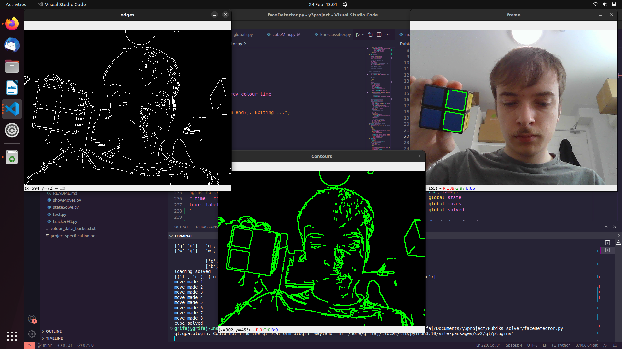
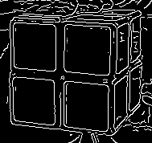
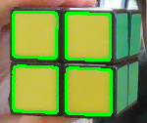
Method – Cube detection
Colours with less contrast sometimes fail to be detected
Edge dilation, changing max and min thresholds
Faces too side-on also fail

Slide 5
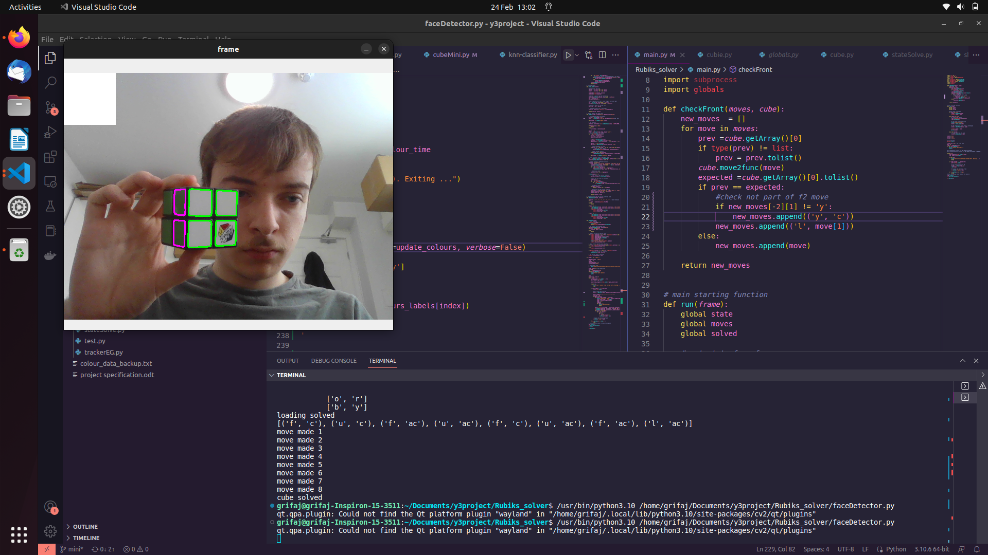
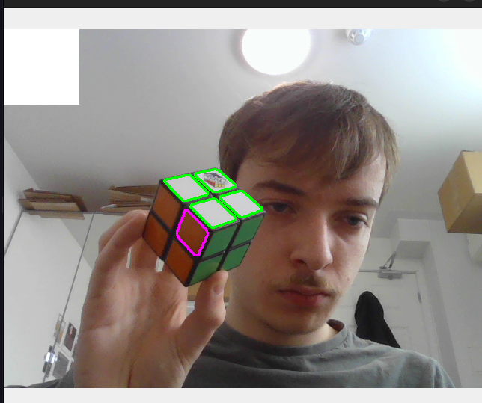
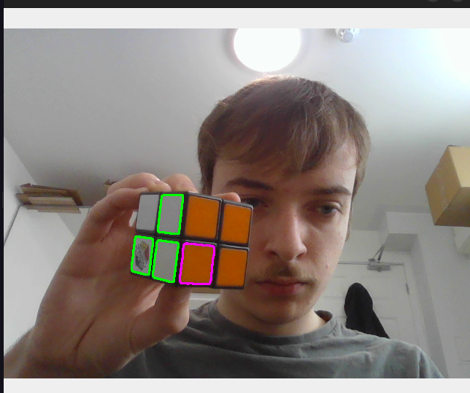
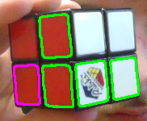
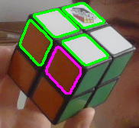
Method – grouping of cubies
Cubies on the same face have similar areas and are located close to each other
Sometimes still fails – should also form square
Good enough?
Correct detection
Failed detection

Slide 6
Method – Colour detection
Difficulty in detecting colours in different lighting conditions

Slide 7
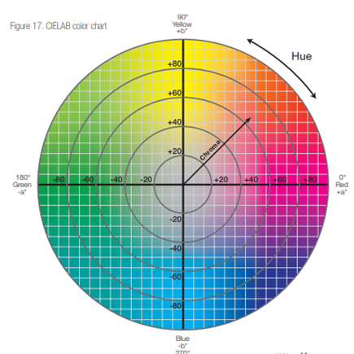
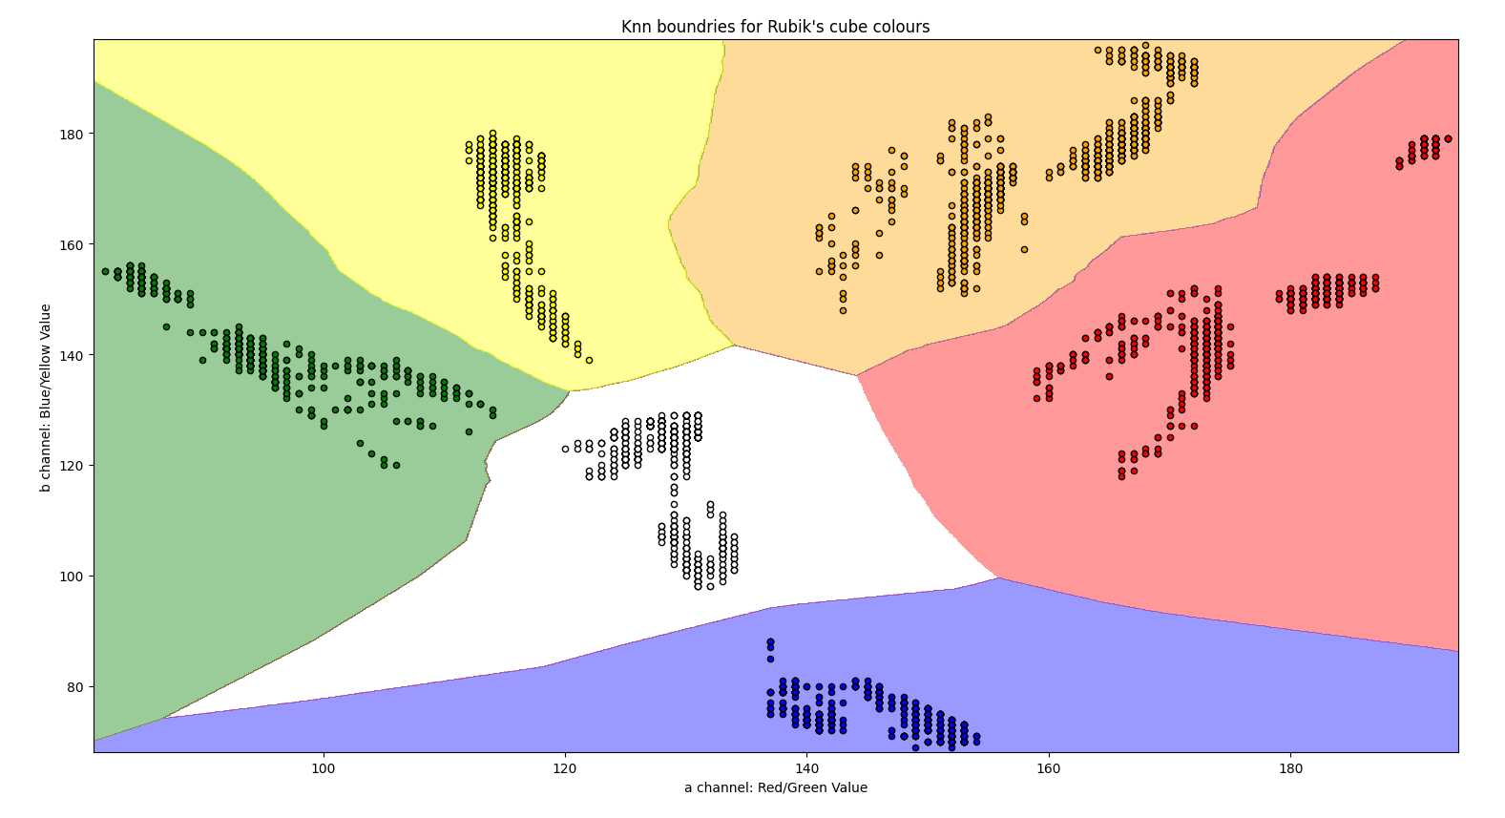
Method – Colour detection
K nearest neighbours – trained on manually labelled data
Convert colours to LAB colour space
Euclidean distance and other methods

Slide 8
Method – Cube rotation
Restricted to moving in predictable direction
Face is identified by the pattern on the face
Would have liked to use centroid tracking, modelled cube

Slide 9
Method - Solver
Iterative deepening A* saves on memory + useful heuristic
Heuristic, used perfect pattern database, could have used Manhattan distance
Database heuristic, multithreading, takes ~20 min to generate

Slide 10
Method – Display moves
Moves are displayed on the cube
Detects move made by expected face
Can’t recover from wrong move being made

Slide 11
Video demonstration

Slide 12
Improvements
More robust tracking – able to account for arbitrary rotation
More exotic cubes – 3x3 megaminx
Faster method for solving cube, koceiemba

