Slide 1
SpringboardAuto Infrastructure

Slide 2
Product Management & Information Technology Organization & Platform Development Lifecycle
Architecture:
Infrastructure Footprint
Network
Server Set Up
Operating Systems & Package Requirements
Platform
Platform Development
Deployment Process
Sprint Lifecycle
Product Management – Tools & Process
Github and Slack Integrations

Slide 3





Architecture Infrastructure Footprint
SBA Remote Office
New York, NY
Site Replication /
Disaster Recovery
SBA Corporate
Irvine, CA
With secure corporate VPN
ORD
IAD
Single-Tenant Infrastructure
100% Uptime Guarantee
Performance & Availability Monitoring
24/7 Engineering Support
Dedicated Pipe
Secure Data Transfer
Cloud Partners

Slide 4










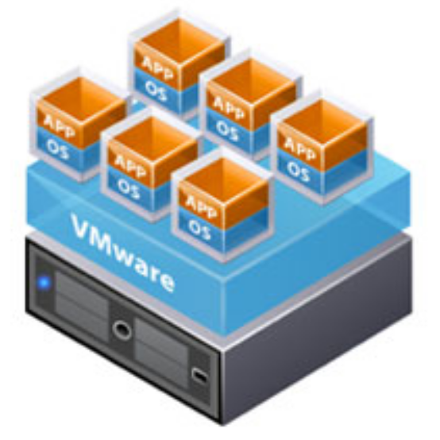

Architecture Network
DMZ
Inside Zone
Secure Zone
F5 LB
Web Assets
Active DB
Server Cluster
F5 LB
Application Servers
Passive DB
Server Cluster
F5 LB
Security Bastions
IP CIDR | Port
IP CIDR | Port
IP CIDR | Port
Cisco ASA 5500-X
Firewall
HP DL380 Octet
Vmware ESXi - NetApp NVME
HSM

Slide 5










Architecture Server Set Up
Public Internet Zone
Third Party Vendors
Agents
Customers
Partners
ATK Load Balancer
Client Load Balancer
Proxy: Route through /api-direct/ to API Server
DMZ
ATK
Client
API Load Balancer
Inside Zone
Web API
going away
WEB API
API
Jobs
Secured Zone
EDW
SQL DB
PostgreSQL
Redis
Mongo DB

Slide 6
Architecture Operating Systems & Package Requirements
Server | Operating System | Port | Package Requirements | Production Server Specification
ATK | RedHat Linux 7 | 3000 | NGINX 1.10.2 Ruby 2.3.1, Rails 5.0.0.1: all packages managed by RubyGems | vCPU (1 core) vRam (8 GBs)
Client | RedHat Linux 7 | 3000 | NGINX 1.10.2 Angular: handled by dev team | vCPU (1 core) vRam (8 GBs)
API | RedHat Linux 7 | 8000 | NGNX 1.10.2 Node.js LTS 8.11.1 Yarn: latest LTS version ImageMagick v6 PDFtk v2.0.2 | vCPU (4 cores) vRam (16 GBs)
Jobs | RedHat Linux 7 | 8000 | Same as API Server | vCPU (2 cores) vRam (8 GBs)
Web API | Will be removed
SQL DB | Windows 2012 R2 | 1433 | SQL Version 2014 SE | vCPU (8 cores) vRam (32 GBs)
PostgreSQL | RedHat Linux 7 | 5432 | PostgreSQL Version 9.6.x | vCPU (2 cores) vRam (8 GBs)
Redis | RedHat Linux 7 | 6379 | Redis Version 2.3.12 | vCPU (2 cores) vRam (4 GBs)
MongoDB | RedHat Linux 7 | 27017 | MongoDB Version 3.2.8 | vCPU (2 cores) vRam (8 GBs)
EDW | Windows 2016 | 1433 | SQL Version 2017 E | vCPU (4 cores) vRam (16 GBs)

Slide 7





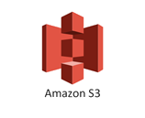





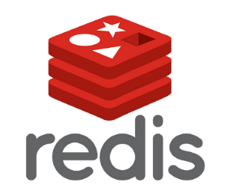


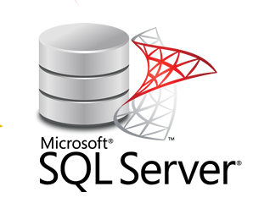
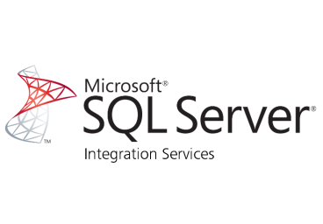
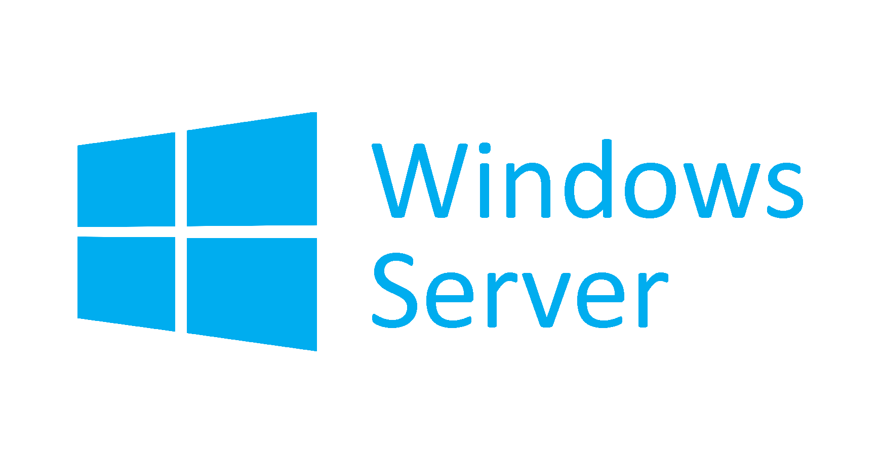

Architecture Platform
Partners
Web Platforms
Platform API
RISK API
Credit App (External)
Complete App
Loan Status
Notary
GAP
Payment Processing
Paperless
Electronic Signing
Vehicle
Notification Engine
Pricing
Credit Decision
Identification
Vehicle Valuation
Pricing
R
E
S
T
R
E
S
T
Customer Portal
Agent Toolkit
Platform DB
Risk DB
Partner APIs
Batch
Jobs
NGNX & node.js

Slide 8













Platform Development Deployment Process
User Experience Testing
Platform Monitoring
Check-Ins
2. Compile + Cover
1. Kick-off Deployment
Backfill
Scrub
4. Test Automation
5. Acceptance Test
Prod
QA
6. Track work, produce release notes, gather feedback and update documentation.
Dev
3. Package & Deploy
NGINX & node.js
Managed Patching

Slide 9
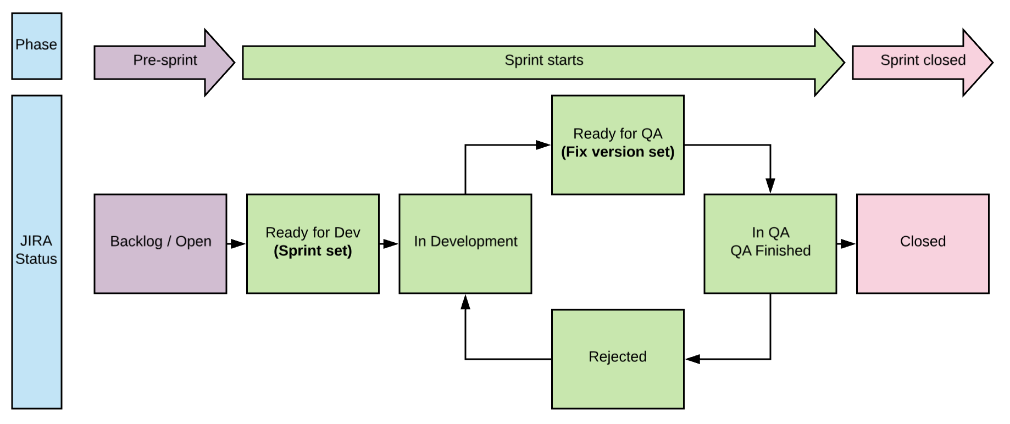
Platform Development Sprint Lifecycle

Slide 10
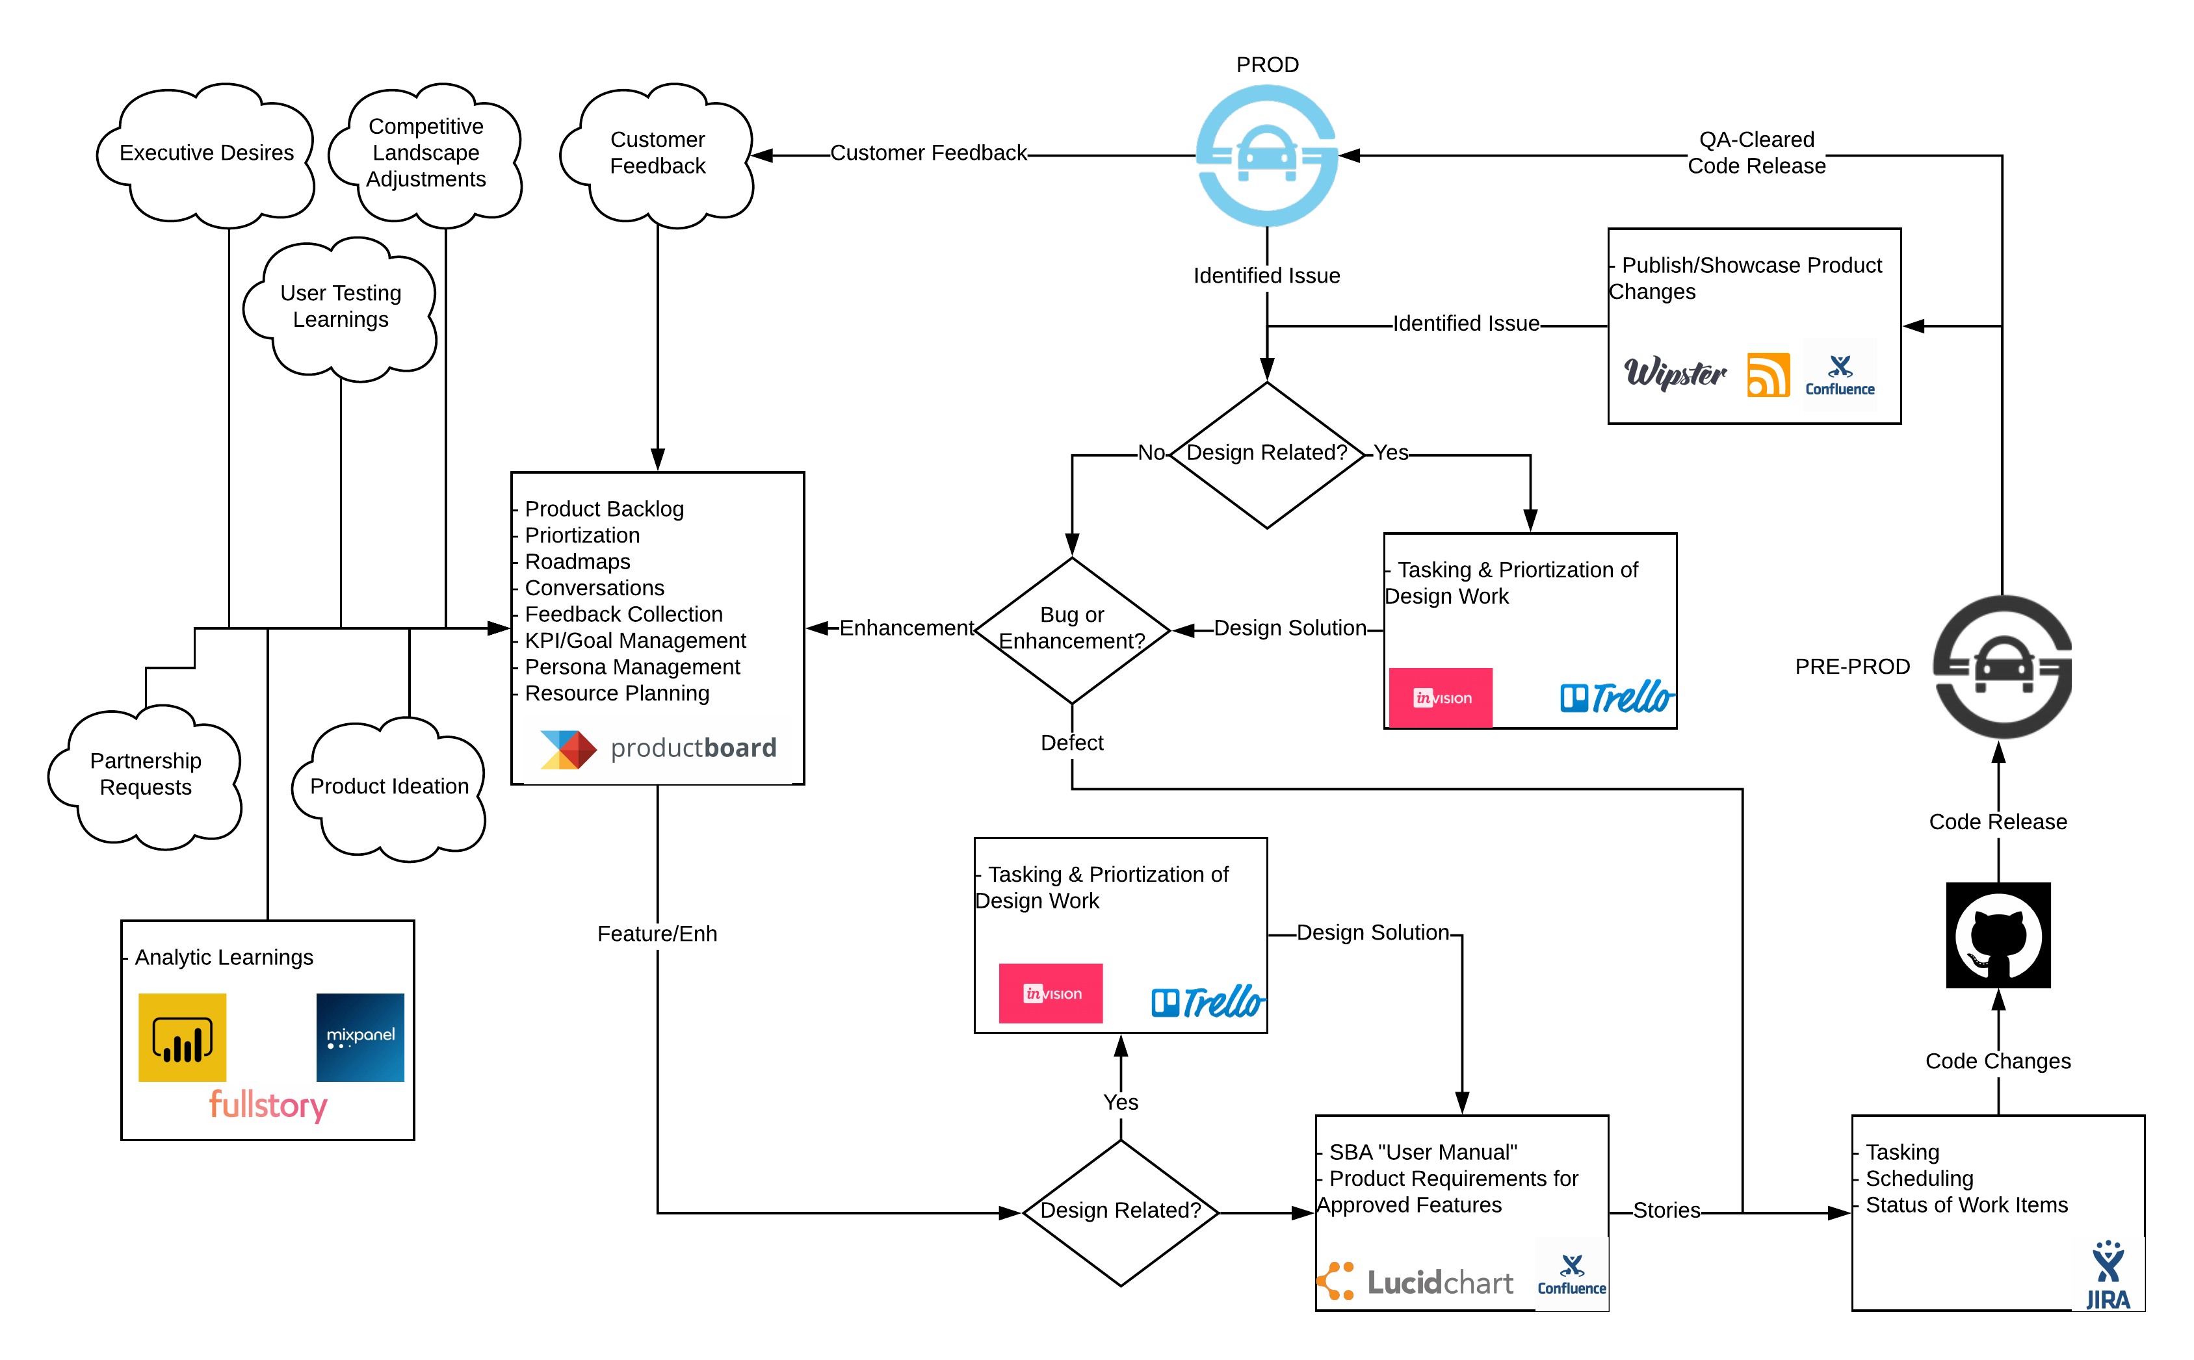
Platform Development Product Management - Process & Tools

Slide 11
Github and Slack Integrations
Slack Integrations
Airbrake
Github
Jira
Travis-CI
Node.js API 4XX and 5XX errors (Custom integration through)
Keymetrics.io/pm2plus (Custom integration)
Github Integrations
Airbrake
Jira
Travis-CI

