Slide 1

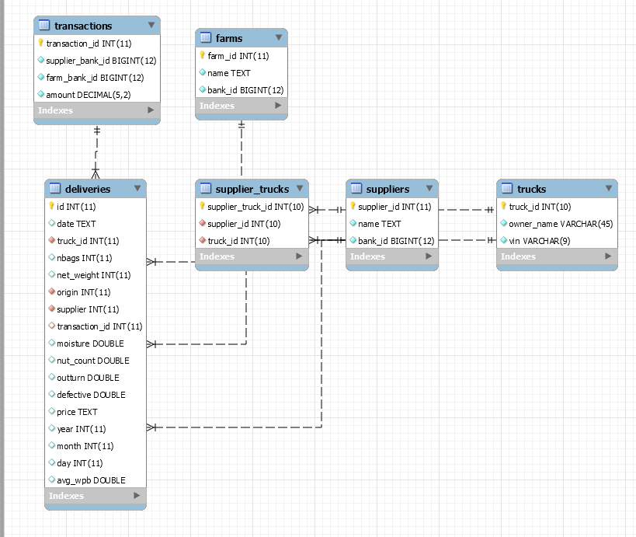
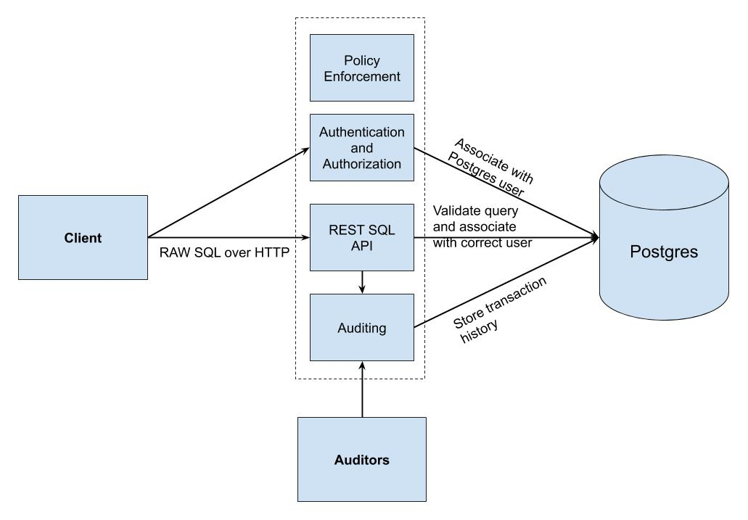
Data Security and Privacy for RESTful API service
B. THOMAS GOLISANO COLLEGE OF COMPUTING & INFORMATION SCIENCES
Aravind Vicinthangal Prathivaathi, Griffin Dunn, Steven Simmons
Introduction
Database Schema
Future Work
Huge amount of sensitive data is being collected as modern era gets taken over by data driven applications.
Data Privacy and security as result have become integral part of application development.
This study is focuses on problem that arise due to lack of data privacy and security, how to protect sensitive data with a simple implementation that has data security as a cornerstone in development.
The current design is a bare-bones structure that is easily adaptable, where future work would involve data security over a distributed network with multiple servers.
Also, security features involving data inference need to studied in depth for data anonymization.
Addition of dynamically scoped roles.
Analyzing data security issues that maybe caused due to addition of middlewares to the application
Automated security alerts and database lockdown features if major security is compromised.
Using user-specific scripts to generate API password and implement automated API password change/minute to enhance security.
Analyze the impact of third-parties and CDNs in role of data privacy and security.
System Design
Summary
Presented a barebones, scalable and adaptable data security design for web-based application that use http/https in communication.
The design uses database features, middlewares and back-end scripts to handle the necessary security features mentioned.
Data privacy is an integral part of the design and every component in the design enforces some aspects of our data privacy policies.
Client acts as an interface to query postgres database using APIs.
Users are assigned passwords and each user is grouped into a roles that have different permissions.
Role-based access control is adopted as part of the security.
Additionally access is also divided among users into API-level access, database-level access and access to both the levels.
The authentication module, API and database handle most of the data security features including access controls, query restriction, field restriction, SQL injection, etc.
The auditing component maintains a log table which tracks database usage, database operations and their timings for each user to help with security and privacy analysis.
Provides a generic design for RESTful web-applications for common data security and privacy issues.
We use a sample cashew-truck delivery data to demonstrate held in postgres hosted on AWS to demonstrate the design and data security requirements.
Security and Privacy Features
Access Control: Both the API and postgres database provide access control. Role-based access control is adopted.
Query Restriction: Different roles have restrictions to queries they can execute. APIs are also restrictive in terms of queries.
Authentication: Password and restriction to APIs visibility/availability for users provide an additional security layer. Also, handles SQL-injection check and data harvesting attacks.
API-only Access:. Each API-only user have access to only a sub-set of the total APIs available, varying from user to user based on role.
Auditing: Time-track user access and operation patterns to make sure privacy policies are being followed, and catch users or bugs that compromise data security.
Policy Enforcement: Data Privacy policies must be enforced on every level of the application and on every user.
Reference
“Data Security and Privacy Protection Issues in Cloud Computing," 2012 International Conference on Computer Science and Electronics Engineering, Hangzhou, 2012, pp. 647-651.
“ Big Data - Security and Privacy," 2015 IEEE International Congress on Big Data, New York, NY, 2015, pp. 757-761.
“Security and privacy for big data: A systematic literature review," 2016 IEEE International Conference on Big Data (Big Data), Washington, DC, 2016, pp. 3693-3702.

