Slide 1
Noisebridge Python Classes
Introduction to Pixar Renderman for Python
Gareth Morgan
gareth@axum.graphics
https://github.com/griffin2000/PRManForPythonCourse

Slide 2
Prerequisites
Go to: https://renderman.pixar.com/view/get-renderman
Click next and select Create a RenderMan Forums Account create an account
Agree to terms and fill in registration form
Click on link in email
Go back to the Get RenderMan page after logging in
Fill in form and go to download link (RenderMan Server is the component we are interested in)

Slide 3
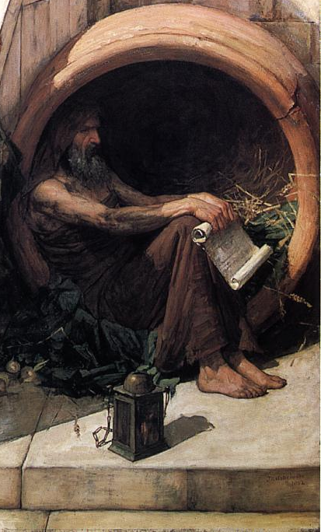
What Socrates actually said
I went to one who had the reputation of wisdom, and observed to him - his name I need not mention; he was a politician whom I selected for examination - and the result was as follows: When I began to talk with him, I could not help thinking that he was not really wise, although he was thought wise by many, and wiser still by himself; and I went and tried to explain to him that he thought himself wise, but was not really wise; and the consequence was that he hated me, and his enmity was shared by several who were present and heard me. So I left him, saying to myself, as I went away: Well, although I do not suppose that either of us knows anything really beautiful and good, I am better off than he is - for he knows nothing, and thinks that he knows. I neither know nor think that I know. In this latter particular, then, I seem to have slightly the advantage of him.
Not Socrates!

Slide 4
What is Renderman?
Properly called Pixar RenderMan or prman
Been around a while (based Ed Catmull’s Phd Thesis from the 1970s)
The first software to win an Oscar
Used on movies including Beauty and the Beast, Avatar and Terminator 2
Used on all the Pixar films from Toy Story to The Good Dinosaur
A production render

Slide 5
Production renderers
Renderers create images
Production renderers are for:
Visual effects for movies
Computer animated films
Architectural visualization
Product pre-viz
Photorealistic
Slow!
Typically integrated into content creation tool

Slide 6
Using Renderman
Environment variable RMANTREE locates the RenderMan Server folder
The RenderMan server application is prman in the bin folder
Takes Renderman Interface Bytestream (RIB) file as an argument

Slide 7
RIB file
Display "sphere.tiff" “tiff" "rgb"
Projection "perspective"
WorldBegin
Translate 0 0 2
Sphere 1 -1 1 360
WorldEnd

Slide 8
PRMan for Python
Python binding for RenderMan
Included in RenderMan Server
To use:
Add $(RMANTREE)/bin to PYTHONPATH
Import prman package

Slide 9
Setup code
import prman
prman.Init()
ri = prman.Ri()
ri.Begin(ri.RENDER)
.
Do some rendering
.
ri.End()

Slide 10
Rendering
ri.Display("sphere.tiff","tiff","rgb")
ri.Projection("perspective")
ri.WorldBegin()
ri.Translate(0,0,2)
ri.Sphere(1,-1,1,360)
ri.WorldEnd()

Slide 11
State
RenderMan is a state machine:
Frame state - Options for frame
World state – Commands to render world
Attribute state – Graphics state for object
Translation state – Sub-set of graphics state

Slide 12
Frame vs World State
for frame in range(0, 10):
xTranslation = (frame*0.1)-0.5
ri.FrameBegin(frame)
ri.Display("sphere.%0.3d.tiff"%frame, "tiff", "rgb")
ri.Projection("perspective")
ri.WorldBegin()
ri.Translate(xTranslation,0,2)
ri.Sphere(1,-1,1,360)
ri.WorldEnd()
ri.FrameEnd()

Slide 13
Frame vs World State
for frame in range(0, 10):
xTranslation = (frame*0.1)-0.5
ri.FrameBegin(frame)
ri.Display("sphere.%0.3d.tiff"%frame, "tiff", "rgb")
ri.Projection("perspective")
ri.WorldBegin()
ri.Translate(xTranslation,0,2)
ri.Sphere(1,-1,1,360)
ri.WorldEnd()
ri.FrameEnd()

Slide 14
Attribute vs World State
ri.AttributeBegin()
ri.Translate(0,0,4)
ri.TransformBegin()
ri.Translate(-1,-1,0)
ri.Sphere(1,-1,1,360)
ri.TransformEnd()
ri.TransformBegin()
ri.Translate(+1,-1,0)
ri.Sphere(1,-1,1,360)
ri.TransformEnd()
ri.TransformBegin()
ri.Translate(0,+1,0)
ri.Sphere(1,-1,1,360)
ri.TransformEnd()
ri.AttributeEnd()

Slide 15
Other transformations
ri.Translate(x,y,z) – Translate along x, y, and z axes
ri.Rotate(degrees,x,y,z) – Rotate around axis
ri.Scale(x,y,z) – Scale in x, y, and z axes
ri.Transform([matrix]) – Set the current transform matrix
ri.ConcatTransform([matrix]) – Concatentate transform matrix

Slide 16
Polygon
ri.AttributeBegin()
ri.Translate(0,0,4)
ri.TransformBegin()
ri.Translate(-1,-1,0)
ri.Sphere(1,-1,1,360)
ri.TransformEnd()
ri.TransformBegin()
ri.Translate(+1,-1,0)
ri.Sphere(1,-1,1,360)
ri.TransformEnd()
ri.TransformBegin()
ri.Translate(0,+1,0)
ri.Sphere(1,-1,1,360)
ri.TransformEnd()
ri.AttributeEnd()

Slide 17
PointPolygon
nverts = [4, 4, 4, 4, 4, 4] indices = [0, 1, 3, 2, 2, 3, 5, 4, 4, 5, 7, 6, 6, 7, 1, 0, 1, 7, 5, 3, 6, 0, 2, 4]
position = [-1.0, -1.0, 1.0, …. -1.0] normal = [0, 0, 1, 0, …. -1, 0, 0] texCoordS = [0.375, 0.625, … 0.125] texCoordT = [0, 0, 0.25, 0.25, .. 0.25, 0.25]
vertexData = {ri.P: position, "facevarying normal N": normal, "facevarying float s": texCoordS, "facevarying float t": texCoordT}
ri.PointsPolygons(nverts,indices,vertexData)

Slide 18
Other Geometry
PatchMesh – Mesh made of quad patches
SubdivisionMesh – Mesh subdivided from smaller control mesh
Blobby – Object represented as signed distance field
Procedural – User defined in C function

Slide 19
Shading
In recent versions RenderMan moved to a path tracing approach: RIS
Physically correct
Ray traced
All the shading implemented via the BXDF function

Slide 20
Lights
Lights implemented via AreaLightSource
PxrAreaLight is most useful
Shape parameter defines types
rect
disk
sphere
cylinder
distant
spot

Slide 21
Ray tracing settings
ri.Hider("raytrace", {"int incremental":1, "int maxsamples":100, "int minsamples": 25})
ri.Integrator("PxrPathTracer", "ffo",
{"int numLightSamples": 4, "int numBxdfSamples": 4,
"int numIndirectSamples": 4, "int allowCaustics": 1})

Slide 22
Light and material
ri.Hider("raytrace", {"int incremental":1, "int maxsamples":100, "int minsamples": 25})
ri.Integrator("PxrPathTracer", "ffo",
{"int numLightSamples": 4, "int numBxdfSamples": 4,
"int numIndirectSamples": 4, "int allowCaustics": 1})

Slide 23
Any questions
?

Slide 24
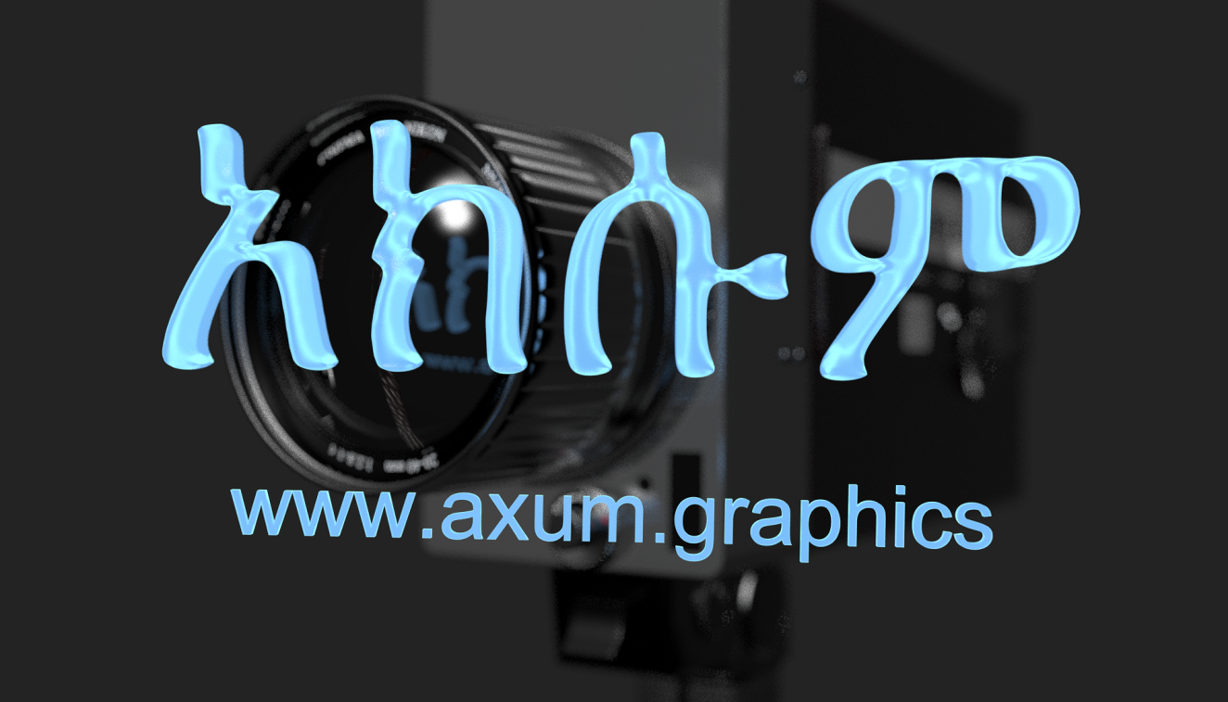
Stay in touch!
Gareth Morgan
gareth@axum.graphics

