Slide 1
Improving Immunohistochemistry Scoring Techniques for Cancer Biopsies with Computer Vision Algorithms
Griffin Calme
Faculty Mentor: Dr. Abhinav Deol

Slide 2
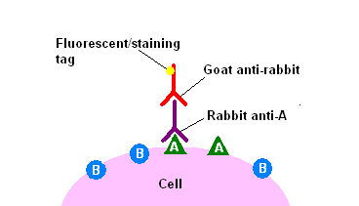
Immunohistochemistry (IHC)
Primary antibody binds to surface antigen
Secondary ‘staining’ antibody binds to primary
Chromogen added to slide reacts with secondary antibody to produce color
https://commons.wikimedia.org/wiki/File:Immunohistochemicalstaining2.PNG

Slide 3
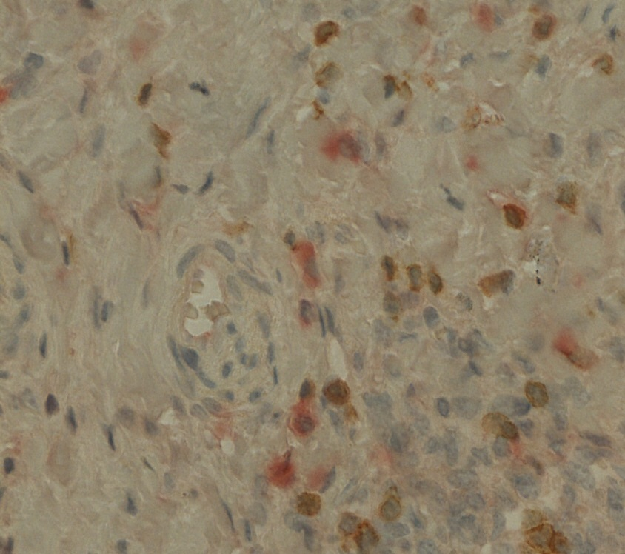

Immunohistochemistry (IHC)
In this case, Diaminobenzidine (brown) = CD3 (infiltrating T-cells)
GBI red = IFN-$γ$ or IL-10 (pairs of identical slides)
Hematoxylin (blue) = Nuclei (all cells)
An example of the staining

Slide 4


Tools Used
Python 3.6
Scikit-Image
Numpy & Matplotlib
https://www.python.org/
http://scikit-image.org/

Slide 5
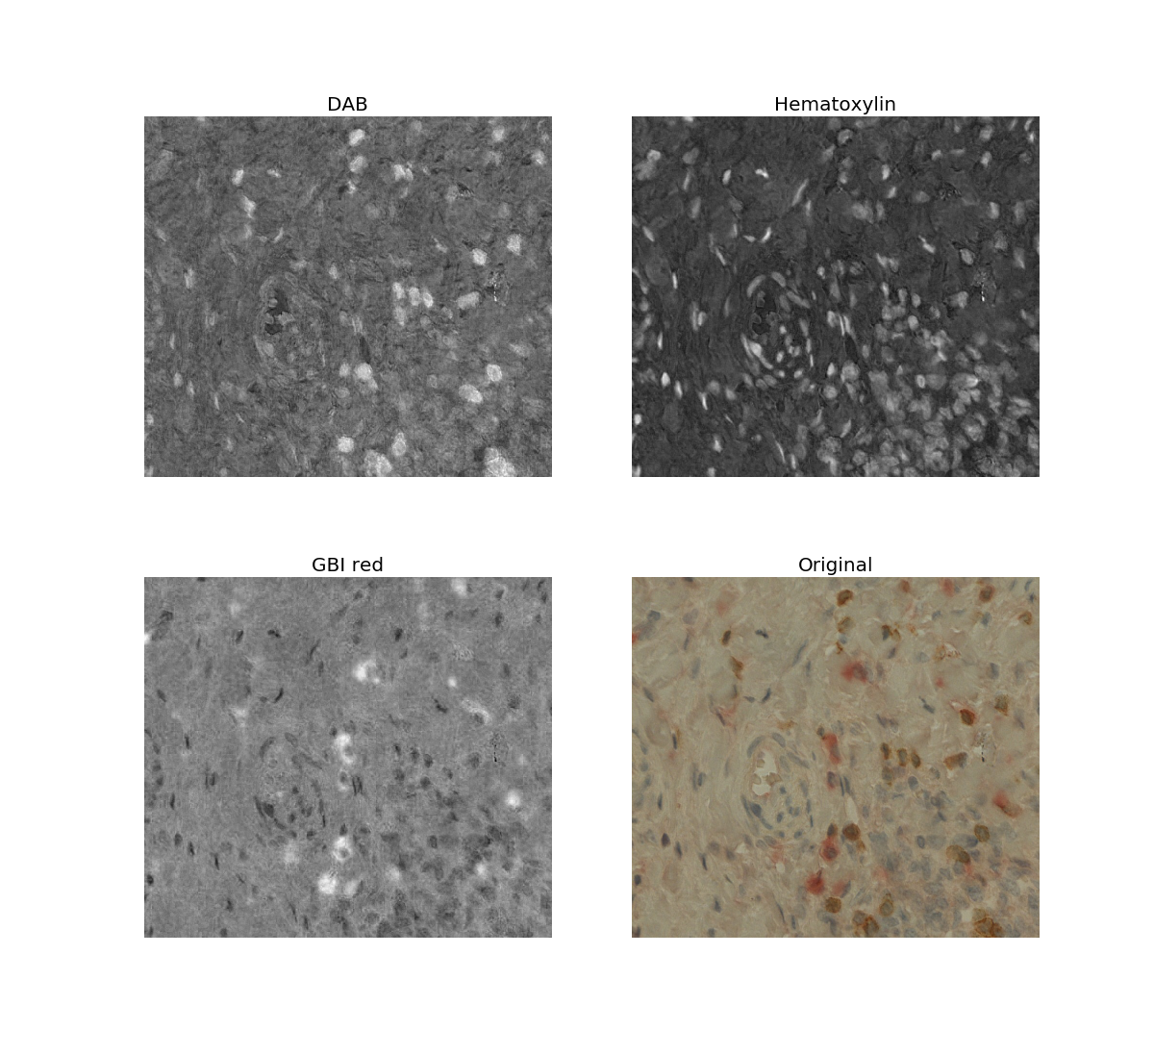
Algorithm 1: Color Deconvolution
Separate stain channels from RGB image
Produces 3 channels, each is a 2D array of stain intensity (from 0-1)
Program output

Slide 6
Algorithm 1: Color Deconvolution
How Does it work

Slide 7
Source Code Repository
Github

