Slide 1


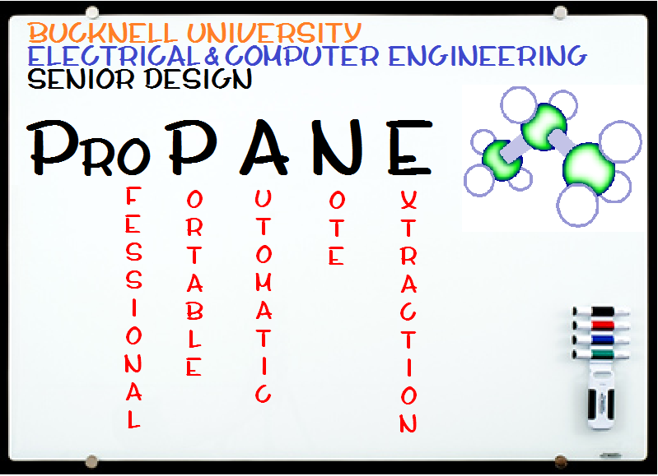
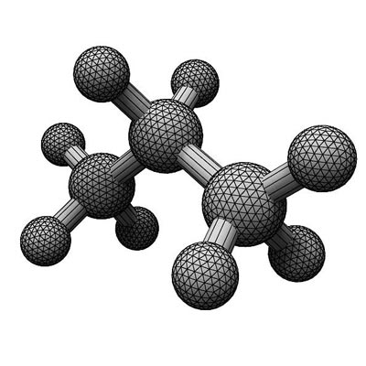
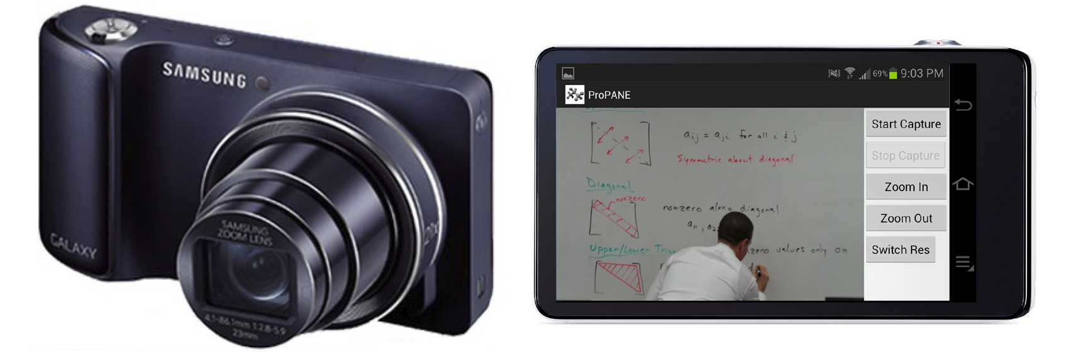
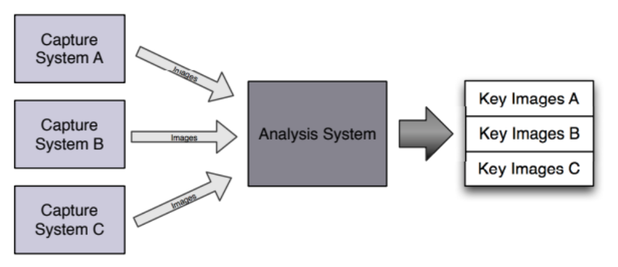
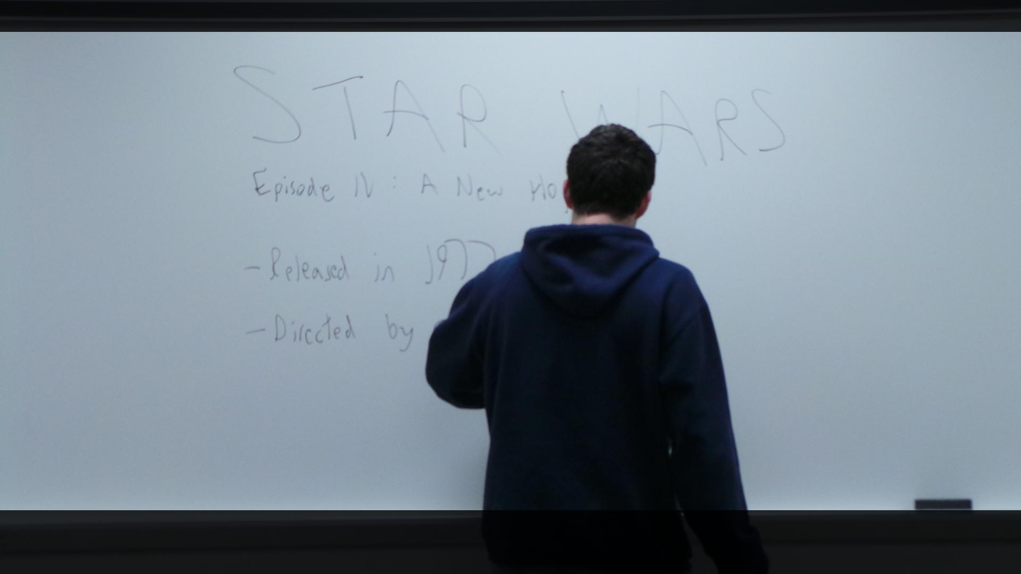
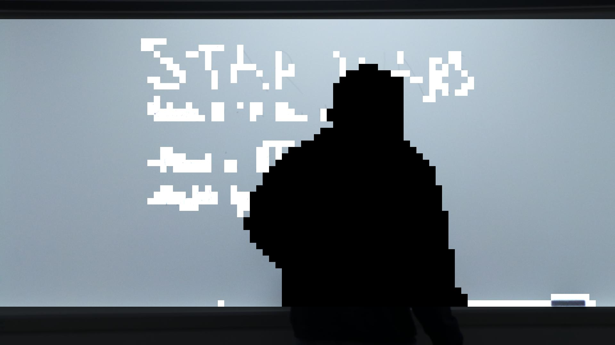
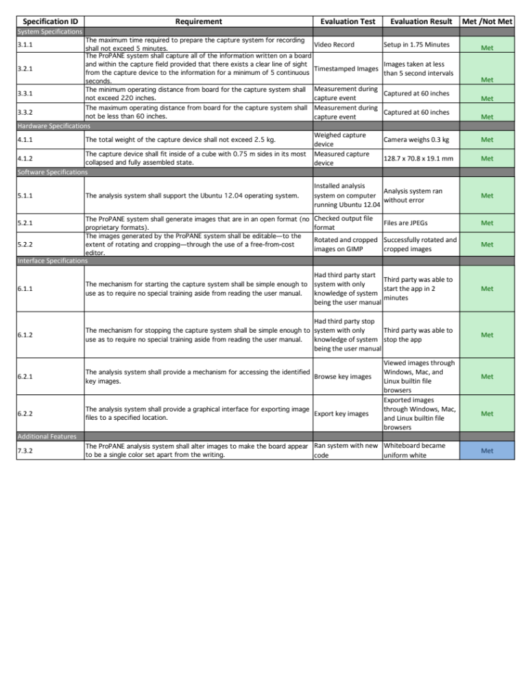
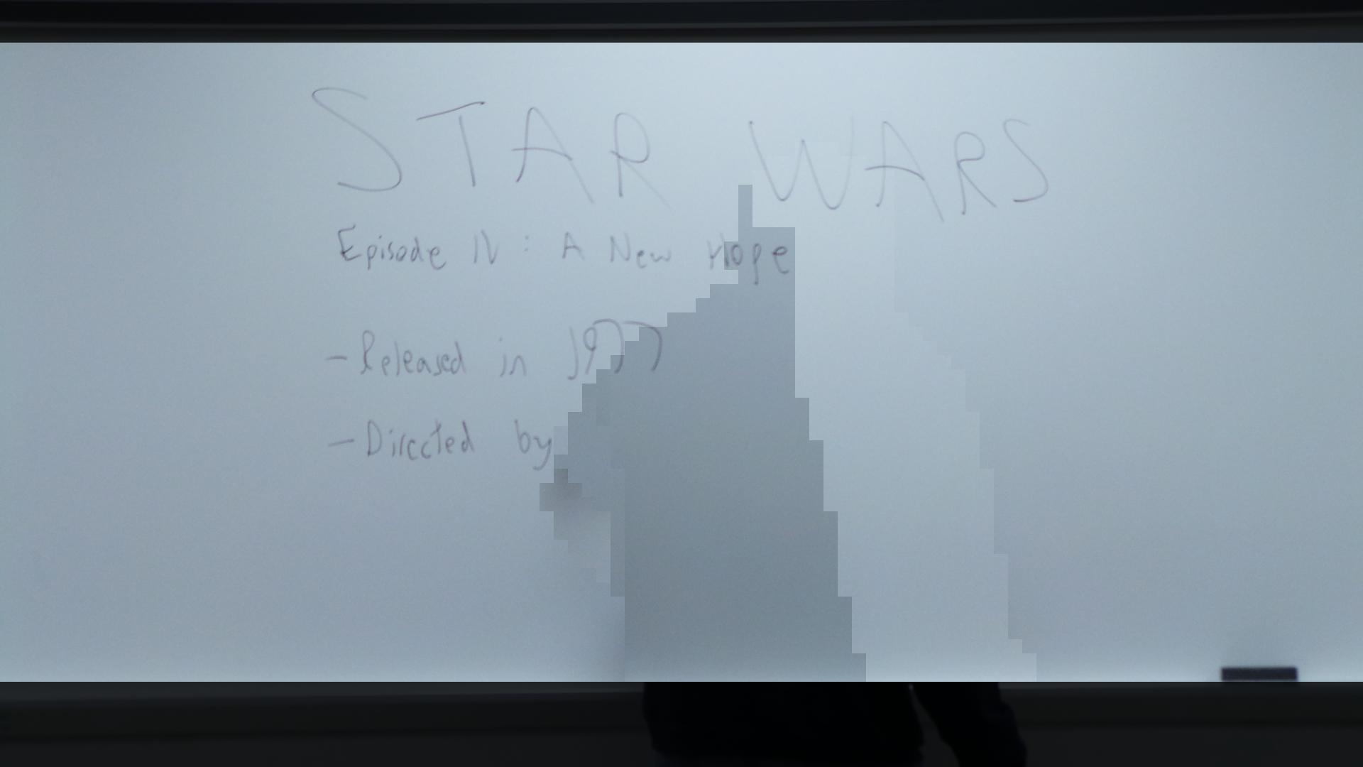
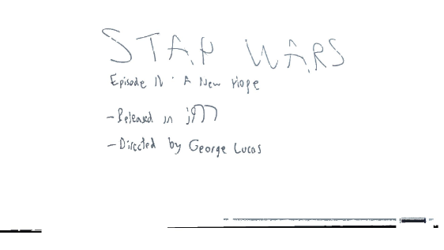
The ProPANE System
Griffin Dunn, Colin Madigan, Phillip Stahlfeld
Bucknell University, Computer & Electrical Engineering
Abstract
The ProPANE system allows for complete capture of the content of a classroom whiteboard. It identifies writing on the board, filters out foreground obstacles, and presents easy to read key images summarizing the lecture for use by a professor or students.
Major System Components
Samsung Galaxy Camera
21x optical zoom
Runs on Android 4.1 “Jelly Bean”
Utilizes custom ProPANE app
Allows for image set capture, color and resolution optimization
Analysis System
Intel Core 2 Duo running Ubuntu 12.04
Supports multiple users
Full access from anywhere on Bucknell campus
System Overview
Capture System
Analysis System
Design Specifications
References
[1] Li-wei He, Zhengyou Zhang, Zicheng Liu, “Why Take Notes? Use the Whiteboard Capture System.” ftp://ftp.research.microsoft.com/pub/tr/tr-2002-89.pdf, September 2002

