Slide 1
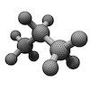
Professional Portable Automatic Note Extraction (ProPANE) System Design
By Griffin Dunn, Colin Madigan, and Phil Stahlfeld

Slide 2
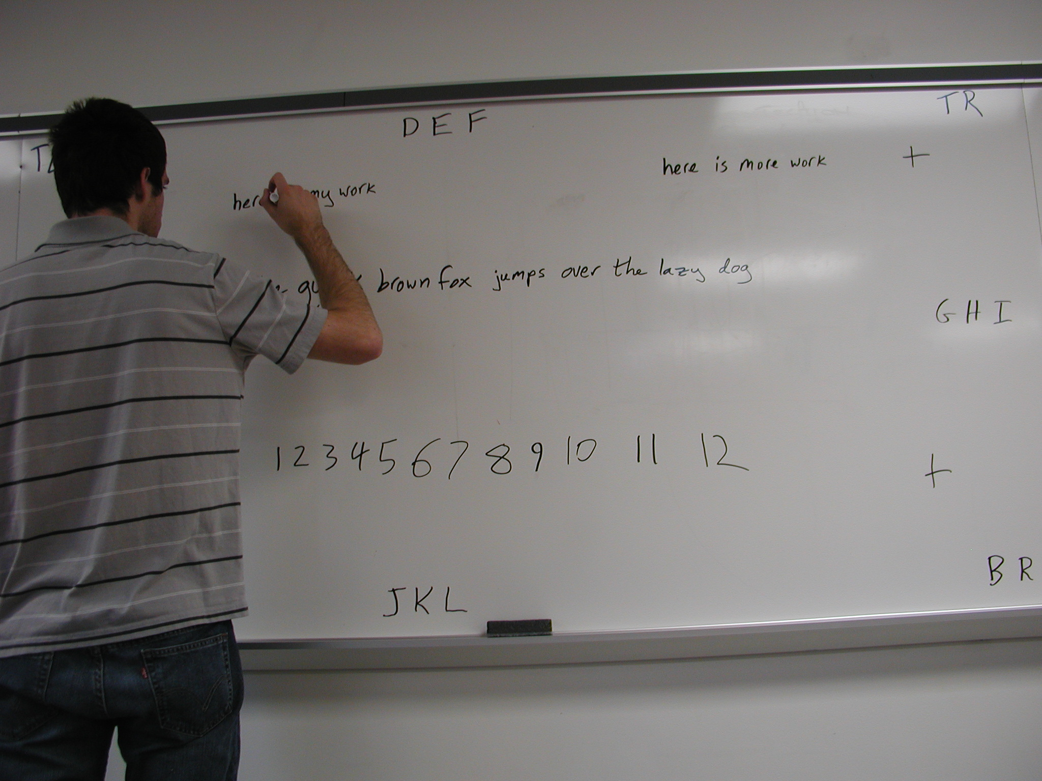
Project Description
Capture images of whiteboards throughout class
Process images
Determine key images
Remove foreground
Return images to Professor
Notes:
What key images are (most information at one point on the board)
Get rid of the person covering some of the information that is on the board
Why are we doing this? Allows professors to compare their lecture notes with what was actually written on the board. Students with disabilities.

Slide 3
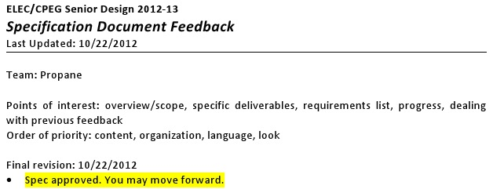
Specifications & Testing
Specifications
Capture 100% of information
Portable System
Wireless
Testing
Standardized set of images
Wall-clock Android app
Notes:
We CANNOT lose information. Even if the key image detection and stitching do not work correctly for an individual run, we still need to capture all of the information that goes on the board. We are legally required to do this.
Transport system from room to room. This is why we can’t use SMART boards. Similar to the Microsoft WCS, but needs to be wireless (i.e. cannot use computer to control camera via USB)

Slide 4
High Level Design
Capture system
Programmable camera
Android app
Analysis system
Dell Desktop
Python application

Slide 5
Capture System Overview
Samsung Galaxy Camera
Sony VCT-R100 Tripod

Slide 6
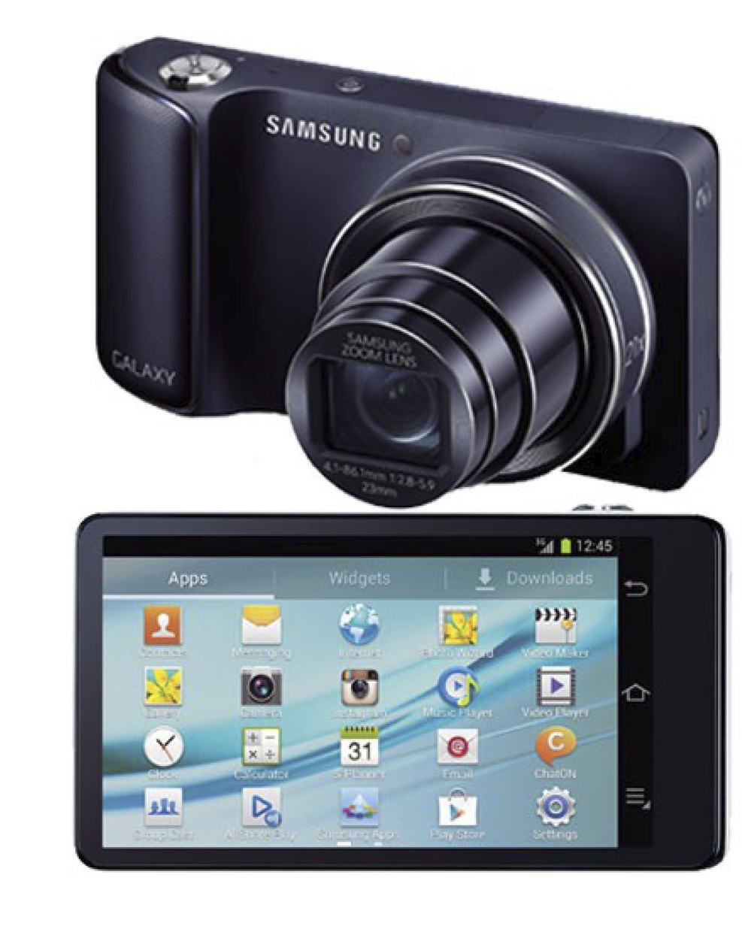
Camera Selection
Samsung Galaxy Camera
Programmable
Wifi
21x Optical zoom
8 hour battery
Notes:
Nikon Coolpix S800c runs Android, but the battery life was not up to par. Only 150 pics on one charge. We need 624 pics for a 52 minute class (assuming 1 picture every 5 seconds as stated in the tech specs)

Slide 7
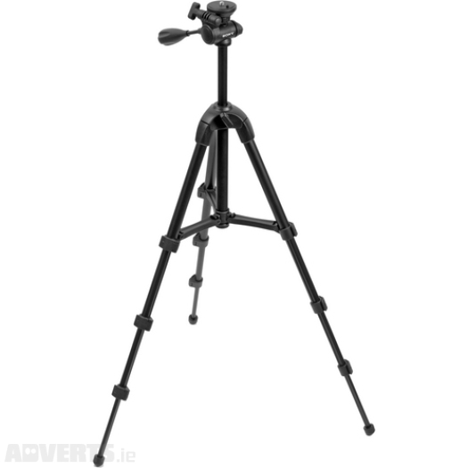
Tripod Selection
Sony VCT-R100 Tripod
14” collapsed
39” extended
Fits in backpack
Notes:
Portable
It’s the most amazing tripod yet

Slide 8
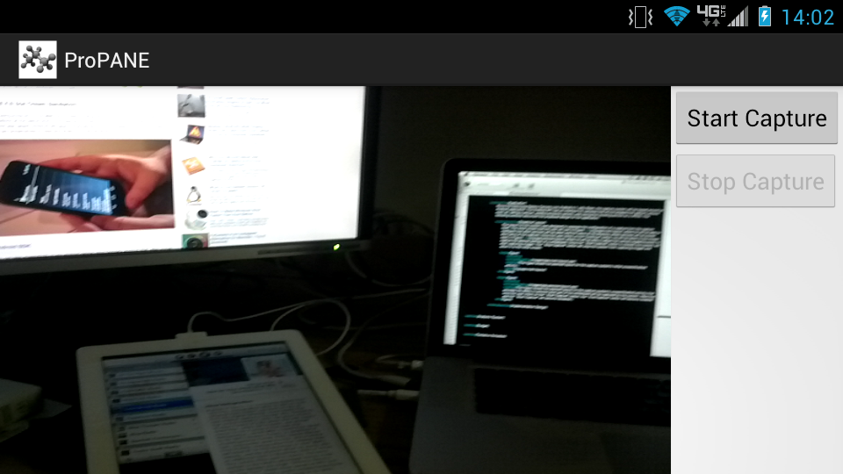
Android App

Slide 9
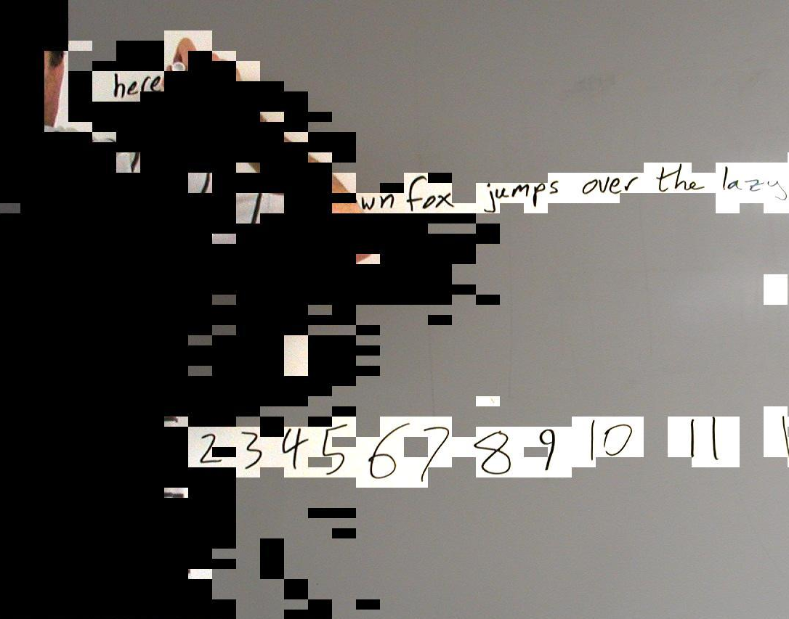
Analysis System Concept
Divide images into cells
Classify cells
Whiteboard
Stroke
Foreground
Identify key images
Remove foreground

Slide 10
February Demos
Android app
Capture configuration
Image capture process
Analysis system
Identify key images in test bed
Remove foreground

Slide 11
Rough Schedule
Panel 4
App on Samsung Galaxy Camera
Panel 5
Functional system
Panel 6
Image tweaks

Slide 12
Budget
Item | Cost
Samsung Galaxy Camera | $500
Sony VCT-R100 | $24
32 GB microSD | $23
TOTAL | $547

Slide 13
Feedback
Questions?
Comments?
Concerns?

Slide 14
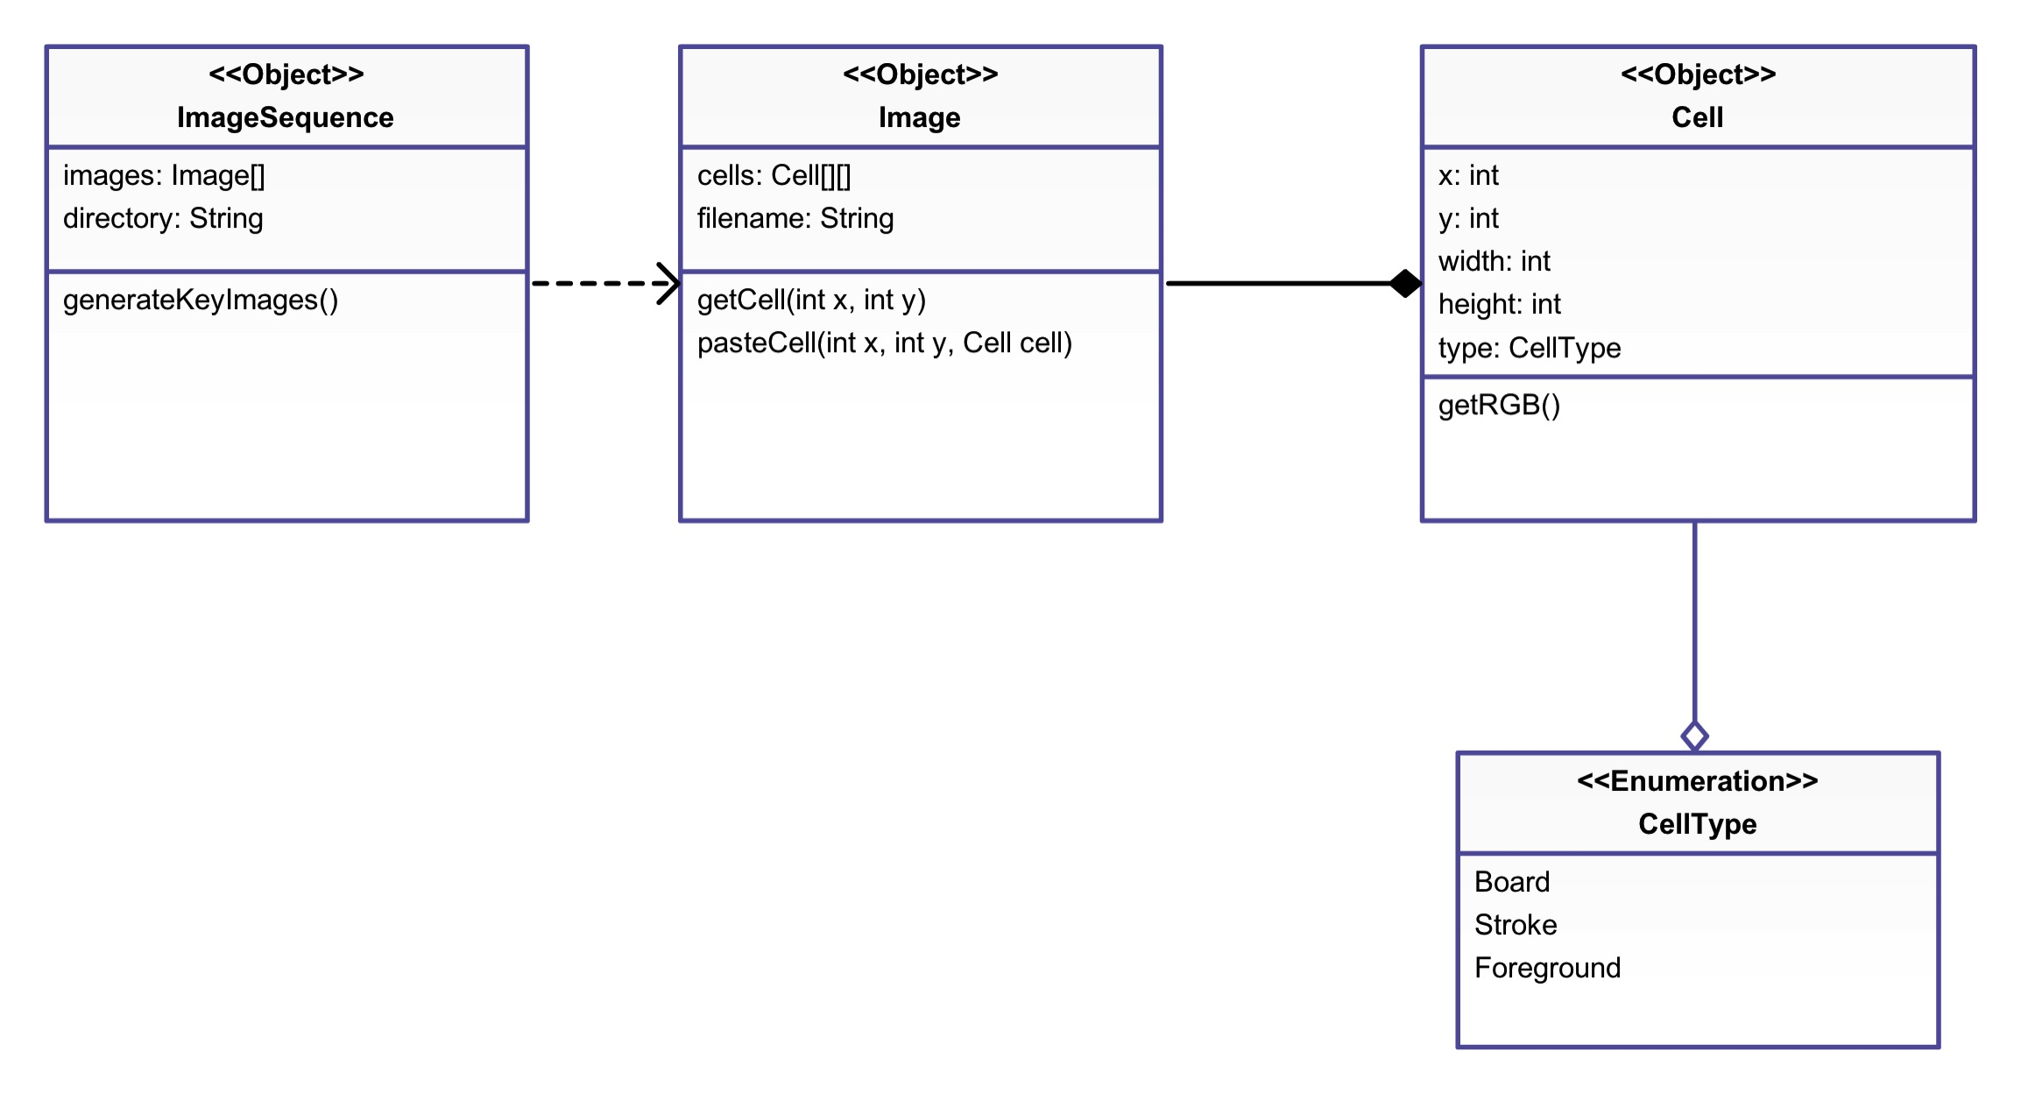
Appendix A

Slide 15
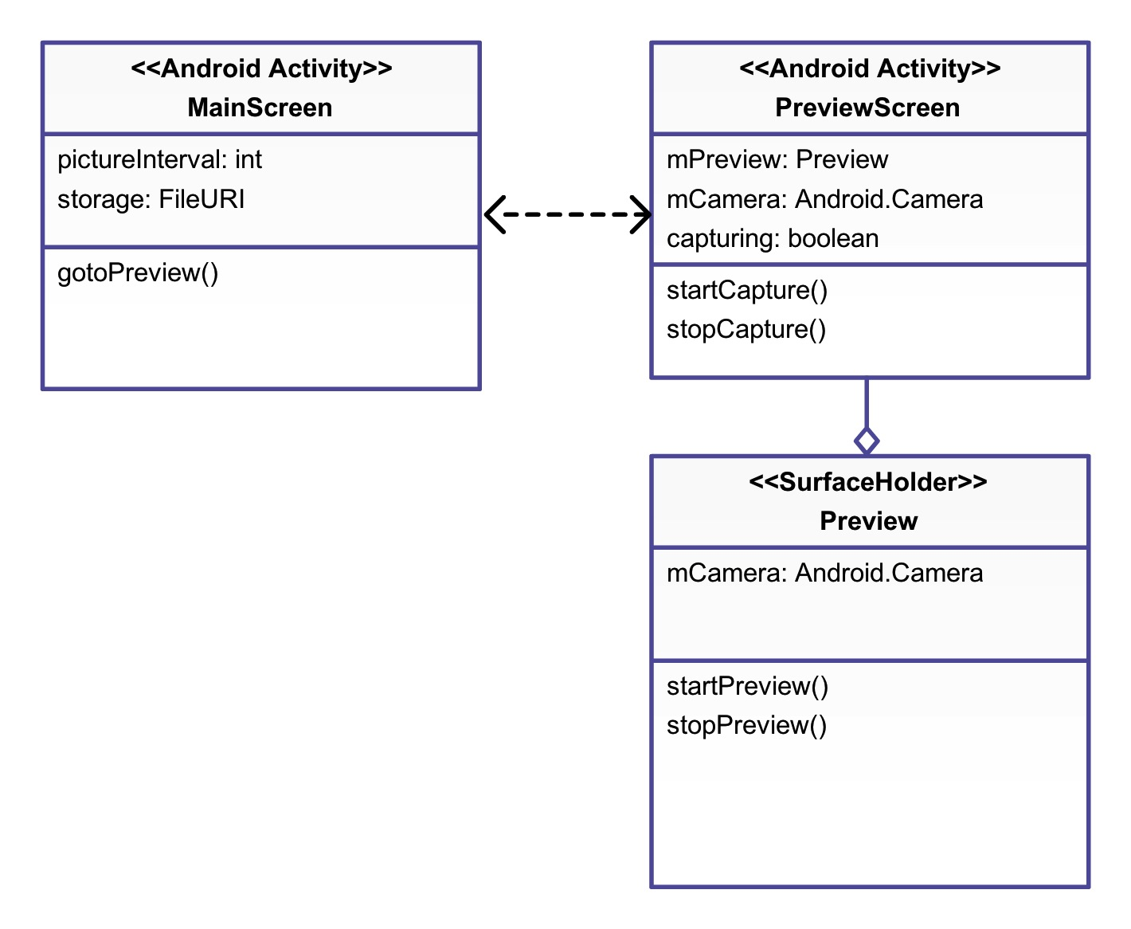
Appendix B

