Slide 1
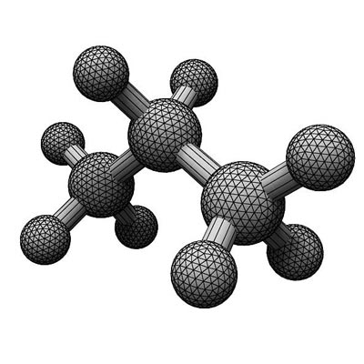




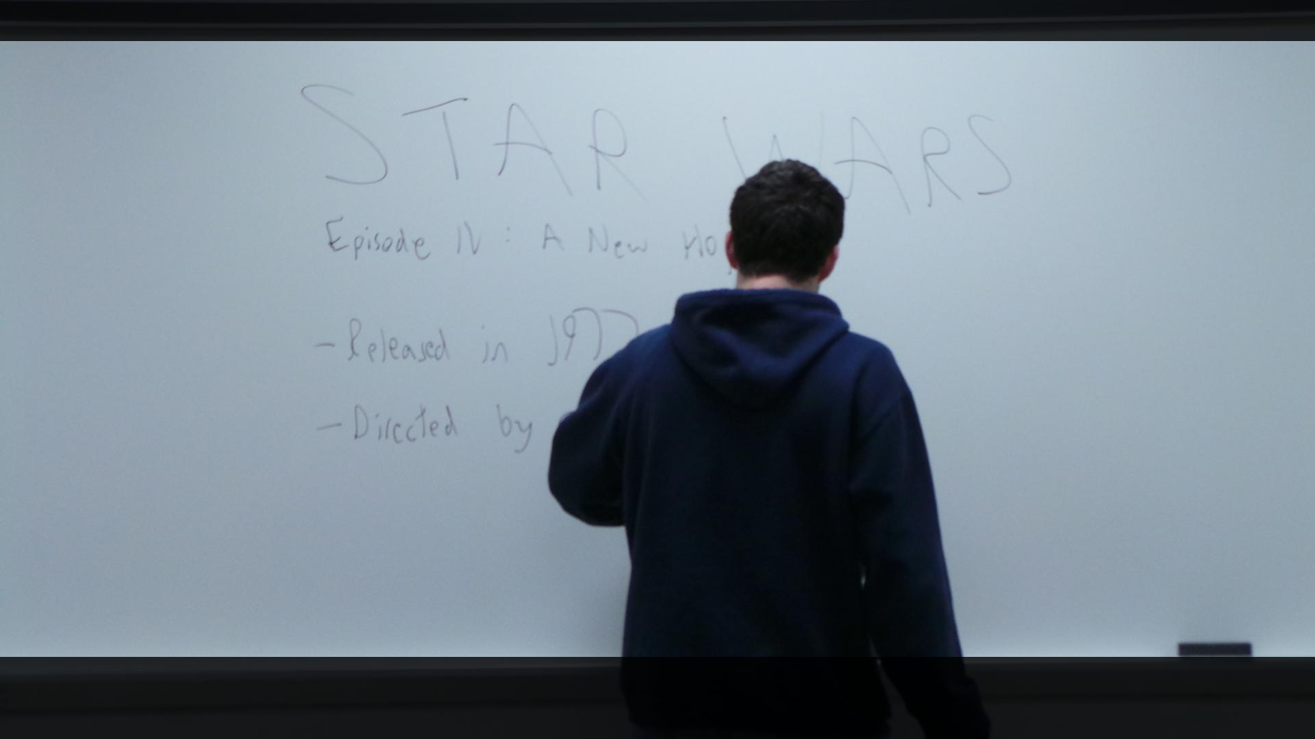
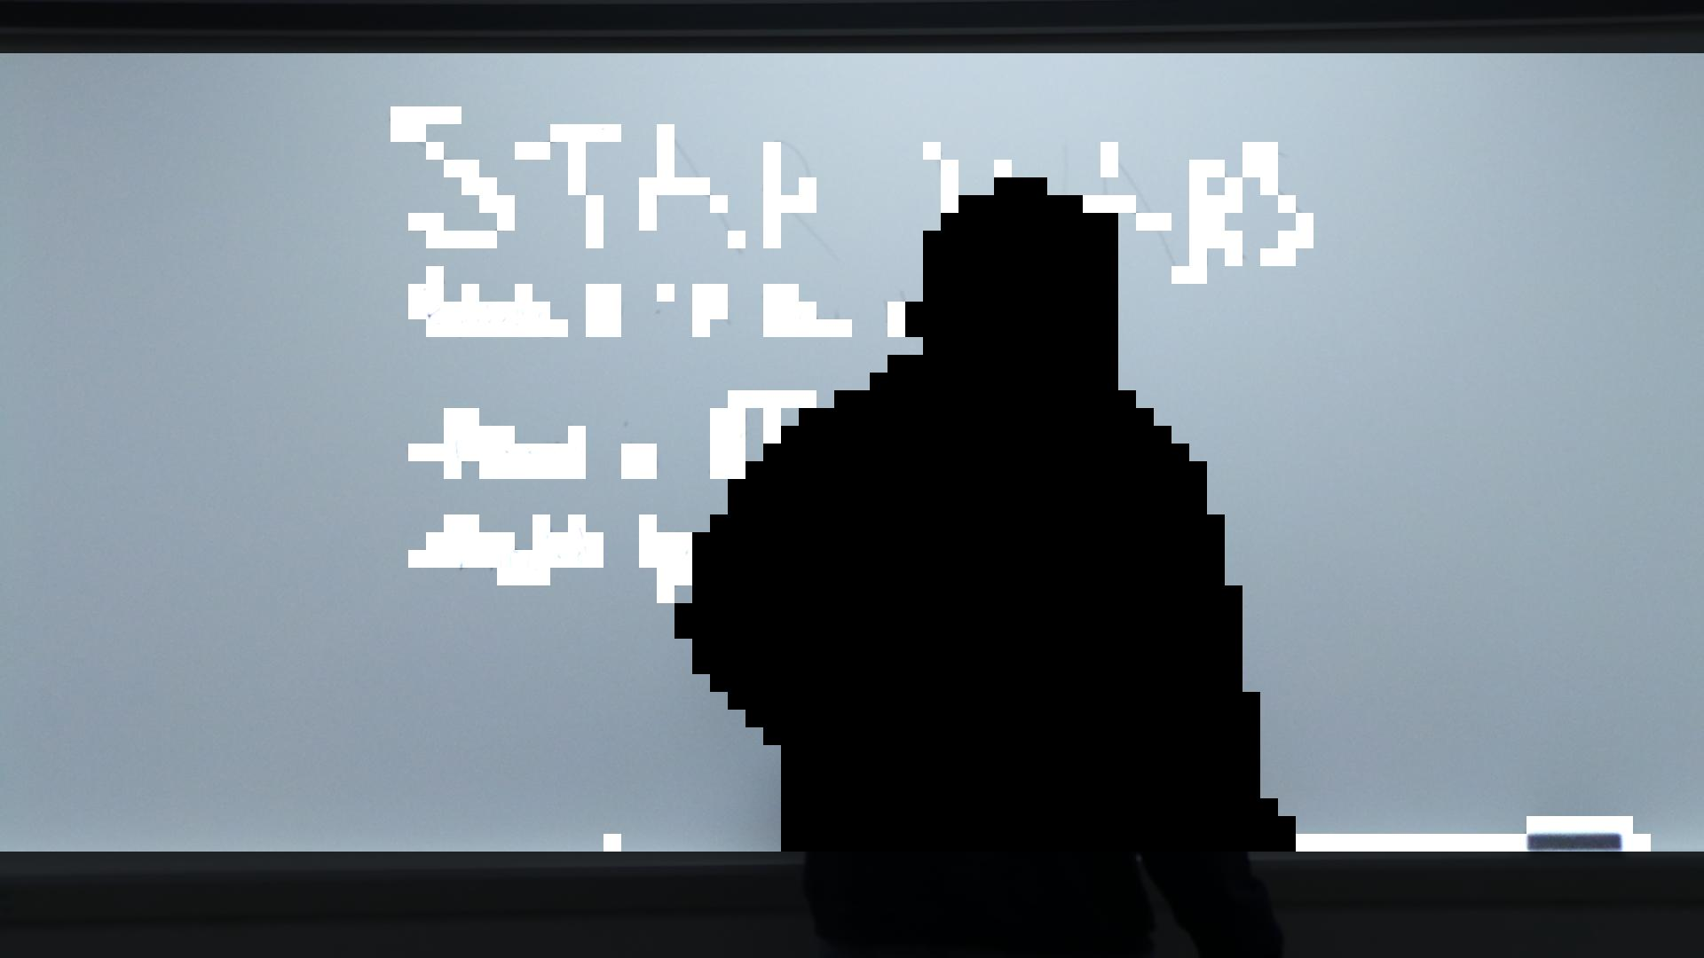
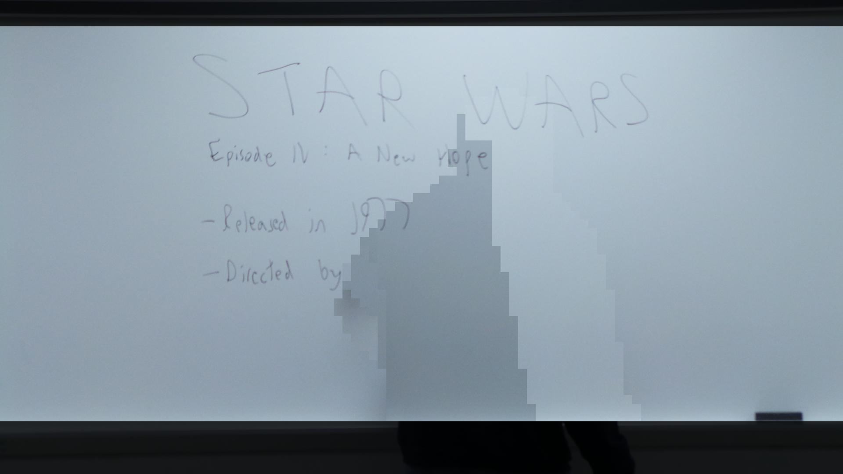
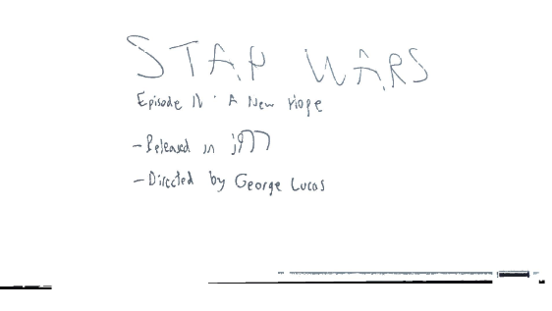
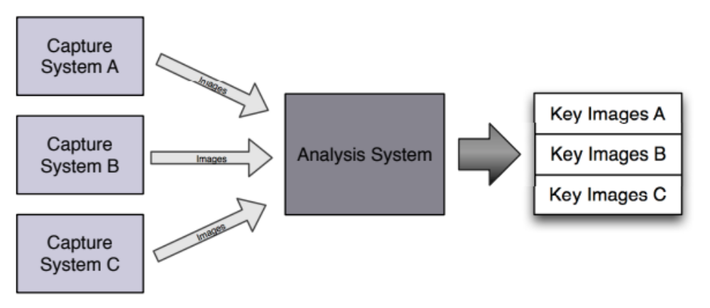
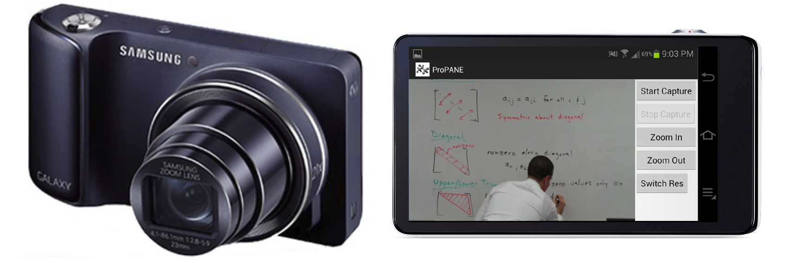
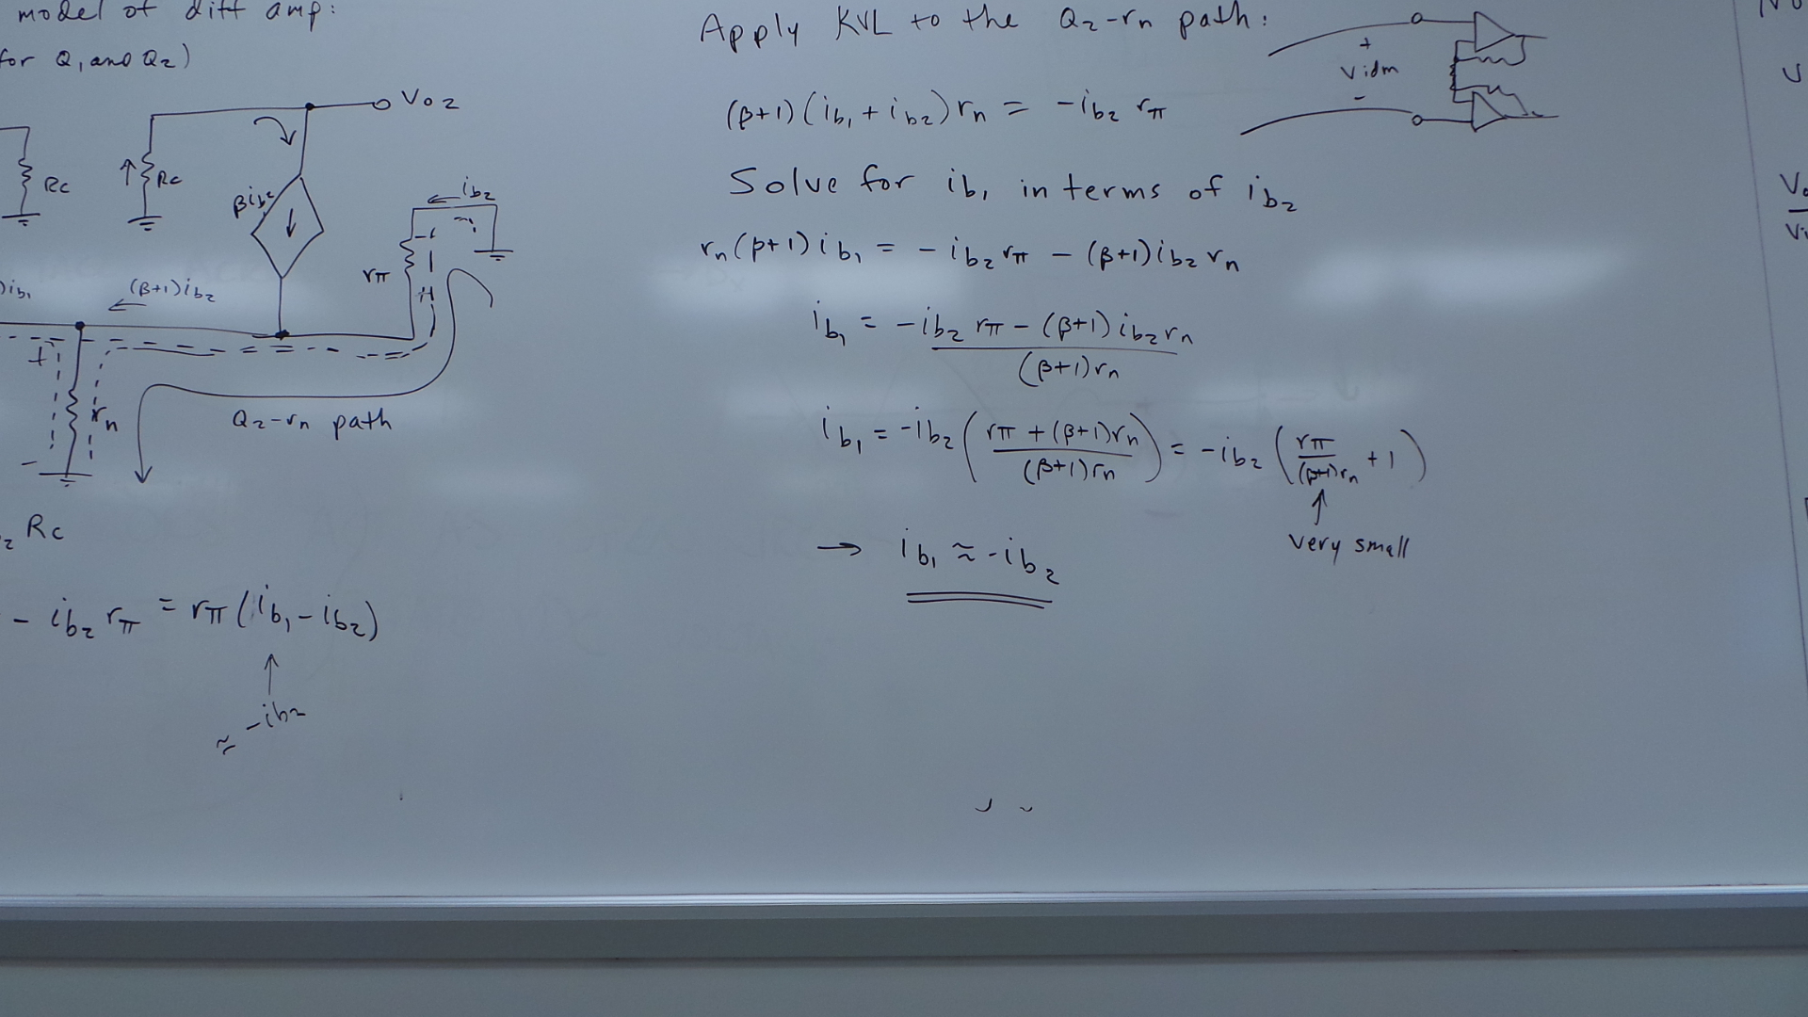
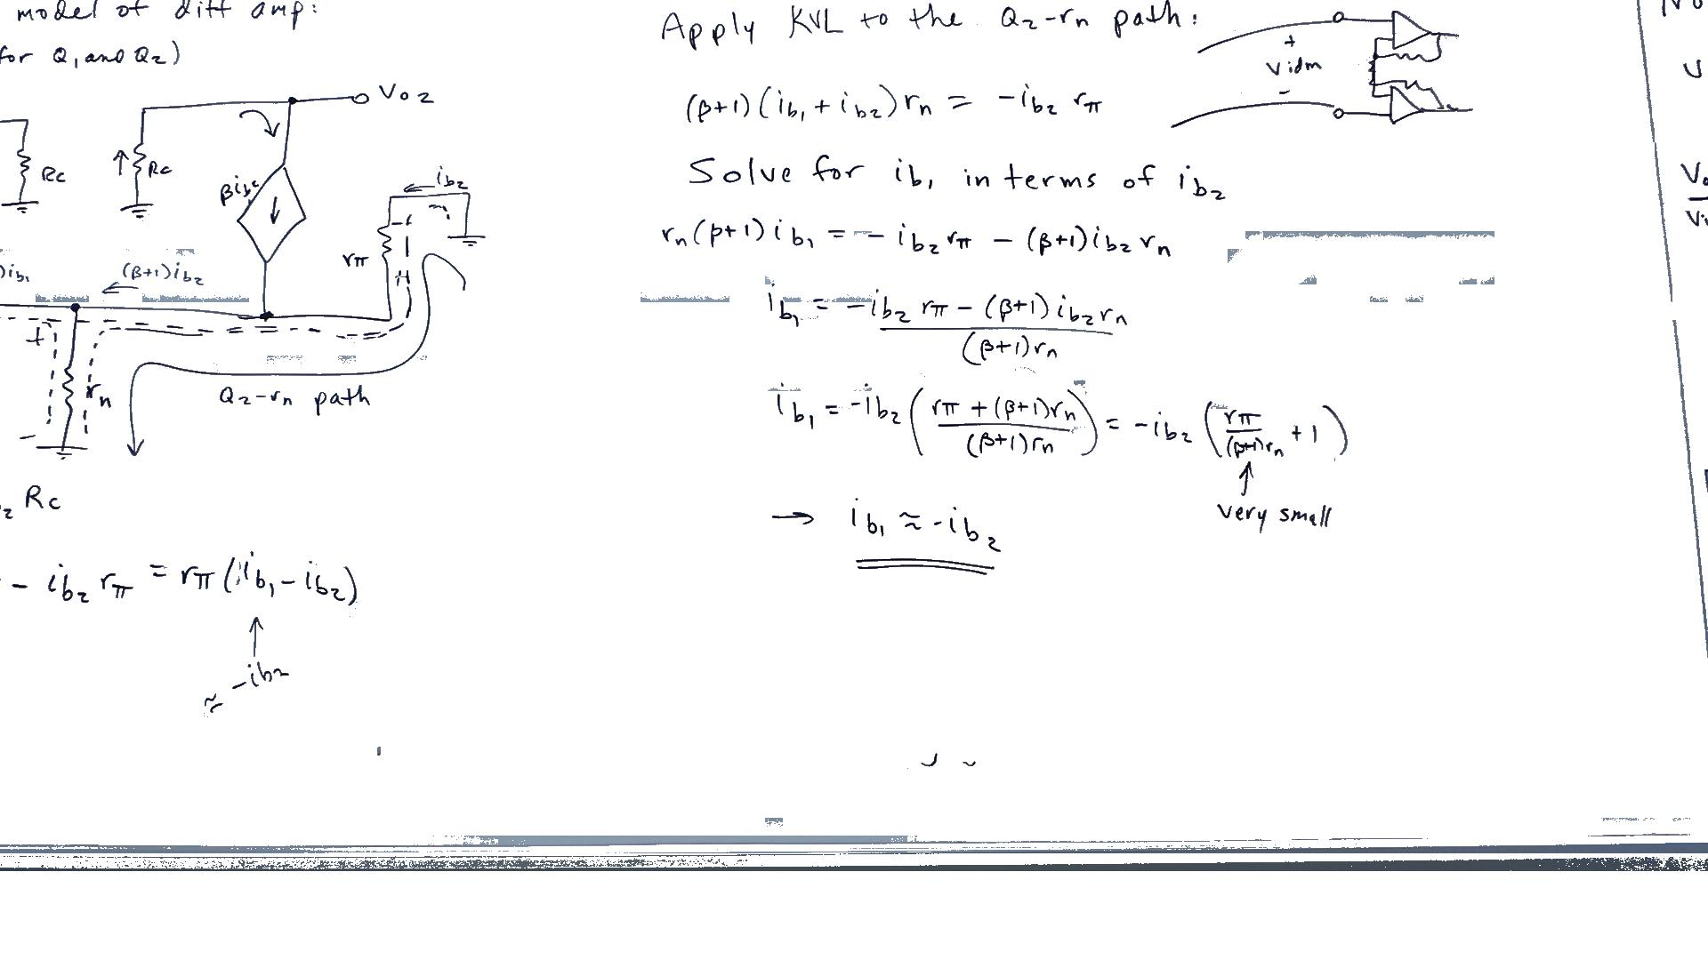
The ProPANE System
Griffin Dunn, Colin Madigan, Phillip Stahlfeld
Bucknell University Electrical & Computer Engineering
ProPANE: the Professional, Portable Automatic Note Extraction System
Overview
The ProPANE system allows for complete capture of the content of a classroom whiteboard. It identifies writing on the board, filters out foreground obstacles, and presents easy to read key images summarizing the lecture for use by a professor or students.
Major System Components
Capture System
Samsung Galaxy Camera with 21x optical zoom for maximum image clarity
Custom ProPANE Android App captures images the board every 5 seconds for the duration of a lecture
Allows for image capture as well as color and resolution optimization
Images are wirelessly uploaded from camera to Analysis System
Analysis System
Python code running on desktop computer with Ubuntu OS
Images are divided into smaller cells
Cells are classified as either Board, Stroke or Foreground.
Foreground objects are removed
Key images are created, and colors are normalized.
The Analysis System: Images showing the flow of the system from raw image, to cell classification and removal, to key image normalization.
The Capture System: The Samsung Galaxy Camera, running the custom ProPANE Android app
System Overview: Shows the progression of our system, and how the components work together
Features
Supports multiple users
Secure access from anywhere on the Bucknell campus
Setup takes under 5 minutes
No training required to operate
Guaranteed to work between 5-18 feet from board
All captured images are available to the user
Key images can be easily browsed and exported
Before and After: A raw image from a lecture, and the relevant key image. Image content courtesy of David Kelley.
We would like to thank our clients, Dr. Robert Midkiff and Dr. Douglas Gabauer, for their guidance and feedback throughout the design process.

