Slide 1
ProPANE Panel 6 Full System Demonstration
Griffin Dunn, Colin Madigan, and Phil Stahlfeld

Slide 2
Agenda
Live demo
Technical specifications review
Feedback

Slide 3
Live demo
Finds key images
Color normalization

Slide 4
Met Spec

Slide 5
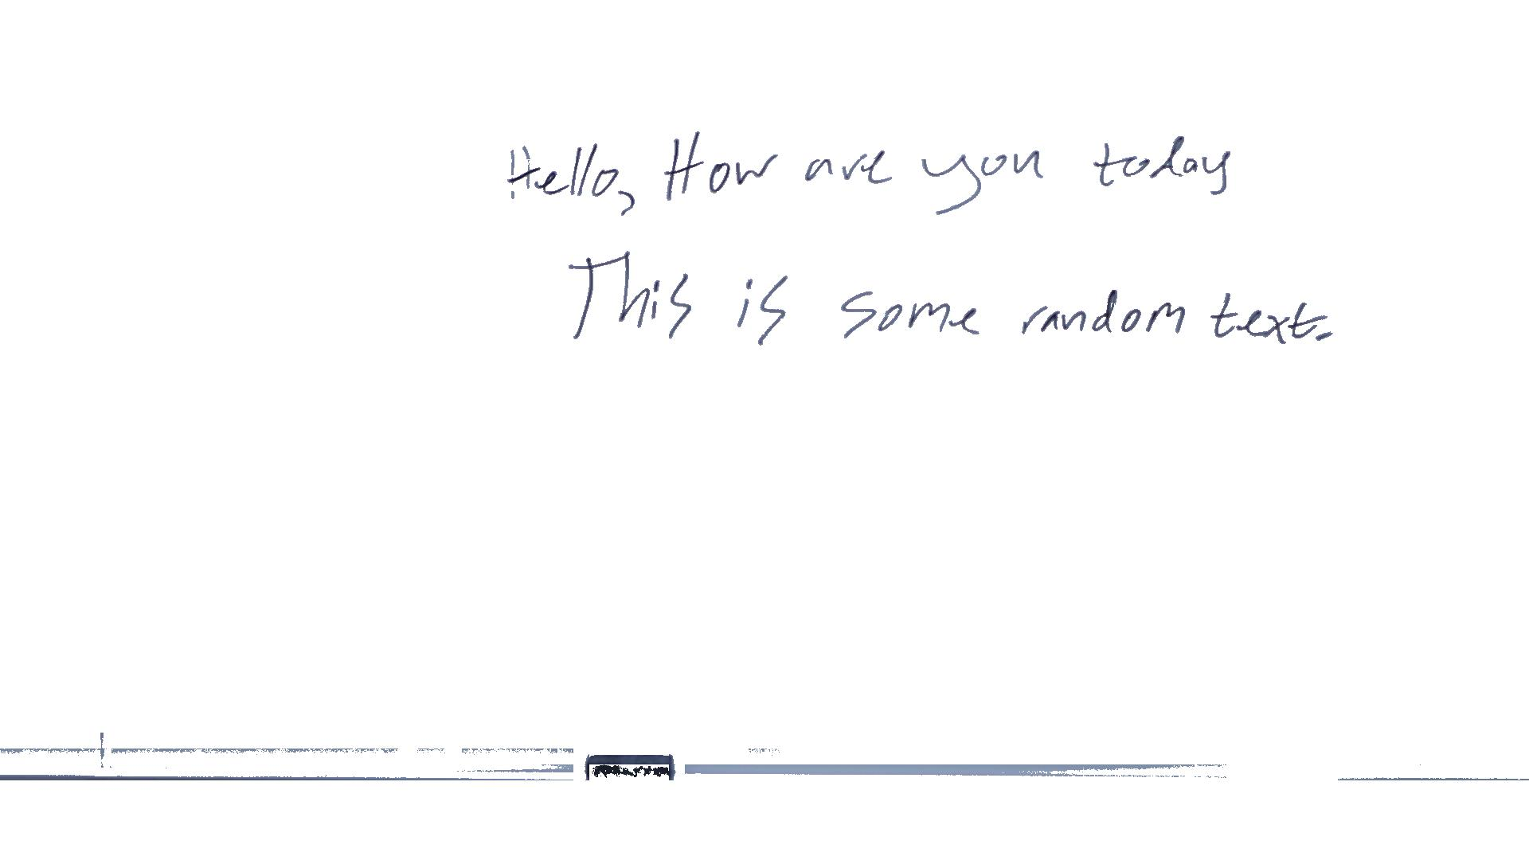
Best Case
Notes:
All text is recognized and there is no foreground in the image

Slide 6
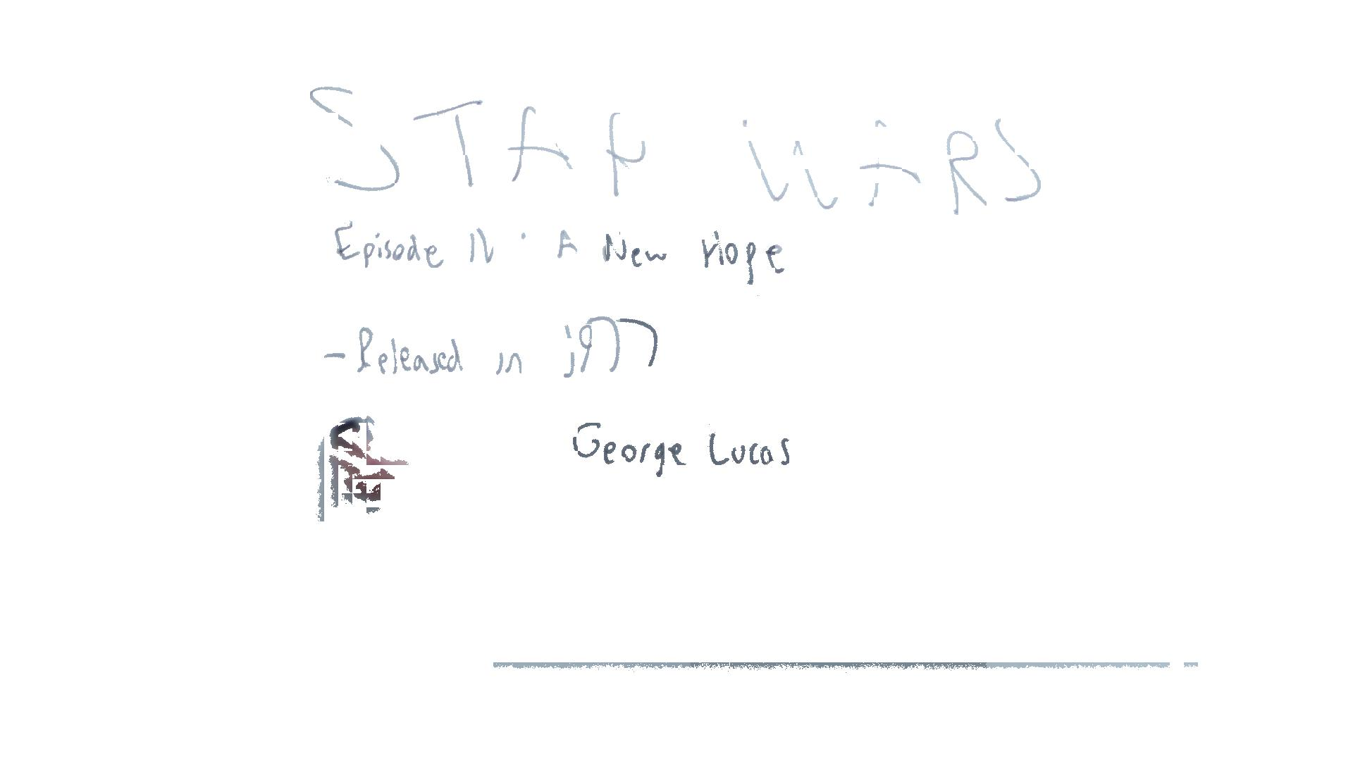
Worst Case
Notes:
Light writing becomes harder to correct and accidental foreground becomes more pronounced

Slide 7
Distance to Board
3.3.1- The minimum operating distance from board for the capture system shall not exceed 220 inches.
If minimum operating distance exceeds 220 inches the camera would be behind the back wall in some classrooms
Capturing at 60 inches shows that this specification is met

Slide 8
Feedback
Questions?
Comments?
Concerns?

Slide 9
Appendix A
In depth review of technical specifications

Slide 10
System Specifications
3.1.1- The maximum time required to prepare the capture system for recording shall not exceed 5 minutes.
3.2.1- The ProPANE system shall capture all of the information written on a board and within the capture field provided that there exists a clear line of sight from the capture device to the information for a minimum of 5 continuous seconds.
3.3.1- The minimum operating distance from board for the capture system shall not exceed 220 inches.
3.3.2- The maximum operating distance from board for the capture system shall not be less than 60 inches.
Notes:
Video on website of setup requiring 1:45 minutes
Timestamps of images
All test captures have been within given range 5 feet to 18 feet

Slide 11
Hardware Specifications
4.1.1- The total weight of the capture device shall not exceed 2.5 kg.
4.1.2- The capture device shall fit inside of a cube with 0.75 m sides in its most collapsed and fully assembled state.
Notes:
Camera weights 0.3 kg
Camera dimensions 128.7 x 70.8 x 19.1 mm

Slide 12
Software Specifications
5.1.1- The analysis system shall support the Ubuntu 12.10 operating system.
5.2.1- The ProPANE system shall generate images that are in an open format (no proprietary formats).
5.2.2- The images generated by the ProPANE system shall be editable—to the extent of rotating and cropping—through the use of a free-from-cost editor.
Notes:
Developed and tested on Ubuntu 12.10
Generate JPEGs
GNU Image Manipulation Program (GIMP) works on JPEGs for Windows/OS X/Linux

Slide 13
Interface Specifications
6.1.1- The mechanism for starting the capture system shall be simple enough to use as to require no special training aside from reading the user manual.
6.1.2- The mechanism for stopping the capture system shall be simple enough to use as to require no special training aside from reading the user manual.
6.2.1- The analysis system shall provide a mechanism for accessing the identified key images.
6.2.2- The analysis system shall provide a graphical interface for exporting image files to a specified location.
Notes:
Ran test on 3rd party. Took 65 seconds from nothing to camera up and running.
Key images are placed in a separate folder
Drag and drop using OS of choice via Samba

