Slide 1
ProPANE Panel 5 Prototype Demonstration
Griffin Dunn, Colin Madigan, and Phil Stahlfeld

Slide 2
Agenda
Live demo
Recorded results
Technical specifications review
Future work
Feedback

Slide 3
Live Demo

Slide 4
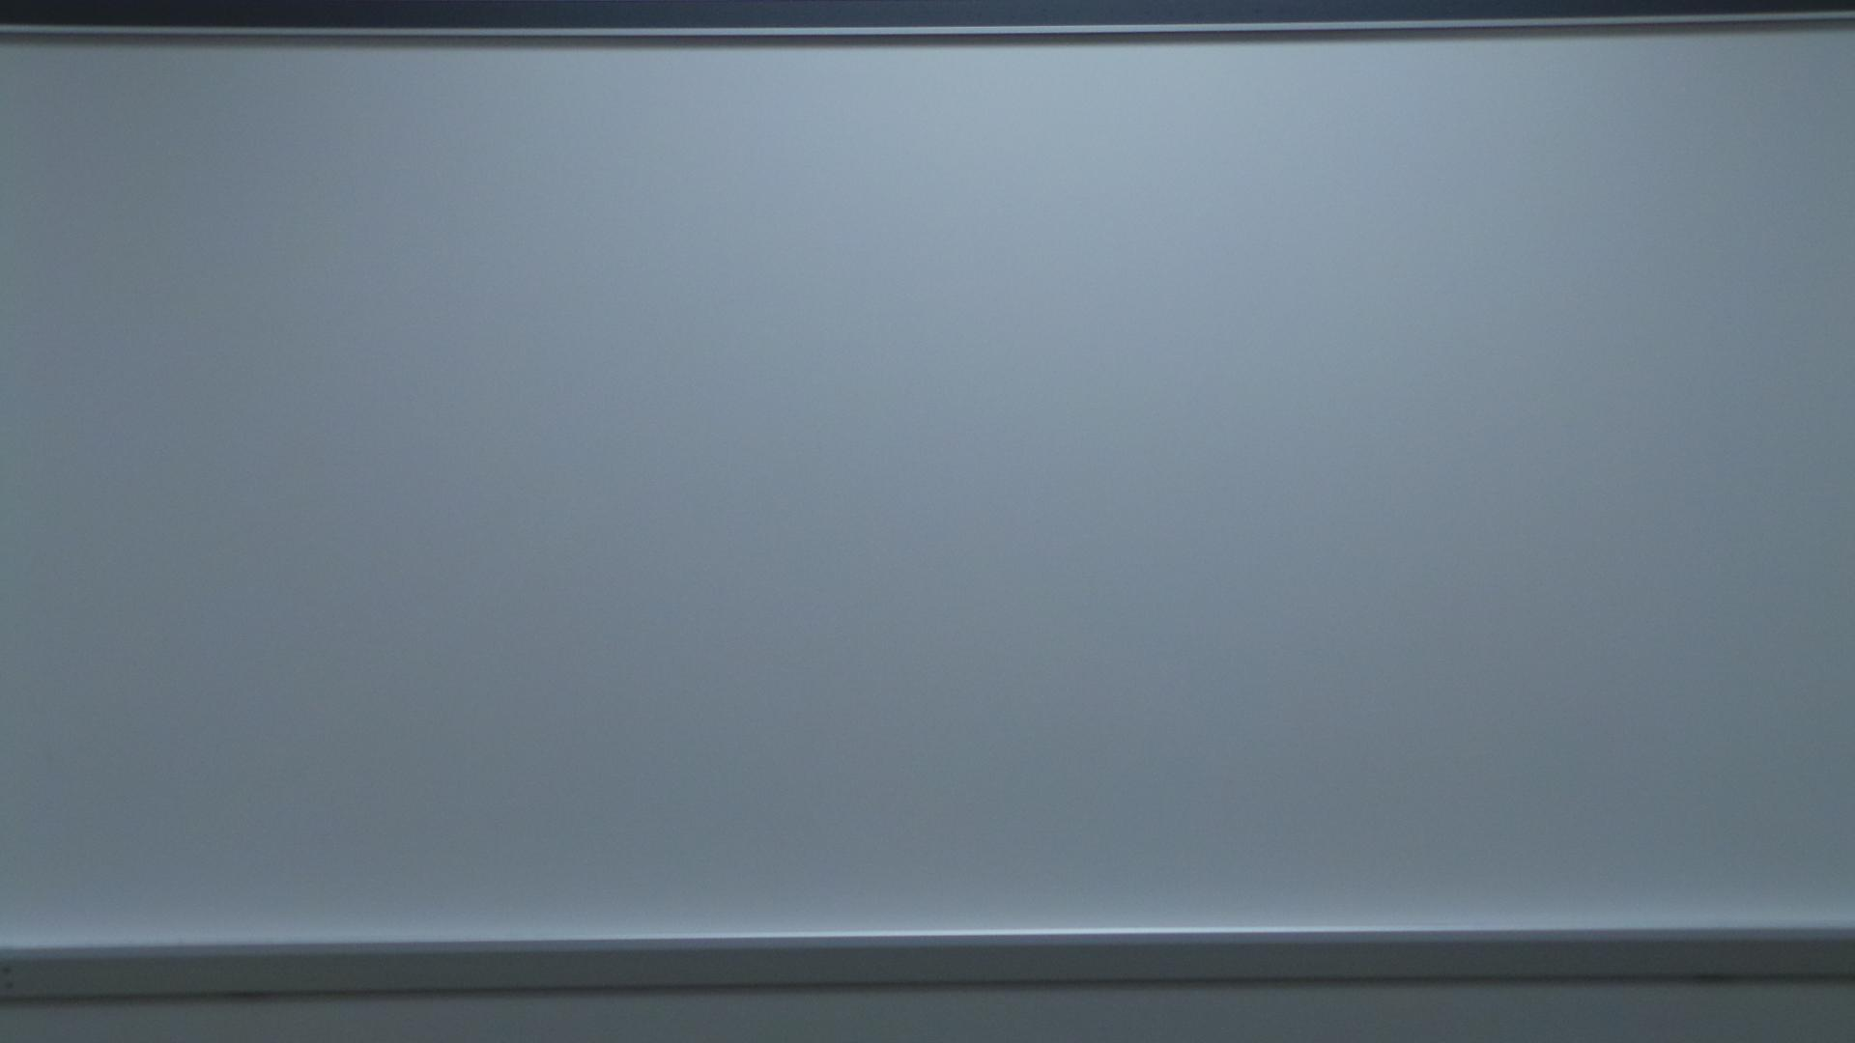
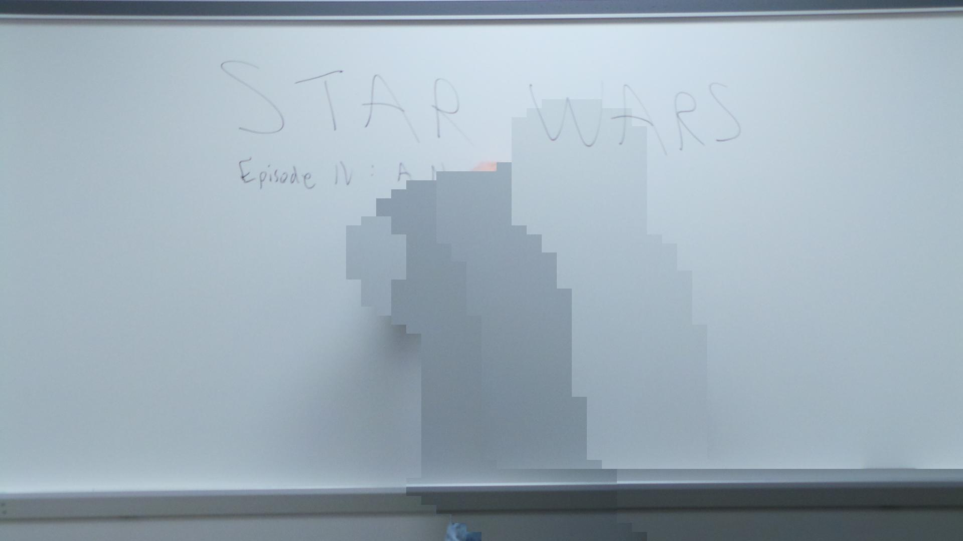
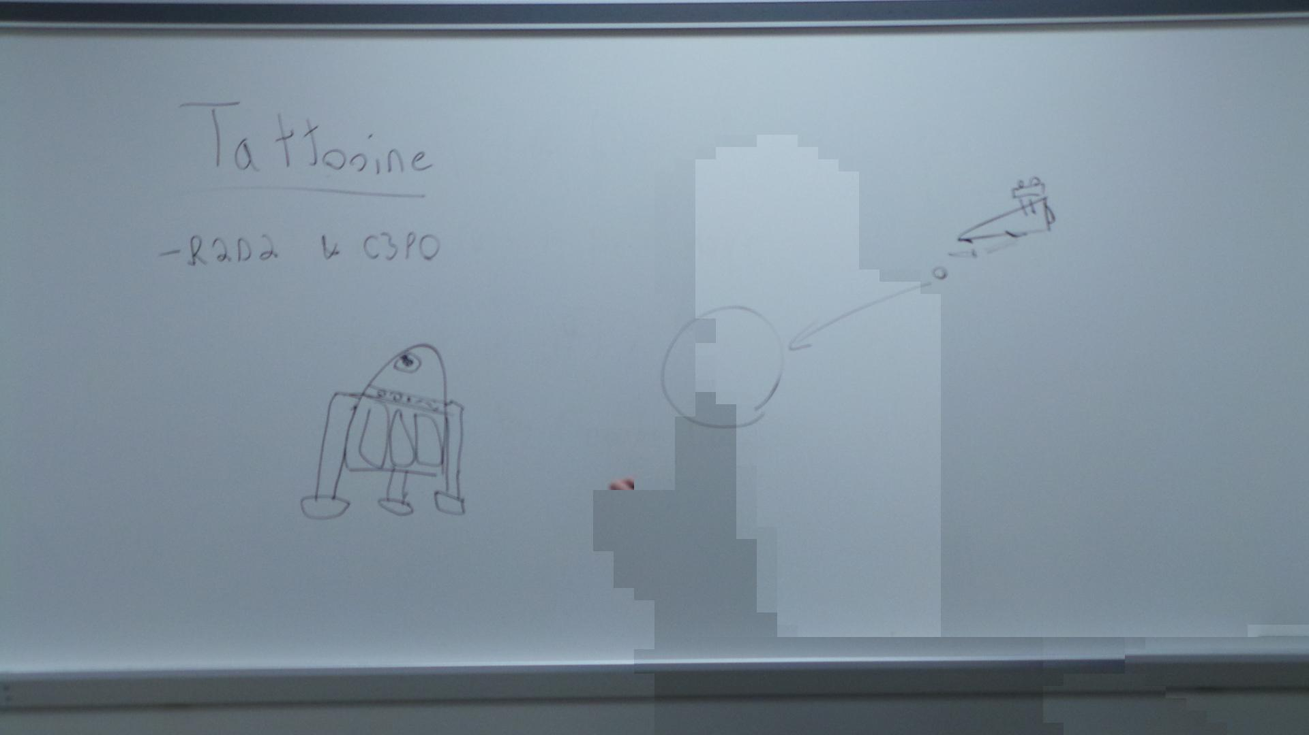
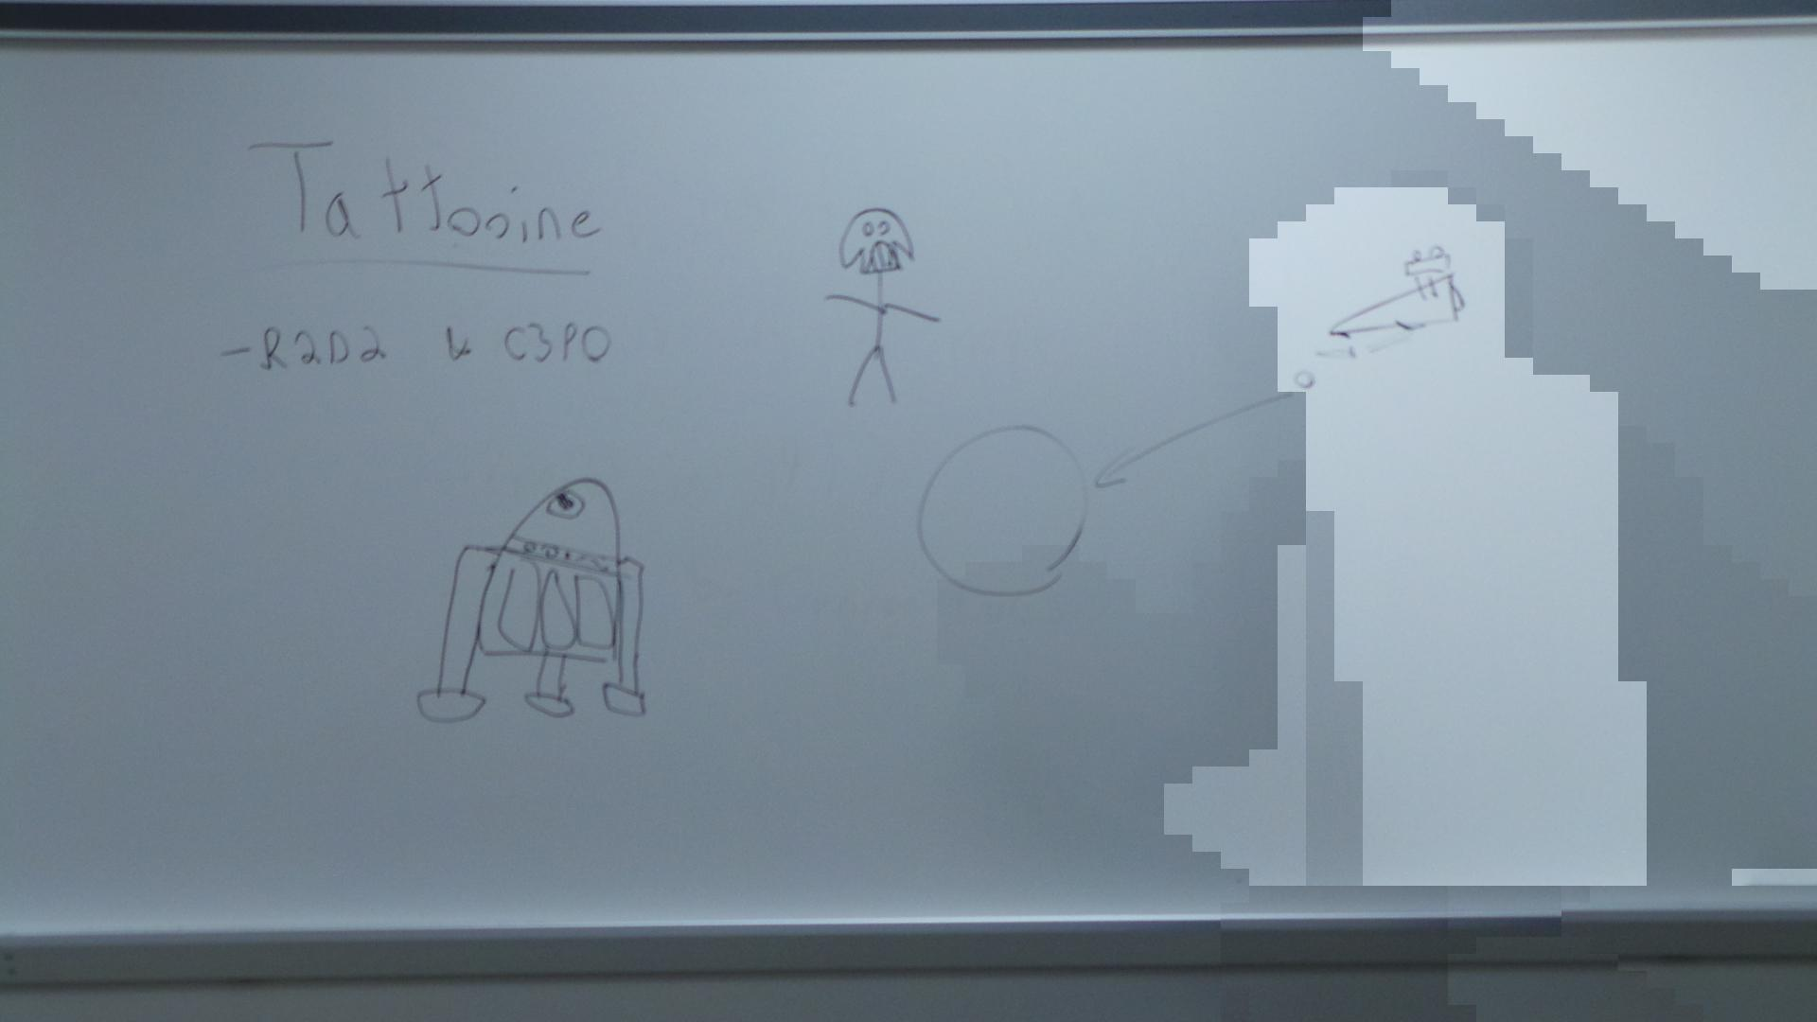
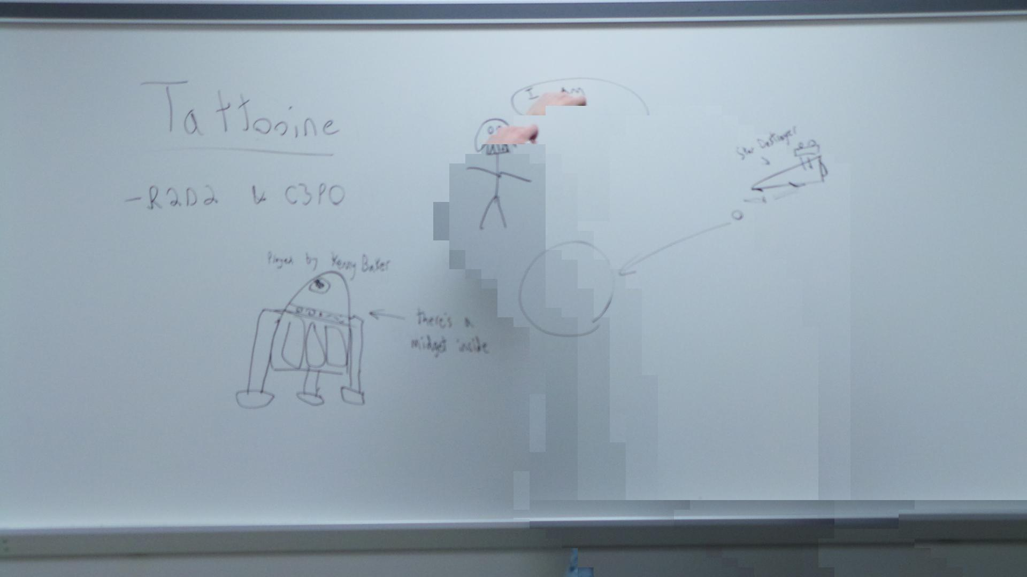
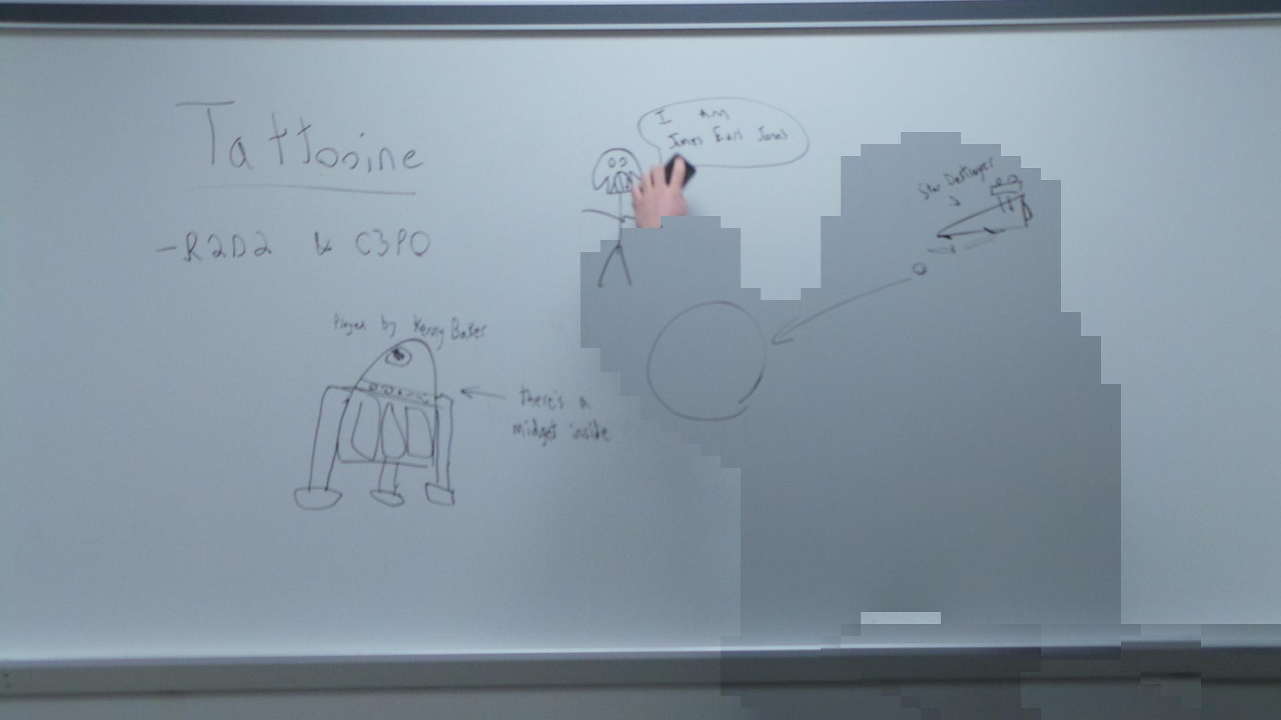
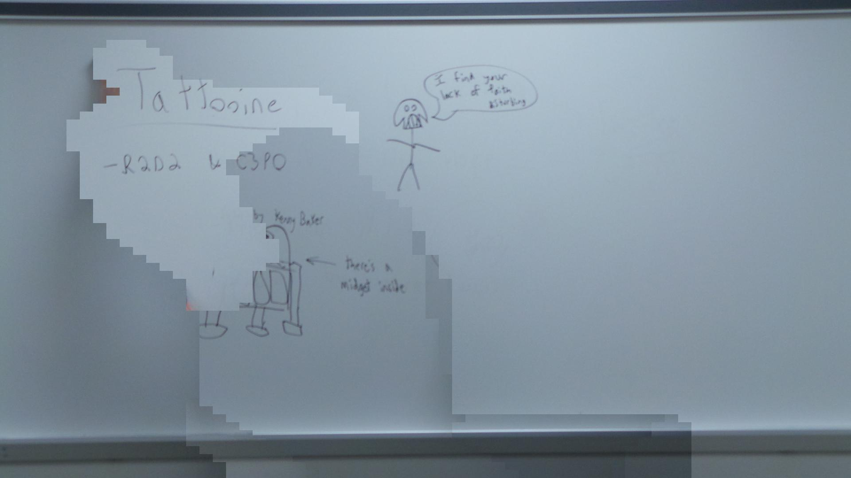
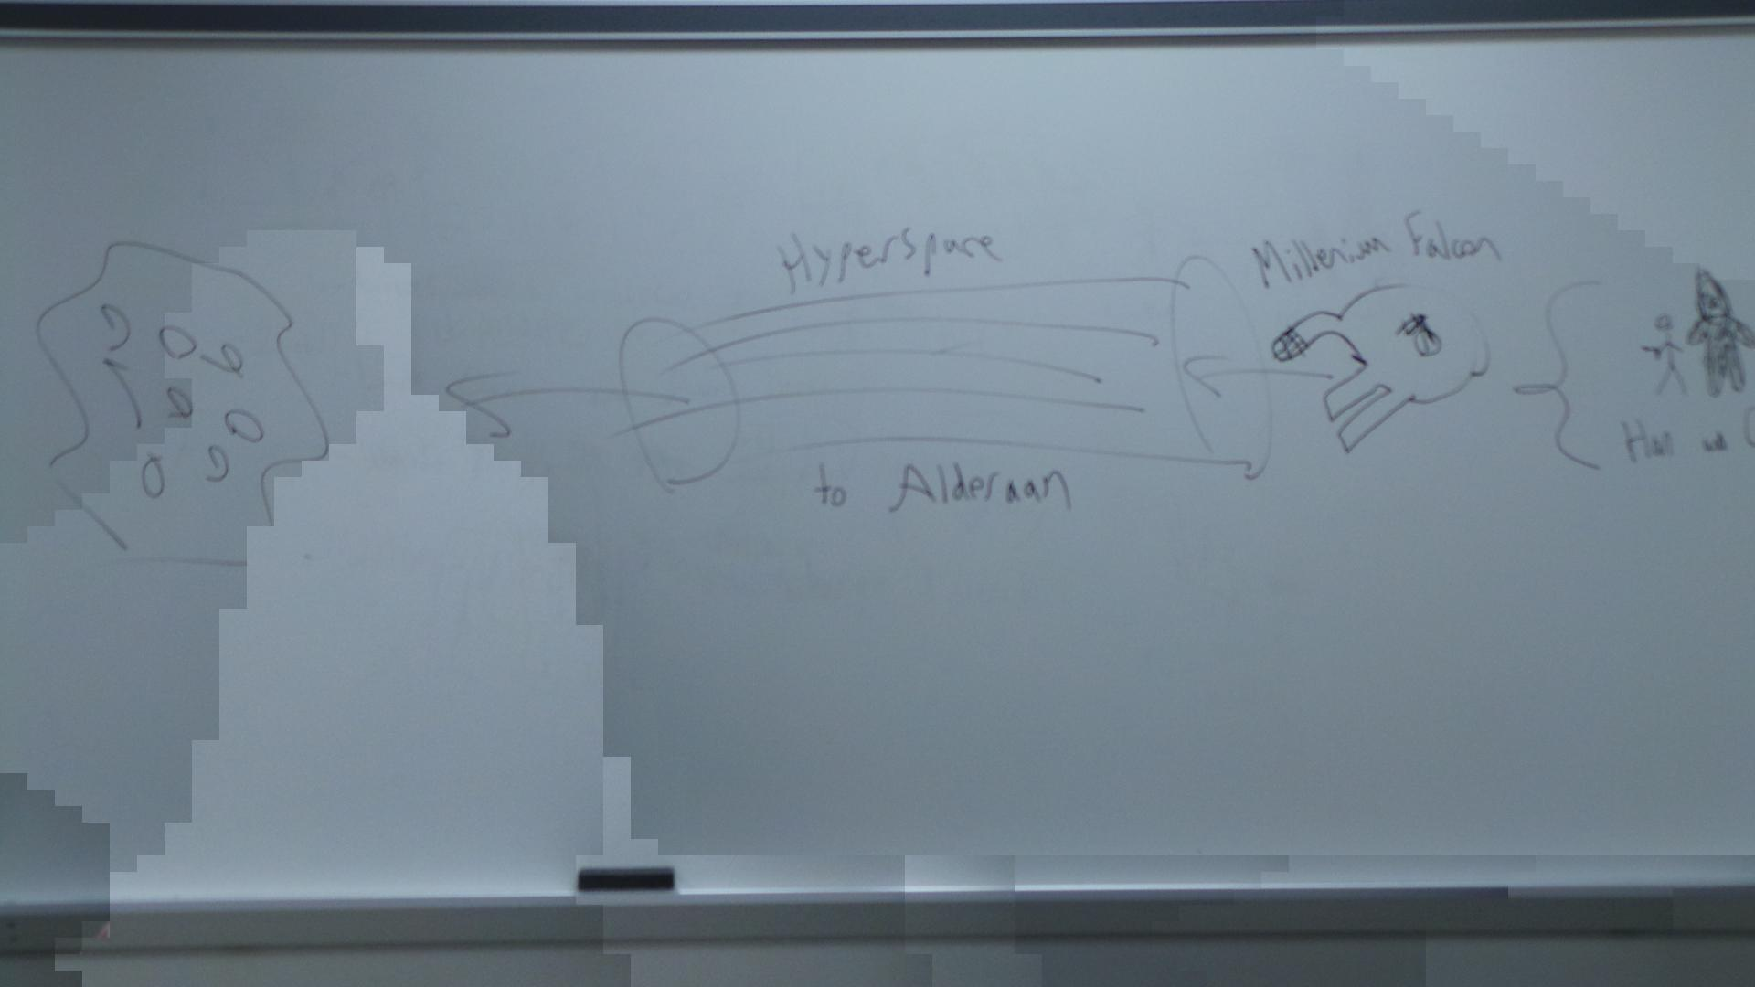
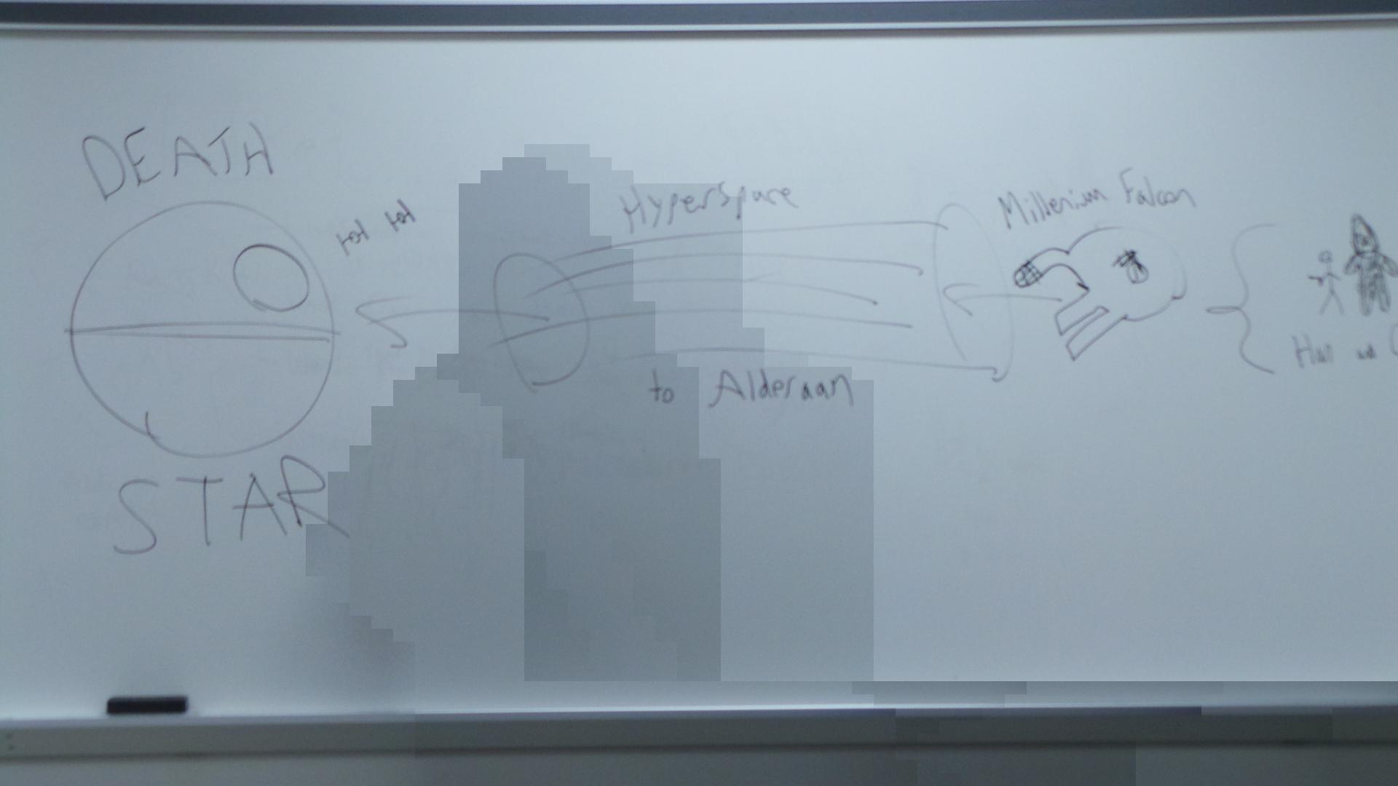
Recorded Results
On the windows box

Slide 5
System Specifications
3.1.1- The maximum time required to prepare the capture system for recording shall not exceed 5 minutes.
3.2.1- The ProPANE system shall capture all of the information written on a board and within the capture field provided that there exists a clear line of sight from the capture device to the information for a minimum of 5 continuous seconds.
3.3.1- The minimum operating distance from board for the capture system shall not exceed 220 inches.
3.3.2- The maximum operating distance from board for the capture system shall not be less than 60 inches.
Notes:
Video on website of setup requiring 1:45 minutes
Timestamps of images
All test captures have been within given range 5 feet to 18 feet

Slide 6
Hardware Specifications
4.1.1- The total weight of the capture device shall not exceed 2.5 kg.
4.1.2- The capture device shall fit inside of a cube with 0.75 m sides in its most collapsed and fully assembled state.
Notes:
Camera weights 0.3 kg
Camera dimensions 128.7 x 70.8 x 19.1 mm

Slide 7
Software Specifications
5.1.1- The analysis system shall support the Ubuntu 12.10 operating system.
5.2.1- The ProPANE system shall generate images that are in an open format (no proprietary formats).
5.2.2- The images generated by the ProPANE system shall be editable—to the extent of rotating and cropping—through the use of a free-from-cost editor.
Notes:
Developed and tested on Ubuntu 12.10
Generate JPEGs
GNU Image Manipulation Program (GIMP) works on JPEGs for Windows/OS X/Linux

Slide 8
Interface Specifications
6.1.1- The mechanism for starting the capture system shall be simple enough to use as to require no special training aside from reading the user manual.
6.1.2- The mechanism for stopping the capture system shall be simple enough to use as to require no special training aside from reading the user manual.
6.2.1- The analysis system shall provide a mechanism for accessing the identified key images.
6.2.2- The analysis system shall provide a graphical interface for exporting image files to a specified location.
Notes:
Ran test on 3rd party. Took 65 seconds from nothing to camera up and running.
Key images are placed in a separate folder
Drag and drop using OS of choice via Samba

Slide 9
Future Work
Whiteboard normalization
Wider capture field
Seamless integration
Cell classification/key image detection

Slide 10
Feedback
Questions?
Comments?
Concerns?

