Slide 1
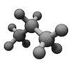
ProPANE Panel 2
Griffin Dunn Colin Madigan Phil Stahlfeld

Slide 2
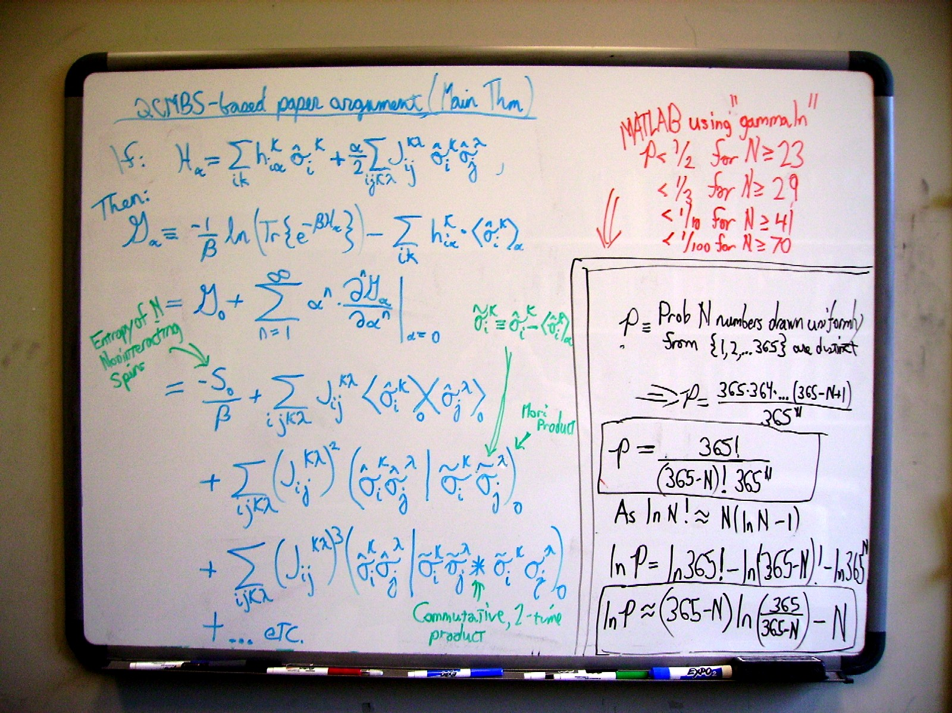
Original Image with Python

Slide 3
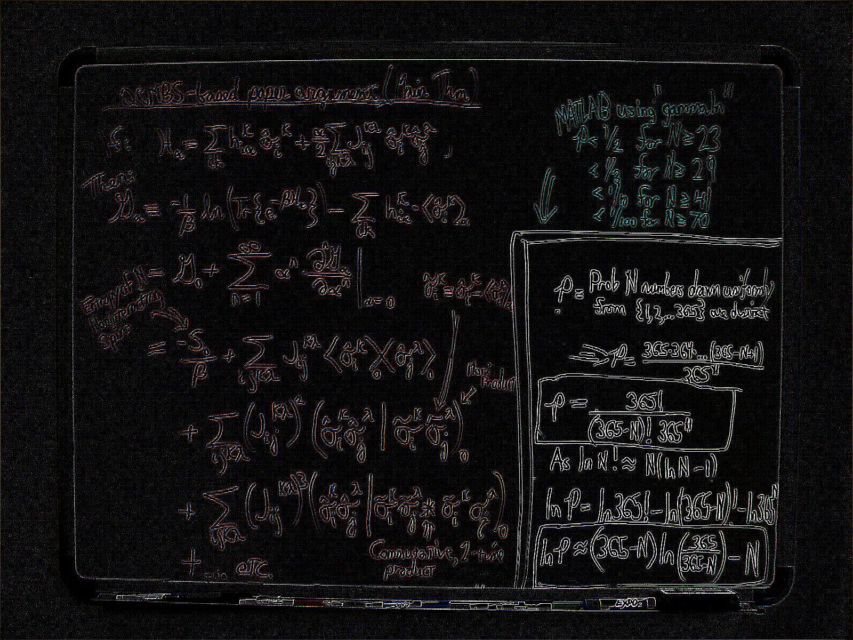
Find Edges Filter with Python

Slide 4
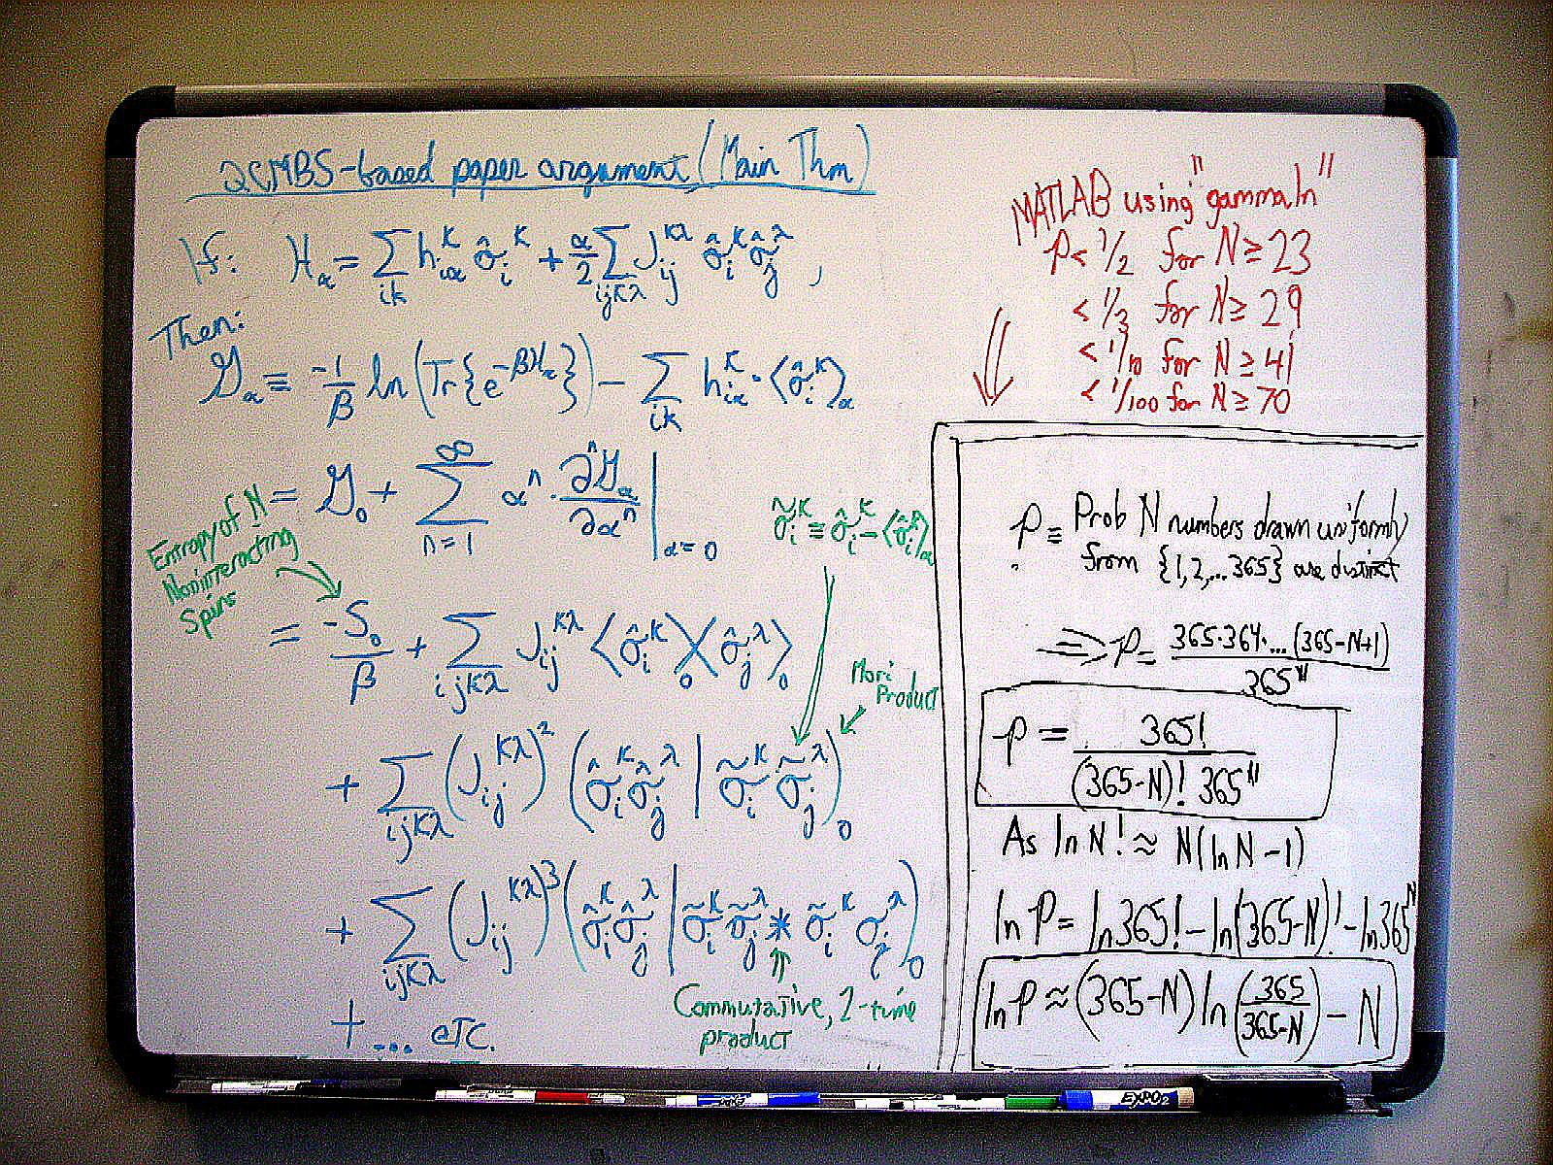
Edge Enhance Filter with Python

Slide 5

Current Filter Progress with Python

Slide 6
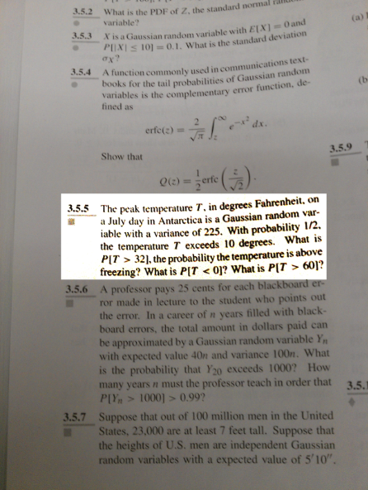
Image Filtering with ImageJ

