Slide 1

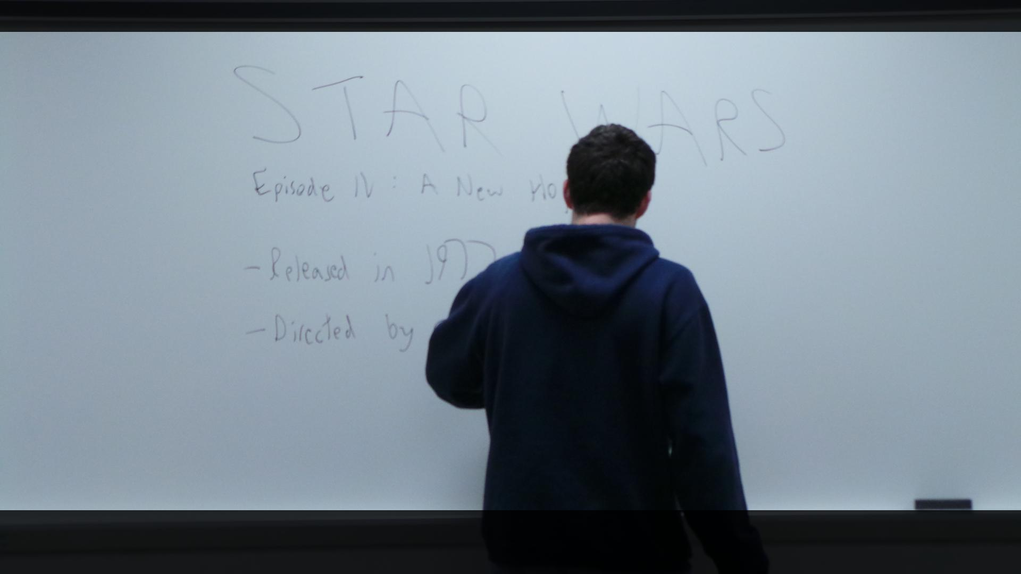
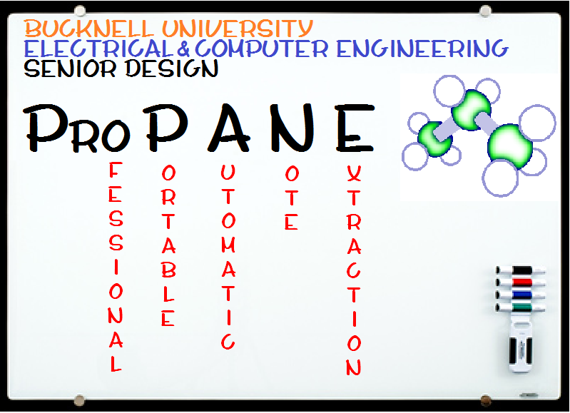
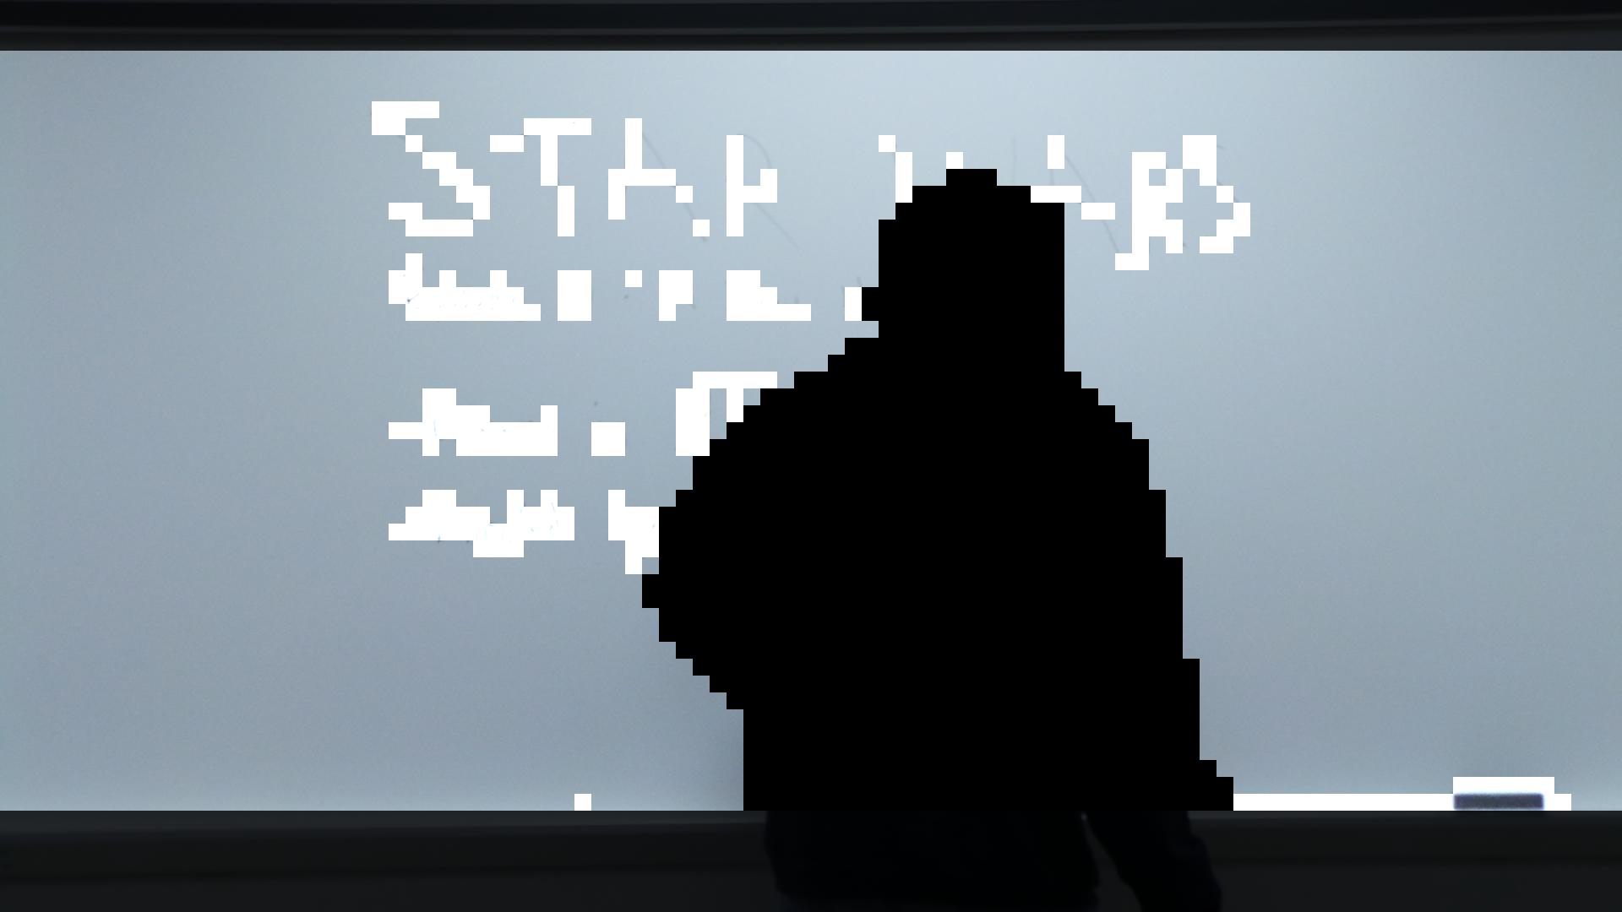
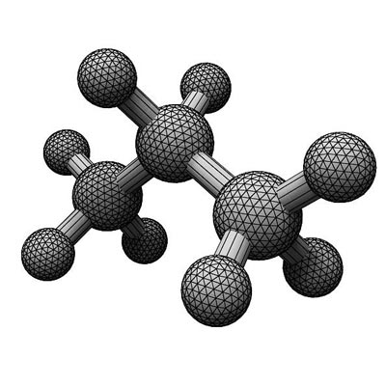
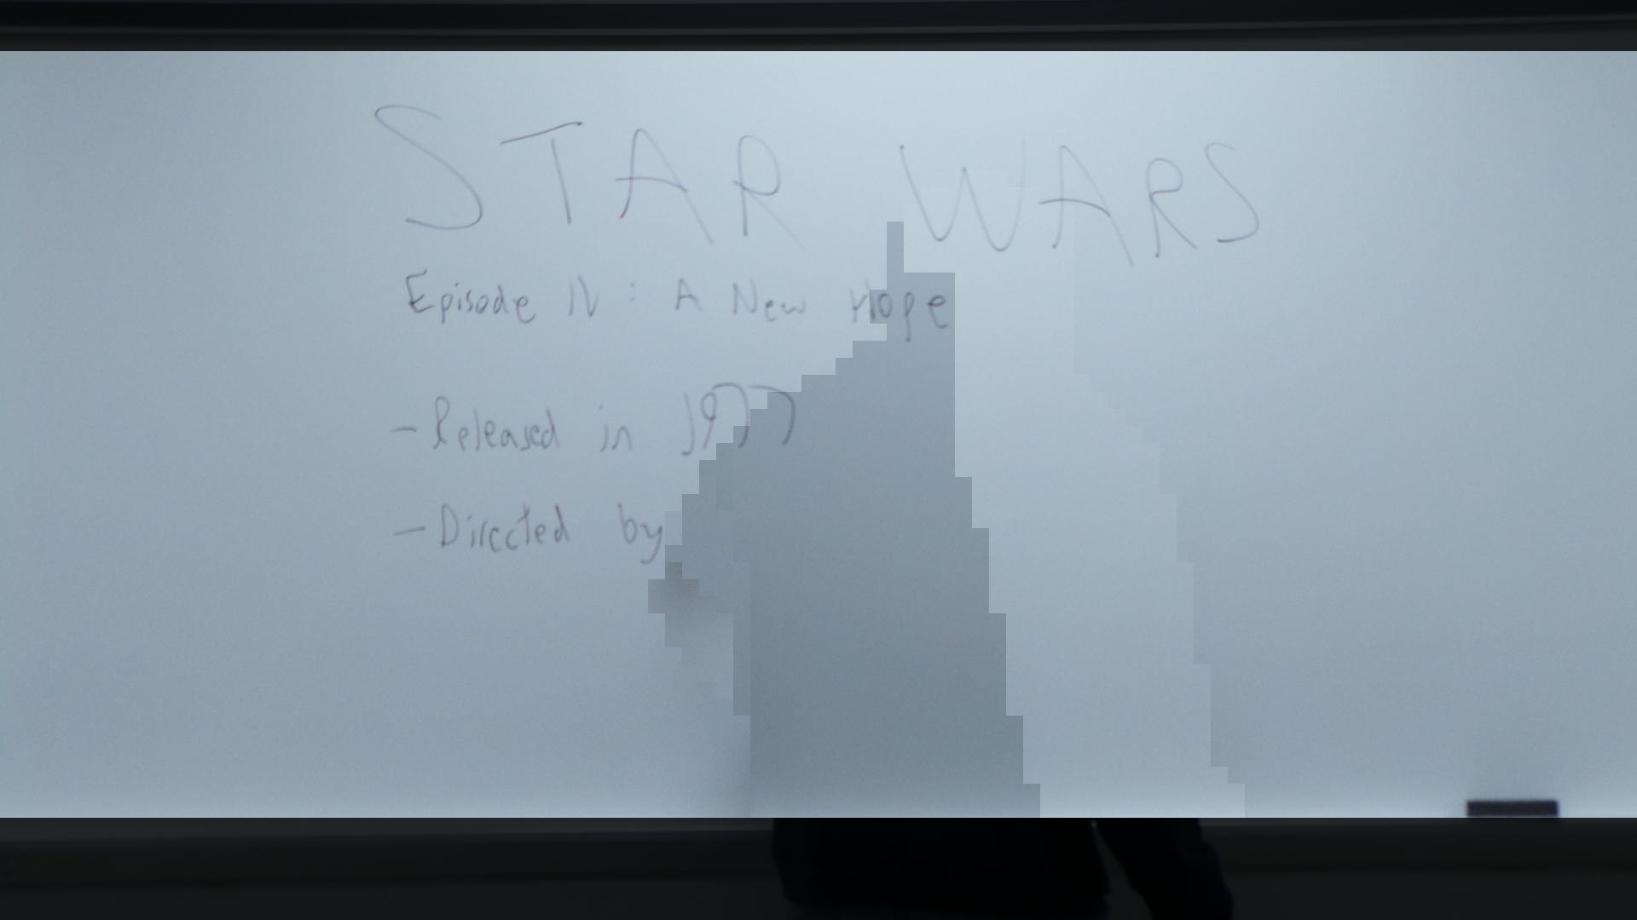
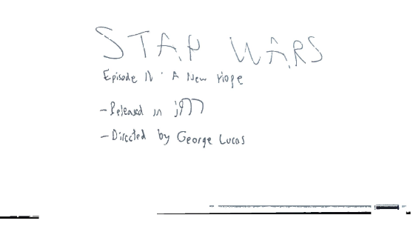
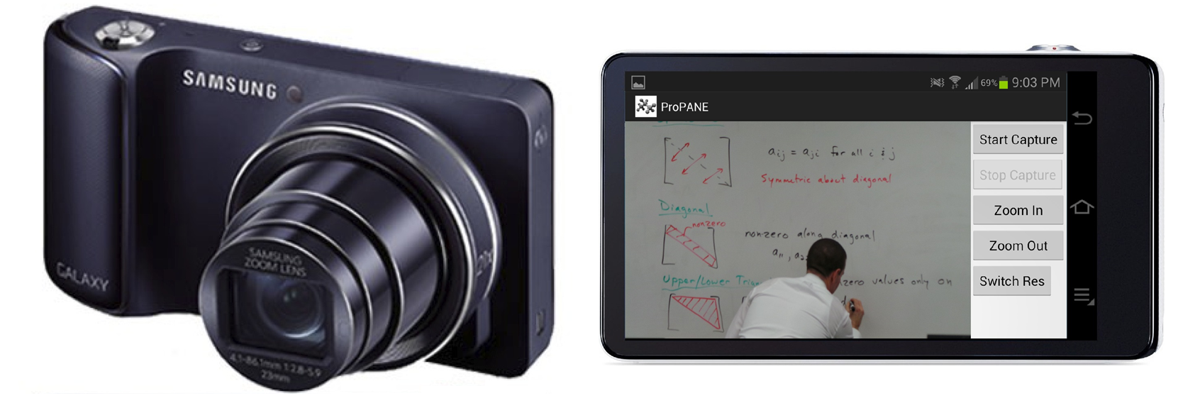
The ProPANE System
Griffin Dunn, Colin Madigan, Phillip Stahlfeld
Bucknell University
Abstract
Board Content Classification
Acknowledgements
The ProPANE system allows for complete capture of the content of a classroom whiteboard. It identifies writing on the board, filters out foreground obstacles, and presents easy to read key images summarizing the lecture for use by a professor or students.
Images are divided into smaller cells
Information such as mean color and standard deviation are calculated
Cells are classified as either Board, Stroke or Foreground.
Foreground objects are removed
Key images are created, and colors are normalized.
Bucknell University
Department of Electrical Engineering
Drs. Robert Midkiff and Douglas Gabauer
Major System Components
Samsung Galaxy Camera
21x optical zoom
Runs on Android 4.1 “Jelly Bean”
Utilizes custom ProPANE app
Allows for image set capture, color and resolution optimization
Analysis System
Intel Core 2 Duo running Ubuntu 12.04
Supports multiple users
Full access from anywhere on Bucknell campus
References
[1] Li-wei He, Zhengyou Zhang, Zicheng Liu, “Why Take Notes? Use the Whiteboard Capture System.” ftp://ftp.research.microsoft.com/pub/tr/tr-2002-89.pdf, September 2002

