Slide 1
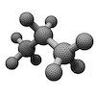
Professional Portable Automatic Note Extraction (ProPANE) System Design
By Griffin Dunn, Colin Madigan, and Phil Stahlfeld

Slide 2
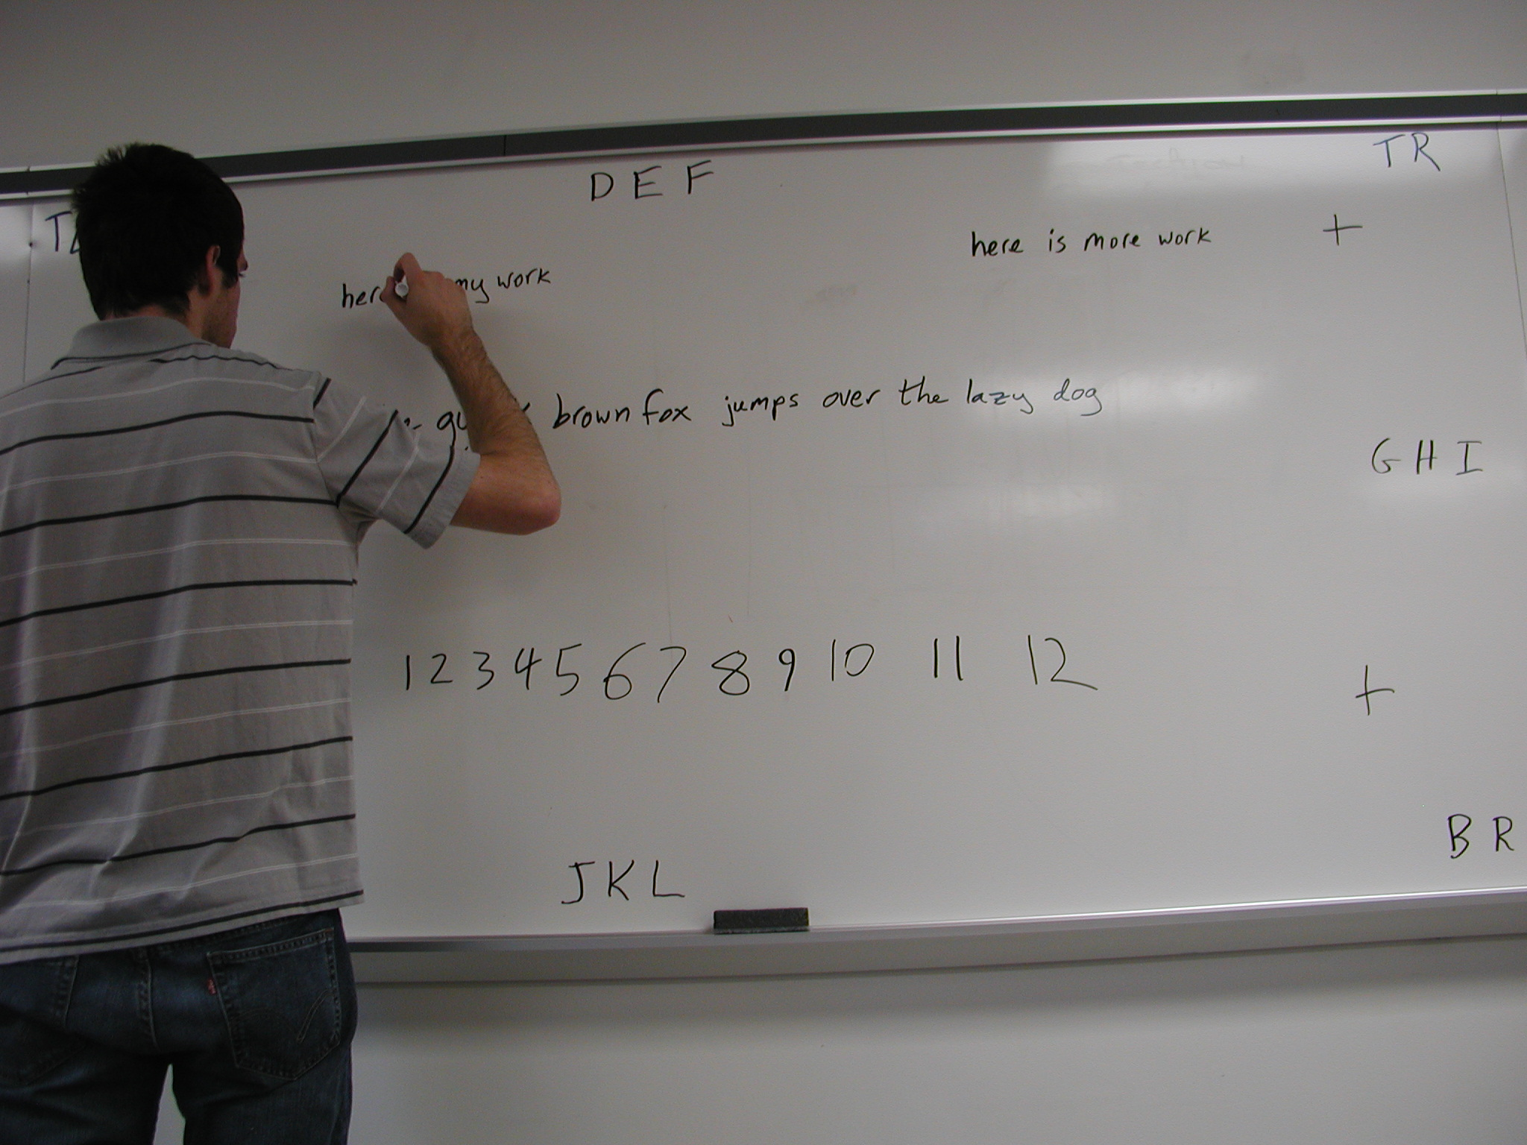
Project Description
Capture images of whiteboards throughout class
Process images
Determine key images
Remove foreground
Return images to Professor

Slide 3
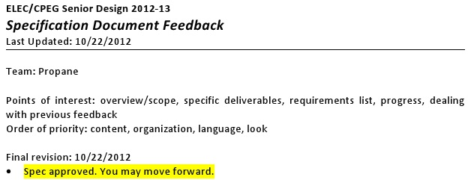
Specifications & Testing
Specifications
Capture 100% of information
Portable System
Wireless
Testing
Standardized set of images
Wall-clock Android app

Slide 4
High Level Design
Capture system
Programmable camera
Android app
Analysis system
Dell Desktop
Python application

Slide 5
Capture System Overview
Samsung Galaxy Camera
Sony VCT-R100 Tripod

