Slide 1

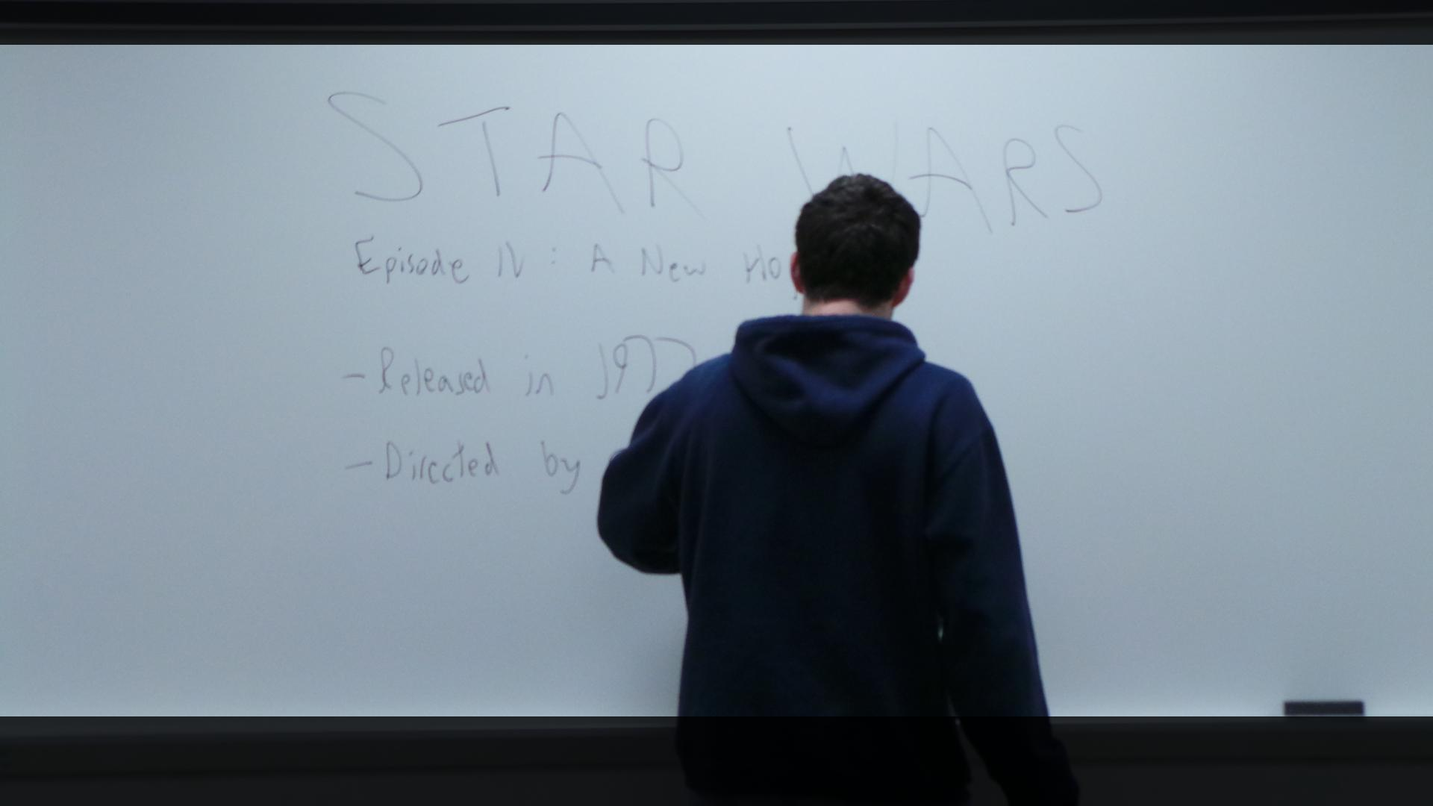
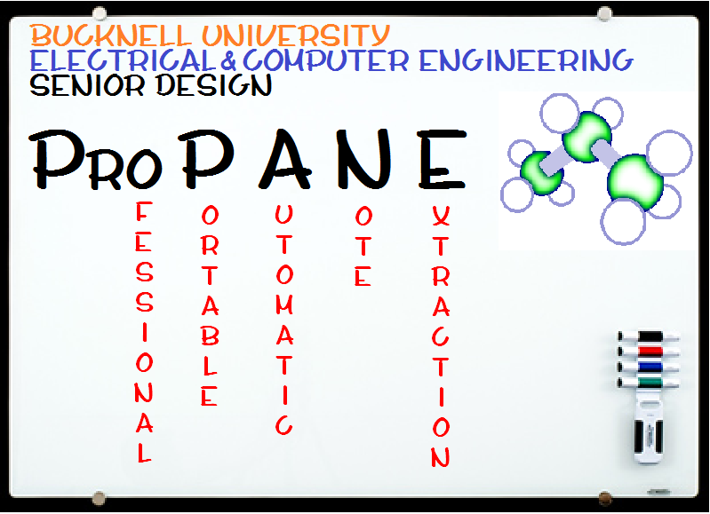
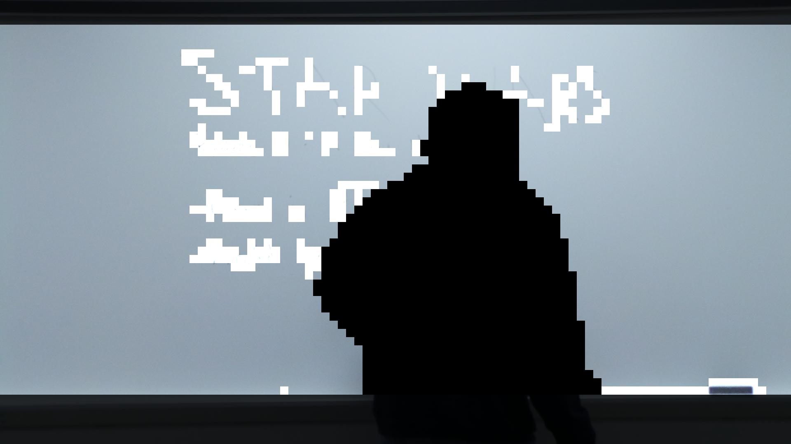
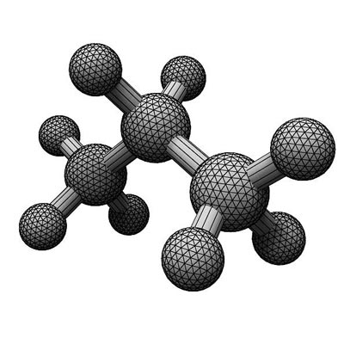
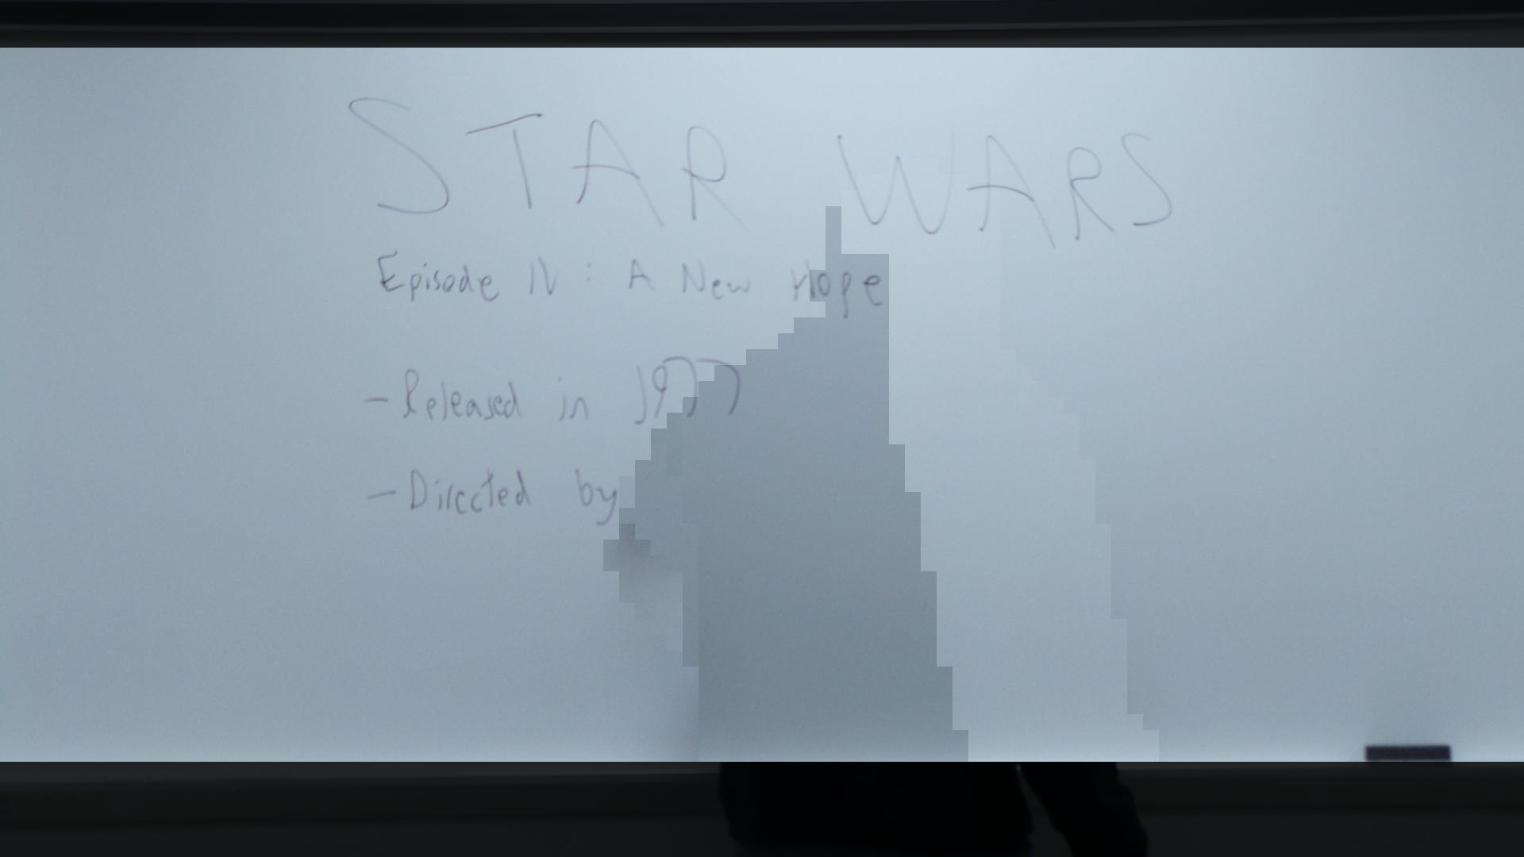
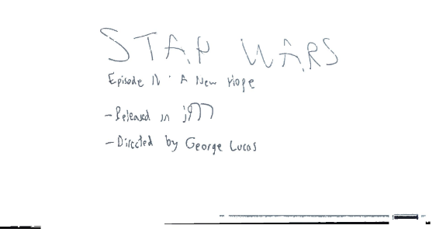
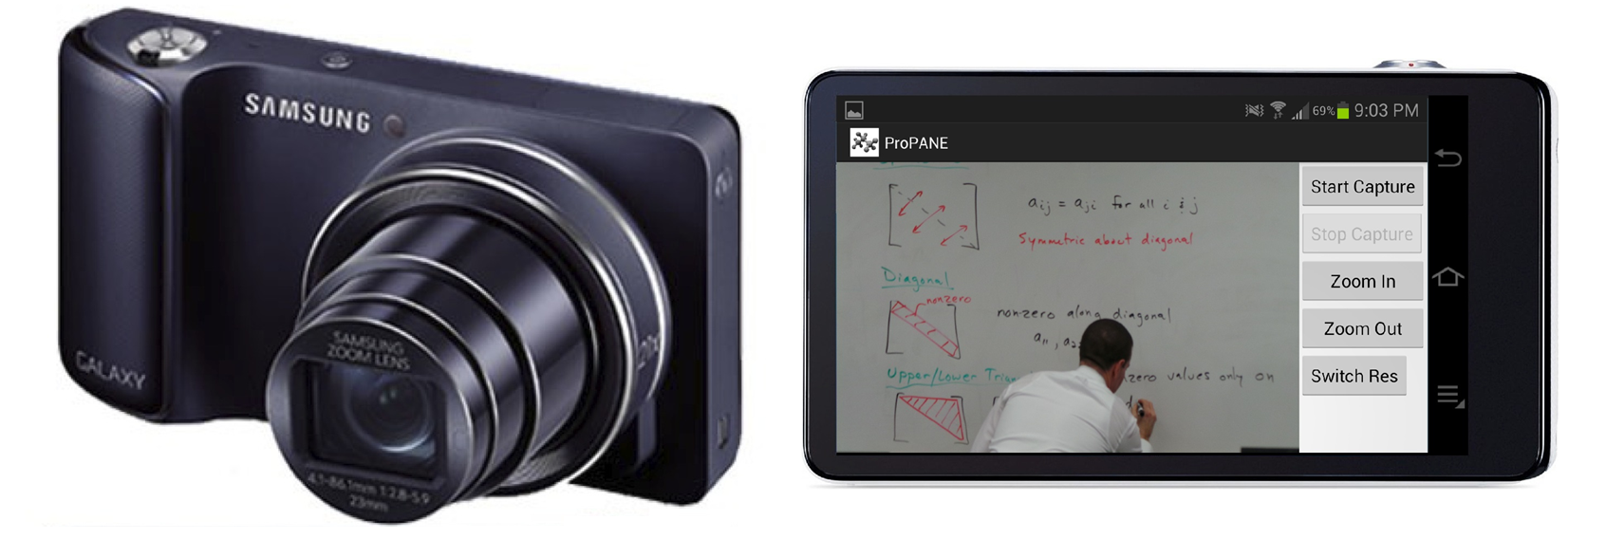
The ProPANE System
Griffin Dunn, Colin Madigan, Phillip Stahlfeld
Bucknell University
Abstract
Frisbee As A Wing
Acknowledgements
The ProPANE system allows for complete capture of the content of a classroom whiteboard. It identifies writing on the board, filters out foreground obstacles, and presents easy to read key images summarizing the lecture for use by a professor or students.
Air trapped by the lip of the Frisbee is not moving with respect to the disc so it generates a region of high pressure below the disc.
Air passing over the top of the disc creates a region of low pressure above the disc.
Pressure differential above and below the disc generates lift.
See image below for how a Frisbee generates lift as it passes through the air [2].
Bucknell University
Department of Electrical Engineering
Major System Components
Samsung Galaxy Camera
21x optical zoom
Runs on Android 4.1 “Jelly Bean”
Utilizes custom ProPANE app
Allows for image set capture, color and resolution optimization
Analysis System
Intel Core 2 Duo running Ubuntu 12.04
Supports multiple users
Full access from anywhere on Bucknell campus
References
[1] Li-wei He, Zhengyou Zhang, Zicheng Liu, “Why Take Notes? Use the Whiteboard Capture System.” ftp://ftp.research.microsoft.com/pub/tr/tr-2002-89.pdf, September 2002

