Slide 1
Reinforcement learning for battery discharge optimisation
Ronan Laker, Phil Moloney, Tom Woolley, Griffin Farrow

Slide 2
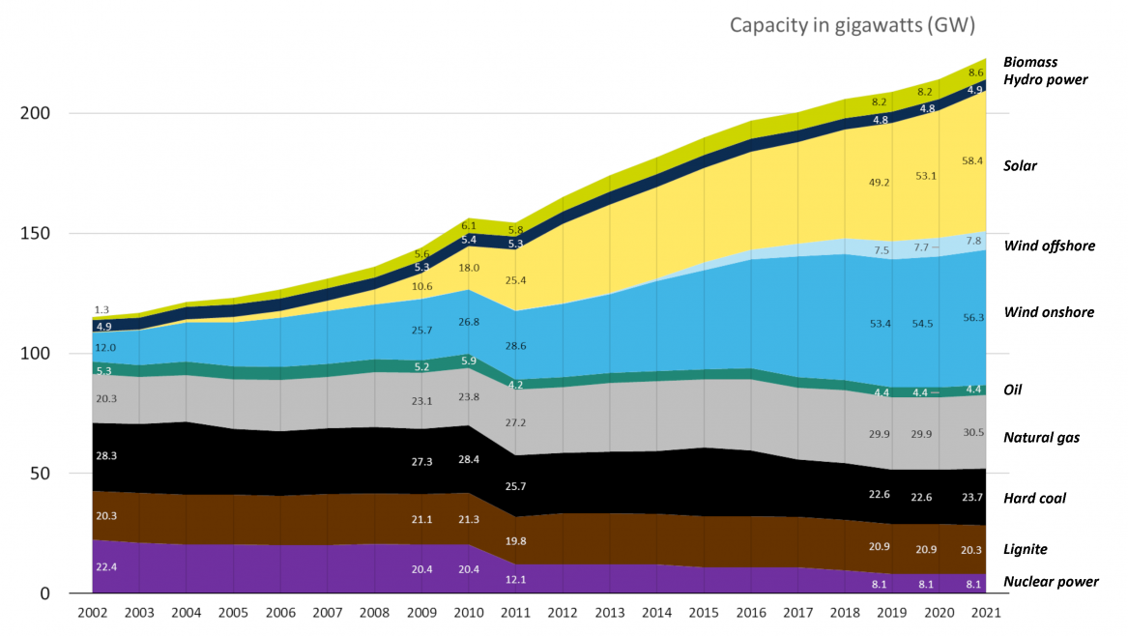
The question: how best to capture energy to make renewables financially viable?
Source: Fraunhofer ISE, power usage in Germany
Notes:
The key question that we’re trying to answer in this project is how best can we capture energy to make renewables financially viable?
Plot shows the energy use in Germany over time and divided into source
Clear uptick in renewables and decrease in fossil fuels
A big barrier on renewables is an inconsistent power. Solution: batteries!
Purpose of this project is to optimise battery charge/discharge schedules to illustrate how batteries for renewables could be viable

Slide 3
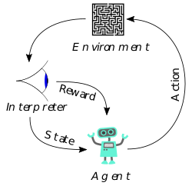
Reinforcement Learning
Notes:
So don't take what I say here as gospel, because I only found out about reinforcment learning yesterday.
Reinforcement learning is method of machine learning that allows an agent to compose a policy which causes it to maximise a reward, by taking actions within an environment.
Our actions for this case are for the battery to charge, discharge and hold charge.
There are several different algorithms, we chose one which is good for general problems, without excessive tuning.
We used the stable baselines package which has a pytorch backend.
Put very simply, we hope to train the agent to buying when the price is low and selling when it is high.

Slide 4
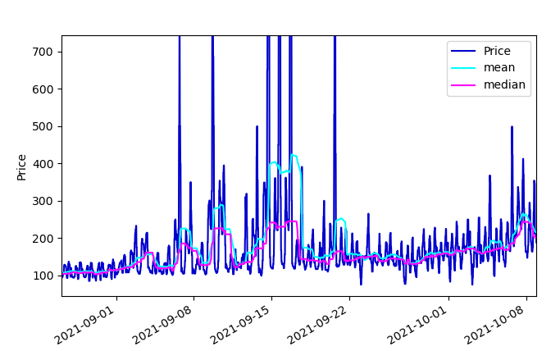
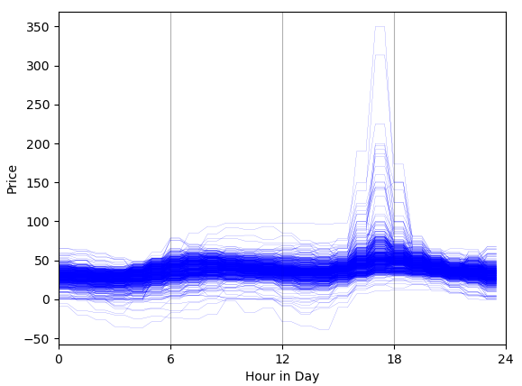
Simple interpretation of price
Daily price map
Reference price
Notes:
If we plot the price for every day in the data set on top of each other, we see that there is a very clear trend with a high around 6am and 6pm.
There are also some large price surges late in the day, which could be a chance to maximise profit.
On the right now,
We want to be able to say what is a low price for a given day and what is a high price.
This requires us to determine some reference value against which to compare the current price.
This will allow the agent to be rewarded for selling high and buying low.
Keeping it very simple to start with, we wanted to just use the average value from the previous 24hr to track the baseline price of this blue curve.
In short, we found that using the median value gave us the best results after also testing with the mean.

Slide 5
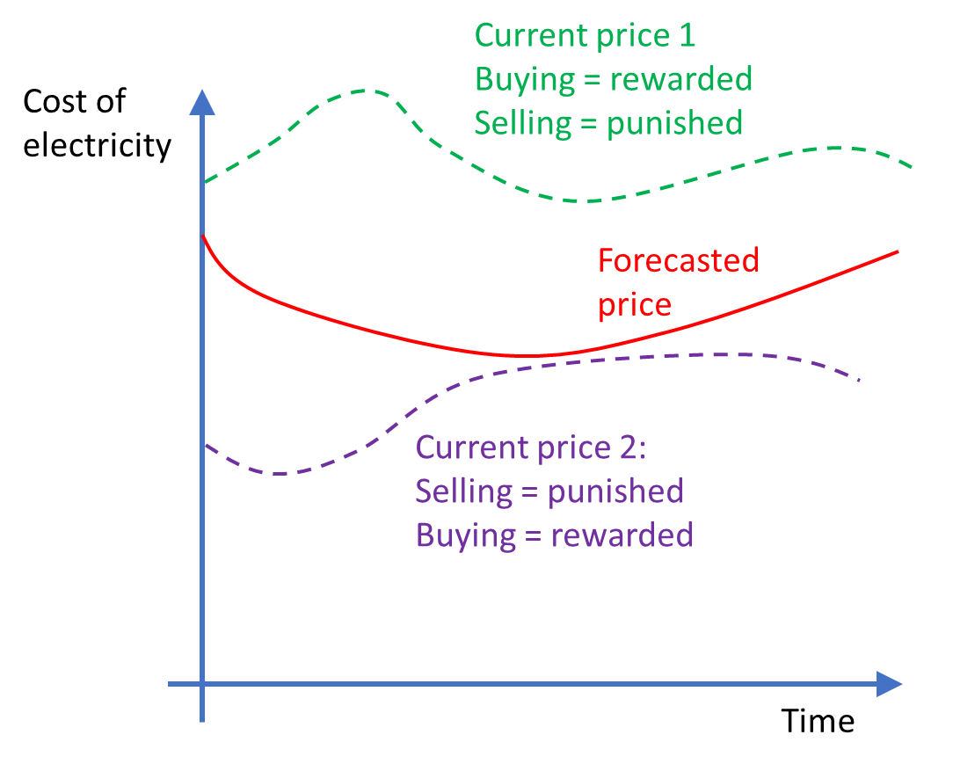
Reward and Punishment
Buying = punished
Selling = rewarded
Cumulative_Reward += (delta_energy) * (current_price - forecasted price)
Notes:
We decided to train the model as follows.
We compared the current price to the forecasted price and if the current price is high, then we rewarded the model for selling and vice versa.
So you can see this cartoon on the left, a reference price is in red while there are two dashed examples of a high price and a low price compared to this reference.
We also wanted to reward more when there was a larger difference in price, so we would effectively be making more money than we might expect at that time.
Our cumulative reward is effectively the opportunity cost, which is what we want to optimise.

Slide 6
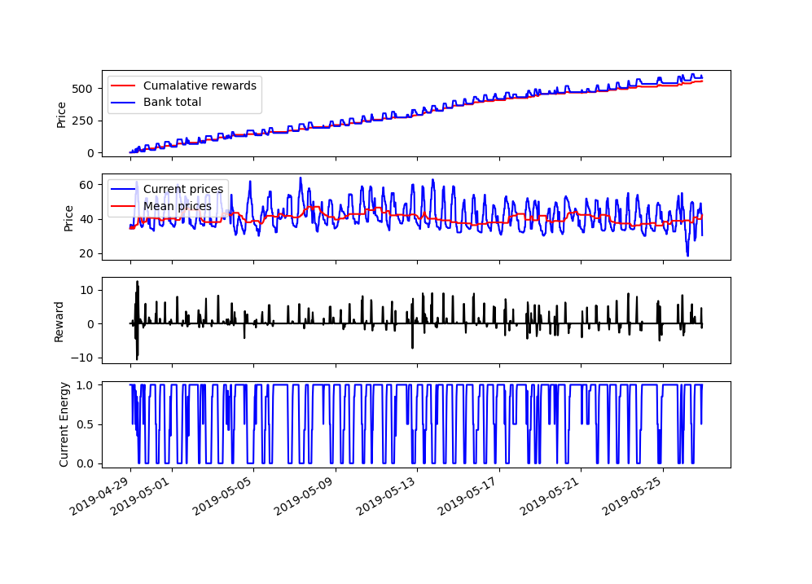
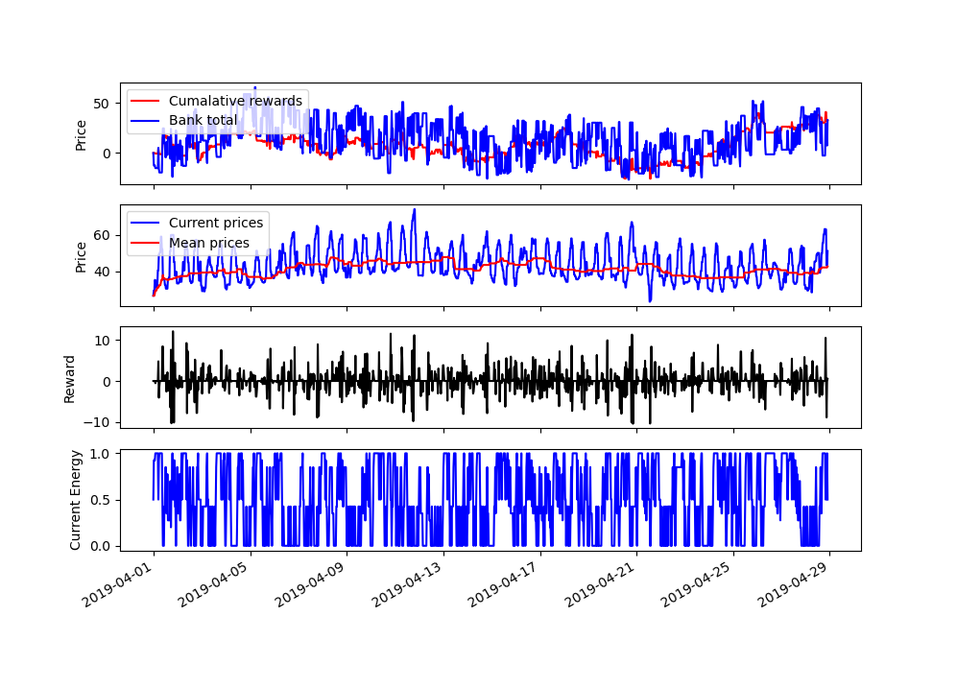
Results: random walk in our environment
After training
Before training
Notes:
This shows the effect of training our model for one month and then applying the model to predict the charge-discharge cycle for the next month
The top plots on these time series show the Bank total in blue for a month, although two different
You can see that without training, we basically have a random process with no knowledge that gains effectively net zero in terms of profit.
Our trained model on the right obviously has a clear trend upward in balance.
The second plot shows the current price against the refence price, which was the median value.
So we want the battery to be charging when the blue is below the red and vice versa.
The next plot shows the instananeuos reward for the given process
so prior to the training, the rewards are equally negative and positive, while the trained model is mostly positive.
I.e. it is charging and discharging at the right time.
The final plot just shows the charge level of the battery.
The trained data seems to have a periodicity which mathces the daily price flutuations.

Slide 7
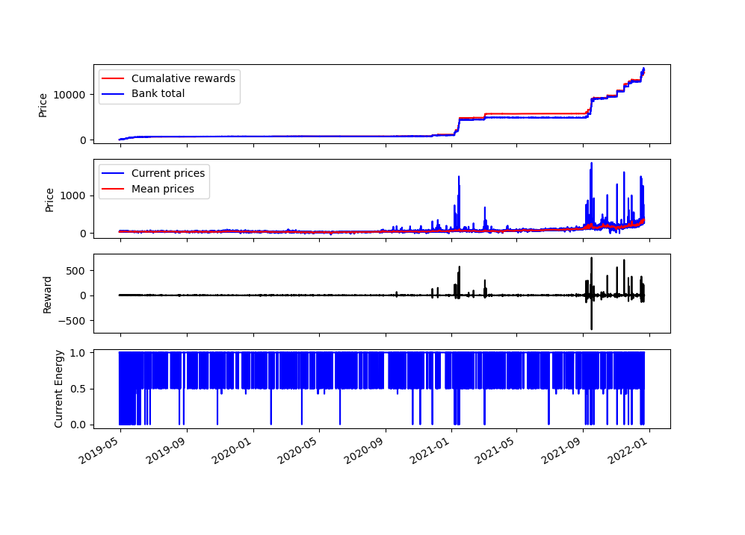
Results: 2021
Whole dataset
Notes:
Finally, we show the predictions of the model over the whole time period
The learned behaviour of our model becomes quite apparent
Our model has worked out that the optimal behaviour is to stay fully charged and only discharged when it can make a large profit
That’s why you see these regions of almost constant bank total (i.e. not making new profit)
Our model has worked out the efficient way to operate is to stay charged and then discharge when you get large spikes in the price, which you can see in the almost step increases in the profit

Slide 8
Conclusions
We trained a reinforcement learning algorithm to optimise profit from battery charging cycle

Slide 9
Future improvements
A better way for handling the spikes in the training data
Incorporating forecast data
Bayesian optimisation for hyperparameter tuning
A more sophisticated reward-punishment scheme
Experiment with alternative algorithms or policies

Slide 10
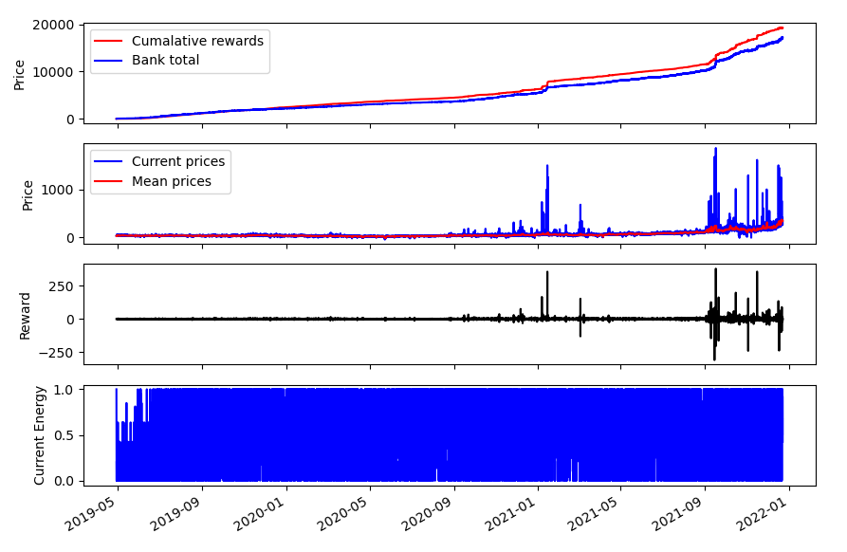
Bonus: Alter the power
Notes:
Means we can sell in successive periods without charging up our battery fully. This means that we can wait for the surge in energy price to fully peak before we sell. Adds another 10,000 profit

Slide 11
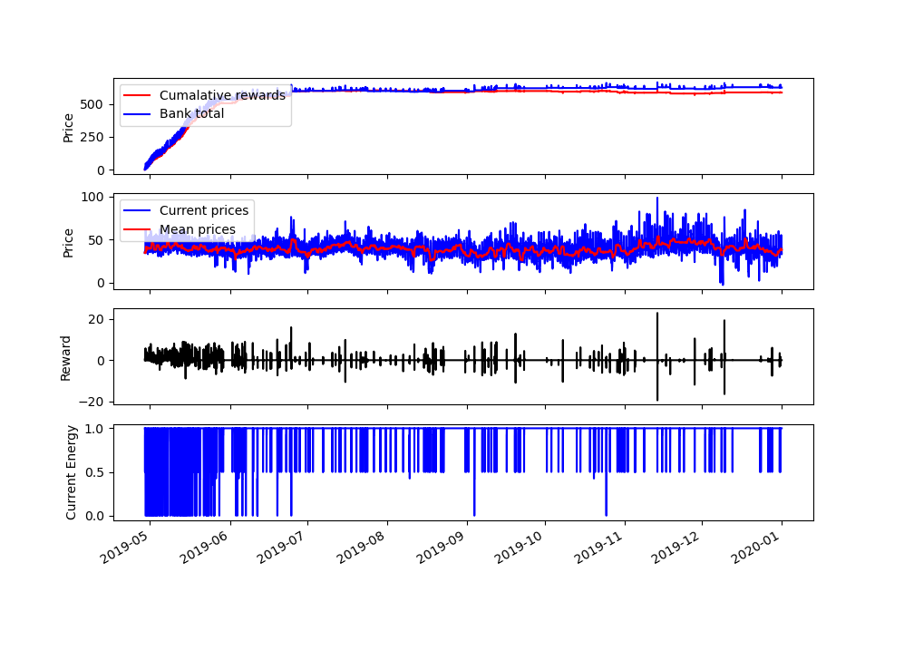
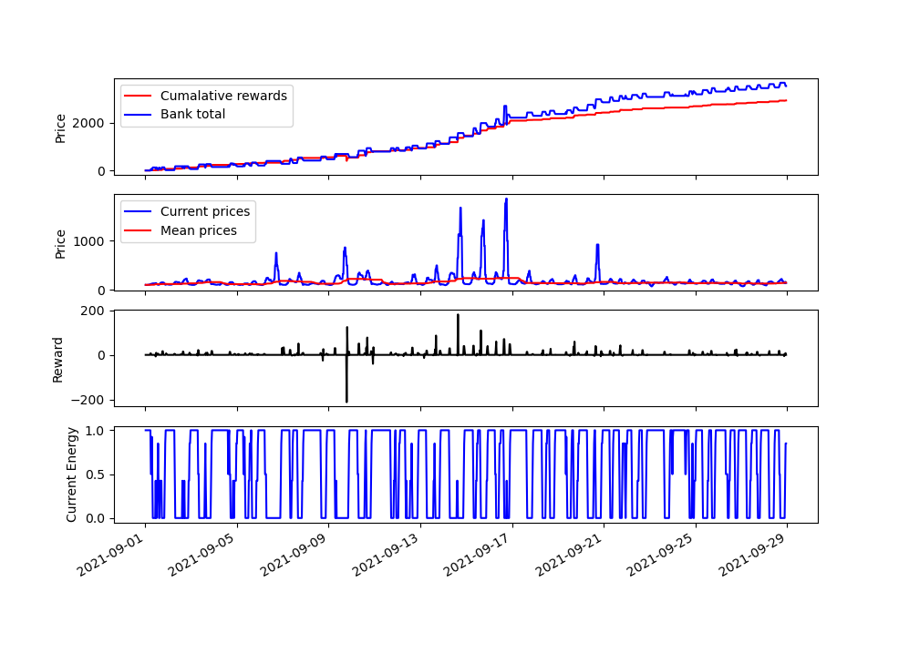
Results: 2019-2020
Predictions over 2019 - 2020
September 2021
Notes:
Just to clarify, this is the same, trained model, now applied to different time periods.
On the left, we use the first month to predict all of 2019-2020
The price flattens out because our battery works out an optimal strategy: stay fully charged and sell where there are large spikes. The price doesn’t have many of these large spikes, tracing the median out, so the profit we make stays flat
However you can see that our strategy is effective at creating cumulative rewards
We also average these results over many different estimators and find that on average our results lead to a positive reward
On the right, we have used our trained model to predict the schedule over the September 2021, which is a particular noisy day. The pattern of our model is even more clear. On days where the price was particularly high, our model makes a large gain in profit

